Slide 1
Stabilizing A Switched Linear System with Disturbance
by Sampled-Data Quantized Feedback
2015 American Control Conference
Guosong Yang and Daniel Liberzon
Coordinated Science Laboratory
University of Illinois at Urbana-Champaign
Urbana, IL 61801

Slide 2











Problem Formulation
Controller
Switched Linear System
Sensor
Decoder
Channel
Encoder
Switched linear system:
is a (finite) index set, are modes (subsystems)
is a switching signal
Information structure:
Sampling: measure and at
Quantization: encode by
Transmits , the data rate is
sampling period
quantization resolution
Objective: Develop a communication and control strategy
  such that the state is exponentially converging
  which is robust w.r.t. the disturbance

Slide 3
Motivation & Literature Review
Motivation:
Switching:
ubiquitous in realistic system models
lots of literature on stability and stabilization
tools: common/multiple Lyapunov functions, slow switching conditions
Limited information:
practical reasons: coarse sensing, limited communication
theoretical interest: how much information is needed
tools: Lyapunov analysis, data rate bound
D
S&Q
[HM99]
[HOV02]
[L14]
Hespanha & Morse, “Stability of switched systems with average dwell-time,” CDC1999
Hespanha, Ortega & Vasudevan, “Towards the control of linear systems with minimum bit-rate,” MTNS2002
Liberzon, “Finite data-rate feedback stabilization of switched and hybrid linear systems,” Automatica, 2014
[HOV02]
SW
[YL15]
[HM99]
[L14]

Slide 4










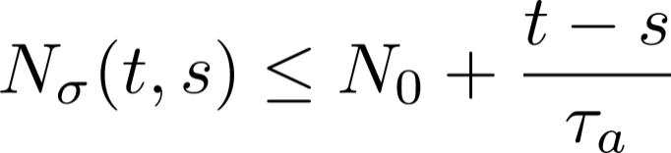



Assumptions
(Stabilizability) For each , there exists such that
is Hurwitz
  If no switching, exponential ISS
(Slow switching) denotes the number of switches on
  There exists dwell-time ([M96]) s.t. for all
    At most one switch on every sampling interval
  There exists average dwell-time ([HM99]) s.t. for all ,
    Less than one switch per sampling interval
(Disturbance) There exists a disturbance bound s.t. which is known to the encoder and decoder
(Data rate) for all
  Lower bound (data rate: )
[M96]
Morse, “Supervisory control of families of linear set-point controllers—Part I. Exact matching,” IEEE TAC, 1996

Slide 5



Main result
Theorem 1. If the average dwell-time is large enough, there is a communication and control strategy such that the state is
exponentially converging w.r.t. the initial value, i.e., for all ,
where
BIBS stable, i.e., for all , there exists such that

Slide 6











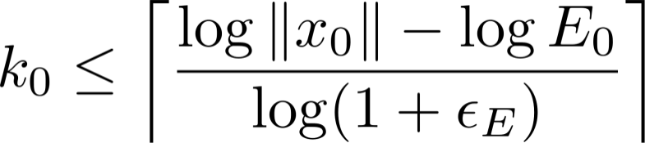

Communication and Control Strategy
Controller
Switched Linear System
Sensor
Decoder
Channel
Encoder
At , the sensor doesn’t know . It zooms-out to capture the state
Receive
Set
on
Controller
Send
Calculate
Sensor
No
Yes
Zoom-in
, while
on
Hence capture at
Both know
Both calculate
independently

Slide 7











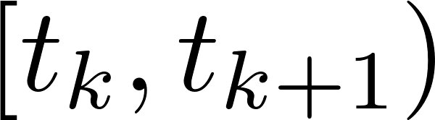
Communication and Control Strategy
Controller
Switched Linear System
Sensor
Decoder
Channel
Encoder
At , the sensor zooms-in to measure the state
Sensor:
Evenly divide the hypercube into boxes
Encode each box by an index from to
Send the index of the box containing the state, and
Controller:
Decode to reconstruct
Auxiliary system
Set on

Slide 8




Communication and Control Strategy
Controller
Switched Linear System
Sensor
Decoder
Channel
Encoder
At , the sensor zooms-in to measure the state
Both sensor and controller know
Both maintain the same auxiliary system and independently calculate
such that

Slide 9

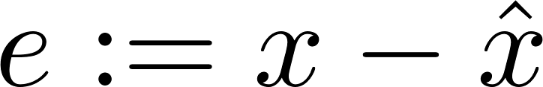
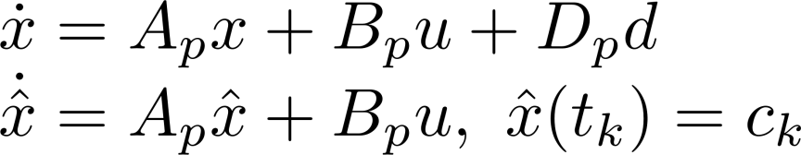
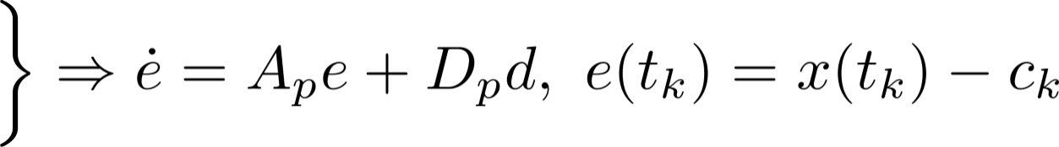
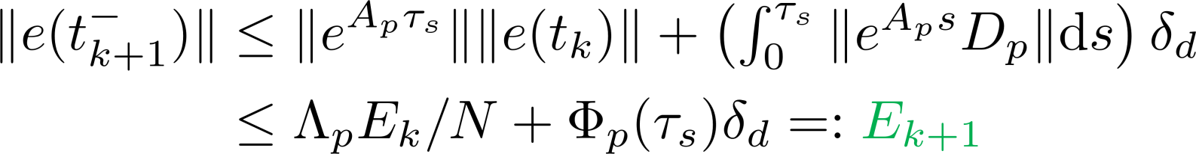
Generating State Bounds
Objective:
Given such that
Calculate such that
Case 1 (easier): Sampling interval with no switch
Let .
Hence
and

Slide 10


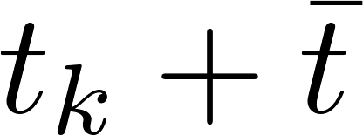




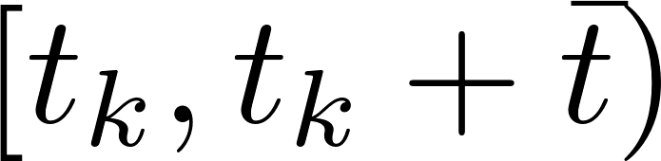



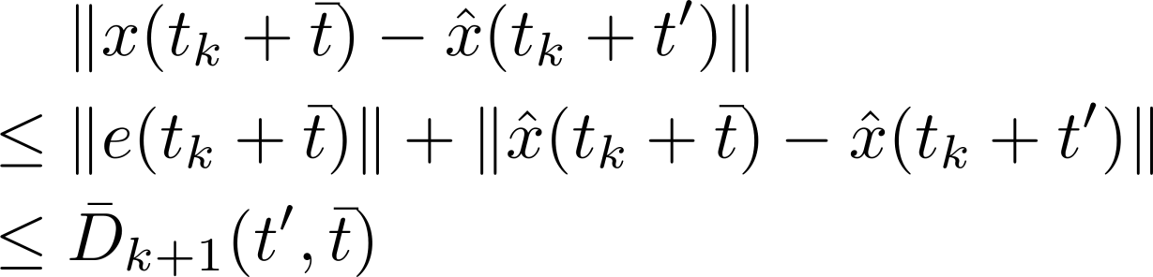



Generating State Bounds
Case 2 (harder): Sampling interval with a switch
Switch at , where
is unknown
Before the switch:
on , similar to the previous case
As is unknown, pick a known
and use as the center

Slide 11

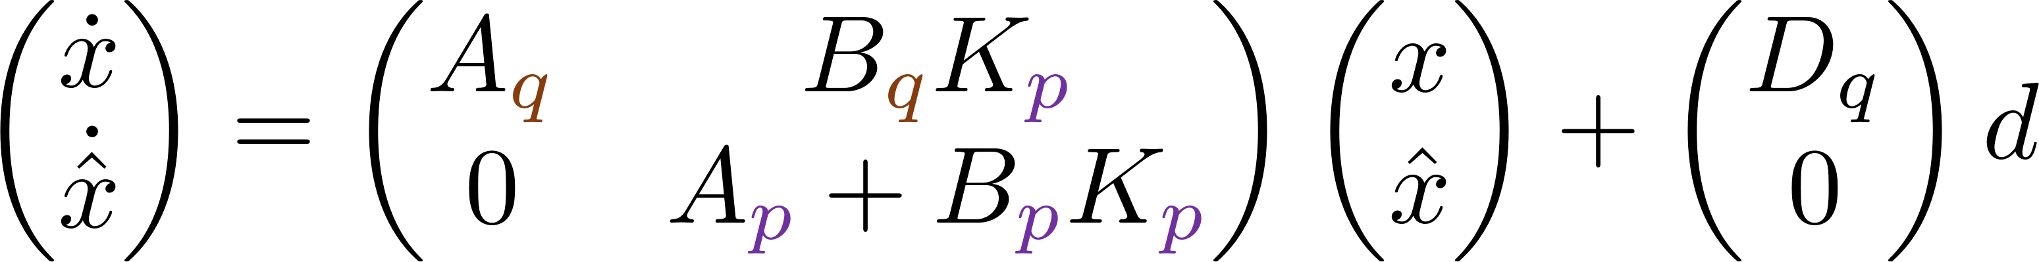

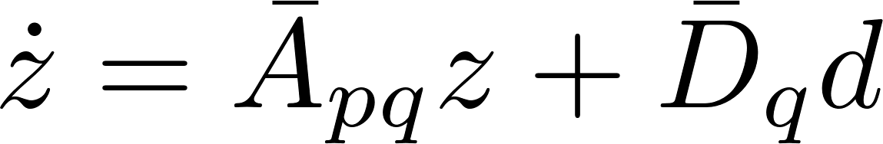

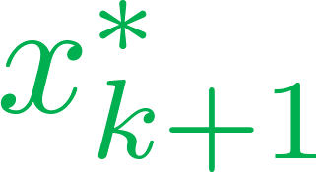



Generating State Bounds
After the switch: on , the closed-loop dynamics is
Let , then
Second auxiliary system:
Lift
Project
onto
Take maximum over to obtain the bound

Slide 12

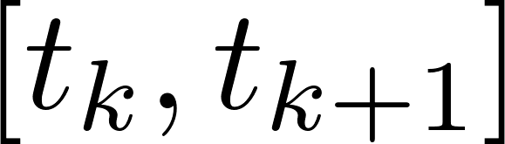

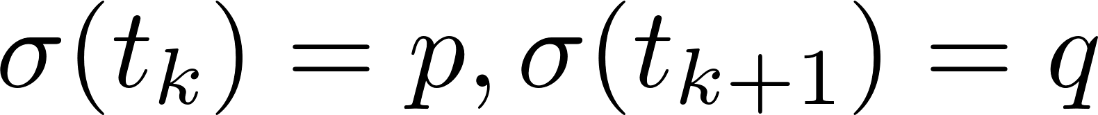
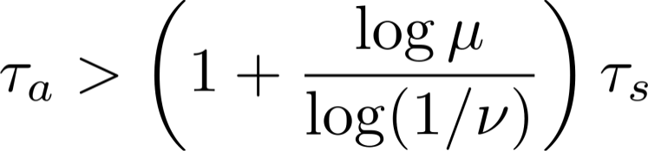

Stability Analysis: Outline
Sampling interval with no switch: on
Assumptions: is Hurwitz (stabilizable), (data rate)
ISS Lyapunov function:
Then
Sampling interval with a switch:
Then
Combined bound for sampling times:
If ADT satisfies ,
then
Exponential convergence w.r.t. initial value: for all
BIBS stability: see paper (if , then same bound on )

Slide 13

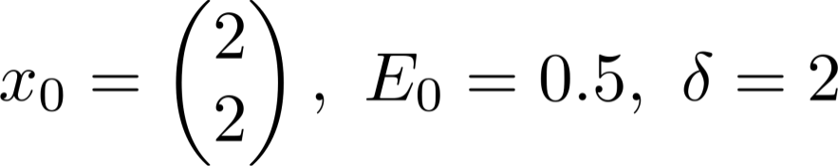
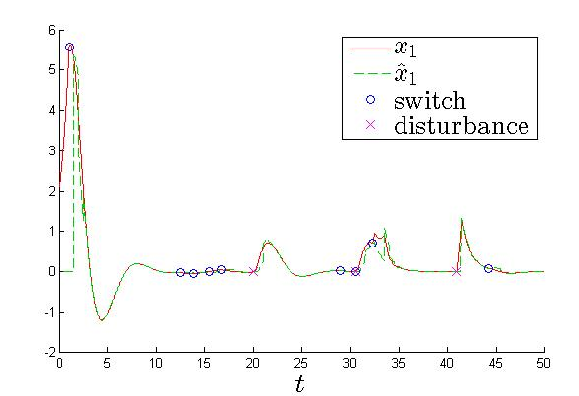



Simulation Result
We keep mostly , and turn it on shortly when becomes small
Theoretically, a sufficient condition is approximately

Slide 14
Conclusion and Future Work
Contribution:
Finite data rate stabilization of a switched linear system with disturbance (sampling, quantization)
Main Step: enlarge the over-approximations of reachable sets to accommodate disturbance
Explicit data rate bound for BIBS stability
Future Work:
Finite but unknown disturbance bound
Zoom-in and zoom-out repeatedly
Input-to-state stability

