Slide 1
Input-to-State Stability for Switched Systems
with Unstable Subsystems:
A Hybrid Lyapunov Construction
Guosong Yang and Daniel Liberzon
Coordinated Science Laboratory
University of Illinois at Urbana-Champaign
Urbana, IL 61801
10/5/26

Slide 2
Outline
Problem formulation and preliminaries
Assumptions and sufficient condition
Proof: auxiliary timer and hybrid ISS Lyapunov function
Simulation
Conclusion

Slide 3
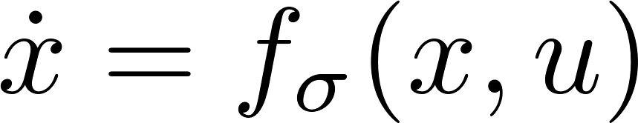
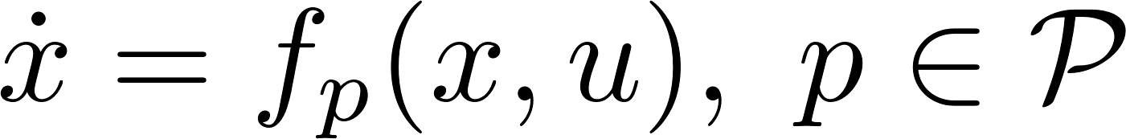



Problem Formulation
Switched system
is a family of dynamical systems
is the index set (arbitrary)
is the switching signal (piecewise constant, right-continuous)
doesn’t change at switches

Slide 4
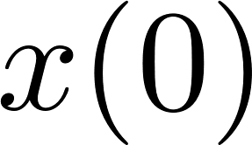


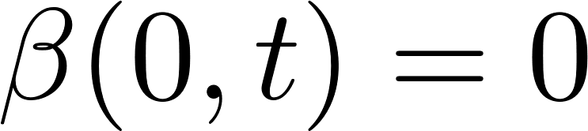

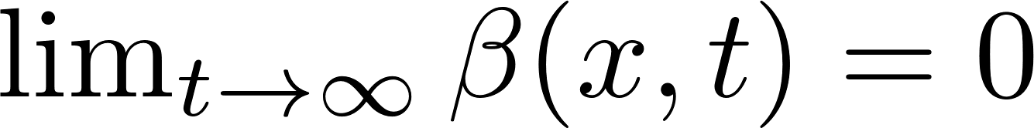

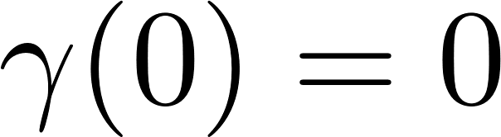

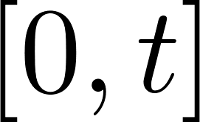
Input-to-State Stability
A dynamical system is input-to-state stable (ISS) if
for all initial condition and all input .
: increasing in , , decreasing in and
: increasing, unbounded and
denotes the essential supremum norm on
For an autonomous system, ISS is equivalent to global asymptotic stability (GAS)

Slide 5



Problem Formulation
Switched system with non-ISS subsystems
The index set
  contains the indices of ISS subsystems
  contains the indices of non-ISS subsystems
Question: When is the switched system ISS?
Obstacles:
  Non-ISS subsystems
  Switching

Slide 6
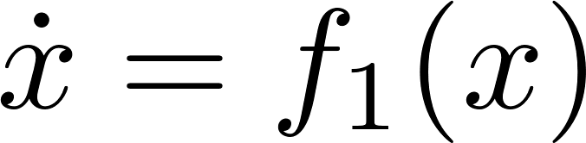
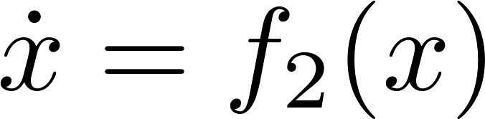
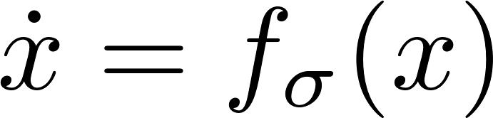
Stability Issue of Switching
Example:
Asymptotic stability of subsystems are not sufficient
for stability of the switched system

Slide 7
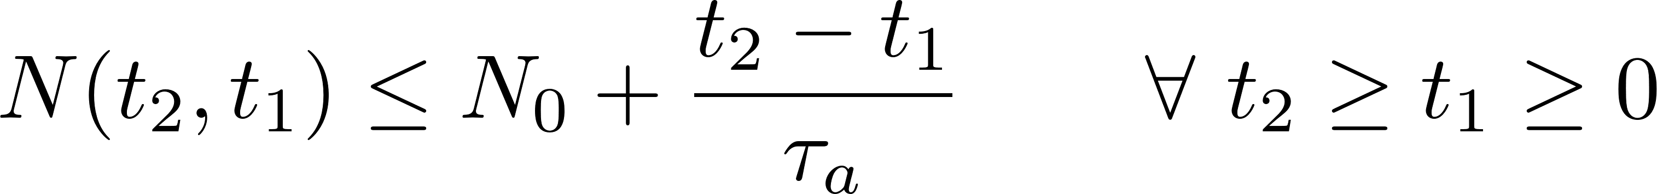
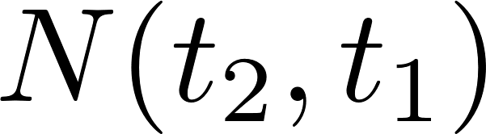
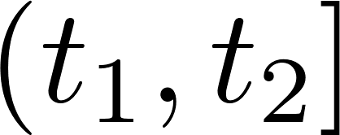



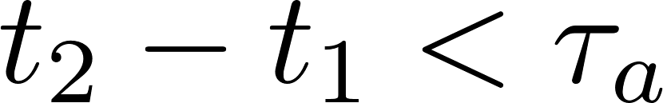
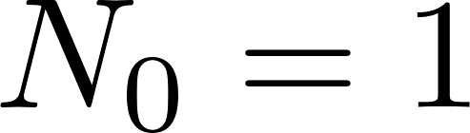
Slow Switching
Average dwell-time condition [Hespanha-Morse-99]
is the number of switches on
is called the average dwell-time
is the chatter bound
  - no switch: cannot switch for any
  - dwell-time: can only switch once for any

Slide 8
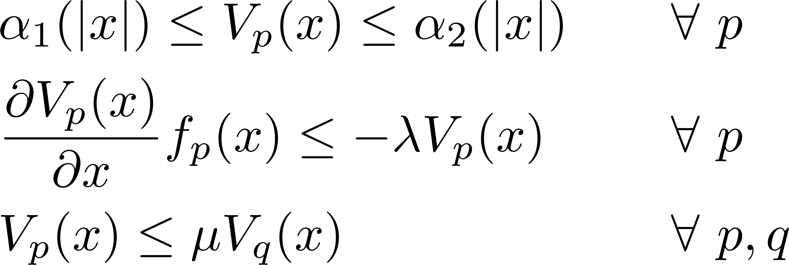

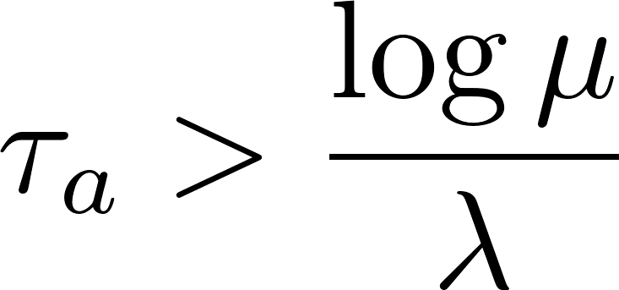
Slow Switching
Average dwell-time condition [Hespanha-Morse-99]
Theorem
is GAS if

Slide 9
Outline
Problem formulation and preliminaries
Assumptions and sufficient condition
Proof: auxiliary timer and hybrid ISS Lyapunov function
Simulation
Conclusion

Slide 10

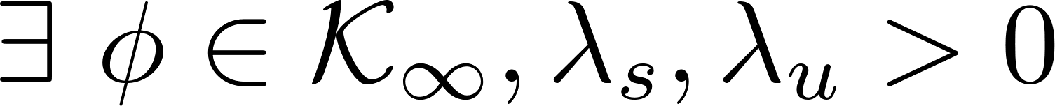
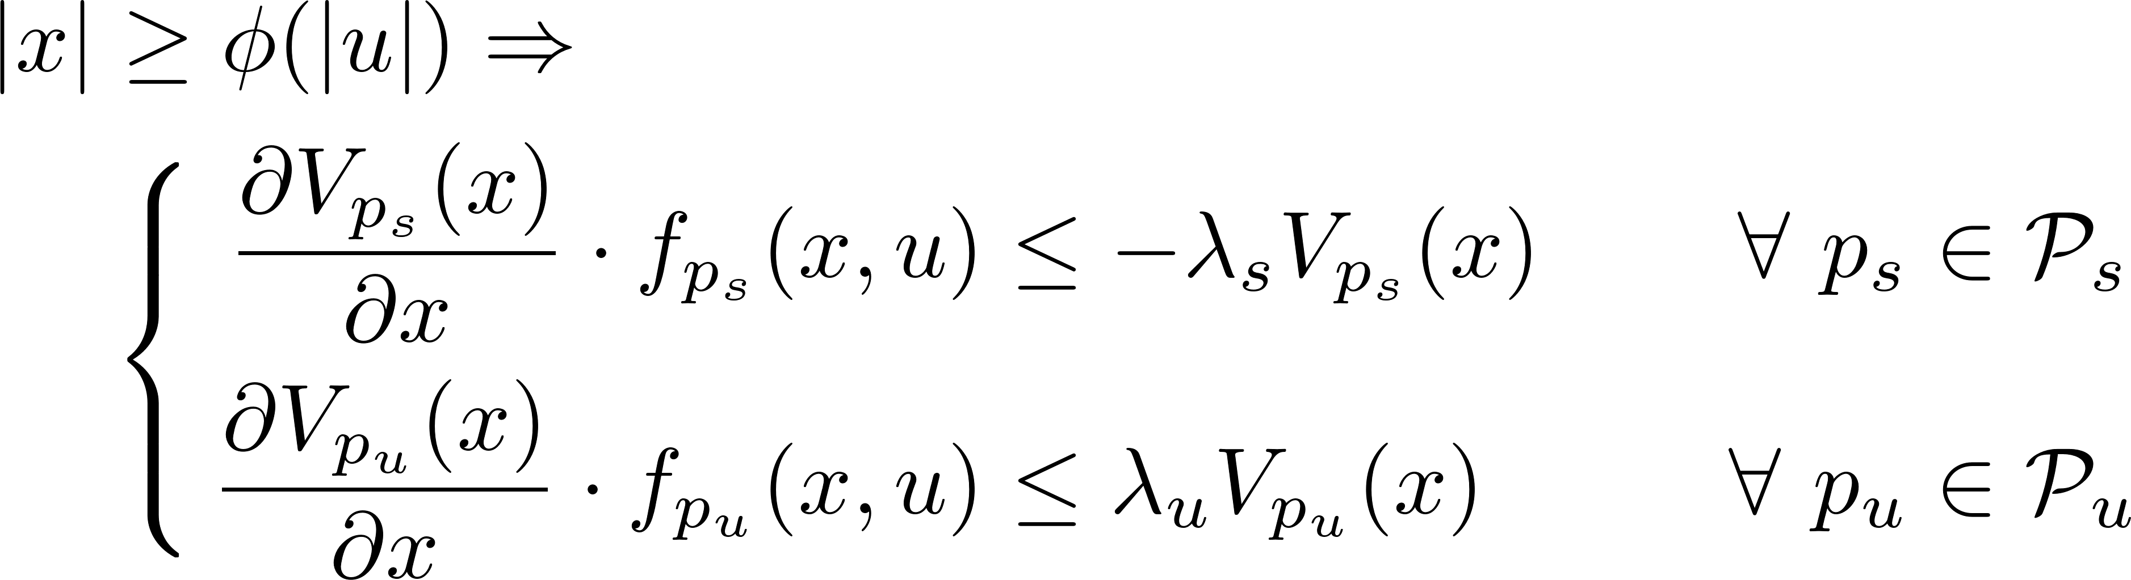
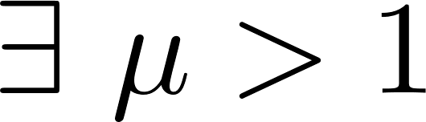
Assumptions on dynamics
Switched system with non-ISS subsystem
Uniform ISS Lyapunov-type Constraint
  s.t.
  s.t.
  s.t.
due to ISS
[Praly-Wang-96]
forward complete
[Angeli-Sontag-99]
discussion in
[Vu-Chatterjee-L-07]

Slide 11
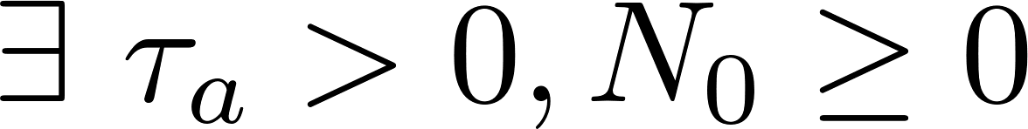
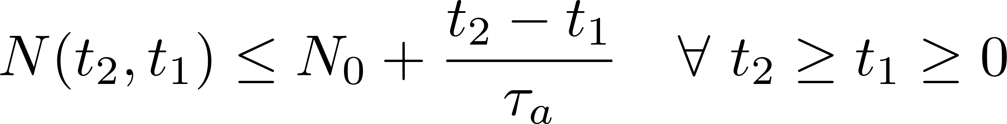

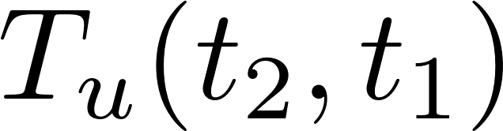
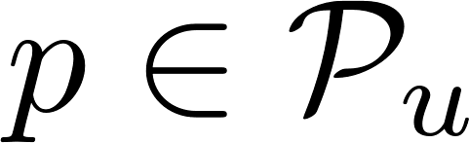
Assumptions on switching
Switched system with non-ISS subsystem
Average dwell-time constraint [Hespanha-Morse-99]
s.t.
Time-ratio constraint [Zhai et al.-00]
s.t.
  is the total activation time of non-ISS subsystems on , i.e., when

Slide 12
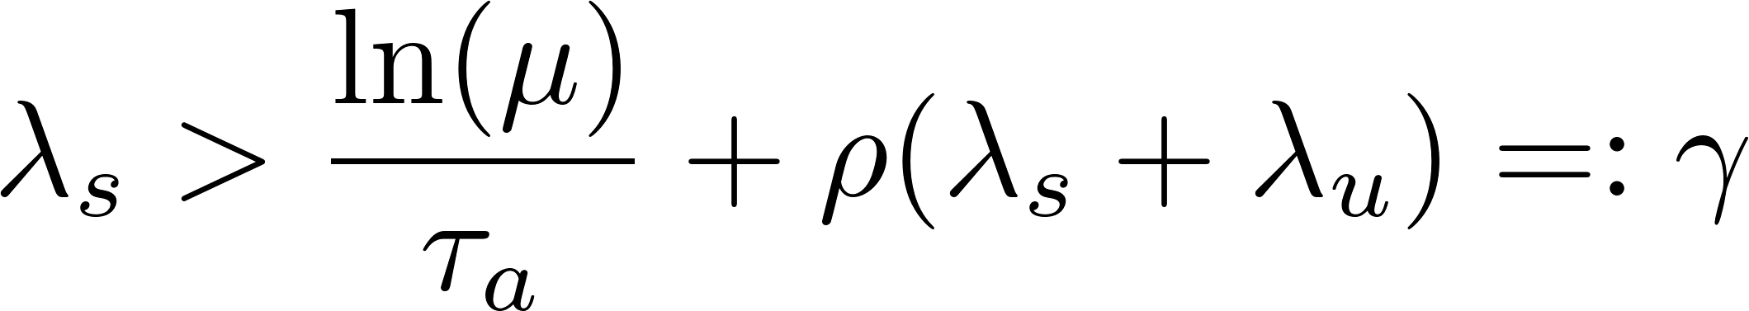
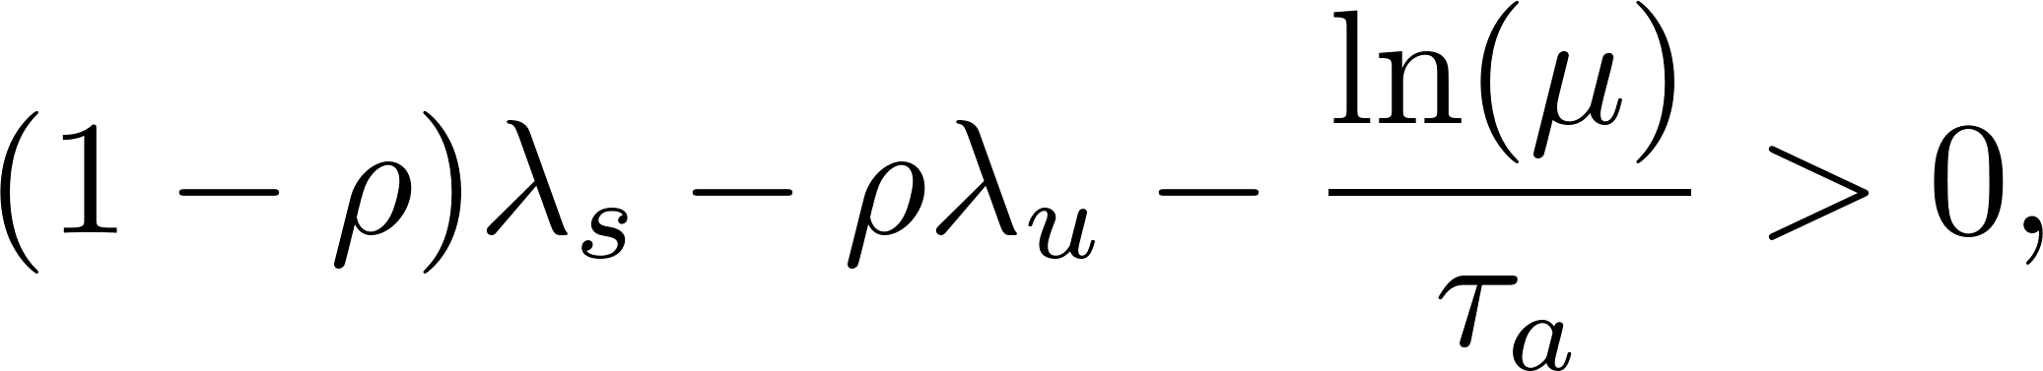
Sufficient condition for ISS
Switched system with non-ISS subsystem
Theorem [Müller-L-2012, Theorem 2]
Suppose all previous assumptions hold. Then the switched system is ISS if
Interpretation: average rate of exponential decay
due to ISS
due to non-ISS
due to switching

Slide 13
Outline
Problem formulation and preliminaries
Assumptions and sufficient condition
Proof: auxiliary timer and hybrid ISS Lyapunov function
Simulation
Conclusion

Slide 14
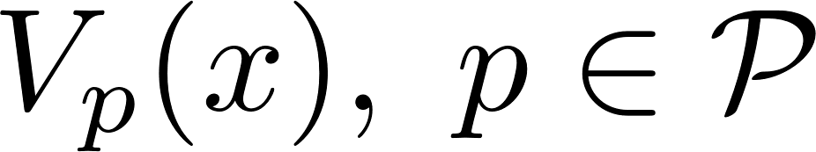
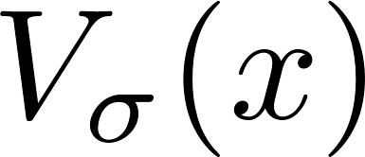
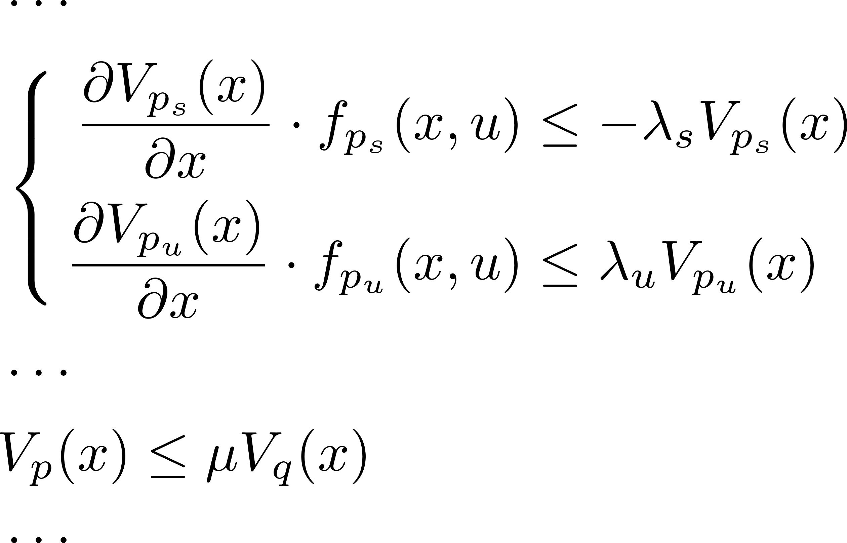
Sketch of Proof
ISS Lyapunov-type functions of subsystems
Concatenation of ISS Lyapunov-type functions

Slide 15

Sketch of Proof
ISS Lyapunov-type functions of subsystems
Concatenation of ISS Lyapunov-type functions
should be
decrease when non-ISS
decrease at switches
Increase when ISS

Slide 16
Sketch of Proof
ISS Lyapunov-type functions of subsystems
Concatenation of ISS Lyapunov-type functions
should be
decrease when non-ISS
decrease at switches
Increase when ISS

Slide 17

Sketch of Proof
ISS Lyapunov-type functions of subsystems
Concatenation of ISS Lyapunov-type functions
should be
decrease when non-ISS
decrease at switches
Increase when ISS
How?
Auxiliary timer and hybrid system

Slide 18

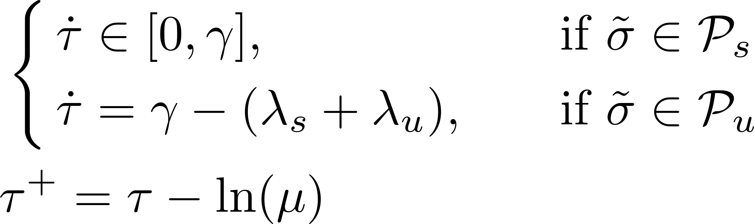

Auxiliary Timer
An auxiliary timer that models the constraints on the switching
increases when an ISS subsystem is active
decreases when a non-ISS subsystem is active
decreases when a switch occurs

Slide 19
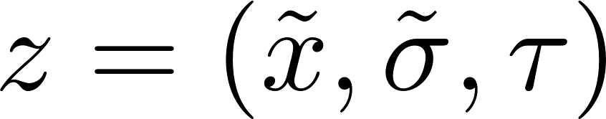
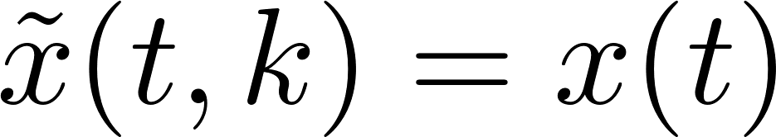
Hybrid System
An auxiliary timer that models the constraints on the switching
A hybrid system with the state
Proposition 1
Suppose all assumptions hold. For any solution to the switched system, there is a complete solution to the hybrid system s.t.
Proof:
Construct a hybrid solution based on the dynamics of the timer
Assumptions guarantee that the solution is complete

Slide 20


Hybrid ISS Lyapunov Function
An auxiliary timer that models the constraints on the switching
A hybrid system with the state
A hybrid ISS Lyapunov function
Proposition 2
decreases along all hybrid solutions to the hybrid system
Proposition 3
Every complete solution to the hybrid system satisfies

Slide 21
Outline
Problem formulation and preliminaries
Assumptions and sufficient condition
Proof: auxiliary timer and hybrid ISS Lyapunov function
Simulation
Conclusion

Slide 22
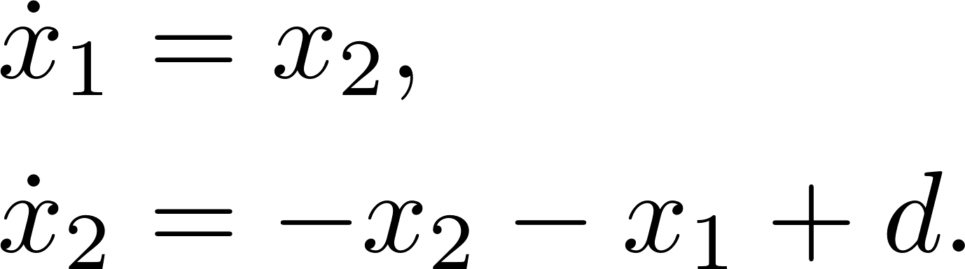
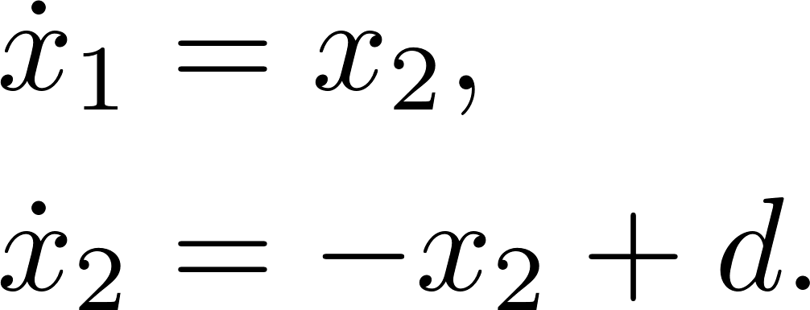
Simulation
Subsystem 1
Subsystem 2:
ISS Lyapunov functions
Switching signal and timer

Slide 23
Simulation
Subsystem 1
Subsystem 2:
ISS Lyapunov functions
Switching signal and timer

Slide 24
Outline
Problem formulation and preliminaries
Assumptions and sufficient condition
Proof: auxiliary timer and hybrid ISS Lyapunov function
Simulation
Conclusion

Slide 25
Conclusion
Contribution
Timer
  Similar techniques in previous results:
    [L-03] for switched system
    [Hespanha-L-Teel-08] for impulsive system
    [L-Nešić-Teel-14] for hybrid system
  Advantage: our construction is able to handle both switches and non-ISS subsystems

Slide 26
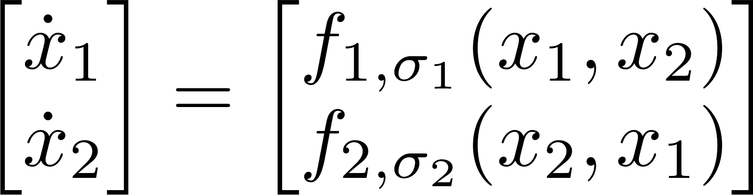
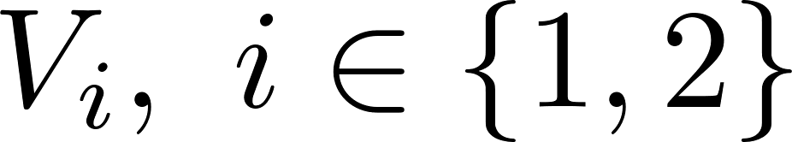
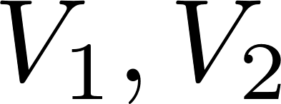
Conclusion
Contribution
Timer
Hybrid ISS Lyapunov function
  Application: interconnected switched systems [Y-L-SCL]
    For each switched system, construct a hybrid ISS Lyapunov function
    Construction a Lyapunov function of the interconnected system based on
    Global asymptotic stability of the interconnected system

Slide 27
Conclusion
Summary
ISS of a switched system with non-ISS subsystems
Constraints on dynamics
Constraints on switching
Sufficient condition for ISS
Auxiliary timer
Hybrid ISS Lyapunov function

Slide 28
Thank you for your attention!

