Slide 1
Finite data-rate stabilization of a switched
linear system with unknown disturbance
NOLCOS 2016 Monterey, California, U.S.
Guosong Yang and Daniel Liberzon
Coordinated Science Laboratory
University of Illinois at Urbana-Champaign
Urbana, IL 61801

Slide 2











Problem Formulation
Controller
Switched Linear System
Sensor
Decoder
Channel
Encoder
Switched linear system:
is a (finite) index set, are modes (subsystems)
is a switching signal
Information structure:
Sampling: measure and at
Quantization: encode by
Transmits , the data-rate is
sampling period
quantization resolution
Objective: Develop a communication and control strategy
  such that the state is exponentially converging
  which is robust w.r.t. the disturbance

Slide 3
Motivation & Literature Review
Switching:
Ubiquitous in realistic system models
Plenty of literature on stability and stabilization
Tools: common Lyapunov functions, slow switching
Limited information:
Practical reasons: coarse sensing, limited communication
Theoretical interest: how much information is needed
Tools: finite data-rate, Lyapunov analysis
[1] [2] [3] | Hespanha & Morse (1999) Vu, Chatterjee & Liberzon (2007) Müller & Liberzon (2012)
[4–7]
Finite
data-rate
Disturbance
[4] [5] [6] [7] | Hespanha, Ortega & Vasudevan (2002) Tatikonda & Mitter (2004) Liberzon & Nešić (2007) Sharon & Liberzon (2012)
[9]
[1–3]
[8]
Switching
[8] | Liberzon (2014)
[9] | Yang & Liberzon (2015)

Slide 4








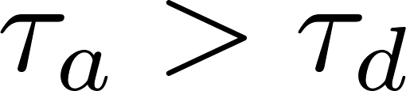

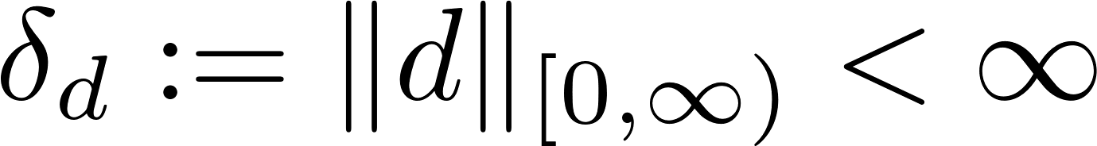


Assumptions
(Stabilizability) For each , there exists such that
is Hurwitz
  If no switching, exponential ISS
(Slow switching) denotes the number of switches on
  There exists a dwell-time ([M96]) such that for all
    At most one switch on every sampling interval
  There exists average dwell-time ([HM99]) such that for all
    Less than one switch per sampling interval
(Disturbance) Essentially bounded disturbance:
  Disturbance bound is unknown to the encoder and decoder
(Data rate) for all
  Lower bound on data rate:
[M96] | Morse (1996) in IEEE Transactions on Automatic Control, vol. 41, pp. 1413–1431
[HM99] | Hespanha & Morse (1999) in 38th IEEE Conference on Decision and Control, pp. 2655–2660

Slide 5


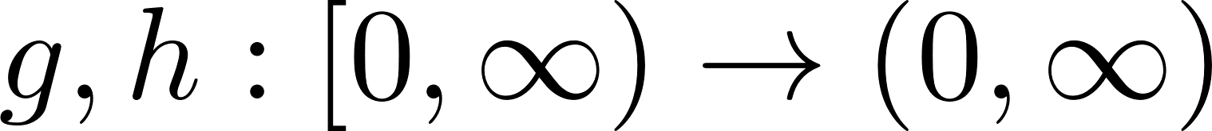




Main result
Theorem 1. Provided that the average dwell-time is large enough, there is a communication and control strategy that yields
Exponential convergence: There exist a rate and gain functions such that
for all .
Practical stability: There exists a constant such that for each , there exists a such that

Slide 6
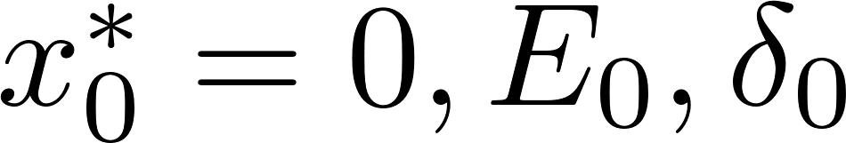

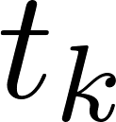
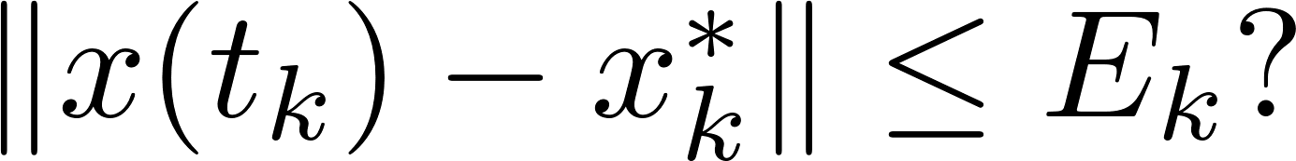
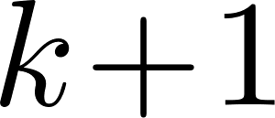
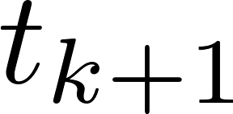
Communication and Control Strategy
Controller
Switched Linear System
Sensor
Decoder
Channel
Encoder
Two stages:
Unknown initial state
Initial values
At each sampling time , determine if
  If true, the state is visible, go to the stabilizing stage
  If false, the state is lost, go to the searching stage
Repeat at
No
Yes
Stabilizing
stage
Searching
stage

Slide 7
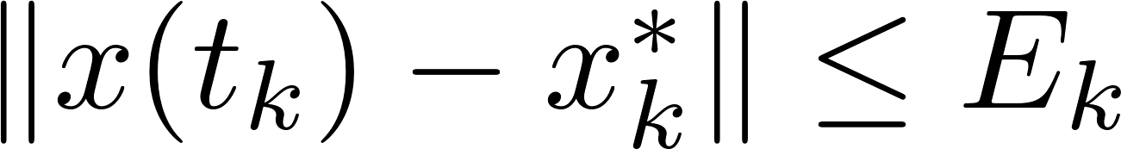







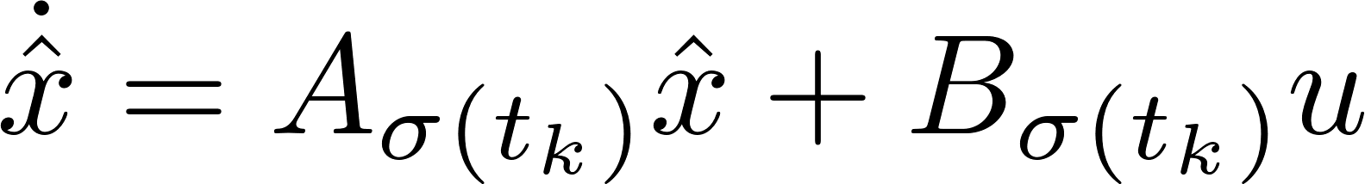

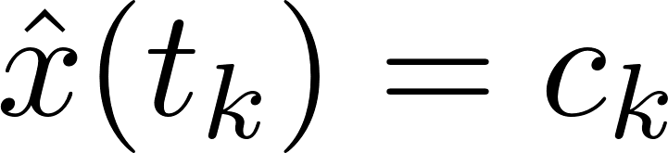

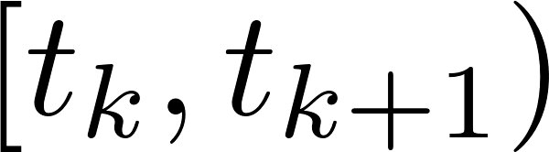
Communication and Control Strategy
Controller
Switched Linear System
Sensor
Decoder
Channel
Encoder
Stabilizing stage
Sensor:
Evenly divide the hypercube into boxes
Encode each box by an index from to
Send the index of the box containing the state, and the active mode
Controller:
Decode to reconstruct
Auxiliary system: with boundary condition:
Set on

Slide 8

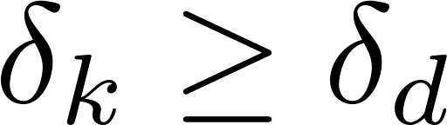


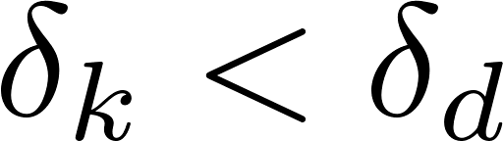
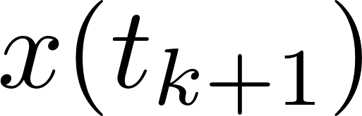

Communication and Control Strategy
Controller
Switched Linear System
Sensor
Decoder
Channel
Encoder
Stabilizing stage
Same auxiliary system in the sensor and the controller
Each calculates such that
  if then
  otherwise , and may escape (but not necessarily)

Slide 9


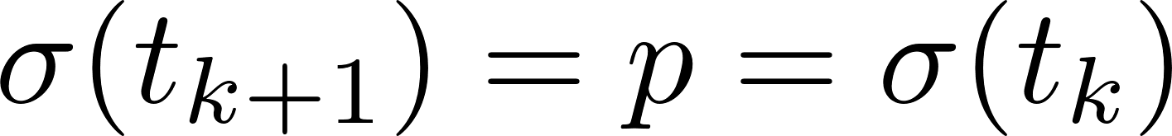
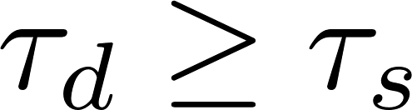
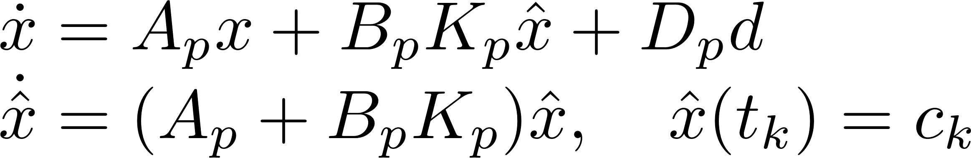
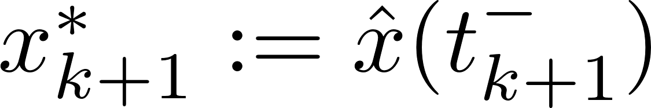
Generating Approximations
Objective:
Given such that
Calculate such that if then
Case 1 (easier):
As , no switch
Closed-loop dynamics:
Hence
Set and

Slide 10

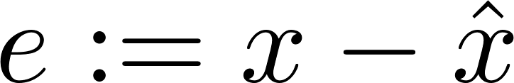
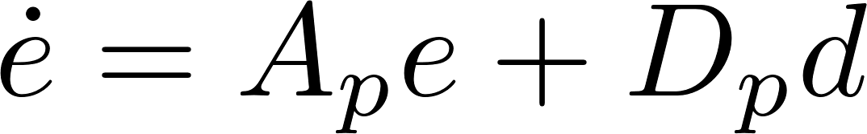
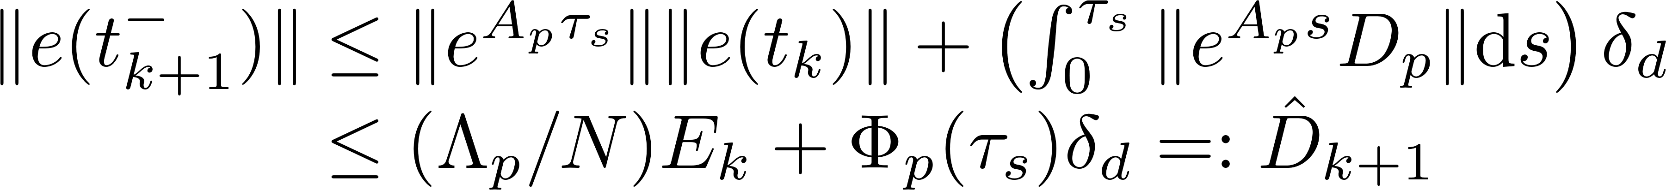
Generating Approximations (detail)
Objective:
Given such that
Calculate such that if then
Case 1 (easier):
As , no switch
Closed-loop dynamics:
Error satisfies with
Hence

Slide 11


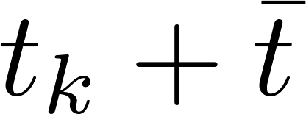



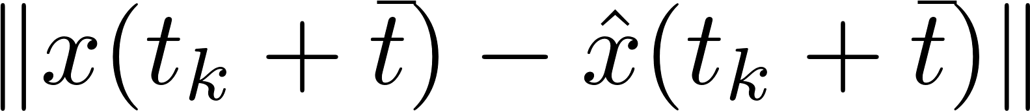


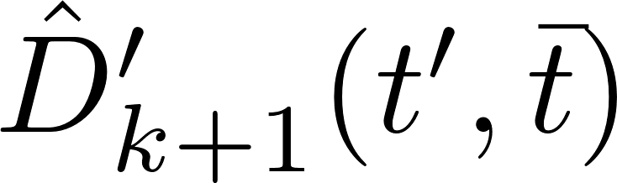



Generating Approximations
Case 2 (harder):
As , one switch
Let denote the unknown switching time
Before the switch:
Similar upper bound for
As is unknown, select and use as the center
Calculate via triangle inequality

Slide 12
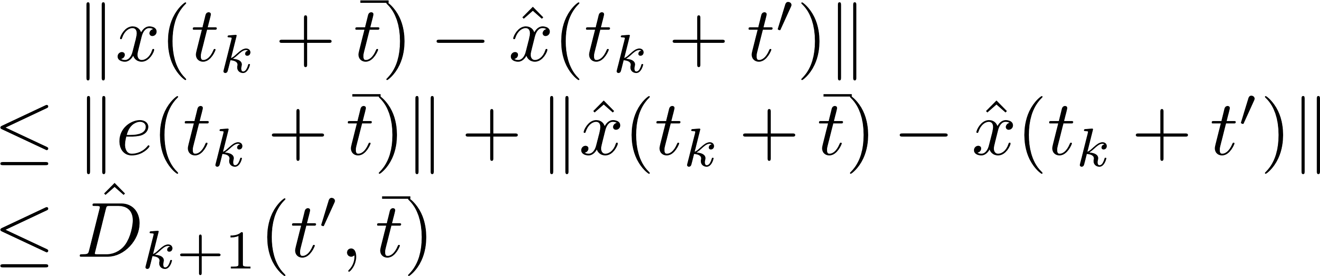
Generating Approximations (detail)
Case 2 (harder):
As , one switch
Let denote the unknown switching time
Before the switch:
At the switch
As is unknown, select and use as the center
Calculate via triangle inequality
The radius is given by

Slide 13
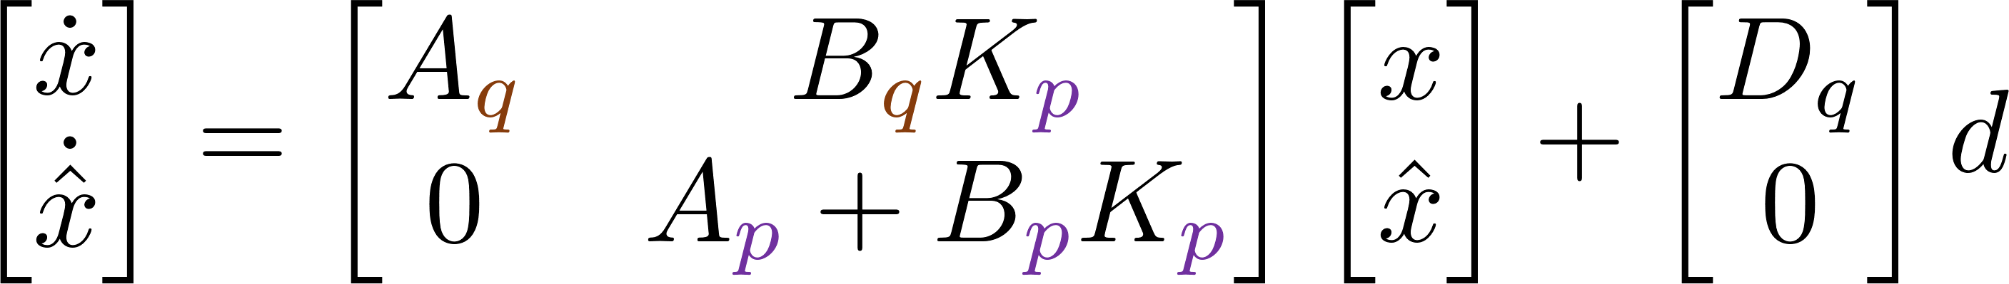

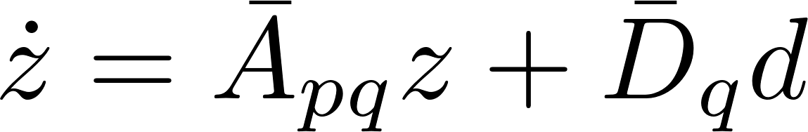
Generating Approximations
Case 2 (harder):
As , one switch
Let denote the unknown switching time
Before the switch:
Similar upper bound for
As is unknown, select and use as the center
Calculate via triangle inequality
After the switch:
Closed-loop dynamics:
Let . Then

Slide 14
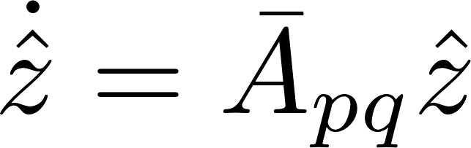

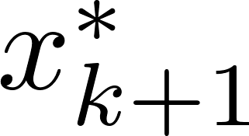

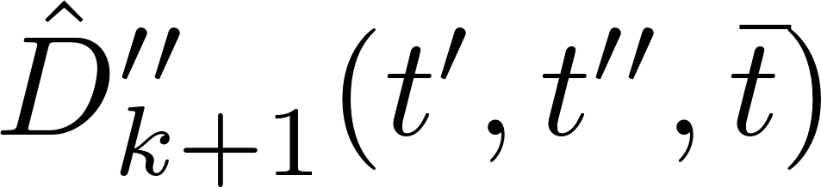

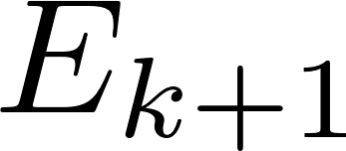

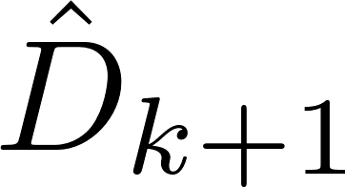

Generating Approximations
After the switch:
Let , then
Second auxiliary system: with boundary condition
Lift
Project
Take maximum over to obtain
Set by first replacing in the formula of with

Slide 15

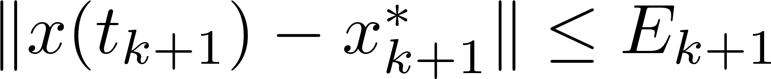

Communication and Control Strategy
Controller
Switched Linear System
Sensor
Decoder
Channel
Encoder
Stabilizing stage
At the next sampling time ,
Set
  If then

Slide 16
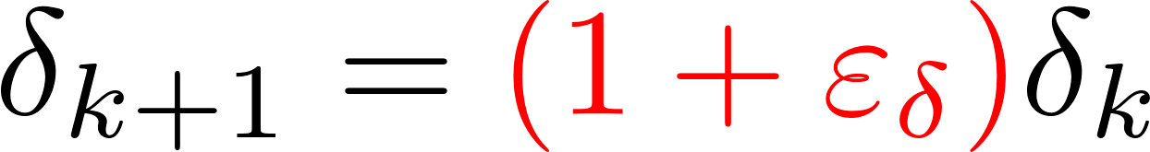
Communication and Control Strategy
Controller
Switched Linear System
Sensor
Decoder
Channel
Encoder
Stabilizing stage
At the next sampling time ,
Set
  If then
  If then the state may escape:
When escape, the sensor and controller learn that , and set
  Finite number of escapes

Slide 17
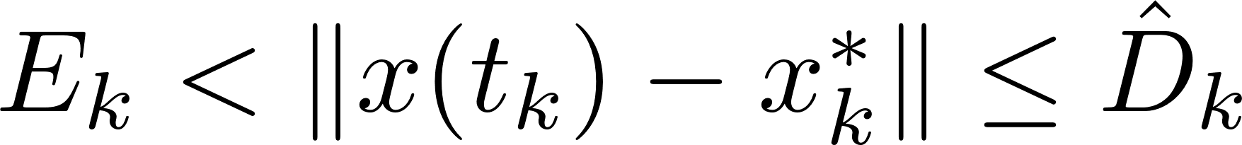
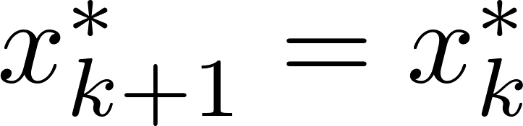
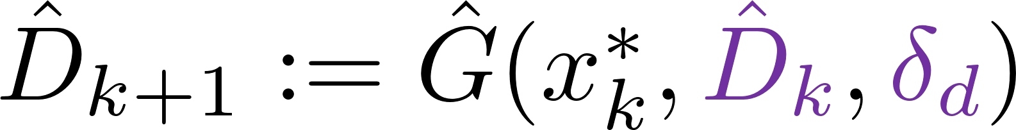
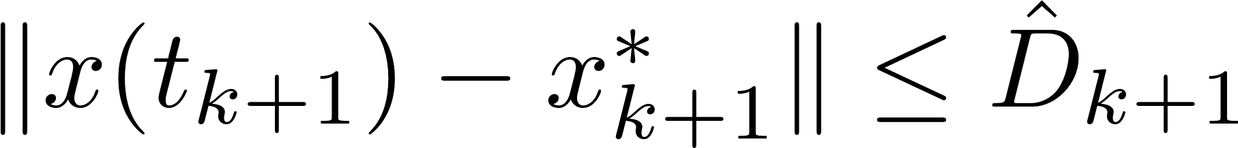
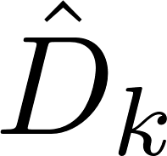
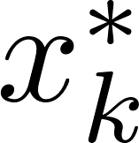
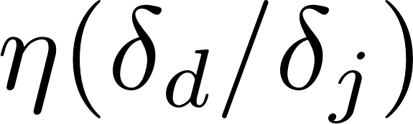

Communication and Control Strategy
Controller
Switched Linear System
Sensor
Decoder
Channel
Encoder
Searching stage
Set
Calculate such that
Set
  Dominating growth rate
  Finite recovery time

Slide 18
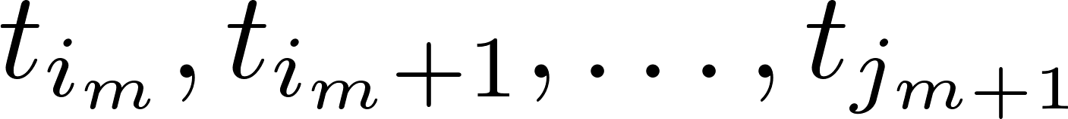
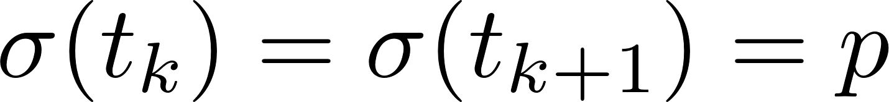
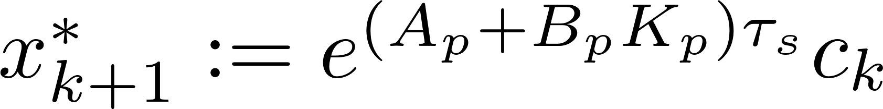

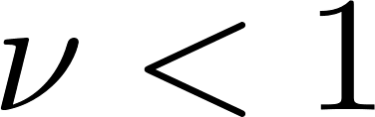
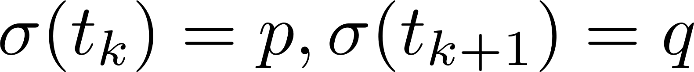
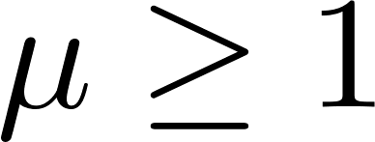
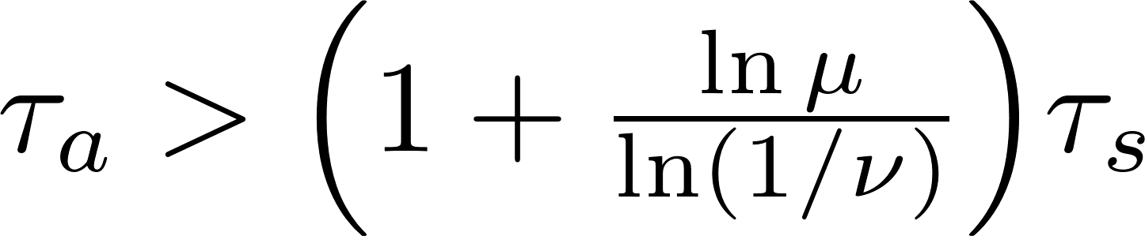

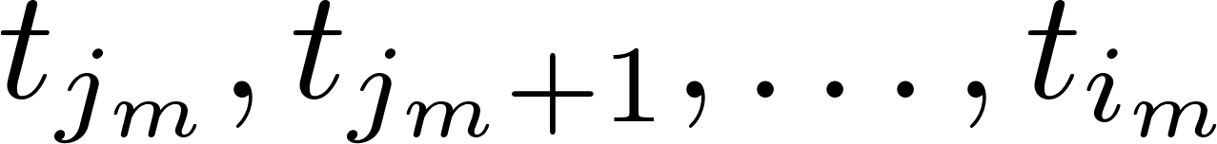

Stability Analysis Outline
Stabilizing stage
Sampling interval with no switch:
  Set and
  Assumptions: is Hurwitz and
  ISS Lyapunov function:
  Then with
Sampling interval with a switch:
  Then with
Combined bound for sampling times:
  If ADT then there exists such that
Searching stage
  Finite length , thus
Finite number of searching stages: exponential convergence

Slide 19
Conclusion and Future Work
Contribution:
Finite data-rate stabilization of a switched linear system with unknown disturbance (sampling, quantization)
Exponential convergence and practical stability
Main Step:
  Employ an iteratively updated estimate of the disturbance bound
  Expand the reachable sets from the case without disturbance
Future Work:
Decrease the estimate during stabilizing stages to achieve input-to-state stability
Minimum data-rate, topological entropy

