Slide 1
On topological entropy of switched linear systems with diagonal, triangular, and general matrices
Guosong Yang¹, A. James Schmidt², and Daniel Liberzon²
¹Center for Control, Dynamical Systems, and Computation
University of California, Santa Barbara
²Coordinated Science Laboratory
University of Illinois at Urbana-Champaign
57th IEEE Conference on Decision and Control
December 19, 2018

Slide 2




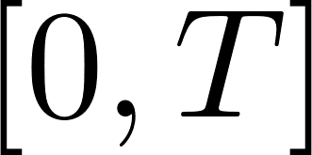





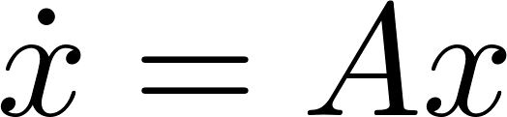
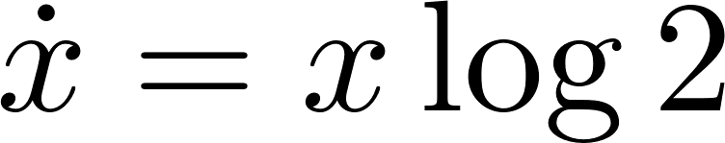
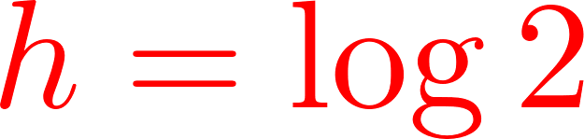
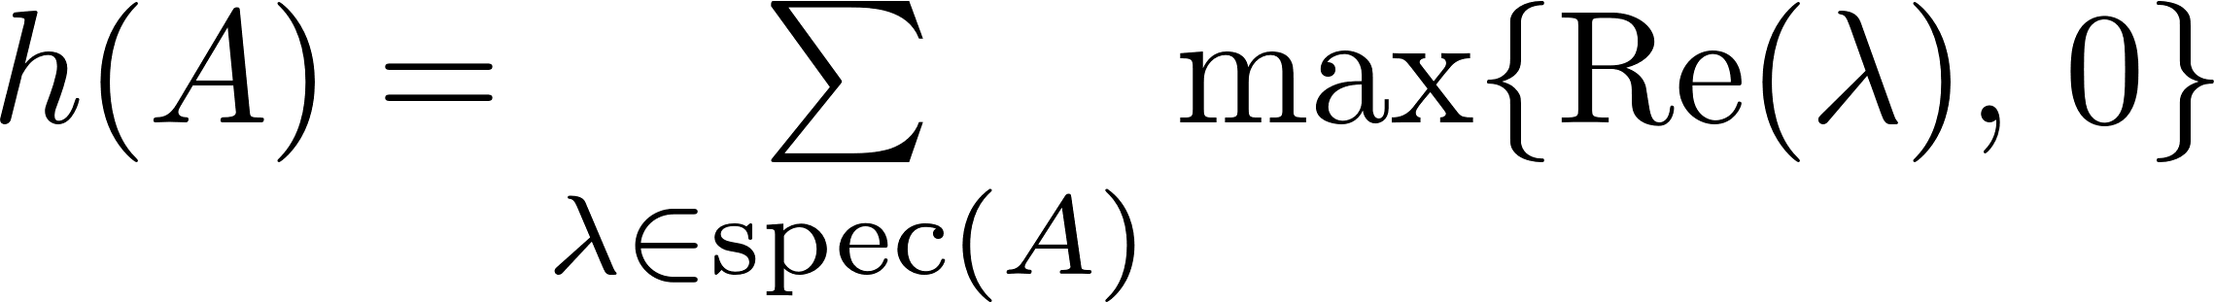
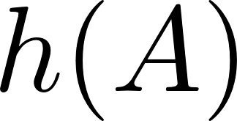
Topological Entropy
Essential idea: uncertainty growth
  Dynamical system with bounded initial set
  Need balls of radius to cover the reachable set on
  Topological entropy: how fast does increase (exponentially)?
Systems theory:
  Originated from [Kolmogorov]
  Defined by [Adler-Konheim-McAndrew; Bowen; Dinaburg]
Control theory: minimal data rate
  Feedback control [Nair-Evans-Mareels-Moran]
  Invariance/exponential stabilization [Colonius-Kawan]
  Estimation [Savkin; Liberzon-Mitra]
Linear time-invariant (LTI) systems:
  The entropy is
  Minimal data rate for feedback stabilization is also [Hespanha-Ortega-Vasudevan; Nair-Evans; Tatikonda-Mitter]

Slide 3

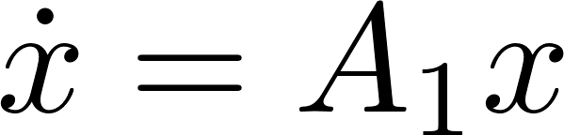
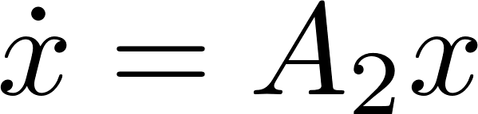
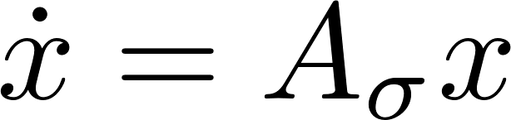
Switched System
Dynamical system switches between multiple dynamics
Ubiquitous in real-world systems
  Electrical network, vehicles, etc.
  Cyber-physical systems: continuous dynamics orchestrated by discrete decisions
Theoretical viewpoint
  Switching between simple dynamics (modes) could generate rich behaviors
  Stable individual modes stable switched system
No minimal data rate or entropy
  Sufficient data rate [Liberzon; Sibai-Mitra; Yang-Liberzon]

Slide 4
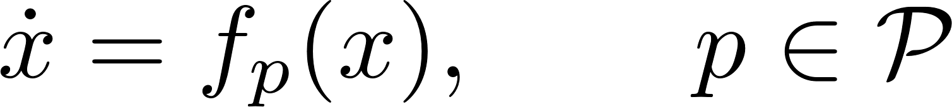
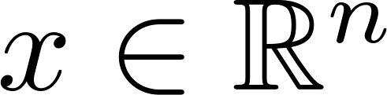

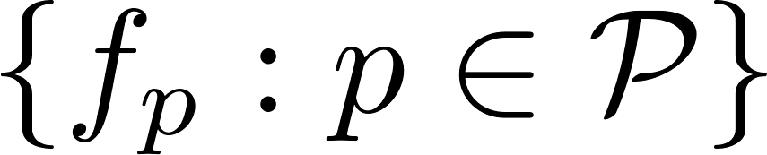
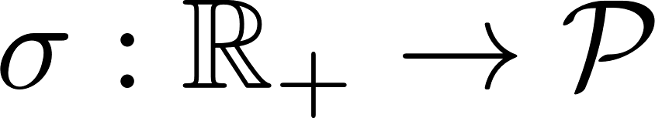
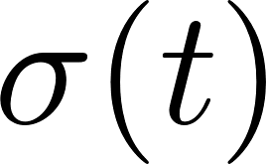

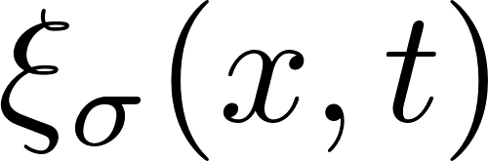



Switched System
A finite family of continuous-time dynamical systems
with the state and an index set .
A switched system
Modes
Switching signal ; active mode
Initial set is compact
Solution : at time with initial state and switching signal

Slide 5

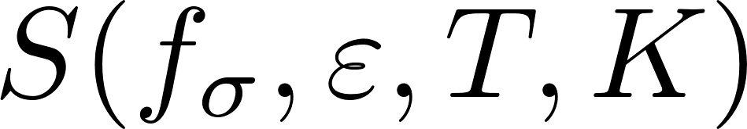
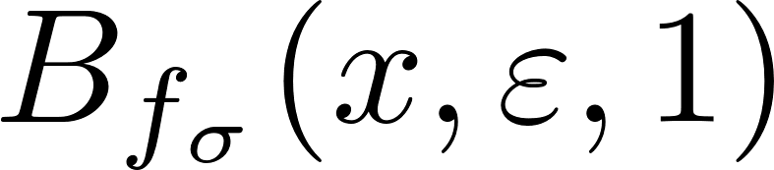
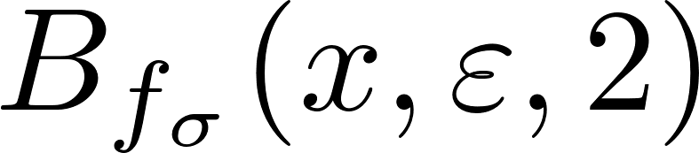
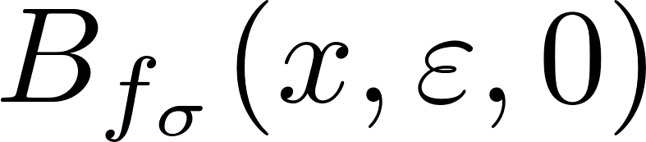
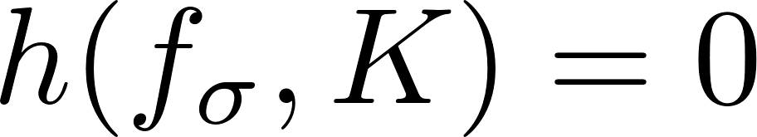
Entropy Definition
A switched system
Given a time horizon and a radius , define the open ball
Let be the minimal number of such balls so that their union covers
The topological entropy is its exponential growth rate
Properties:
  Nonnegative
  Depends on the switching signal and the initial set
  Independent of the norm
  Stability implies

Slide 6
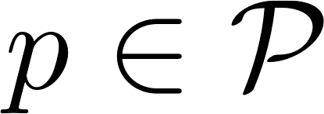
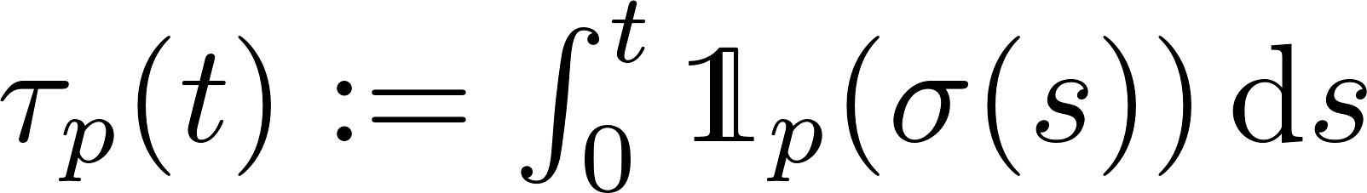
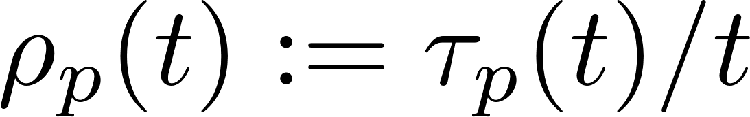
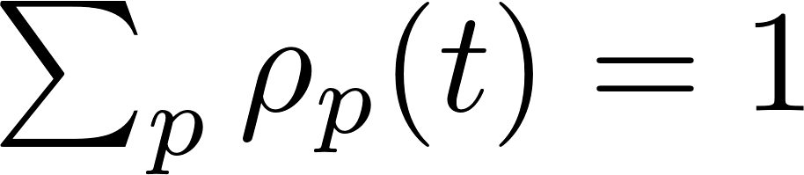
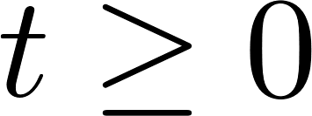
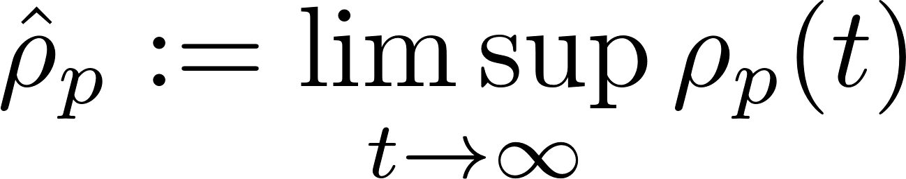
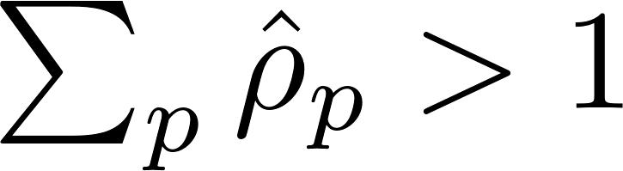
Active Time and Active Rates
For a switching signal , define the following quantities:
The active time of mode over :
The active rate of mode over :
  Then for all .
The asymptotic active rate of mode :
  It is possible that .

Slide 7
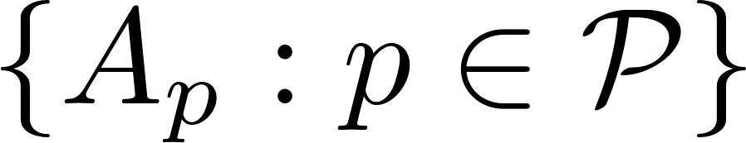
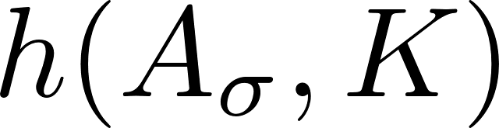
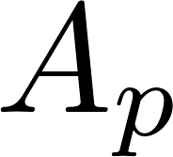
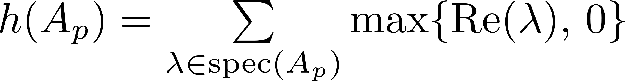
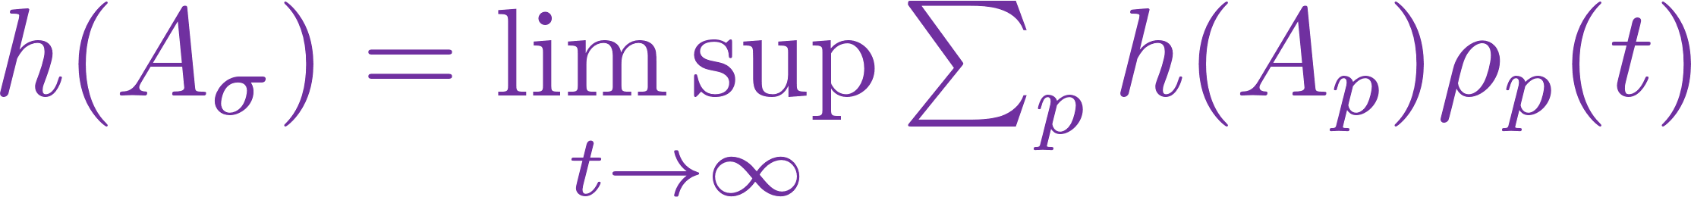
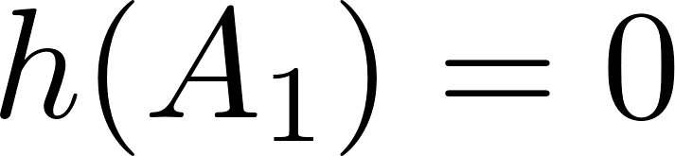
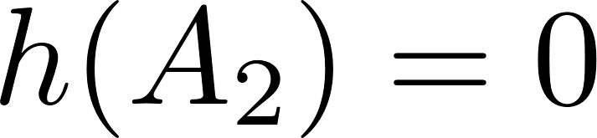
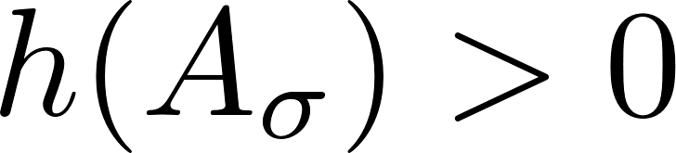
Entropy of Switched Linear Systems
A switched linear system generated by a family of matrices :
Proposition. The entropy is independent of
Recall: for each individual mode , the entropy is given by
Question: ?

Slide 8
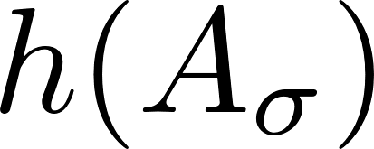
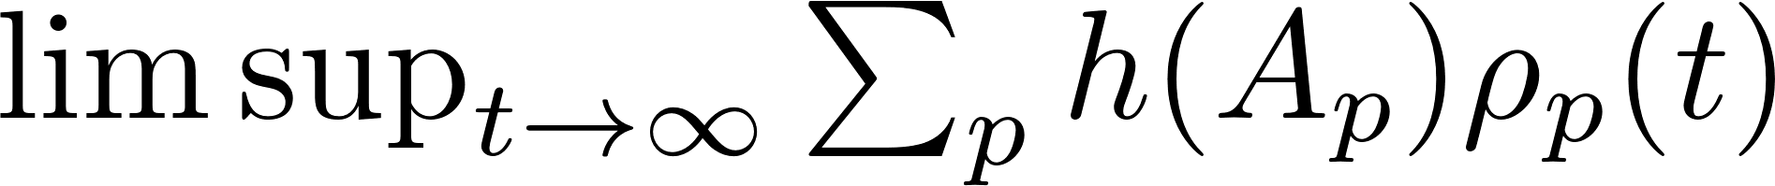

Entropy of Switched Linear Systems
A switched linear system generated by a family of matrices :
Theorem.
Proof sketch:
  Upper bound:
  Lower bound:
Implications:
  The upper bound holds for all induced matrix norms,
  Gap between bounds: in general,
  No exact formula due to lack of “alignment” between eigenspaces
  Relation between and is unknown
Better upper bounds:
  If are commuting, then stable individual modes stable switched system
  Entropy of switching linear systems with commutation structure?
can be improved using matrix measure

Slide 9
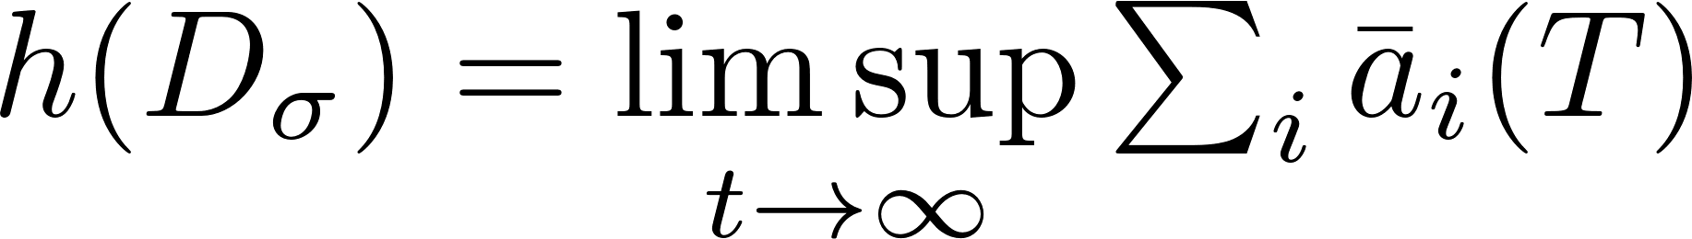
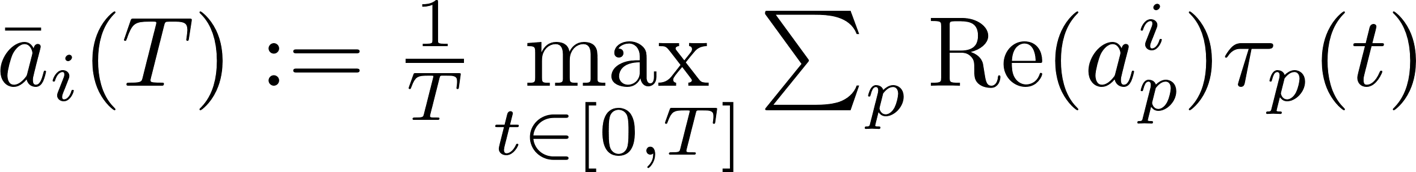

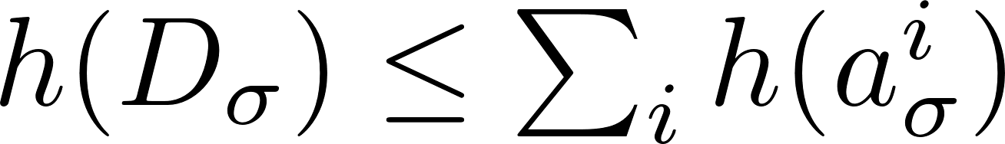
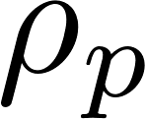

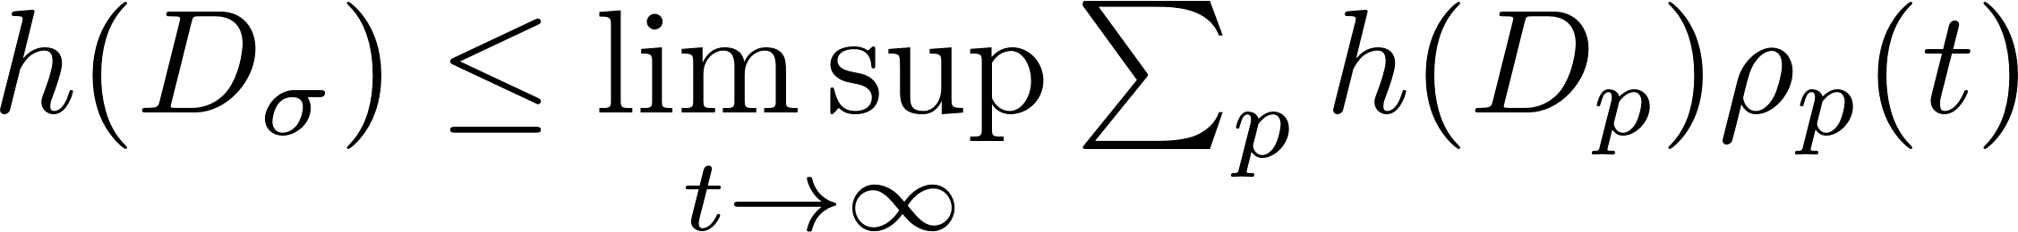
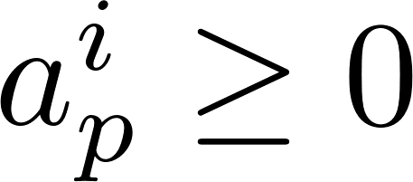
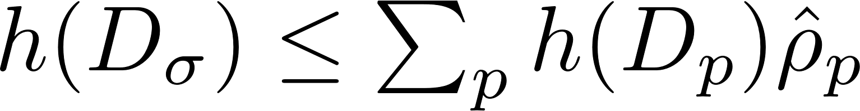
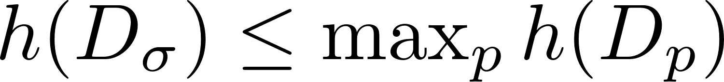
Entropy of Switched Diagonal Systems
A switched linear system generated by :
Theorem. with
Proof sketch:
  “Aligned” eigenspace:
Proposition. ; equal if all active rates are converging
Proposition. ; equal if all eigenvalues
Corollary. And
Entropy of switched triangular systems
Entropy for the -th component
Entropy of mode
No diagonalization
Independent of switching

Slide 10
Entropy of Switched Triangular Systems
A switched linear system generated by a family of upper triangular matrices:
Theorem: an upper bound for entropy
  Only depends on the diagonal entries
  The off-diagonal entries are absorbed into a polynomial function of time
Simpler but more conservative upper bounds

Slide 11
Conclusion
Contributions:
A notion of topological entropy for switched systems
General switched linear systems
  Entropy is independence to the initial set
  Upper and lower bounds for entropy
Switched linear systems with commutation structure
  Formula for entropy of switched diagonal systems
  Upper bounds for entropy of switched diagonal/triangular systems
Future research:
Characterizations for switching in entropy computation and stability analysis
  Stability: slow-switching conditions such as average dwell-time
  Entropy: active time/rate
Thank you!
Better data rate requirements and bounds for entropy?

