Slide 1
Stabilizing A Switched Linear System with Disturbance
by Sampled-Data Quantized Feedback
2015 American Control Conference
Guosong Yang and Daniel Liberzon
Coordinated Science Laboratory
University of Illinois at Urbana-Champaign
Urbana, IL 61801
Notes:
Guosong Yang
Stabilizing a Switched linear system with Disturbance by Sampled-data Quantized feedback
Daniel Liberzon.

Slide 2











Problem Formulation
Controller
Switched Linear System
Sensor
Decoder
Channel
Encoder
Switched linear system:
is a (finite) index set, are modes (subsystems)
is a switching signal
Information structure:
Sampling: measure and at
Quantization: encode by
Transmits , the data rate is
sampling period
quantization resolution
Objective: Develop a communication and control strategy
  such that the state is exponentially converging
  which is robust w.r.t. the disturbance
Notes:
Stabilization of a switched linear system
State, control input, the unknown disturbance
Triplet of matrices A_p, B_p, D_p, the index of the mode
Index set, calligraphic P
Switching signal
Information structure
Sensor only measures, at t_k = k tau_s, sampling period
Between two consecutive sampling time t_k and t_k+1, the state and active subsystem is completely unknown
Quantizes the data before sending, x(t_k) is encoded by an integer i_k from 0 to N^n_x, dimension of the state-space, resolution of quantization
Sends i_k and the index of the active subsystem sigma(t_k)
This many bits for i_k, and this many bits for sigma(t_k), transmission occurs only at the sampling time, that is, every tau_s, data rate is finite, in this form
Strategy, using a transmission with a finite data rate, exponentially decaying w.r.t the initial value
Robust w.r.t. the disturbance, converge to a small value if the disturbance is small

Slide 3
Motivation & Literature Review
Motivation:
Switching:
ubiquitous in realistic system models
lots of literature on stability and stabilization
tools: common/multiple Lyapunov functions, slow switching conditions
Limited information:
practical reasons: coarse sensing, limited communication
theoretical interest: how much information is needed
tools: Lyapunov analysis, data rate bound
D
S&Q
[HM99]
[HOV02]
[L14]
Hespanha & Morse, “Stability of switched systems with average dwell-time,” CDC1999
Hespanha, Ortega & Vasudevan, “Towards the control of linear systems with minimum bit-rate,” MTNS2002
Liberzon, “Finite data-rate feedback stabilization of switched and hybrid linear systems,” Automatica, 2014
[HOV02]
SW
[YL15]
[HM99]
[L14]
Notes:
Show some motivation for our work
Switching, common in realistic system models, lots of literature on stability and stabilization of switched systems, common tools, constructing of common/multiple Lyapunov functions, and imposing condition on the frequency
Control with limited information using sampling and quantization, many practical reasons, like coarse sensing or limited communication due to budget limit or security concern, the question of how much information is need to stabilize a system is quite intriguing on the theoretical level, common tools, Lyapunov analysis, and data rate constraints
Overlapping of tools, interested, stabilization of switched systems with limited information
Mention some earlier results that are particularly relevant to our work
Three challenges, disturbance, switching, sampling and quantization
In 1999, Hespanha and Morse, stability of switched system with disturbance, by imposing the average dwell-time condition
In 2002, Hespanha and others, minimum data rate needed to stabilize a linear system with disturbance, several more similar results, Tatikonda and Mitter
In 2014, Liberzon, stabilization of switched linear system with finite data rate feedback,
Direct generalization of this paper, all the three constraints: disturbance, switching, limited information

Slide 4










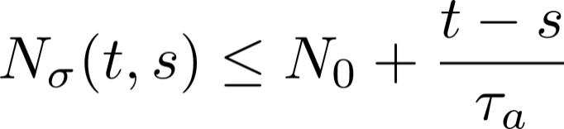



Assumptions
(Stabilizability) For each , there exists such that
is Hurwitz
  If no switching, exponential ISS
(Slow switching) denotes the number of switches on
  There exists dwell-time ([M96]) s.t. for all
    At most one switch on every sampling interval
  There exists average dwell-time ([HM99]) s.t. for all ,
    Less than one switch per sampling interval
(Disturbance) There exists a disturbance bound s.t. which is known to the encoder and decoder
(Data rate) for all
  Lower bound (data rate: )
[M96]
Morse, “Supervisory control of families of linear set-point controllers—Part I. Exact matching,” IEEE TAC, 1996
Notes:
First, all the subsystems are stabilizable, if no switching, system can be easily made exponentially ISS by state feedback
Second, switching is slow in the following sense
First, dwell-time tau_d, every two consecutive switches, separate at least tau_d, tau_d larger tau_s, on every sampling interval, there is at most one switch
Also average dwell-time tau_a, on average, at most one switch for every tau_a units of time, less than once per sampling inerval, on some sampling interval, no switch at all
Thirdly, magnitude of the disturbance is upper-bounded by a number delta_d, which is know to the encoder and decoder
Finally, sampling period tau_s and quantization resolution N satisfies this inequality, form of data rate, N needs to be sufficiently large w.r.t. tau_s, lower bound on the data rate

Slide 5



Main result
Theorem 1. If the average dwell-time is large enough, there is a communication and control strategy such that the state is
exponentially converging w.r.t. the initial value, i.e., for all ,
where
BIBS stable, i.e., for all , there exists such that
Notes:
Main result, average dwell-time is large enough
Establish a communication and control strategy
State, exponentially decaying w.r.t. the initial value, norm of the state, upper-bounded, product of an exponentially decaying term, nonlinear gain on norm of the initial state, plus an nonlinear gian on the disturbance bound
BIBS stable, state will always be small if the initial value and the disturbance are both small

Slide 6











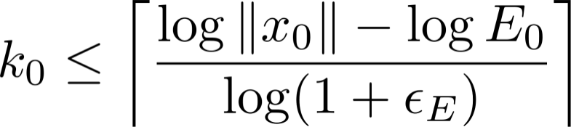

Communication and Control Strategy
Controller
Switched Linear System
Sensor
Decoder
Channel
Encoder
At , the sensor doesn’t know . It zooms-out to capture the state
Receive
Set
on
Controller
Send
Calculate
Sensor
No
Yes
Zoom-in
, while
on
Hence capture at
Both know
Both calculate
independently
Notes:
Sensor, the initial state x_0, a number E_0
Staring from k = 0, if the state is in the hypercube of radius E_0 (hypercube because infinite norm)
If not, zoom-out, a larger box with radius E_k+1, repeat at t_k+1
Sends 0, overflow symbol, controller knows, not captured, set u = 0, following sampling interval
Variation of constants, triangular inequality, an upper bound, norm of the state, sequence E_k, growth rate dominates, capture in a finite time
If inside, zoom-in

Slide 7











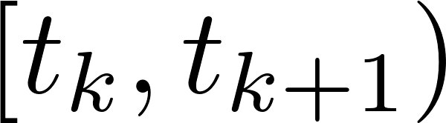
Communication and Control Strategy
Controller
Switched Linear System
Sensor
Decoder
Channel
Encoder
At , the sensor zooms-in to measure the state
Sensor:
Evenly divide the hypercube into boxes
Encode each box by an index from to
Send the index of the box containing the state, and
Controller:
Decode to reconstruct
Auxiliary system
Set on
Notes:
State is inside a hypercube of radius E_k centered at x_k^* (first capture, x_k^* = 0)
Sensor evenly divides, N^n_x hypercubic boxes, N per dimension, encode, from 1 to N^n_x, send i_k, along with sigma(t_k)
Controller knows, encoding protocol, reconstruct c_k from i_k, auxiliary system of x^hat, exponentially stable, is Hurwitz, initialized at c_k, input u, next sampling interval, feedback form

Slide 8




Communication and Control Strategy
Controller
Switched Linear System
Sensor
Decoder
Channel
Encoder
At , the sensor zooms-in to measure the state
Both sensor and controller know
Both maintain the same auxiliary system and independently calculate
such that
Notes:
Over-approximation of reachable set, x(t_k+1), a hypercube of radius E_k+1 centered at x_k+1^*
Both the sensor and the controller, the same auxiliary system, derive the same x_k+1* and E_k+1

Slide 9

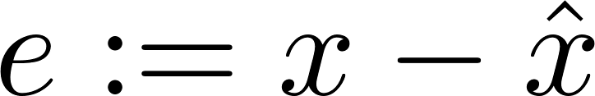
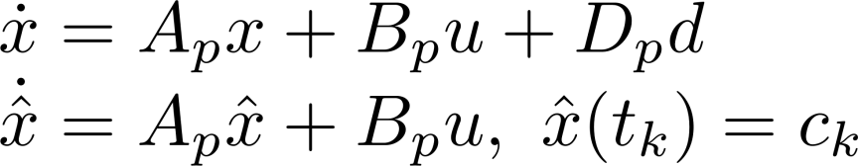
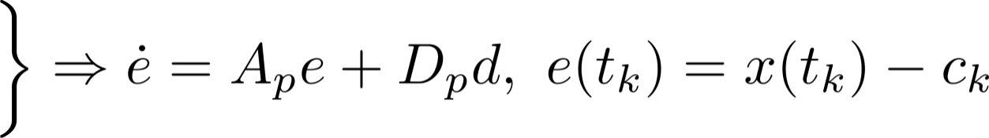
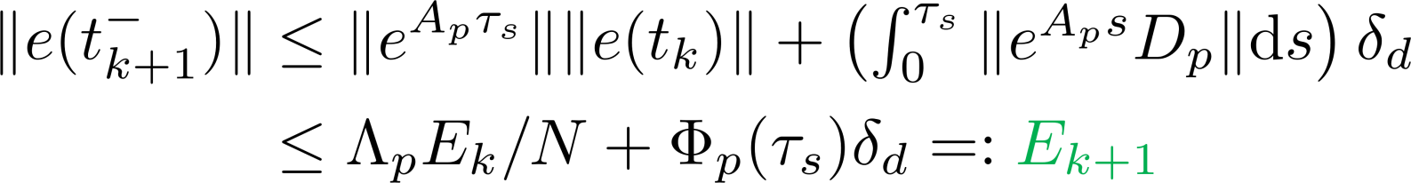
Generating State Bounds
Objective:
Given such that
Calculate such that
Case 1 (easier): Sampling interval with no switch
Let .
Hence
and
Notes:
Ready to derive state bounds
Easier case, sampling interval with no switch
As at most one switch on every sampling interval, no switch if switching signal are equal
Formula of the switched linear system with disturbance and the auxiliary system
Error, difference between the real and auxiliary states, dynamics of e, variation of constants, triangular inequality, upper-bound, right before the next sampling time
Hypercube, t_k+1, radius E_k+1, center x_k+1^*, auxiliary state right before t_k+1
Compared with no disturbance, term added to enlarge over-approximation of reachable set, accomodate

Slide 10


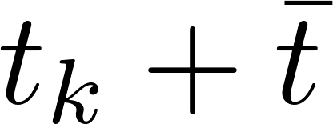




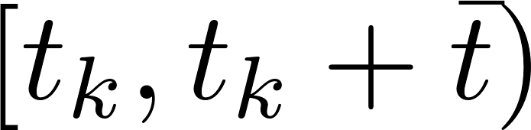



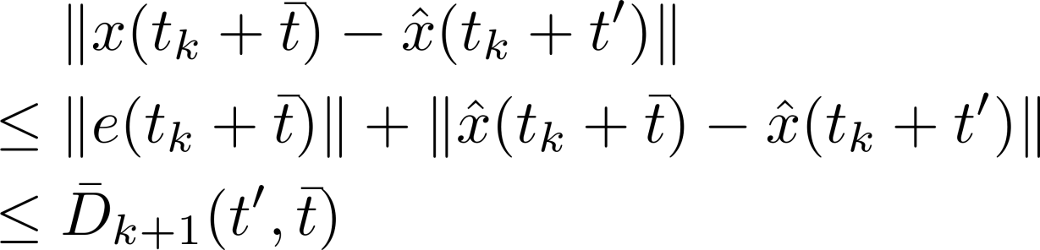



Generating State Bounds
Case 2 (harder): Sampling interval with a switch
Switch at , where
is unknown
Before the switch:
on , similar to the previous case
As is unknown, pick a known
and use as the center
Notes:
Harder case, sampling interval with a switch
ADT, exactly one switch if switching signal not equal
Let t_k + t^bar denote the switching time, t^bar unknown to the sensor and the controller
Before the switch, similar to the previous case, upper-bound on the error
Cannot use as t_bar unknown, pick a known t’ during the sampling interval, compare the state x at the switching time t_k + t^bar to the auxiliary state x^hat at t_k + t’, triangular inequality, hypercube, radius D^bar_k+1, center, x^hat(t_k + t’)

Slide 11

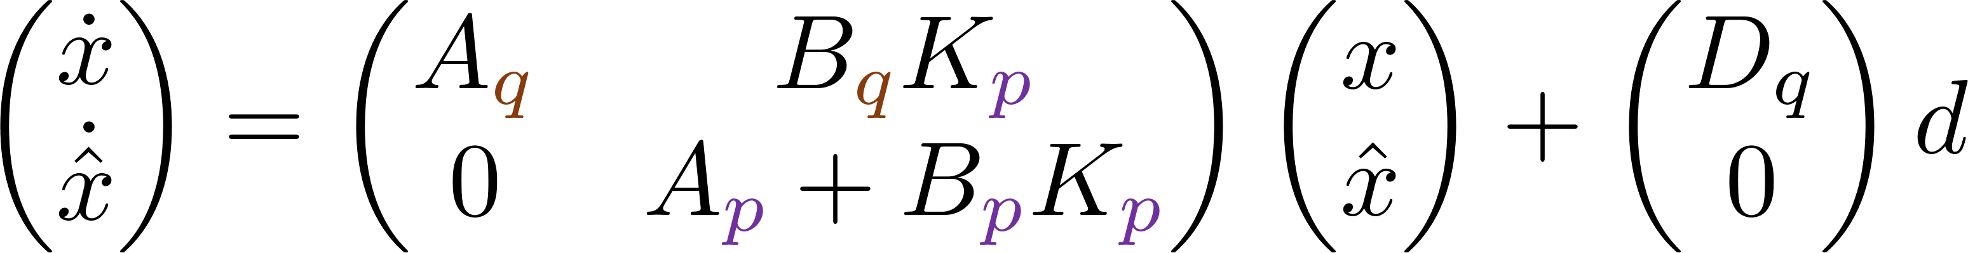

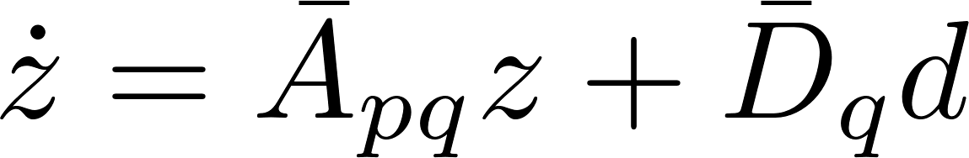

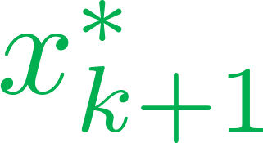



Generating State Bounds
After the switch: on , the closed-loop dynamics is
Let , then
Second auxiliary system:
Lift
Project
onto
Take maximum over to obtain the bound
Notes:
After the switch, the closed-loop dynamics
Define z as the concatenation of x and x^hat, differential equation, a second auxiliary system of z^hat, with the same A^bar_pq
Transformation from x to z, lifting the hypercube containing x(t + t^bar), a state-space of twice the dimension
Second auxiliary system, initialized at this point, center of the higher dimensional hypercube
Letting the system of z evolve for tau_s – t^bar units of time, hypercube containing the state z at the next sampling time t_k+1
Again, as t_bar is unknown, pick a known t’’ in the sampling interval, compare z(t_k+1) with the second auxiliary state z^hat at t_k + t’’
Project onto the original state-space, over-approximation of the reachable set at t_k+1, hypercube of radius E^bar_k+1
Next state bound E_k+1 is defined to be maximum of the radius E^bar_k+1 over all t_bar between 0 and tau_s
In this way, we are able to construct E_k+1 for the case of a sampling interval with a switch

Slide 12

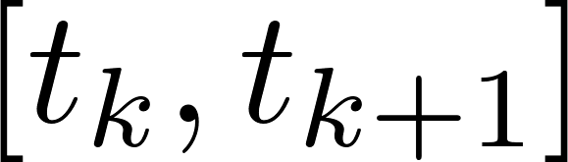

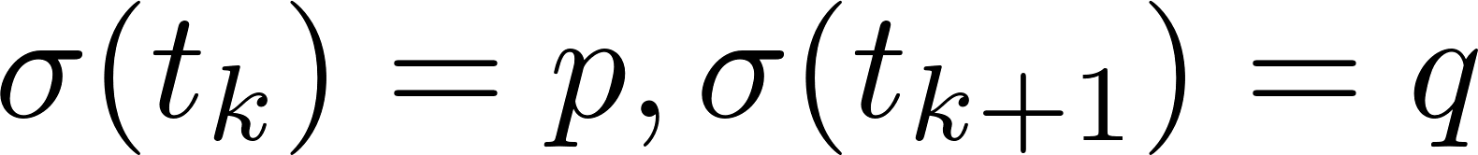
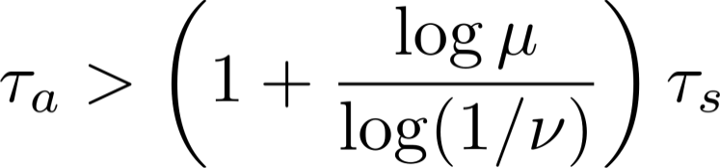
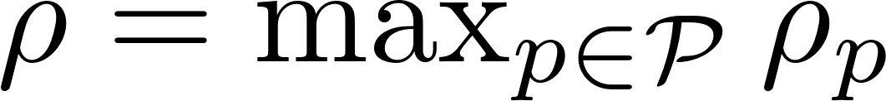
Stability Analysis: Outline
Sampling interval with no switch: on
Assumptions: is Hurwitz (stabilizable), (data rate)
ISS Lyapunov function:
Then
Sampling interval with a switch:
Then
Combined bound for sampling times:
If ADT satisfies ,
then
Exponential convergence w.r.t. initial value: for all
BIBS stability: see paper (if , then same bound on )
Notes:
Sampling interval with no switch, formula for x_k+1^* and E_k+1
ISS Lyapunov function, P_p, solution to the Lyapunov equation of A_p + B_p K_p, rho_p, a sufficiently large constant, the value of the ISS Lyapunov function at t_k+1, upper-bound, nu < 1
Sampling interval with a switch, similar upper-bound on the ISS Lyapunov function at t_k+1, mu geq 1
Combing the above two bounds, invoking the average dwell-time condition, if ADT satisfies this lower bound w.r.t. tau_s, then the value of the ISS Lyapunov function at sampling times is exponentially decaying w.r.t first capture
Exponentially decaying bound, norm of the state
More details on the proof of BIBS stability, in the paper

Slide 13

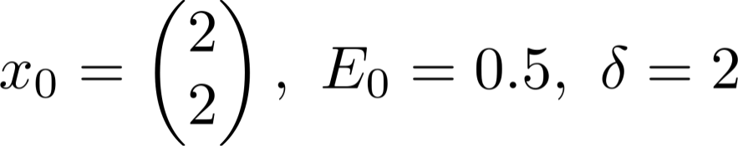
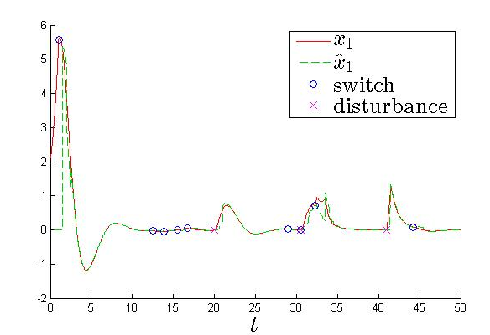



Simulation Result
We keep mostly , and turn it on shortly when becomes small
Theoretically, a sufficient condition is approximately
Notes:
Switched linear system of two modes, parameters satisfy all the assumptions
Initial state, (2, 2), E_0, 0.5, zoom-out
Set the disturbance d to be mostly 0, turn it on shortly when x small
Plot of the first state x_1, first auxiliary state x^hat_1, blue circles indicate the switches, pink crosses indicate turning on the disturbance
Capture the state via zooming-out, achieve exponential decay during zoom-in, is robust w.r.t. the disturbance
Theoretically sufficient condition on the average dwell-time is approximately 50, while stabilize a switched linear system with average dwell-time 8, theoretical bound are quite conservative for this example

Slide 14
Conclusion and Future Work
Contribution:
Finite data rate stabilization of a switched linear system with disturbance (sampling, quantization)
Main Step: enlarge the over-approximations of reachable sets to accommodate disturbance
Explicit data rate bound for BIBS stability
Future Work:
Finite but unknown disturbance bound
Zoom-in and zoom-out repeatedly
Input-to-state stability
Notes:
In this work, suppose encoder and decoder know the bound on the disturbance
Generalize to the case that disturbance is bounded but bound is unknown
In this case, the state may escape after capture, zoom-out again to recapture
Establish input-to-state stability

