Slide 1
Finite data-rate stabilization of a switched
linear system with unknown disturbance
NOLCOS 2016 Monterey, California, U.S.
Guosong Yang and Daniel Liberzon
Coordinated Science Laboratory
University of Illinois at Urbana-Champaign
Urbana, IL 61801
Notes:
Thank you all for coming to the last talk in the last session of the symposium
Guosong Yang

Slide 2











Problem Formulation
Controller
Switched Linear System
Sensor
Decoder
Channel
Encoder
Switched linear system:
is a (finite) index set, are modes (subsystems)
is a switching signal
Information structure:
Sampling: measure and at
Quantization: encode by
Transmits , the data-rate is
sampling period
quantization resolution
Objective: Develop a communication and control strategy
  such that the state is exponentially converging
  which is robust w.r.t. the disturbance
Notes:
Stabilizing a switched linear system w/ control input and unknown disturbance
Among a finite number of modes indexed by p
Calligraphic P, set of all indices
Switching signal, specify active mode
Information structure
The state and active mode are available only at t_k = k tau_s
Between two consecutive sampling time t_k and t_k+1, the state and active mode are completely unknown (don’t know exact switching time)
The state is quantized before sending, x(t_k) is encoded by an integer i_k from 0 to N^n_x, dimension of the state-space
Sends i_k and the active mode sigma(t_k)
This many bits for i_k, and this many bits for sigma(t_k), transmission occurs only at sampling times, that is, every tau_s, data-rate is finite, in this form
Strategy for this information structure, exponentially decaying w.r.t the initial value
Robust w.r.t. the disturbance

Slide 3
Motivation & Literature Review
Switching:
Ubiquitous in realistic system models
Plenty of literature on stability and stabilization
Tools: common Lyapunov functions, slow switching
Limited information:
Practical reasons: coarse sensing, limited communication
Theoretical interest: how much information is needed
Tools: finite data-rate, Lyapunov analysis
[1] [2] [3] | Hespanha & Morse (1999) Vu, Chatterjee & Liberzon (2007) Müller & Liberzon (2012)
[4–7]
Finite
data-rate
Disturbance
[4] [5] [6] [7] | Hespanha, Ortega & Vasudevan (2002) Tatikonda & Mitter (2004) Liberzon & Nešić (2007) Sharon & Liberzon (2012)
[9]
[1–3]
[8]
Switching
[8] | Liberzon (2014)
[9] | Yang & Liberzon (2015)
Notes:
Interested in switching, common in realistic system models, lots of literature on stability and stabilization of switched systems
Common tools: constructing of a common Lyapunov function, and imposing condition on the switch frequency
Control with limited information, many practical reasons, like coarse sensing or limited communication due to budget constraint or security concern
How much information is need to stabilize a system is quite intriguing on the theoretical perspective
Common tools: finite data-rate using sampling and quantization, Lyapunov analysis
Overlapping of tools, encourage, stabilization of switched systems with limited information
Mention some earlier results that are particularly relevant to our work
Three challenges, disturbance, finite data-rate and switching
Literature for systems with two of the three features
Preliminary results in which the disturbance admits a known bound.

Slide 4








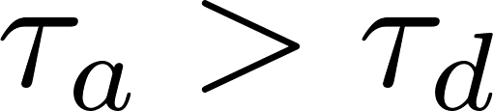

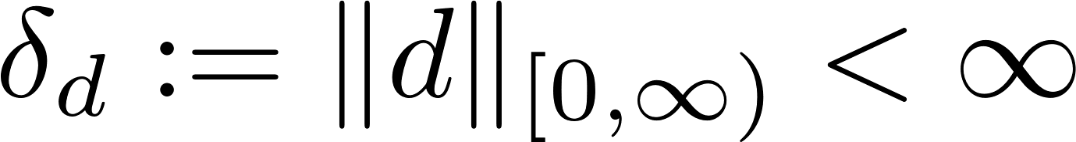


Assumptions
(Stabilizability) For each , there exists such that
is Hurwitz
  If no switching, exponential ISS
(Slow switching) denotes the number of switches on
  There exists a dwell-time ([M96]) such that for all
    At most one switch on every sampling interval
  There exists average dwell-time ([HM99]) such that for all
    Less than one switch per sampling interval
(Disturbance) Essentially bounded disturbance:
  Disturbance bound is unknown to the encoder and decoder
(Data rate) for all
  Lower bound on data rate:
[M96] | Morse (1996) in IEEE Transactions on Automatic Control, vol. 41, pp. 1413–1431
[HM99] | Hespanha & Morse (1999) in 38th IEEE Conference on Decision and Control, pp. 2655–2660
Notes:
First, all the subsystems are stabilizable, if no switching, system can be easily made exponentially ISS by state feedback
Second, switching is slow in the following sense
First, dwell-time tau_d, every two consecutive switches, separate at least tau_d, tau_d larger tau_s, on every sampling interval, there is at most one switch
Also average dwell-time tau_a, on average, at most one switch for every tau_a units of time, less than once per sampling interval, on some sampling interval, no switch at all
Thirdly, the disturbance is essentially bounded, unknow to the encoder and decoder
Finally, sampling period tau_s and quantization resolution N satisfies this inequality, form of data rate, N needs to be sufficiently large w.r.t. tau_s, lower bound on the data-rate

Slide 5

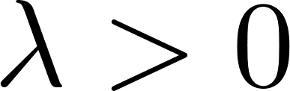
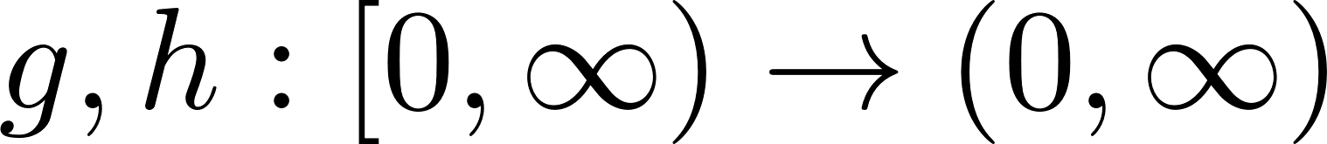




Main result
Theorem 1. Provided that the average dwell-time is large enough, there is a communication and control strategy that yields
Exponential convergence: There exist a rate and gain functions such that
for all .
Practical stability: There exists a constant such that for each , there exists a such that
Notes:
Main result, average dwell-time is large enough
Establish a communication and control strategy
State, exponentially decaying w.r.t. the initial value, norm of the state, upper-bounded, product of an exponentially decaying term, nonlinear gain for norm of the initial state, plus nonlinear gain for the disturbance bound
Practical stability, if the initial state and the disturbance are both small, then the state will be bounded in the neighborhood of a ball of radius C’

Slide 6
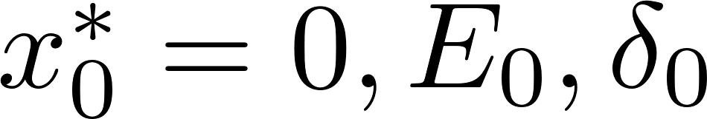

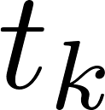
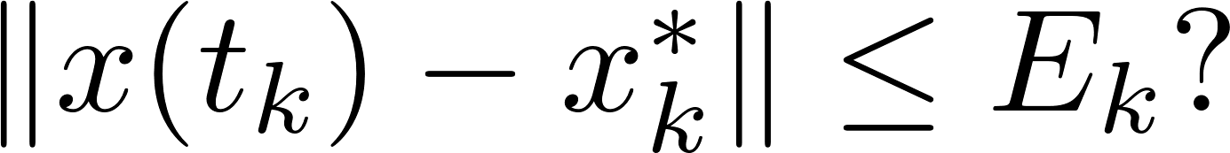
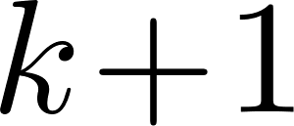
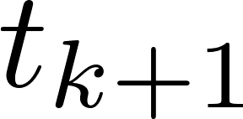
Communication and Control Strategy
Controller
Switched Linear System
Sensor
Decoder
Channel
Encoder
Two stages:
Unknown initial state
Initial values
At each sampling time , determine if
  If true, the state is visible, go to the stabilizing stage
  If false, the state is lost, go to the searching stage
Repeat at
No
Yes
Stabilizing
stage
Searching
stage
Notes:
Initial state is unknown
Both sensor and controller, the same values E_0 and delta_0
At each sampling time, if this inequality holds: use a hypercube of radius E_k centered at x_k^* in the state space, if the state is inside

Slide 7
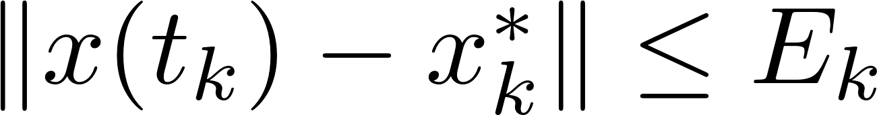







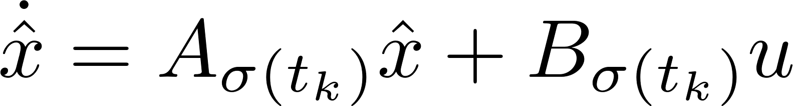

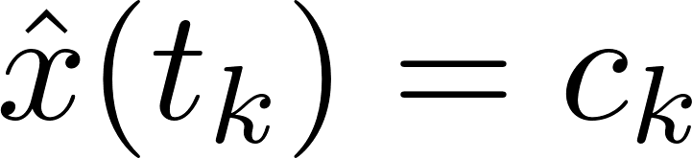

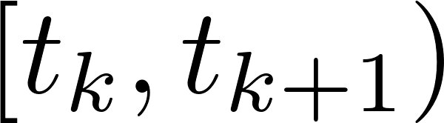
Communication and Control Strategy
Controller
Switched Linear System
Sensor
Decoder
Channel
Encoder
Stabilizing stage
Sensor:
Evenly divide the hypercube into boxes
Encode each box by an index from to
Send the index of the box containing the state, and the active mode
Controller:
Decode to reconstruct
Auxiliary system: with boundary condition:
Set on
Notes:
State is inside a hypercube of radius E_k centered at x_k^*
N^n_x hypercubic boxes, N per dimension, encode, from 1 to N^n_x, send i_k, along with the active mode at t_k
Same encoding protocol, reconstruct c_k from i_k, reset auxiliary system of x^hat, w/o disturbance, auxiliary state resets to c_k
Control input, stabilizing gain matrix, A + BK is Hurwitz, auxiliary system is stable

Slide 8

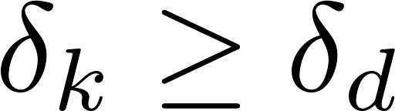


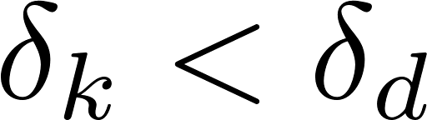
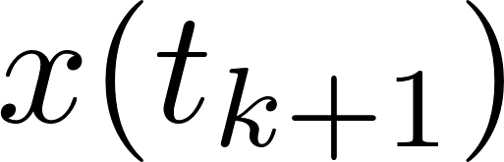

Communication and Control Strategy
Controller
Switched Linear System
Sensor
Decoder
Channel
Encoder
Stabilizing stage
Same auxiliary system in the sensor and the controller
Each calculates such that
  if then
  otherwise , and may escape (but not necessarily)
Notes:
Both the sensor and the controller, the same auxiliary system
Calculate the quantization hypercube for the next sampling time, radius E_k+1, centered at x_k+1^*
If the estimate is larger than the disturbance bound
If it is smaller

Slide 9


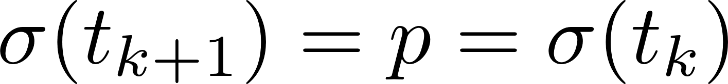
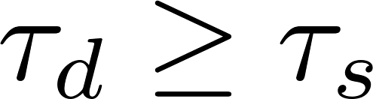
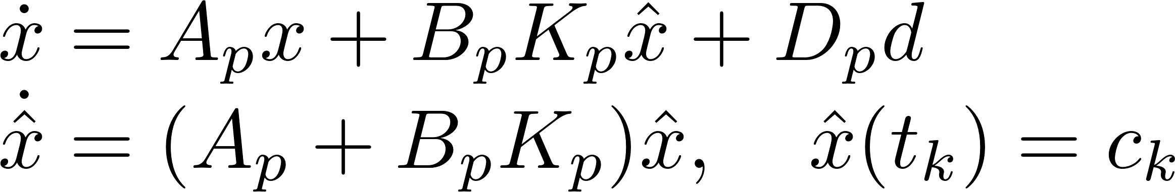
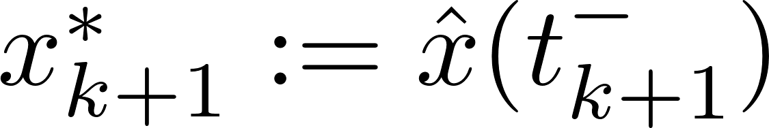
Generating Approximations
Objective:
Given such that
Calculate such that if then
Case 1 (easier):
As , no switch
Closed-loop dynamics:
Hence
Set and
Notes:
Demonstrate the derivation of x_k+1^* and E_k+1
Easier case, active mode is the same
As at most one switch on every sampling interval, no switch
Closed-loop dynamics
Set x_k+1^* to be the auxiliary state right before next sampling
Variation of constants, bound for the difference between the real and auxiliary states right before next sampling, depends on the disturbance bound
Set E_k+1 be replacing delta_d with its estimate delta_k

Slide 10

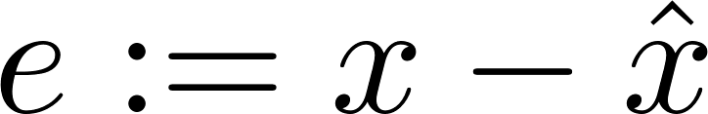
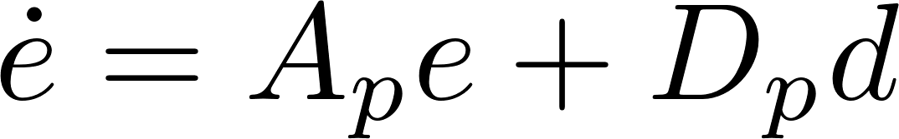
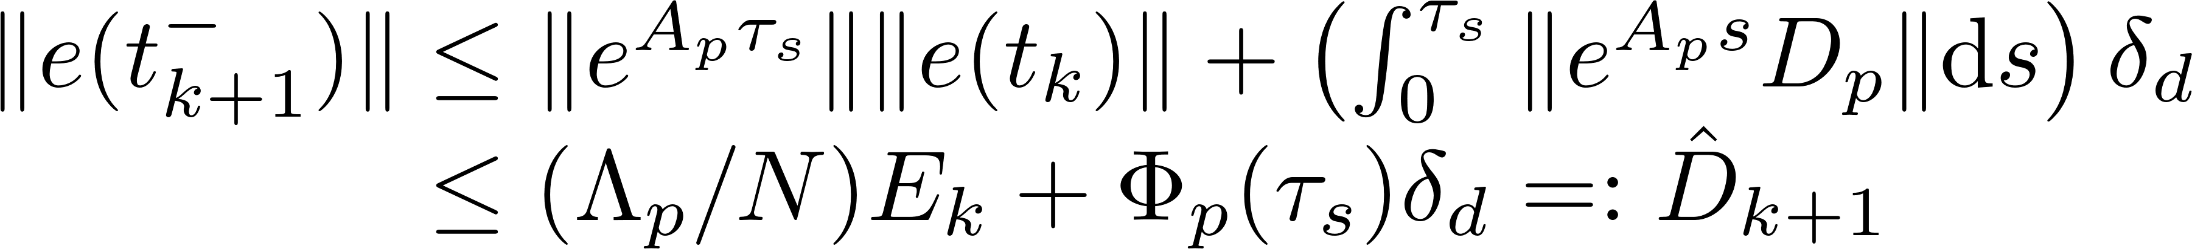
Generating Approximations (detail)
Objective:
Given such that
Calculate such that if then
Case 1 (easier):
As , no switch
Closed-loop dynamics:
Error satisfies with
Hence
Notes:
Backup

Slide 11


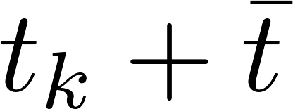



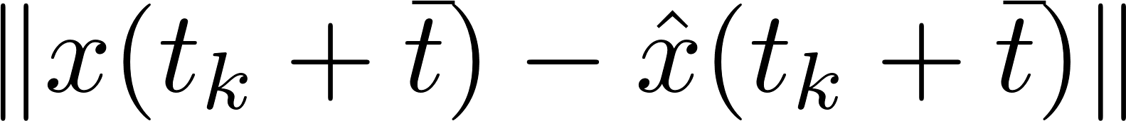


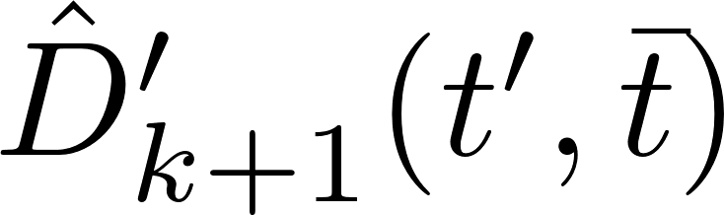



Generating Approximations
Case 2 (harder):
As , one switch
Let denote the unknown switching time
Before the switch:
Similar upper bound for
As is unknown, select and use as the center
Calculate via triangle inequality
Notes:
Harder case, active modes are different
Exact one switch
Let t_k + t^bar denote the switching time, where t^bar is unknown
Before the switch, similar to the case w/o switch, upper-bound on the error right before switch
As t_bar unknown, the auxiliary state at switching is unknown
Pick an arbitrary t’, new center
Calculate the reachable set via triangle inequality

Slide 12
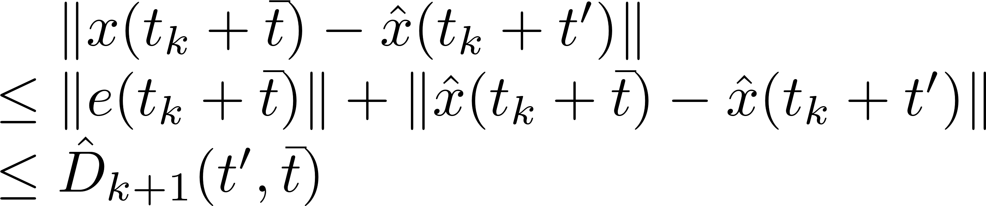
Generating Approximations (detail)
Case 2 (harder):
As , one switch
Let denote the unknown switching time
Before the switch:
At the switch
As is unknown, select and use as the center
Calculate via triangle inequality
The radius is given by
Notes:
Backup

Slide 13
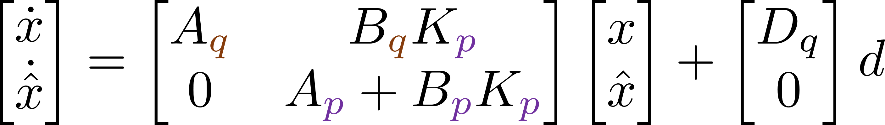

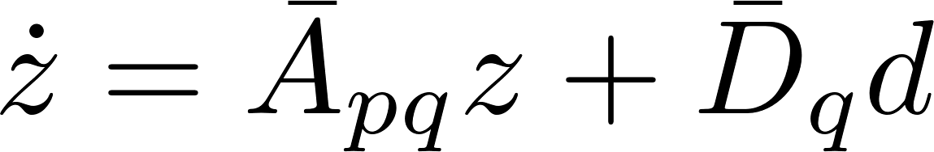
Generating Approximations
Case 2 (harder):
As , one switch
Let denote the unknown switching time
Before the switch:
Similar upper bound for
As is unknown, select and use as the center
Calculate via triangle inequality
After the switch:
Closed-loop dynamics:
Let . Then
Notes:
After switch, the control is still generated using the auxiliary system for the active mode before switch
Mismatch in the closed-loop dynamics
Concatenation, differential equation

Slide 14
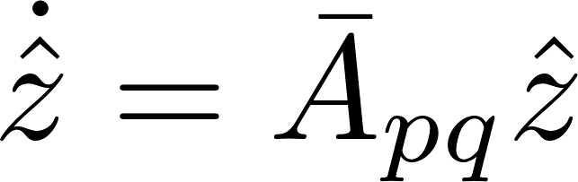

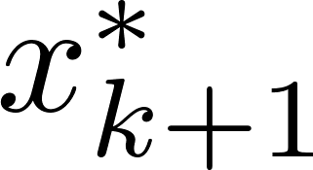

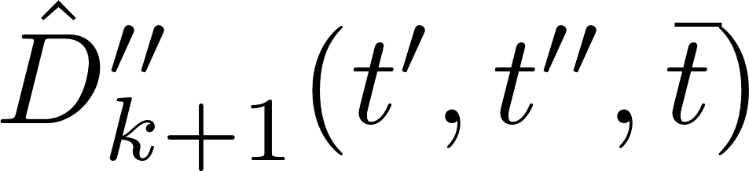

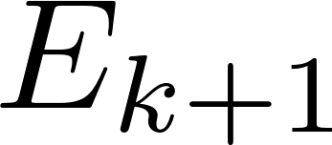

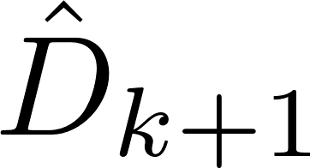

Generating Approximations
After the switch:
Let , then
Second auxiliary system: with boundary condition
Lift
Project
Take maximum over to obtain
Set by first replacing in the formula of with
Notes:
Consider a second auxiliary system, differential equation w/o disturbance
Auxiliary state is the concatenation of x^hat with itself
Visually, the reachable set is lifted to the state-space of z, its center the second auxiliary state z_hat
Propagate the reachable set for z right before the next sampling
Again, due to unknown switching time, select an arbitrary t’’, new center
Calculate the radius via triangle inequality
Finally, project the reachable set onto the state-space of x
Take maximum to remove dependence on the unknown switching time

Slide 15

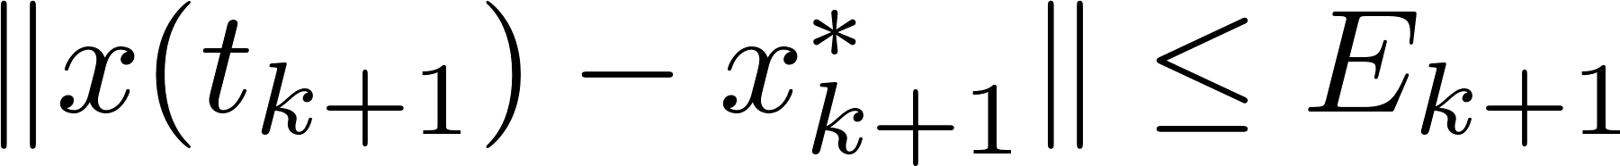

Communication and Control Strategy
Controller
Switched Linear System
Sensor
Decoder
Channel
Encoder
Stabilizing stage
At the next sampling time ,
Set
  If then
Notes:
In summary, in stabilizing stages, we derive the reachable set, radius is a function of the disturbance bound delta_d
Set the radius of the quantization hypercube by replacing delta_d with its estimate
If the estimate is larger, the state is guaranteed to be visible

Slide 16
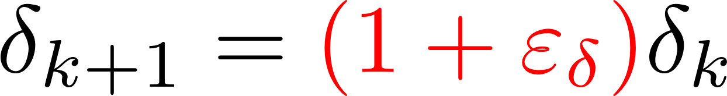
Communication and Control Strategy
Controller
Switched Linear System
Sensor
Decoder
Channel
Encoder
Stabilizing stage
At the next sampling time ,
Set
  If then
  If then the state may escape:
When escape, the sensor and controller learn that , and set
  Finite number of escapes
Notes:
Otherwise the hypercube is smaller than the reachable set, and it is possible that the state escapes
In this way, whenever the state escapes, learn that the estimate is too small, enlarge by a constant factor
Finite number of escapes, once the estimate becomes larger than the actual value, no more escape

Slide 17
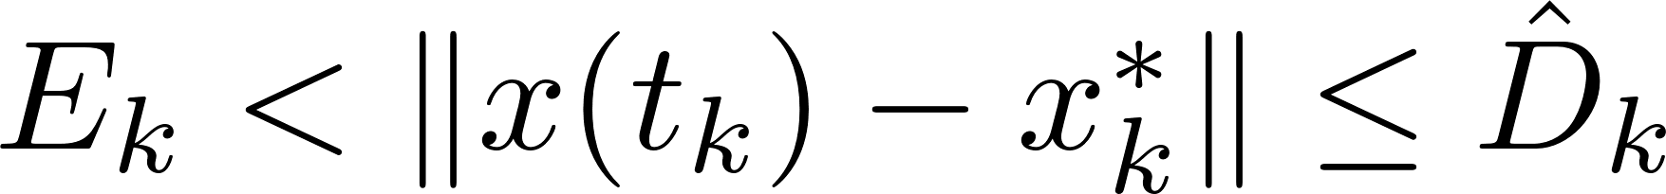
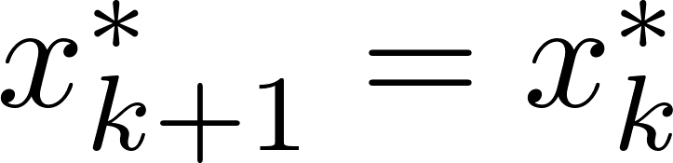
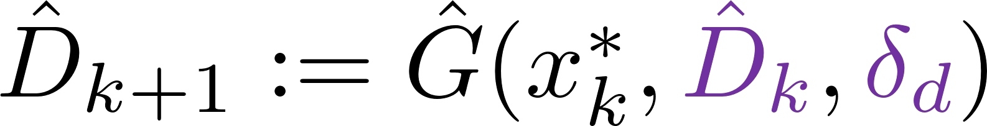
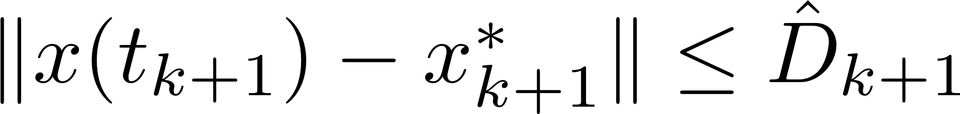
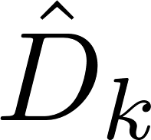
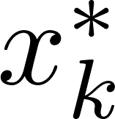
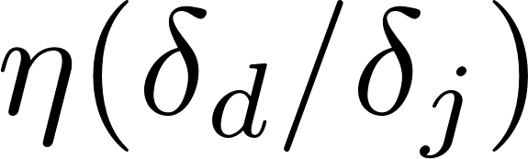

Communication and Control Strategy
Controller
Switched Linear System
Sensor
Decoder
Channel
Encoder
Searching stage
Set
Calculate such that
Set
  Dominating growth rate
  Finite recovery time
Notes:
In a searching stage, at t_k the state lie between the quantization hypercube and the reachable set
The new quantization hypercube is centered at the same point
Calculate the reachable set at the next sampling time in a similar manner as in a stabilizing stage
Its radius is a function of D_k^hat and the disturbance bound delta_d
Set the radius for the quantization hypercube by replacing D_k^hat with (1 + epsilon_E) E_k, and delta_d with its estimate delta_k
Additional factor 1 + epsilon_E gives dominating growth rate
Recover in finite time

Slide 18
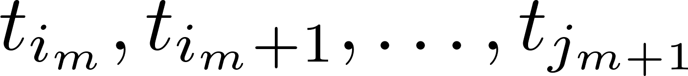
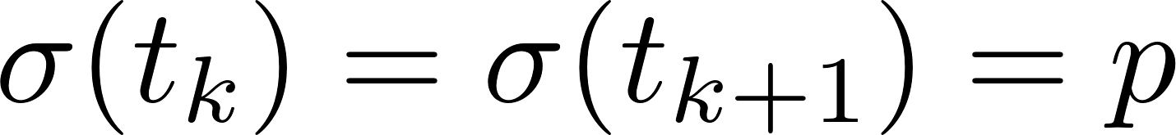
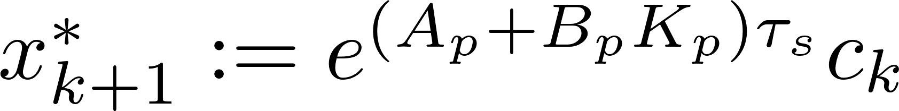

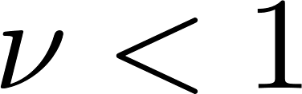
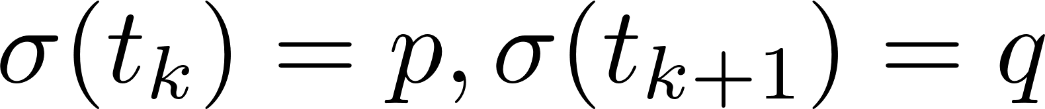
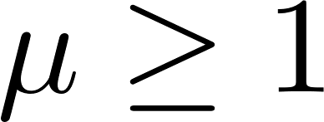
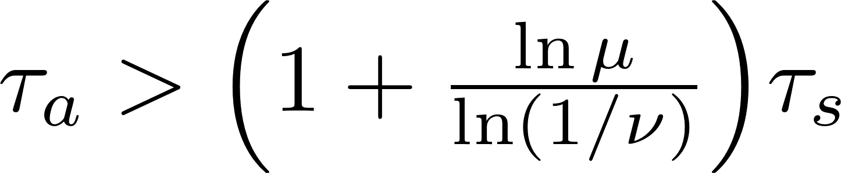



Stability Analysis Outline
Stabilizing stage
Sampling interval with no switch:
  Set and
  Assumptions: is Hurwitz and
  ISS Lyapunov function:
  Then with
Sampling interval with a switch:
  Then with
Combined bound for sampling times:
  If ADT then there exists such that
Searching stage
  Finite length , thus
Finite number of searching stages: exponential convergence
Notes:
For sampling interval w/o switch, the center and radius of the new quantization hypercube are given by these formulas
We have assumed that Hurwitz and less than 1
In this case the closed-loop system will be exponentially converging
ISS Lyapunov functions in this form
Its value at the next sampling time satisfies this inequality with nu less than 1
For sampling interval w/ sw, the ISS Lyapunov function satisfies an inequality in the same form with mu geq 1
If the ADT is large enough, the values of V at sampling times in stabilizing stages are exponential converging
In searching stages, we derive an upper-bound for V at recovery
Finite number of searching stages, an exponentially converging bound for the state

Slide 19
Conclusion and Future Work
Contribution:
Finite data-rate stabilization of a switched linear system with unknown disturbance (sampling, quantization)
Exponential convergence and practical stability
Main Step:
  Employ an iteratively updated estimate of the disturbance bound
  Expand the reachable sets from the case without disturbance
Future Work:
Decrease the estimate during stabilizing stages to achieve input-to-state stability
Minimum data-rate, topological entropy

