Slide 1
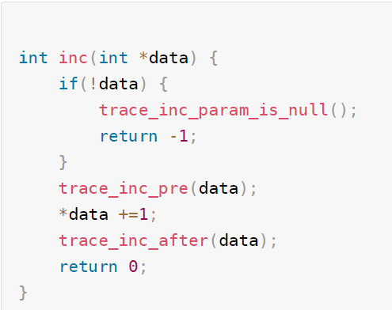
Trace point
遍历
func
func
func
Trace point
Trace point

Slide 2
3
BRK first happed
kprobe_breakpoint_handler(){
pre_handler();
modify_pc_to_slot() }
register_kprobe() {
replace_with_BRK64 }
2
Func()
instruction
4
BRK ret
Excute_slot_instruction;
Trigger_brk64
register_kprobe() {
kprobe_alloc_slot();
copy_inst_to_slot()
copy_BRK64_to_slot() }c
5
BRK happed again
1
slot
kprobe_breakpoint_ss_handler(){
post_handler
modify_pc_to_ori }
slot
slot

Slide 3
Func_1 2 3 4 5() {
int a; ---→ mov x0, 0
int b ; ---→ mov x1,0
func();
int c = a+b; -- -> ldr x2, x3.-----→ brk/int3 --→ exception handler（）
----→ ret;
--→ b 0x333333;
printf(“%d,”,c)
funcd()
}
Func_no_na me() {
b 0x333333
----------→ exchecption_handler()
restore pc -> }

Slide 4
Subsytem {
mod1:
Mod2 }
submodule1
submodule2

Slide 5
Func_1 2 3 4 5() {
func1() caller -→ LR / stack --→ exit_handler_back()
nop -------
}
Func1(10, 20) {
nop
nop -→ bl trace_caller -> bl call_bak_list -> for each caller_back1/2/ 3;
-> bl call_pid_filter -> check pid -> for each caller_back1;
int b = 10+20;
if b > 0 {
return 1; } else
return 0;
}

