Slide 1
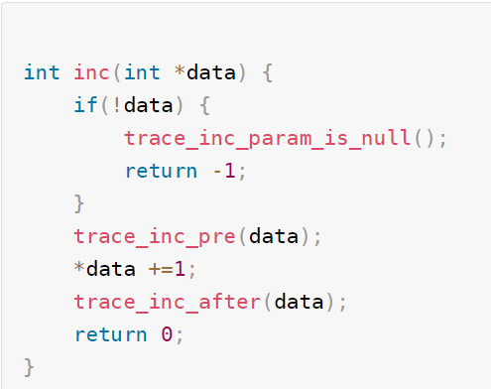
Trace point
遍历
func
func
func
Trace point
Trace point

Slide 2
3
BRK first happed
kprobe_breakpoint_handler(){
pre_handler();
modify_pc_to_slot() }
register_kprobe() {
replace_with_BRK64 }
2
Func()
instruction
4
BRK ret
Excute_slot_instruction;
Trigger_brk64
register_kprobe() {
kprobe_alloc_slot();
copy_inst_to_slot()
copy_BRK64_to_slot() }c
5
BRK happed again
1
slot
kprobe_breakpoint_ss_handler(){
post_handler
modify_pc_to_ori }
slot
slot

Slide 3
Func_1 2 3 4 5() {
int a; ---→ mov x0, 0
int b ; ---→ mov x1,0
func();
int c = a+b; -- -> ldr x2, x3.-----→ brk/int3 --→ exception handler（）
----→ ret;
--→ b 0x333333;
printf(“%d,”,c)
funcd()
}
Func_no_na me() {
b 0x333333
----------→ exchecption_handler()
restore pc -> }

Slide 4
Subsytem {
mod1:
Mod2 }
submodule1
submodule2

Slide 5
Func_1 2 3 4 5() {
func1() caller -→ LR / stack --→ exit_handler_back()
nop -------
}
Func1(10, 20) {
nop
nop -→ bl trace_caller -> bl call_bak_list -> for each caller_back1/2/ 3;
-> bl call_pid_filter -> check pid -> for each caller_back1;
int b = 10+20;
if b > 0 {
return 1; } else
return 0;
}

Slide 6
USER
Syscall: fsconfig()
vfs_parse_fs_param
vfs_parse_fs_string
other subsys
VFS
fs_context->ops->parase_param
FS SERVER
Parse param
Parse param
Parse param

Slide 7
file_systems
tmpfs
procfs
ext4
struct file_system_type {
name = “tmpfs”,
fs_flags = FS_USERNS_MOUNT | FS_ALLOW_IDMAP
parameters = shmem_fs_parameters
init_fs_context = shmem_init_fs_context
fs_supers
struct super_block {}
struct super_block {}
struct super_block {}
struct super_block {}

Slide 8
struct fs_context {
const struct fs_context_operations *ops;
struct file_system_type *fs_type;
void *fs_private;
void *sget_key;
struct dentry *root
struct user_namespace *user_ns;
unsigned int sb_flags;
unsigned int sb_flags_mask;
};
struct file_system_type {
struct hlist_head fs_supers;
};
struct fs_context {
void *sget_key;
struct dentry *root
unsigned int sb_flags;
unsigned int sb_flags_mask;
};

Slide 9
struct super_block {
const struct fs_context_operations *ops;
struct file_system_type *fs_type;
void *fs_private;
void *sget_key;
struct dentry *root
struct user_namespace *user_ns;
unsigned int sb_flags;
unsigned int sb_flags_mask;
};

Slide 10
file_systems
tmpfs
procfs
ext4
struct file_system_type {
fs_supers
struct super_block {}
struct super_block {}
struct super_block {
fs_type
}

Slide 11
slot_virt (FIXMAP 虚存地址)
FIXMAP
有效地址: slotvirt + 1234
非4K对齐: offset: 1234
256K(slot 0)
early_ioremap()
Mmio -1
126k
256K (slot 1)
Mmio -2
256K
…
prev_map (有效虚存起始)
prev_size (物理内存size)

Slide 12
memblock->memory
memblock->reserved
end

