Slide 1
HW4
From LeetCode
401. Binary Watch
39. Combination Sum
46. Permutations
47. Permutations II
52. N-Queens II
From My Interview (NOT Backtracking)
Implement a queue class given a stack class

Slide 2
Basic Steps
(Preprocessing)
Start at Step 0
At Step N
Output the constructed solution
At Step i < N:
Iterate through each available choice
Add the choice to the solution under construction
(Label the choice as used/visited)
Go to Step i+1
Remove the added choice
(Label the choice as available)
- Check/Trim/Skip by
Order
Repetition
Constraints

Slide 3

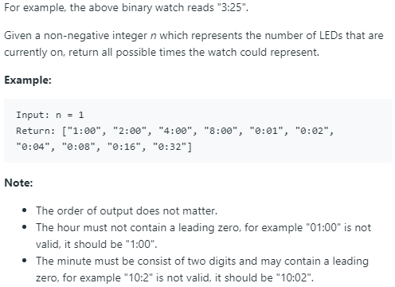

Slide 4
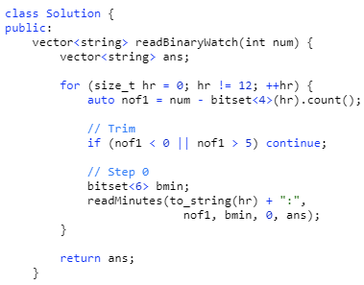
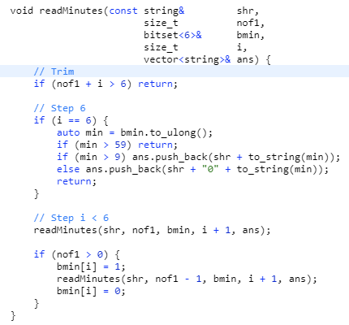
Backtrack for each possible hour
Explicit iteration of choices for minutes
Trim by constraints
No labels needed

Slide 5
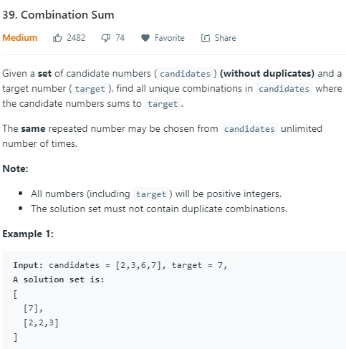
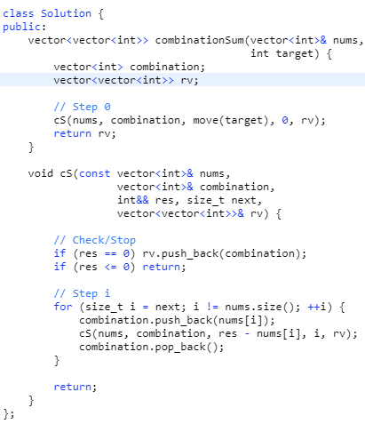
Trimming by “next”
Check for stop at each step
No labels needed

Slide 6
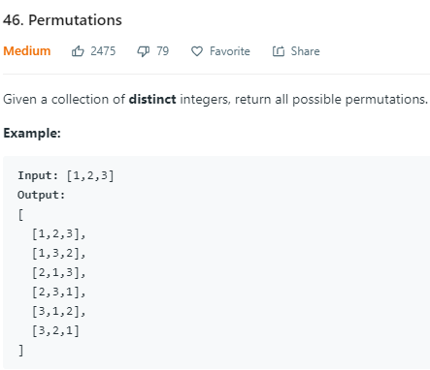
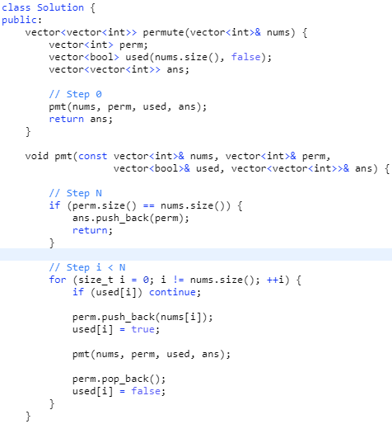
Has all the basic steps

Slide 7
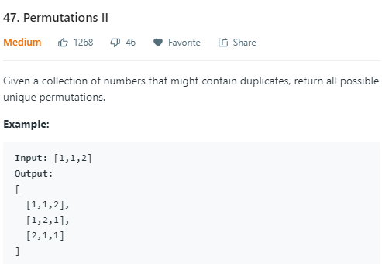
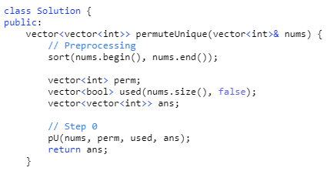
Preprocess by sorting

Slide 8
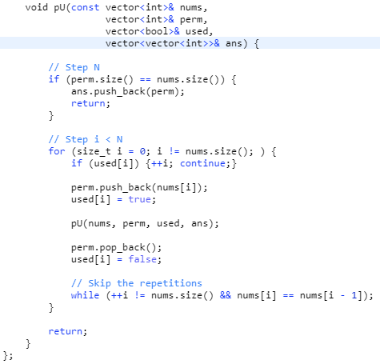
Skip repetitions
No trimming!
Can you solve it with a hash table?
It’ll be much slower, though.

Slide 9
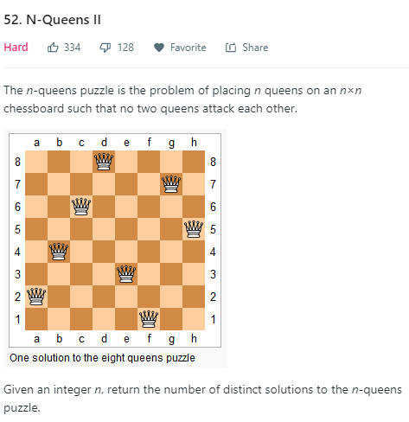
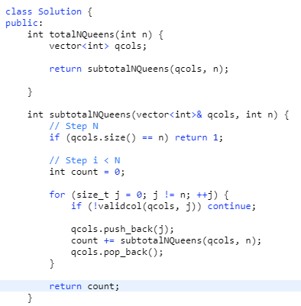
Label by “qcols”
Return count directly

Slide 10
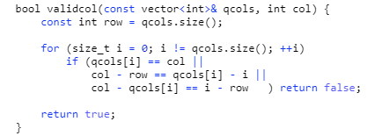

Slide 11
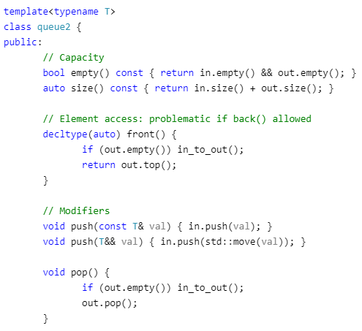
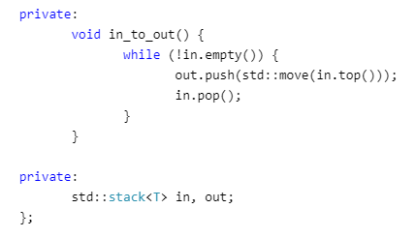
Use two stacks
Check/Transfer elements in pop() and front()
Each element is exactly pushed and popped twice

