Slide 1
Language Model Fine-tuning
Media Attitudinal Representation
Bias Measurement
Instance from Fox
LM Fine-tunning
Predicted Tokens
Original
Instance
Augmented
Instance
Original
Instance
Masked
Instance
Fine-tuned LM
Representation Generator
Fox Vector
Distance Calculator
Train
set
Data Augmentor
LM for Fox
Dev
set
Mask Model
LM for Fox
LM for CNN
LM for CNN
Instance from CNN
Predicted Tokens
CNN Vector

Slide 2
Lead to the end of the individual health insurance [MASK]
Fine-tuned
LM
CNN | market (0.640) | . (0.079) | markets (0.063)
Fox | . (0.511) | market (0.151) | system (0.088)
Representation Generator
 | . | market | markets | system
CNN | 0.079 | 0.640 | 0.063 | 0.000
Fox | 0.511 | 0.151 | 0.000 | 0.088
Mask Model
Lead to the end of the individual health insurance market.
Instance Vector
Predicted Token
Masked Instance
Lead to the end of the [MASK] health insurance market.
Fine-tuned
LM
CNN | us (0.517) | american (0.13) | individual (0.128)
Fox | private (0.788) | national (0.055) | public (0.049)
Representation Generator
 | american | individual | national | private | public | us
CNN | 0.130 | 0.128 | 0.000 | 0.000 | 0.000 | 0.517
Fox | 0.000 | 0.000 | 0.055 | 0.788 | 0.049 | 0.000
Original Instance
Mask Model
Instance Vector
Predicted Token
Masked Instance

Slide 3
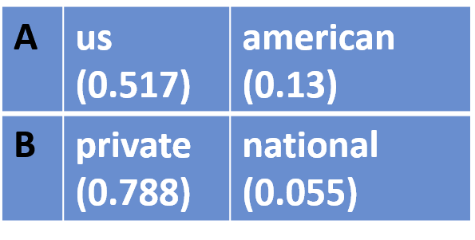
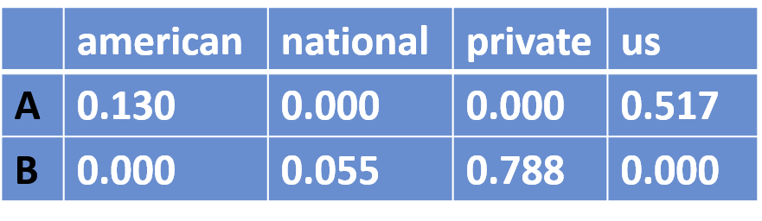
Fine-tuned
LM
Lead to the end of the [MASK] health insurance market.
Representation Generator
Instance Vector
Masked Instance
Predicted Token

Slide 4
 | Question-answer pair | Single sentence
Declarative | Obamacare is good. ___(Y/T/M/N/F) | Obamacare is ___(good/bad).
Interrogative | Is Obamacare good? ___(Y/T/M/N/F) | Is Obamacare ___(good/bad)?
Association | Obamacare good. ___(Y/T/M/N/F) | Obamacare ___(good/bad).

Slide 5
 |  | Question-answer pair | Single sentence
Declarative | Pattern | Topic is Adj / Noun. ___ | Topic is ___.
Declarative | Example | Obamacare is good. ___(Y/N) | Obamacare is ___(good/bad).
Interrogative | Pattern | Is Topic Adj / Noun? ___ | Is Topic ___.
Interrogative | Example | Is Obamacare good? ___(Y/N) | Is Obamacare ___(good/bad)?
Association | Pattern | Topic Adj / Noun. ___ | Topic ___.
Association | Example | Obamacare good. ___(Y/N) | Obamacare ___(good/bad).

