Slide 1
Audible
Shawn, Yuriy, Grace

Slide 2

Find Data
Audible Data found on Kaggle

Slide 3

Goal
Data engineering path
Curate & refine original dataset to become a valuable resource
Make it easily accessible for Data Analyst to be able to answer possible inquires from target audience in the future

Slide 4
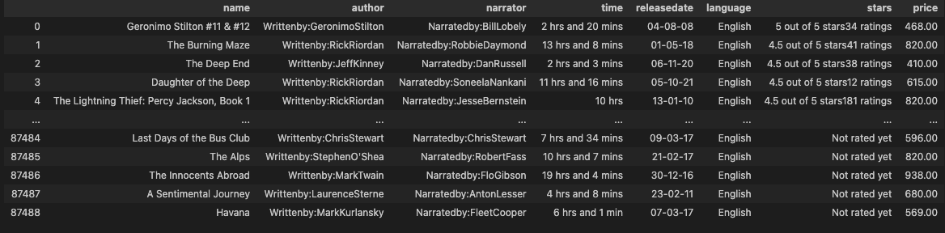
Clean Data
Look at column data types
Fix columns (author, narrator, time, stars, and price)

Slide 5
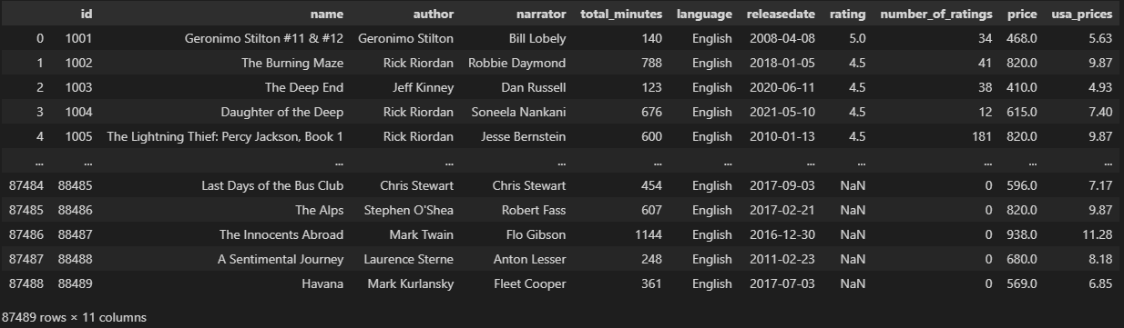
Cleaned Data
Libraries used ( pandas, pandera, re, seaborn, missingno)

Slide 6
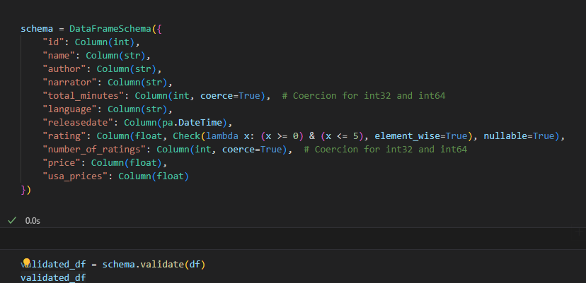
Pandera
“Pandera is a Union.ai open source project that provides a flexible and expressive API for performing data validation on dataframe-like objects to make data processing pipelines more readable and robust.”

Slide 7
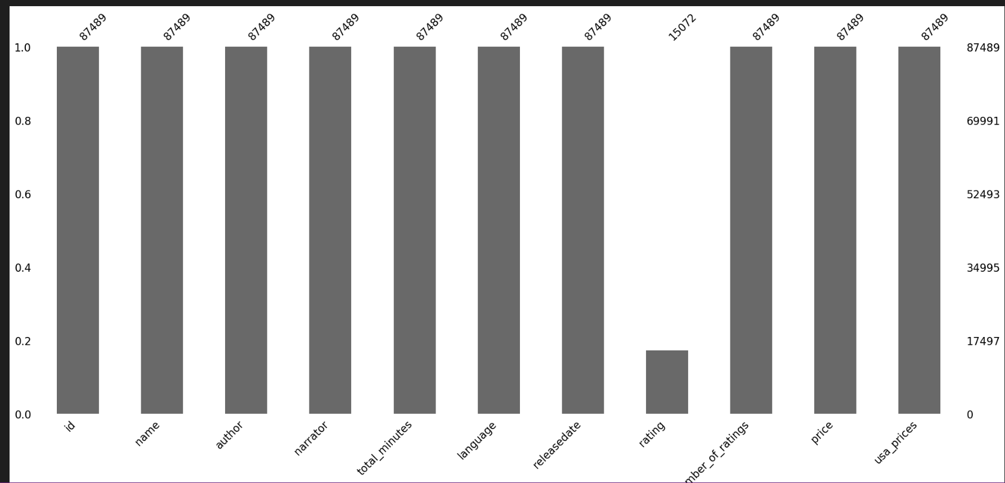
Missingon

Slide 8
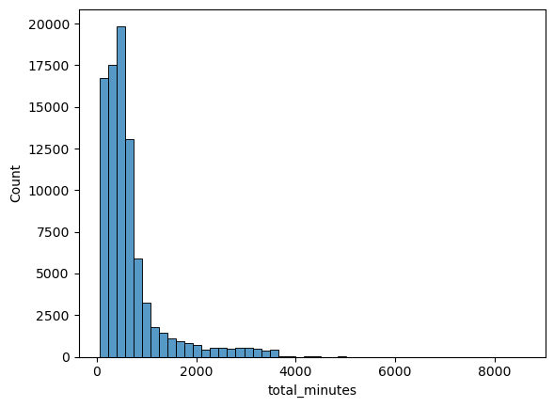
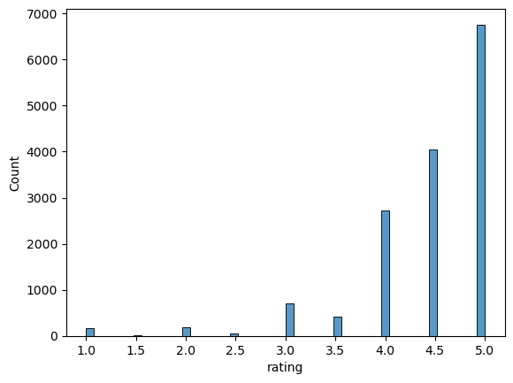
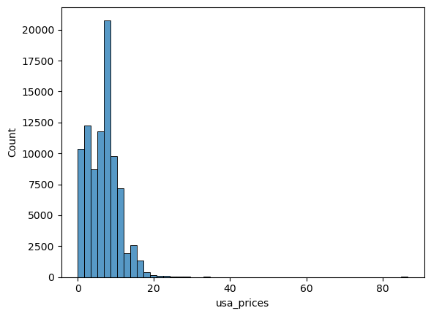
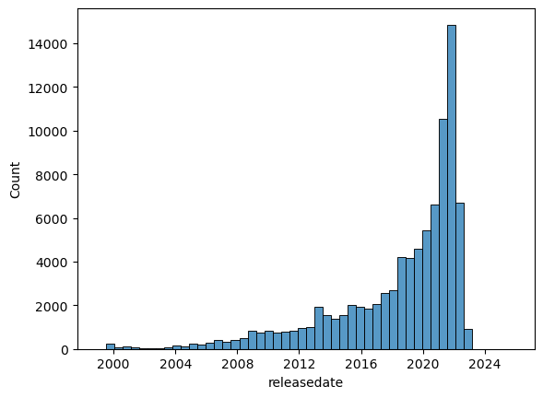
Seaborn

Slide 9
Export/Import Data (CSV=>SQL)
Data was exported from Pandas Dataframe using pd.to_csv
ERD was created using QuickDBDiagrams
A Database was created in PGAdmin, and the QickDBDiagrams Create Script was run to create each of three tables.
CSVs were imported into their respective tables to populate the dataset
Queries were run to establish the following: ​
Most Frequently Rated Books​
Highest Rated Books​
Most/Least Expensive Books​
Highest Rated Authors (weighted by most rated)​
Frequency of Author/Narrator Teams (How often they worked together)

Slide 10
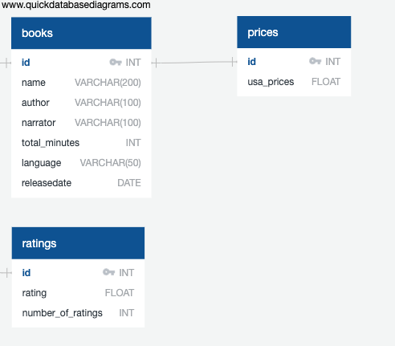
ERD

Slide 11
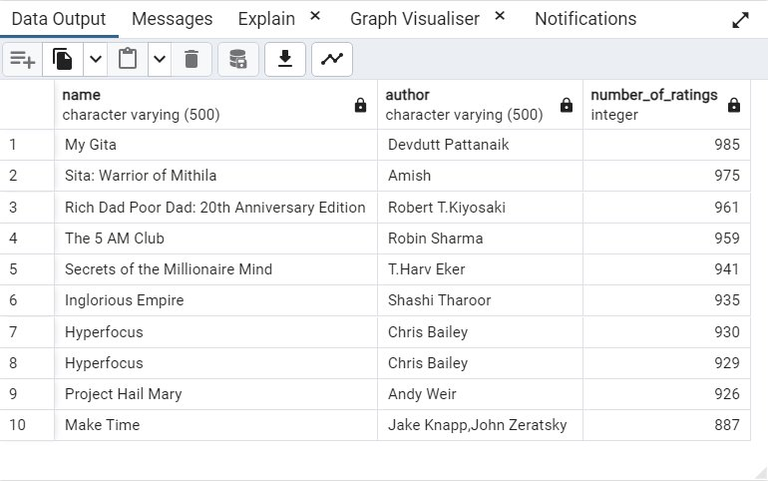
--QUERY FOR THE MOST FREQUENTLY RATED BOOKS​ ​ SELECT BOOKS.NAME, BOOKS.AUTHOR, RATINGS.NUMBER_OF_RATINGS​ FROM BOOKS​ JOIN RATINGS ON BOOKS.ID = RATINGS.ID​ ORDER BY RATINGS.NUMBER_OF_RATINGS DESC​ LIMIT 10;

Slide 12
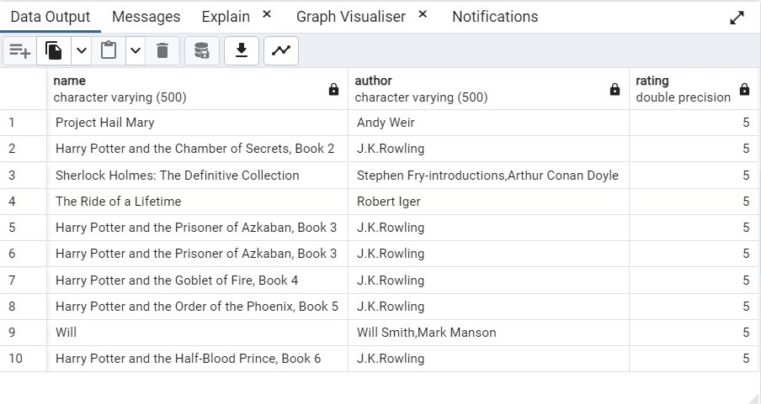
--QUERY FOR THE HIGHEST RATED BOOKS (SUB CATEGORIZED BY NUMBER OF RATINGS)​ ​ SELECT BOOKS.NAME, BOOKS.AUTHOR, RATINGS.RATING ​ FROM BOOKS​ JOIN RATINGS ON BOOKS.ID = RATINGS.ID​ WHERE RATINGS.RATING IS NOT NULL​ ORDER BY RATINGS.RATING DESC, RATINGS.NUMBER_OF_RATINGS DESC ​ LIMIT 10;

Slide 13
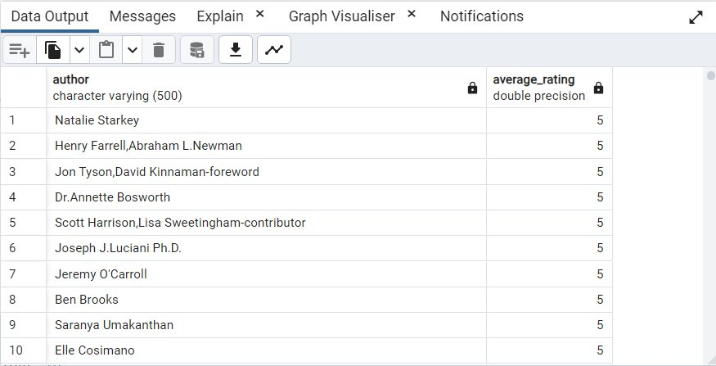
--HIGHEST RATED AUTHORS​ ​ SELECT BOOKS.AUTHOR, AVG(RATINGS.RATING) AS AVERAGE_RATING​ FROM BOOKS​ JOIN RATINGS ON BOOKS.ID = RATINGS.ID​ WHERE RATINGS.RATING IS NOT NULL​ GROUP BY BOOKS.AUTHOR​ ORDER BY AVERAGE_RATING DESC;

Slide 14
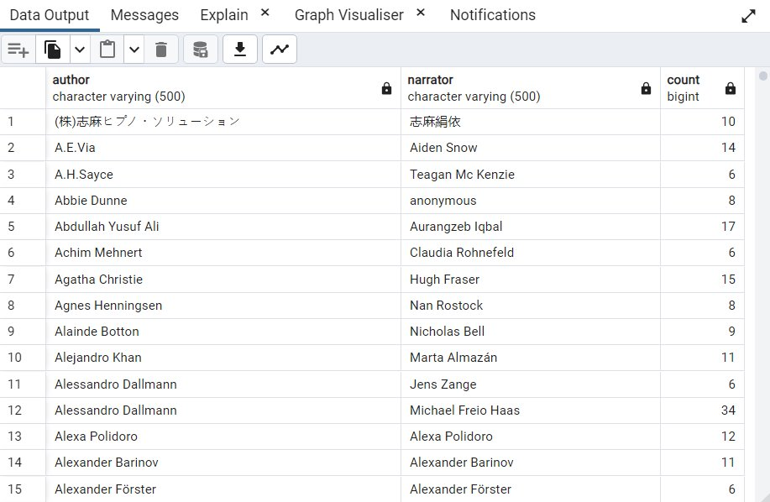
--NARRATORS THAT WORK WITH THE SAME AUTHOR FREQUENTLY​ ​ SELECT AUTHOR, NARRATOR, COUNT(*) AS COUNT​ FROM BOOKS​ GROUP BY AUTHOR, NARRATOR​ HAVING COUNT(*) > 5​ ORDER BY AUTHOR;

