Slide 1
磁盘
磁盘
Kafka
service
磁盘
service
磁盘
Pipeline
Pipeline+Transformer
磁盘
Pipe
Pipe
磁盘
PipeRecv
PipeSend
PipeRecv
PipeSend

Slide 2
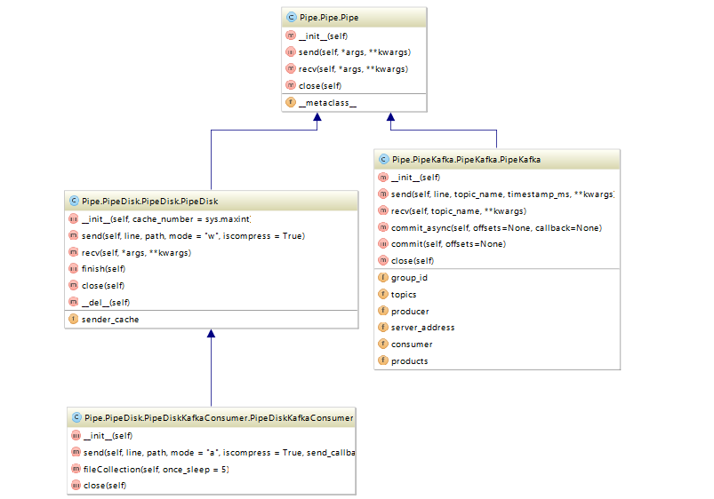

Slide 3
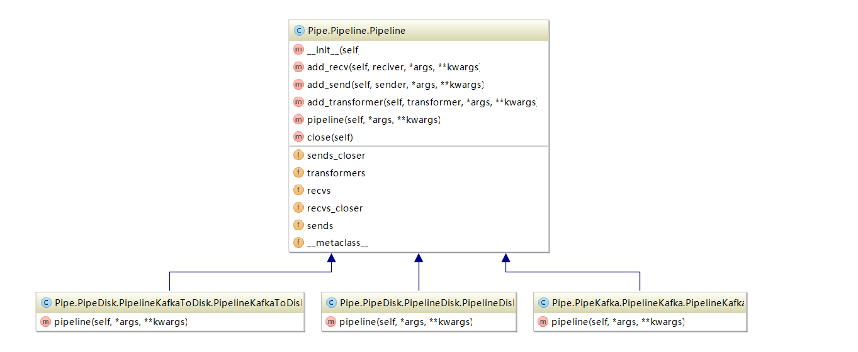

Slide 4
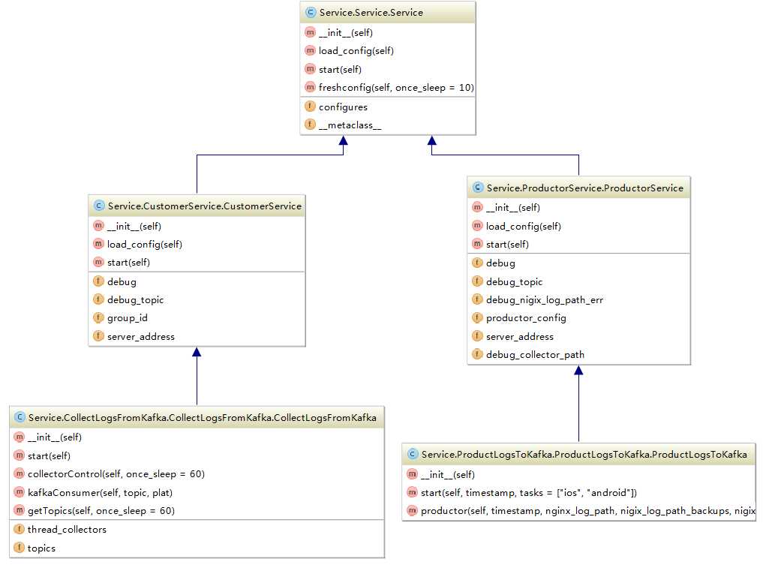

Slide 5
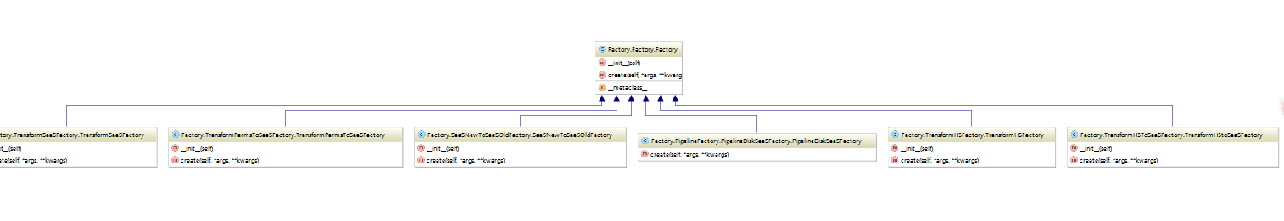
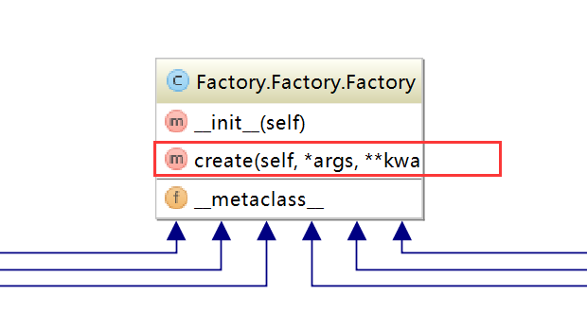






Slide 6
