Slide 1

Marginal Inference in Continuous Markov Random Fields using Mixtures
Yuanzhen Guo
Hao Xiong
Nicholas Ruozzi

Slide 2
Key notes
Continuous inference in graphical models is important in scientific applications but challenging in practice
Existing methods are extremely limited (special cases, small scales)
Our approximate inference approach is scalable and applicable to general models
Easy to extend to new settings with minor modifications

Slide 3
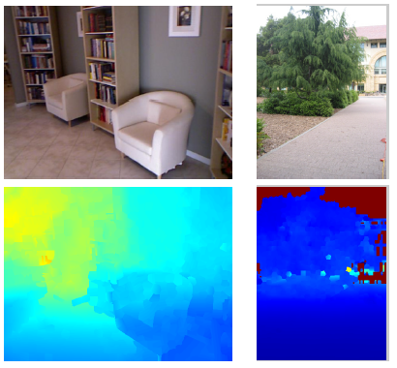
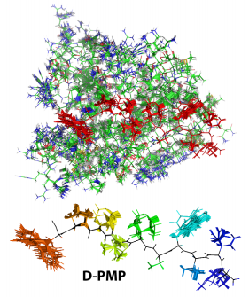
Continuous inference applications
Depth estimation from a single image
Protein side chain particles and closeup of first ten amino acids
[Liu and etc., CVPR 2014]
[Pacheco and Sudderth , ICML 2015]

Slide 4
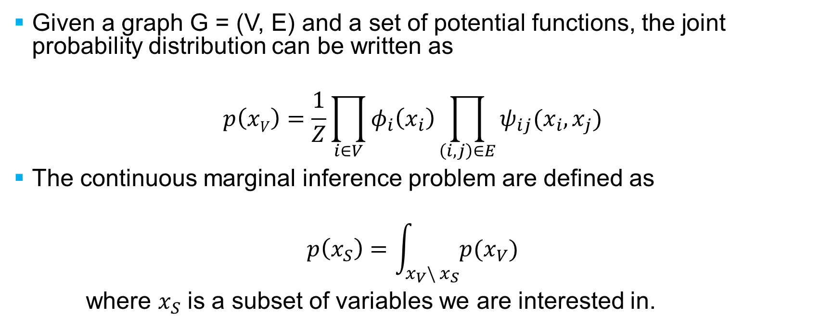
Continuous marginal inference in MRF
Given a graph G = (V, E) and a set of potential functions, the joint probability distribution can be written as
$$p\left(xV\right)=\frac{1}{Z}\prod_{i∈V}{φ_{i}\left(x_{i}\right)\prod_{\left(i,j\right)∈E}{ψ_{ij}(x_{i},x_{j})}}$$
The continuous marginal inference problem are defined as
$$p\left(x_{S}\right)=\int_{x_{V}\backslash x_{S}}{p(x_{V})}$$
where $x_{S}$ is a subset of variables we are interested in.

Slide 5
Why marginal inference is hard
Potential functions can be arbitrary (exact integration is computationally hard)
Particle based message passing methods (PBP, EPBP, etc.)
Messages are not in closed forms
Highly depend on proposal distribution
Particle sampling costs too much time
Nonparametric methods (nonparametric BP, kernel BP, etc.)
Scale poorly and sometimes unreasonable beliefs
Expectation Propagation
Convergence/accuracy issues with simple exponential families

Slide 6
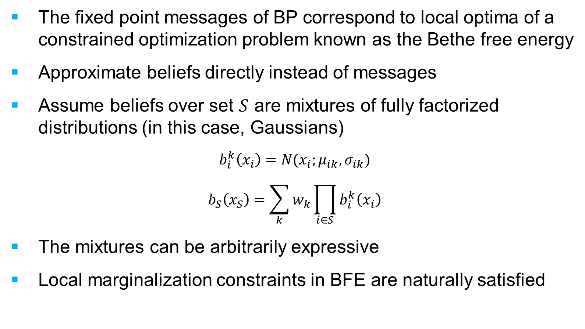
Our approach
The fixed point messages of BP correspond to local optima of a constrained optimization problem known as the Bethe free energy
Approximate beliefs directly instead of messages
Assume beliefs over set $S$ are mixtures of fully factorized distributions (in this case, Gaussians)
$$b_{i}^{k}\left(x_{i}\right)=N(x_{i};μ_{ik},σ_{ik})$$
$$b_{S}\left(x_{S}\right)=\sum_{k}{w_{k}\prod_{i∈S}{b_{i}^{k}\left(x_{i}\right)}}$$
The mixtures can be arbitrarily expressive
Local marginalization constraints in BFE are naturally satisfied

Slide 7
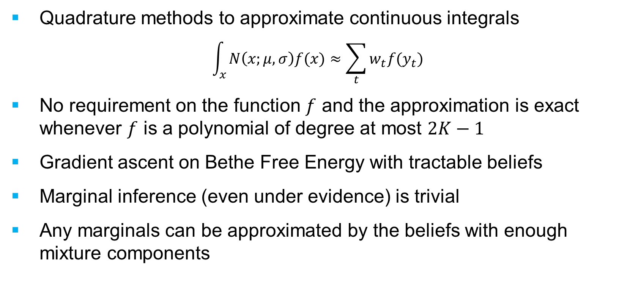
Our approach
Quadrature methods to approximate continuous integrals
$$\int_{x}{N\left(x;μ,σ\right)f(x)≈\sum_{t}{w_{t}f(y_{t})}}$$
No requirement on the function $f$ and the approximation is exact whenever $f$ is a polynomial of degree at most $2K−1$
Gradient ascent on Bethe Free Energy with tractable beliefs
Marginal inference (even under evidence) is trivial
Any marginals can be approximated by the beliefs with enough mixture components

Slide 8
UCI datasets with Chow-Liu Trees

Slide 9
Image denoising
Log-partition function
Mean square error
Denoised images

Slide 10
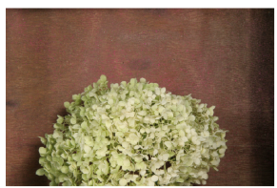
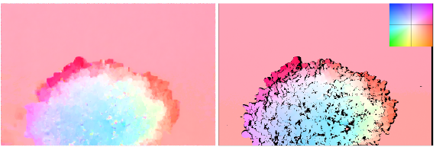
Scalability
Optical flow model on 584x388 grid graph with over 200,000 random variables
With a GPU implementation, our method completed 5,000 iterations in just under 200 seconds (.04 sec/iteration)
Original Image
QBethe
Ground truth

Slide 11
Beyond marginals
With fully factorized beliefs, MAP and Marginal MAP problems can be easily handled
Unlike message passing algorithms, our method is able to capture global information
Naturally extend to continuous-discrete mixed case as well as can be easily vectorized
From inference to learning with maximize likelihood

Slide 12

Thank you

