Slide 1

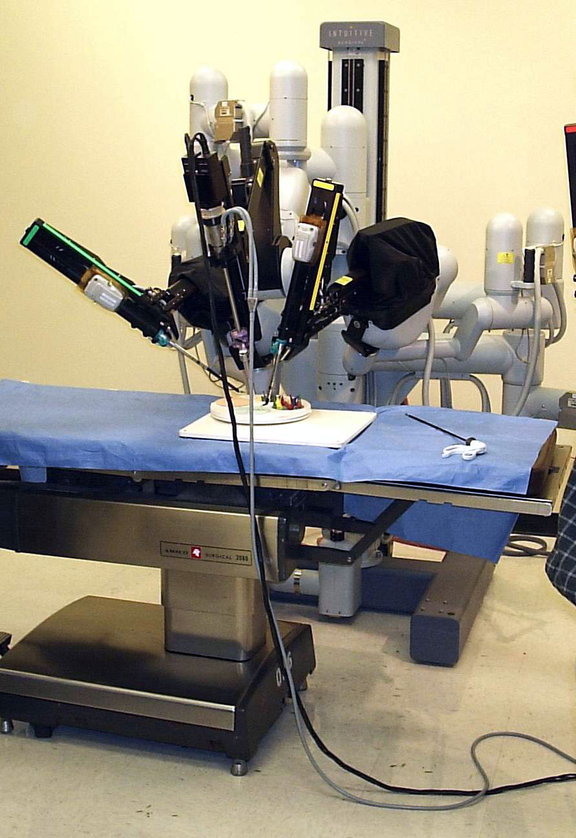
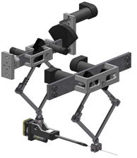
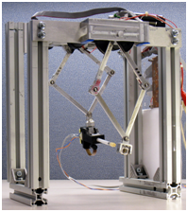
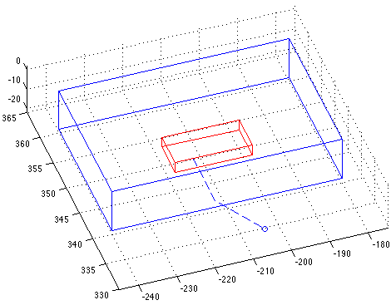
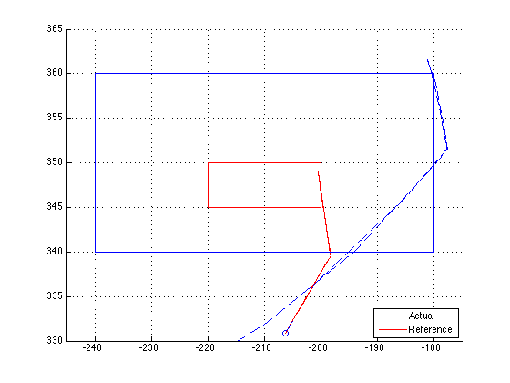
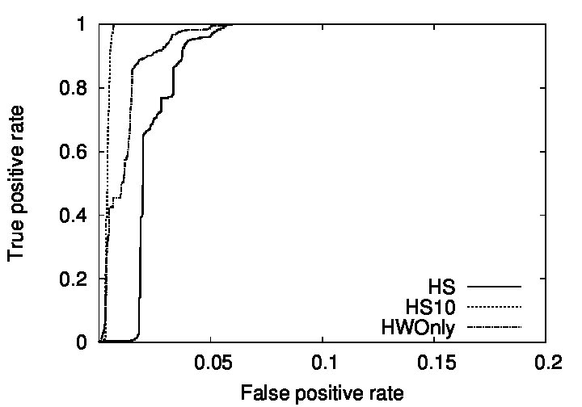
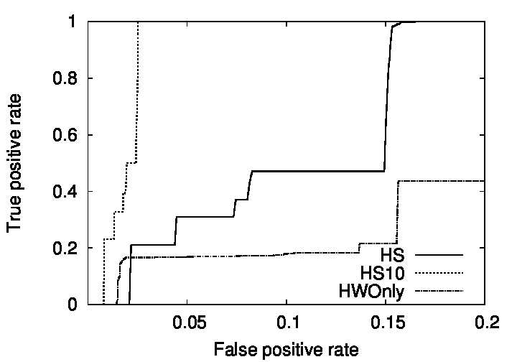
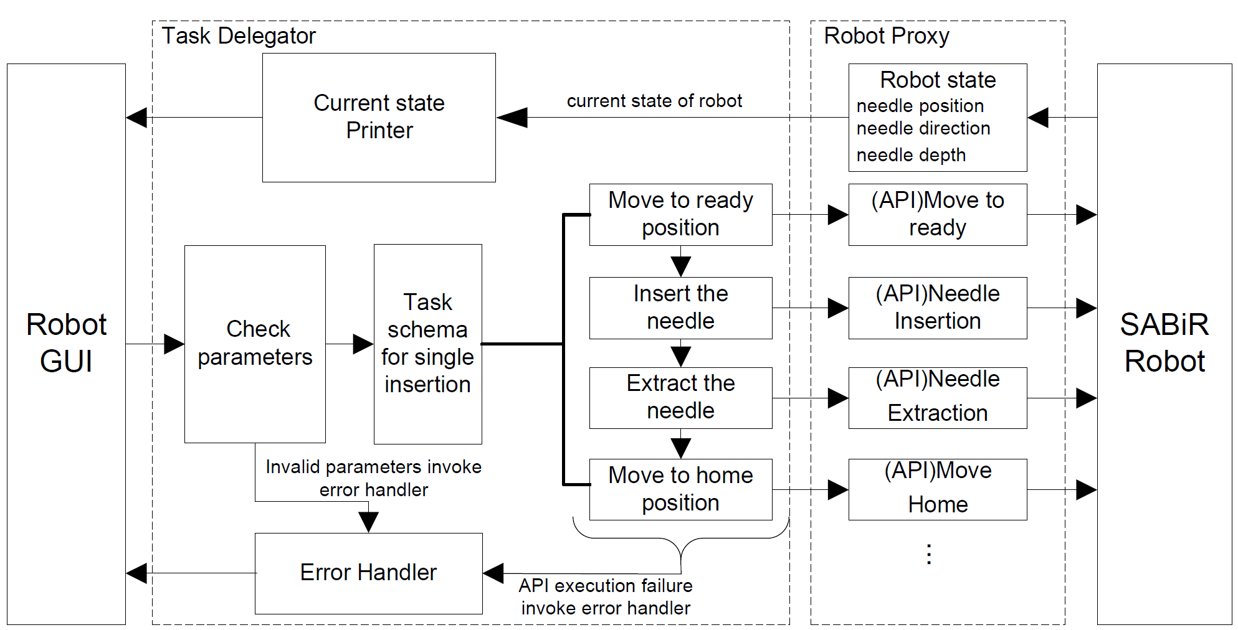
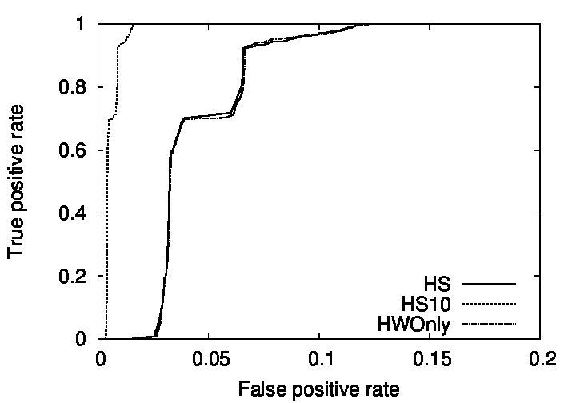
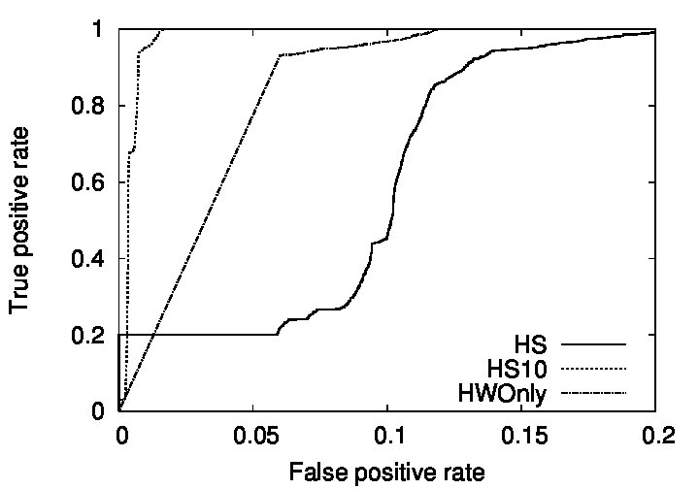
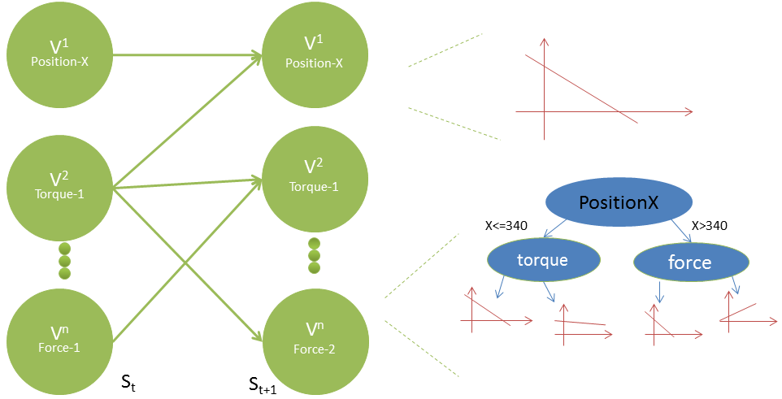
A Framework for Validation and Monitoring of Robotic Surgery Systems
Kai Liang, Feng Cao, Zhuofu Bai, Mark Renfrew,
Soumya Ray (co-PI), Andy Podgurski (co-PI), M. Cenk Çavuşoğlu (PI)
Department of Electrical Engineering and Computer Science, Case Western Reserve University
1. Robotic Surgery Systems
4. Testbed and Simulation Environment
7. Empirical Evaluation
Cyber-physical systems using robotic systems to aid surgical procedures
Small incision, less blood loss, less pain, shorter recovery time, minimize side effects
We evaluate 3 DBNs on 3 A&A events and plot ROC graphs.
DBNs:
HS: standard joint hardware/software model
HS10: joint hardware-software model looking ahead 10 steps
HWOnly: hardware variables only.
A&A Events:
Encoder Failure: A&A event caused by hardware component failure
Out-Of-Workspace: A&A event caused by software bug (missing boundary condition check)
Sweep: A&A event caused by inadequate control or imperfect target geometry estimate or unexpected target motion
Small Animal Biopsy Robot (SABiR)
2. Adverse and Anomalous Events
5. Software Architecture and Data Collection
[D]uring a da Vinci’s beating heart double vessel coronary artery bypass graft procedure at the hospital, there was an unexplained movement on the system arm [which] caused the feet at the distal end of the endowrist stabilizer instrument to tip downward resulting in damage to the myocardium of the patient’s left ventricle. (MAUDE report, FDA 2008)
Unexpected events that potentially injure patients
Inadequate haptic control, violations of a motion or force limits, system crashes and hangs, software bugs causing unexpected behavior
ROC graphs for detecting out-of-workspace and sweep A&A events.
ROC graphs predicting sweep A&A events, 0.5s (left) and 1s (right) before the event.
3. Phased Validation Approach
6. Modeling Joint Hardware--Software State
8. Current Research Directions
Expanding the capabilities of our robotic system
Flexible needles, realistic tissue parameters and model skin interactions
Improved path planning algorithm and an active image guidance system
Online visualization of the robot state
An interface to support human labeling of trajectories recorded during normal usage to update our models and simulation and obtain data about A&A events in the field
Constructing a low-dimensional usage envelope of the system using the learned DBNs
Using the learned DBNs and causal inference to localize faulty controller code.
We model the time-evolution of the joint software/hardware state space of the system using dynamic Bayesian networks (DBNs).
The testbed system is modeled with 30 hardware and 87 software variables.
Hardware variables represent observed sensor data, software variables represent intermediate controller computations.
References
[1] M. C. Cavusoglu, Medical Robotics in Surgery, in Wiley Encyclopedia of Biomedical Engineering, M. Akay, Editor, 2006, John Wiley and Sons, Inc.
[2] FDA, Adverse Event Report 2955842-2008-01144: Intuitive Surgical Inc., Da Vinci S Surgical System Endoscopic Instrument Control System, July 15, 2008.
[3] O. Bebek, M. J. Hwang, and M. C. Cavusoglu. Design of a Parallel Robot for Needle Based Interventions on Small Animals. IEEE/ASME Trans. on Mechatronics, 2011.
[4] R. Jackson, and M. C. Cavusoglu. Modeling of Needle-Tissue Interaction Forces during Surgical Suturing. In Proceedings of the IEEE International Conference on Robotics and Automation (ICRA 2012), Minneapolis, MN, May 14-18, 2012, pp. 4675-4680.
[5] R. Jackson and M. C. Cavusoglu. Needle Path Planning for Autonomous Robotic Surgical Suturing. In Proceedings of the IEEE International Conference on Robotics and Automation (ICRA 2013), Karlsruhe, Germany, May 6-10, 2013. Finalist for the best medical robotics paper award.
[6] K. Liang, F. Cao, Z. Bai, M. Renfrew, M. C. Cavusoglu, A. Podgurski and S. Ray. Detection and Prediction of Adverse and Anomalous Events in Medical Robots. In Proceedings of Innovative Applications of Artificial Intelligence, 2013.
[7] M. Renfrew, Z. Bai, and M. C. Cavusoglu. Particle Filter Based Active Localization of Target and Needle in Robotic Image-Guided Intervention Systems. Proceedings of the 9th IEEE International Conference on Automation Science and Engineering (CASE 2013).
Acknowledgements
This work was supported in part by the NSF Cyber-Physical Systems program under grant CISE CNS-1035602.
Notes:
1

