Slide 1
Social Signal Interpretation XML Tutorial
Johannes Wagner <wagner@openssi.net>
(last update: 12.01.16)
http://openssi.net

Slide 2
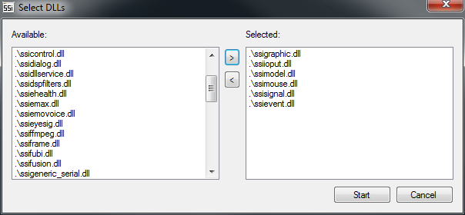
XML Editor
Start bin/<Win32|x64>/<vc100|vc120>/xmledit.exe
Select DLLs you want to use (press ‘strg‘ to select multiple) ssievent.dll, ssigraphic.dll, ssioput.dll, ssimodel.dll, ssimouse.dll, ssisignal.dll
Not selected
Selected

Slide 3
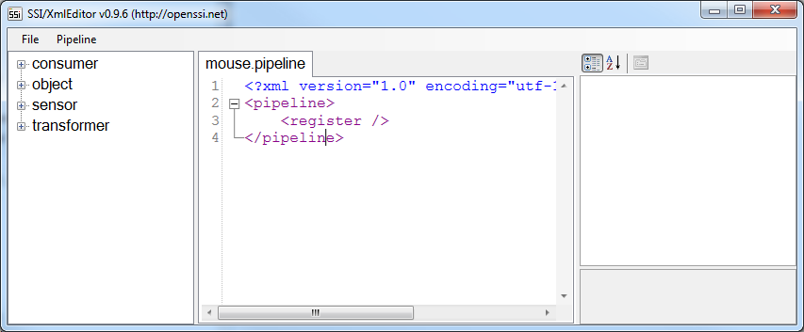
Pipeline
Start bin/<Win32|x64>/<vc100|vc120>/xmledit.exe
Create a new pipeline (File>New) and save it (File->Save)
Components
Editor
Properties

Slide 4
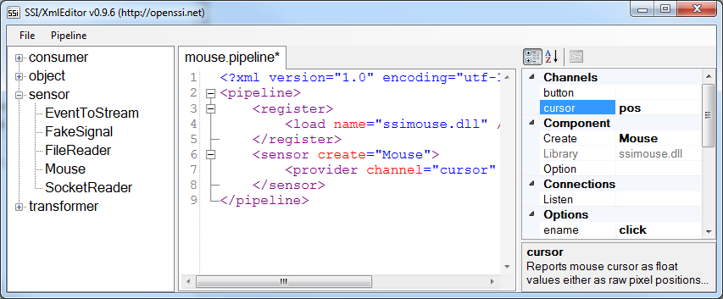
Cursor Provider
Expand the sensor-tree and insert a Mouse (double click)
Place cursor in line <sensor… to display properties
Below Channels assign pin-name to cursor (e.g. pos)
3.
2.
1.

Slide 5
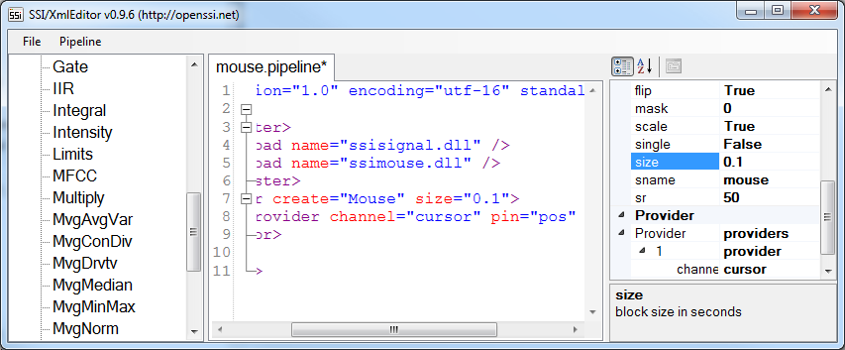
Change Options
When you click on an option in the property panel you‘ll find additional information at the bottom of the panel
Set option size to 0.1
2.
1.

Slide 6
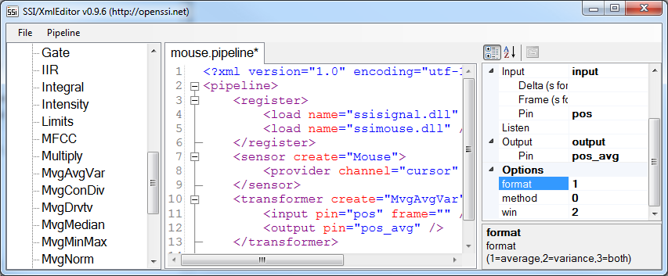
Smoothing Transformer
Place cursor in a new line below </sensor> and insert a MvgAvgVar (expand transformer-tree)
Set input pin to (pos) and assign an output pin (pos_avg)
Set frame size as samples per second (e.g. "10") or as seconds (e.g. "0.2s")
Set option format to 1 and option win to 2
2.
3.
1.
4.

Slide 7
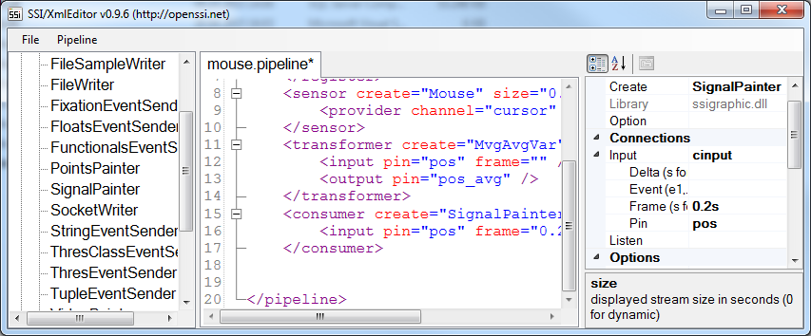
Plot Consumer
Place cursor in a new line below </transformer> and add a SignalPainter (expand consumer-tree)
Set input pin to pos and choose frame size (e.g. 0.2s)
Set option size to 10.0
Press F5 to run pipeline
4.
1.
2.

Slide 8
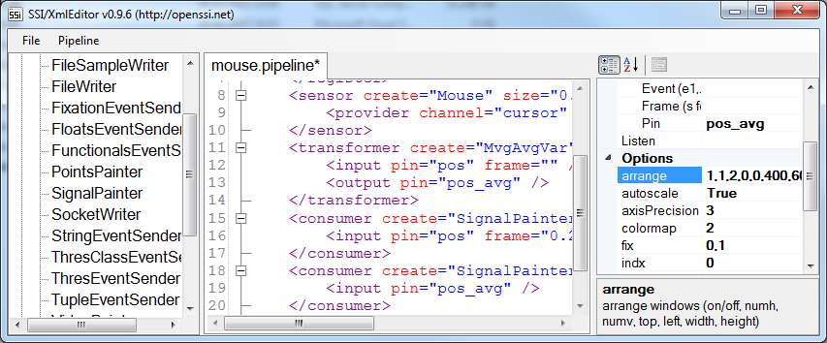
Another Plot Consumer
To compare the raw cursor signal with the filtered version insert another SignalPainter consumer and connect it with input pin cursor_avg (and same frame size as before)
Set option size to 10.0
Set option arrange to 1,1,2,0,0,400,600
1.
3.

Slide 9
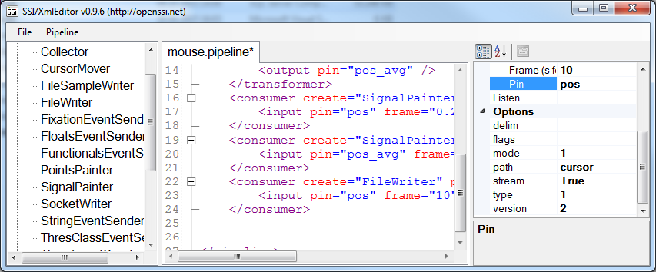
File Consumer
Add a FileWriter (consumer) and connect it to pos
Set frame size (e.g. 10)
Set a path and change file mode to 1 (=ASCII)
When you run the pipeline cursor position will be stored to disk (two files cursor.stream and cursor.stream~ will be created)
2.
1.
3.

Slide 10
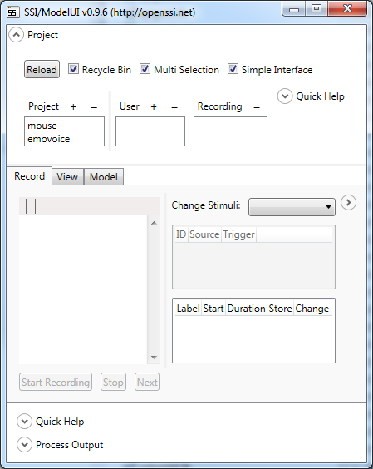
ModelUI
Start modelui.exe
select project mouse
2.

Slide 11
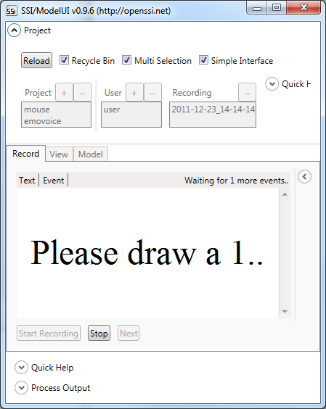

Record
Select user
Click Start Recording
Follow instructions on screen
Draw inside the GUI while holding the left mouse button pressed
1.
4.
3.
2.

Slide 12
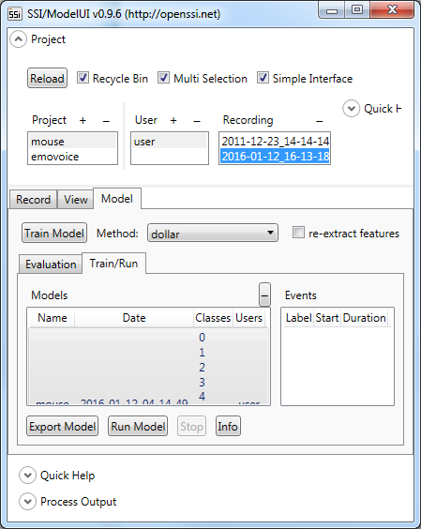
Train
Switch to Model panel and select Train/Run
Select one or more recordings (by holding the ctrl key)
Select dollar as training method
Press Train Model to train model
2.
1.
4.
3.

Slide 13
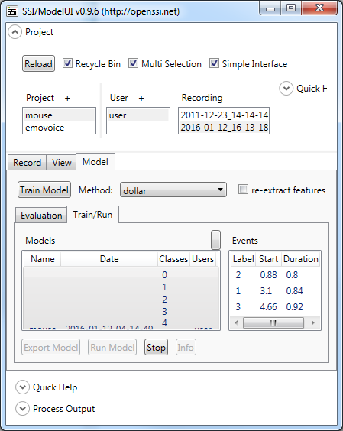
Run
Select the trained model and click Run Selected Model
Draw inside the GUI by holding the left mouse button pressed
Classification results are displayed when you release the mouse button
2.
1.
3.

Slide 14
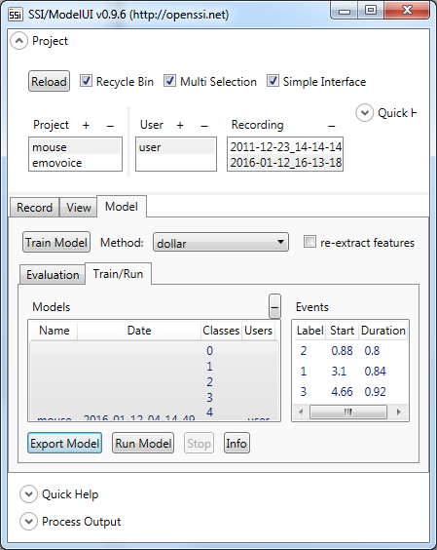
Export
Select the trained model
Click Export Model
Save model in the same folder as the pipeline you have created earlier
1.
2.

Slide 15
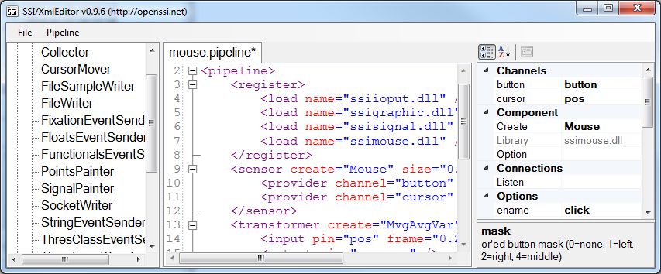
Button Provider
Switch back to the editor and place cursor again in the <sensor… line
Set mask of mouse sensor to 1
Assign a name to the button channel name (e.g. button)
3.
1.

Slide 16
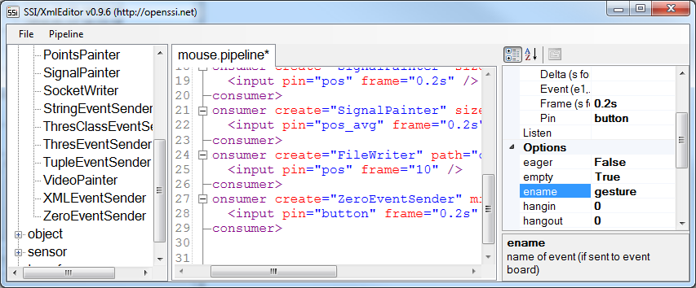
Button Trigger
Add a ZeroEventSender (consumer) with input pin button and
Set frame size to 0.2s
Input an event name by setting option ename (e.g. gesture) and set option mindur to 0.3
2.
3.
1.

Slide 17
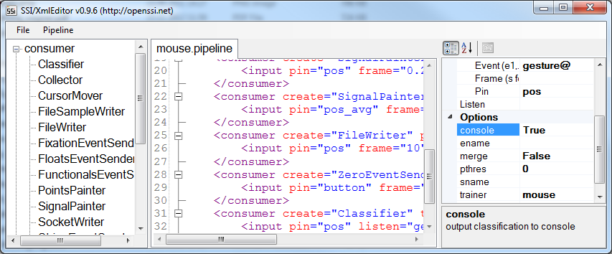
Classifier
Insert a consumer of type Classifier and set input to pos
Instead of a frame size set gesture@ as Event name
Set trainer to the previously trained model (mouse) and console to True
Detected gestures will now be displayed on the console when you run the pipeline
1.
2.
3.

