Slide 1
2020 U.S.
Presidential Election
State Analysis
(feat internet traffic stuff lol)

Slide 2
“The Swing”
Investigating the similarity in changes of total votes within each states for -
House of Representatives elections
Senator elections
Presidential Elections.
Variable of Interest is Total (R votes ÷ D votes)
The House vs. POTUS elections:
Let the presidential (POTUS) election year be Y 0, compare the changes in the House elections between Y -6 and Y -2, and the changes for POTUS elections between Y -4 and Y 0.
The Senate vs. POTUS elections:
Both states have a Class I seat and a Class III seat in the Senate, and each seat reelect every 6 years.
Compare the past 6 senator election results to the POTUS election results.

Slide 3
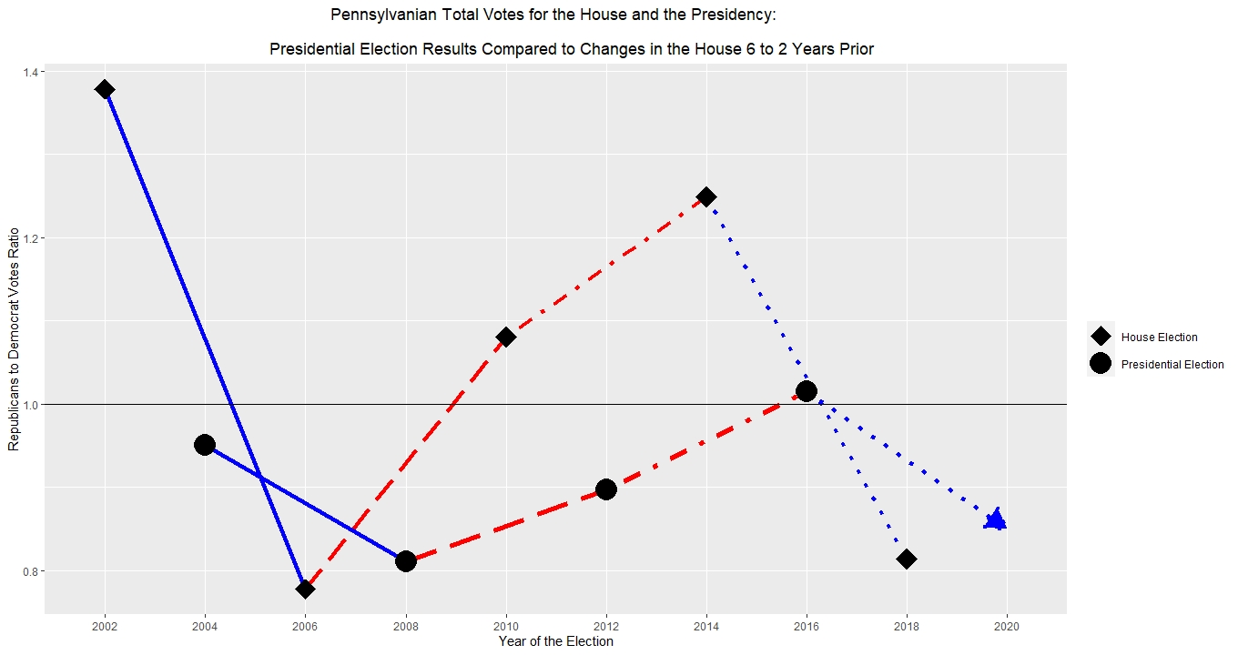

Slide 4
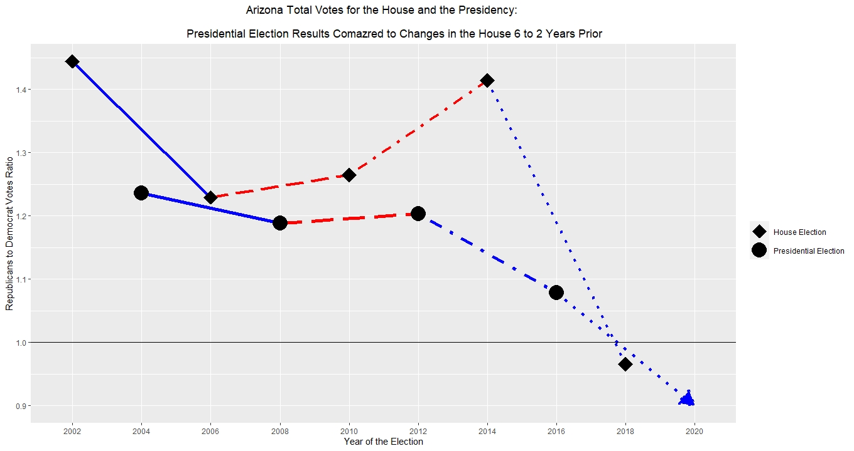

Slide 5
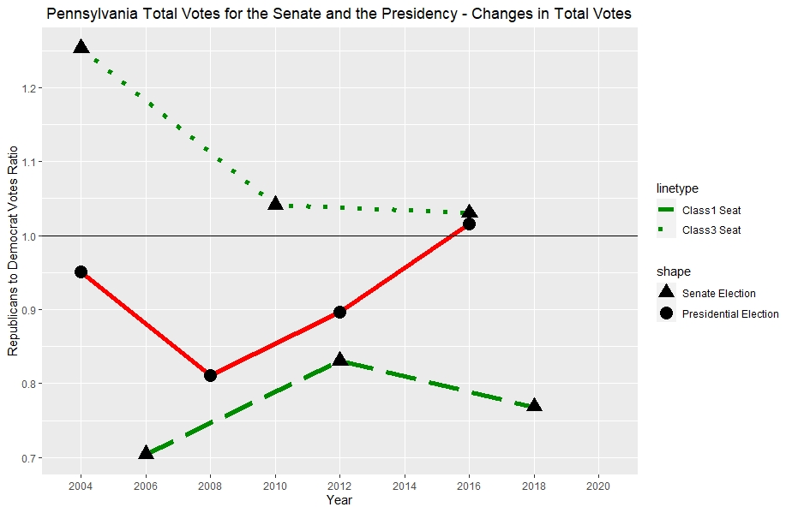
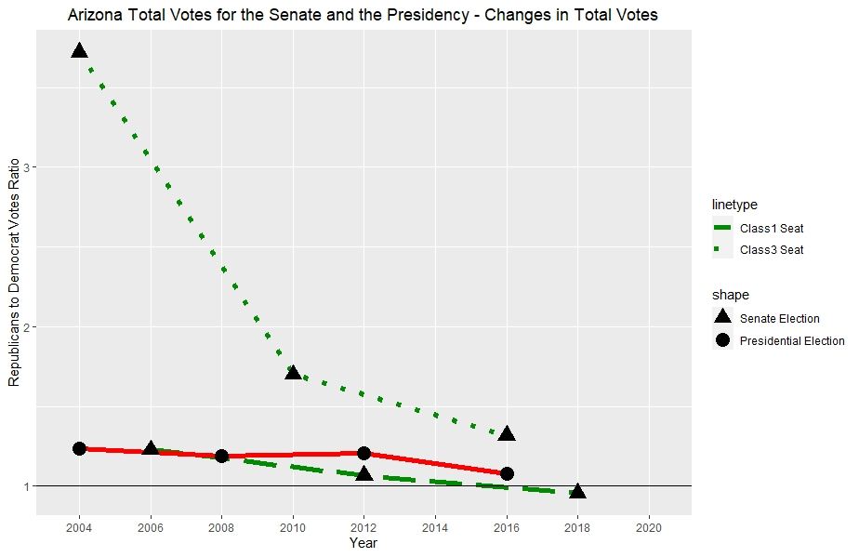

Slide 6
Important Variables

Slide 7
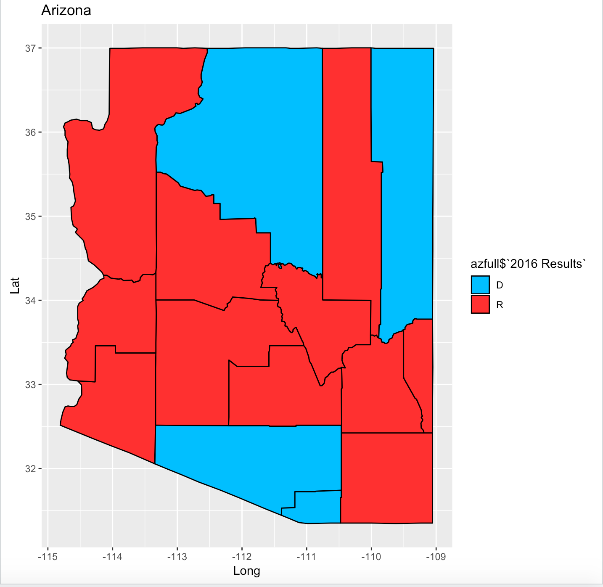

Slide 8
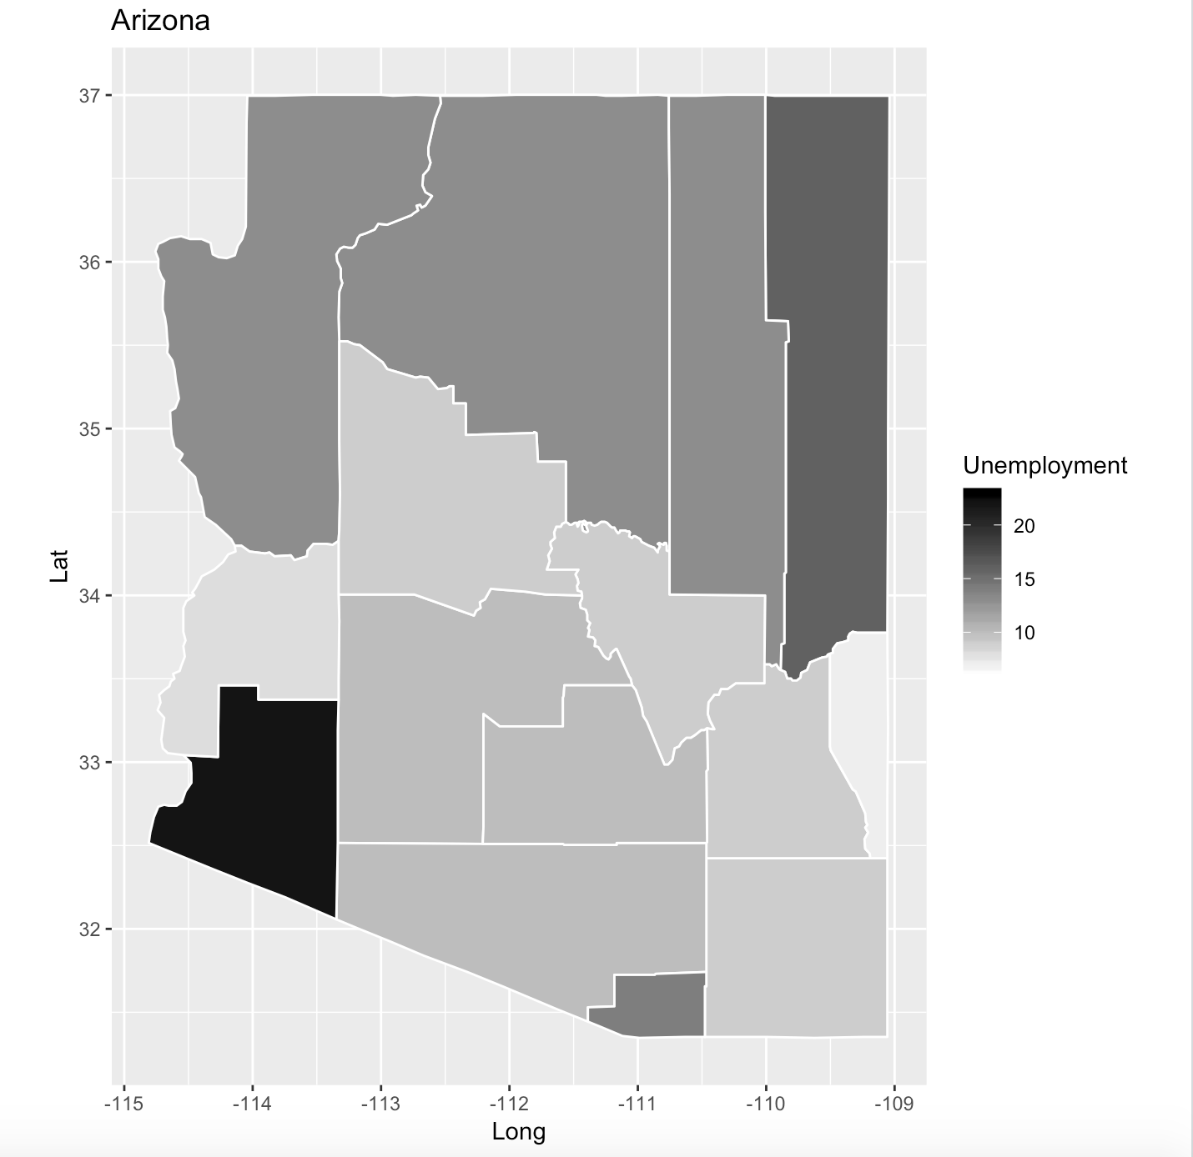

Slide 9
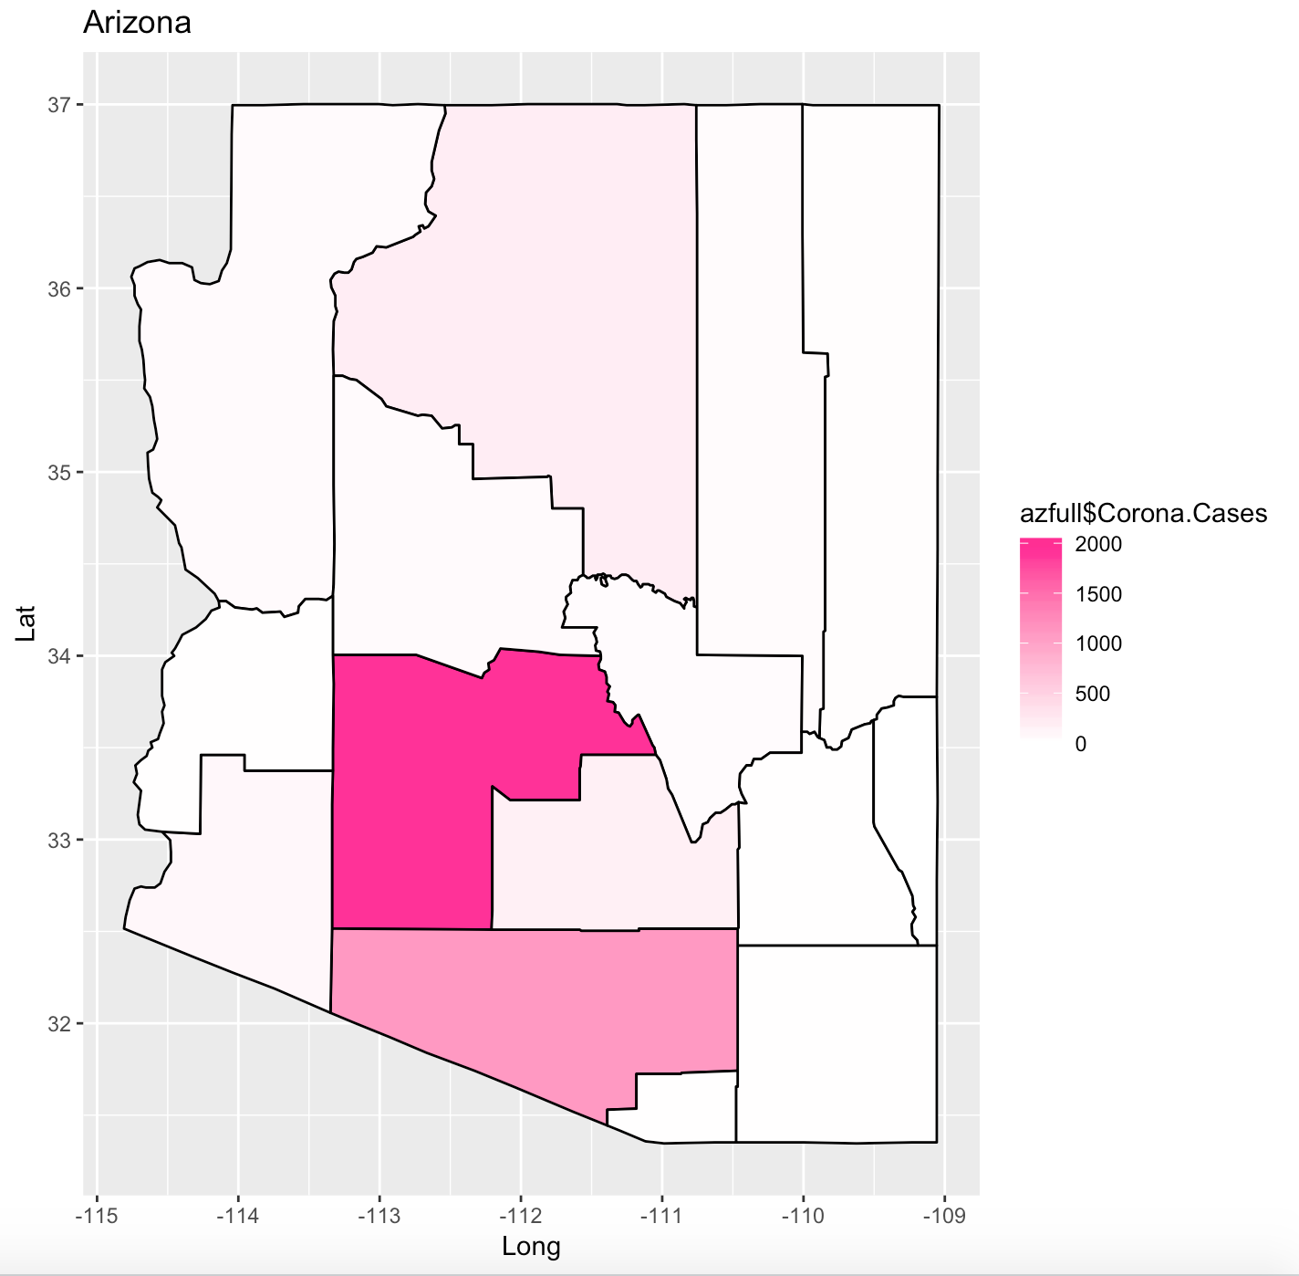

Slide 10
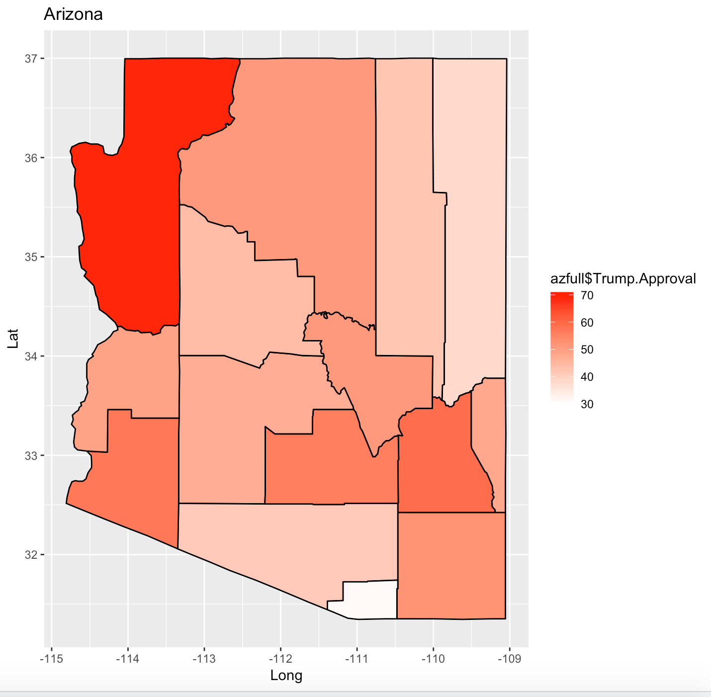

Slide 11
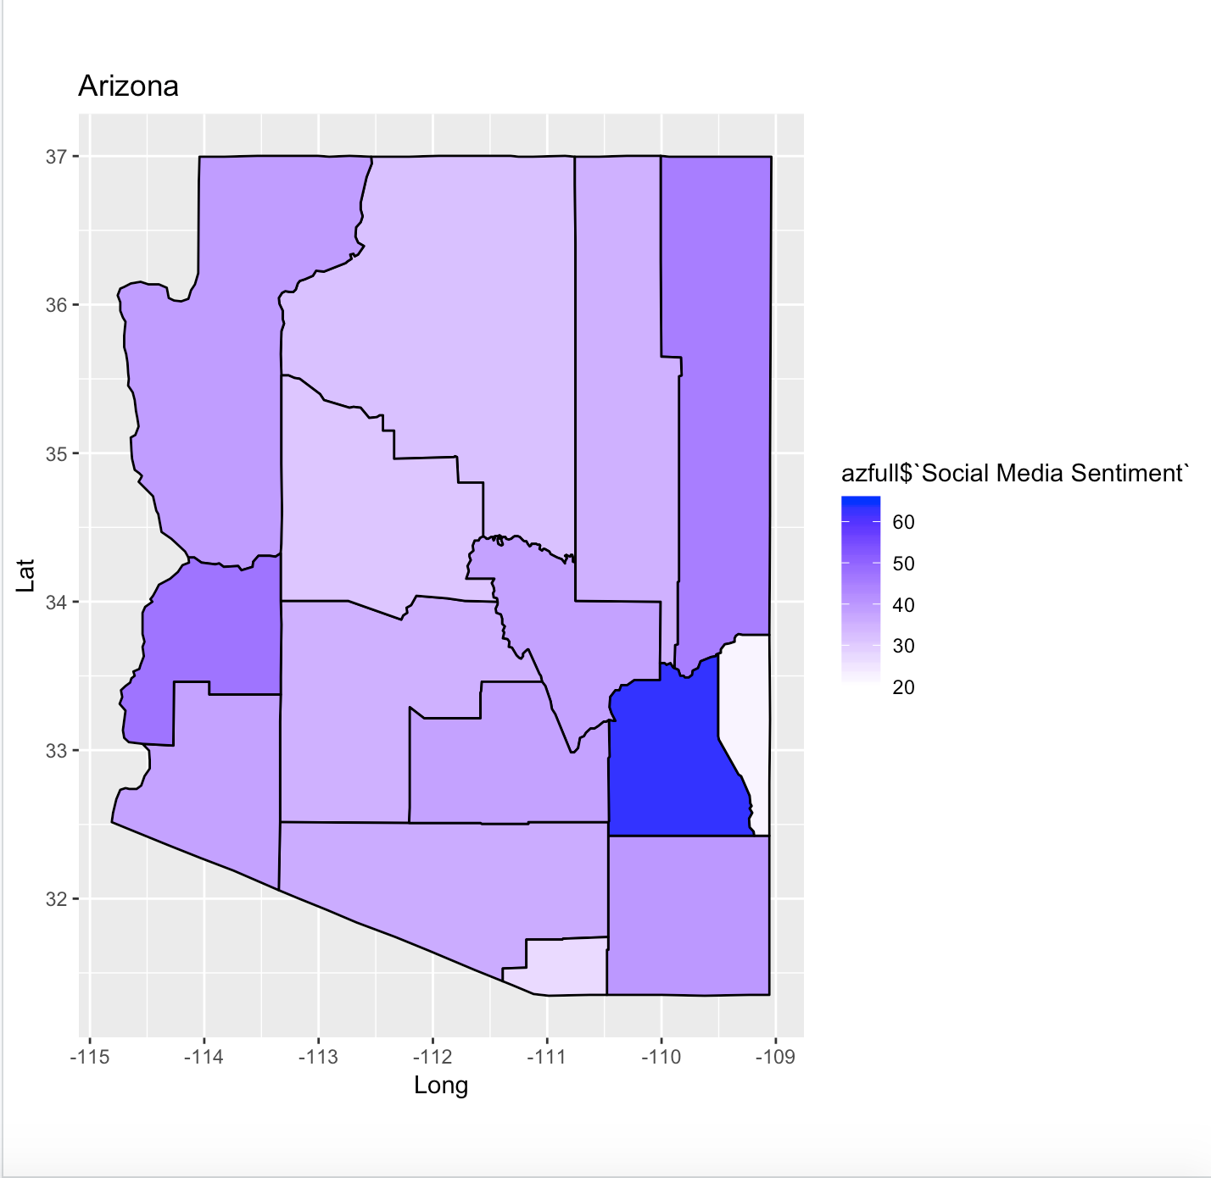

Slide 12
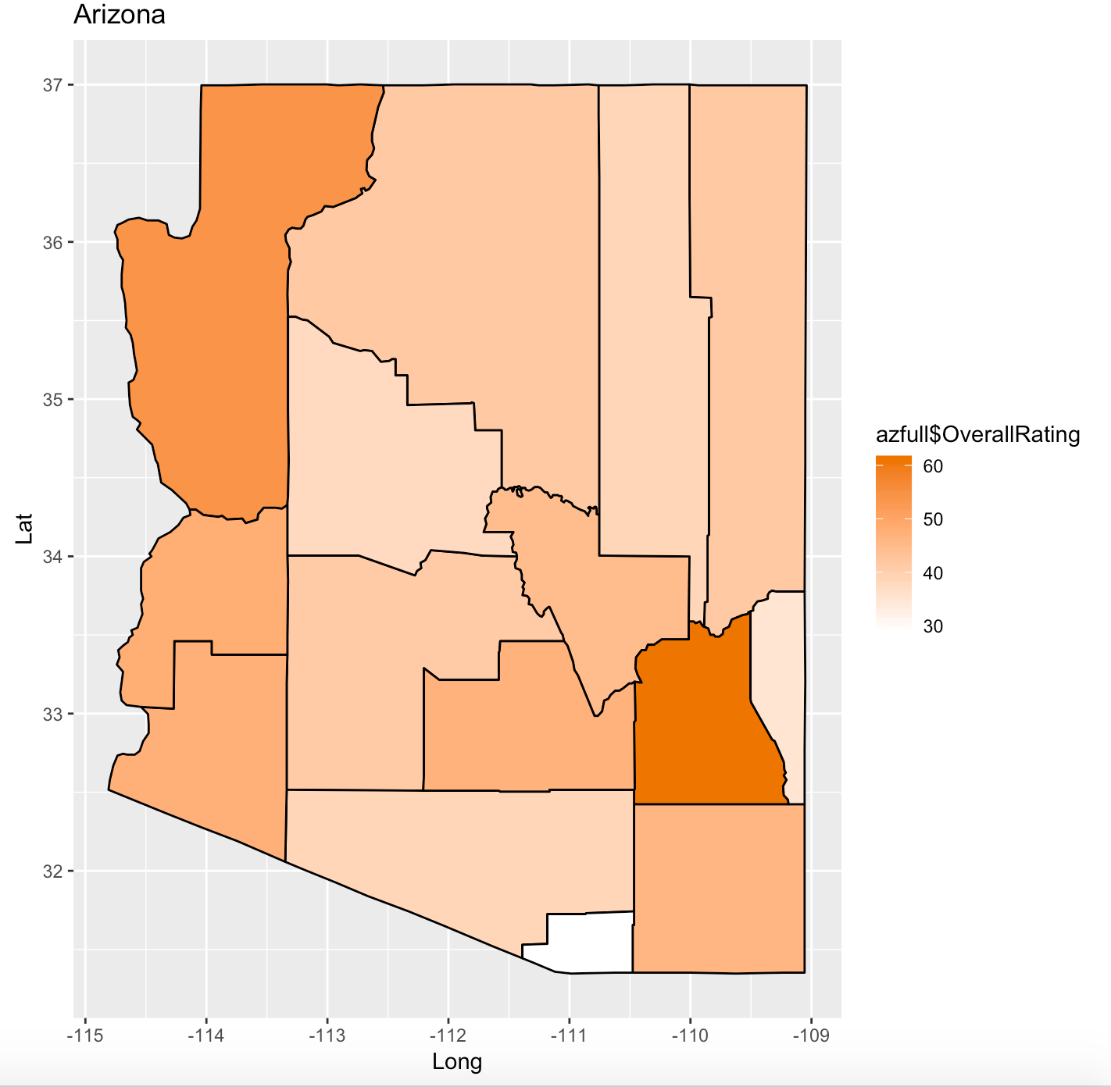

Slide 13
Internet Traffic
Goal: Use historical state-level internet traffic data from Trends to try and predict 2016 election margins (percentage).
CSVs were algorithmically fetched and combined using Python package “pytrends.”
Investigation of potential correlation b’ween search trends + margins from 2016 election dataset from class.

Slide 14
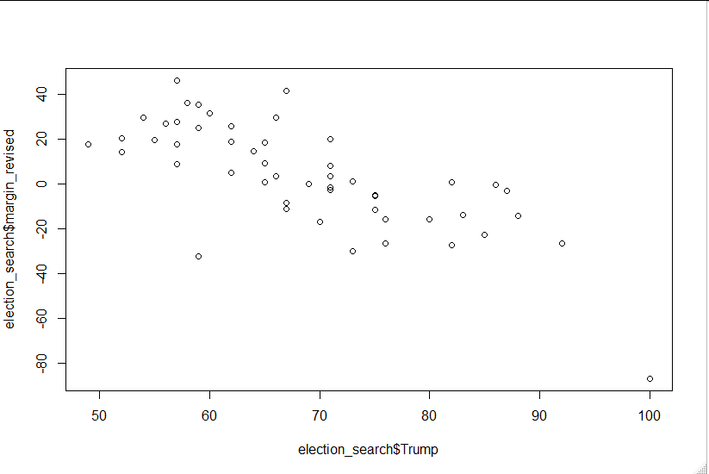
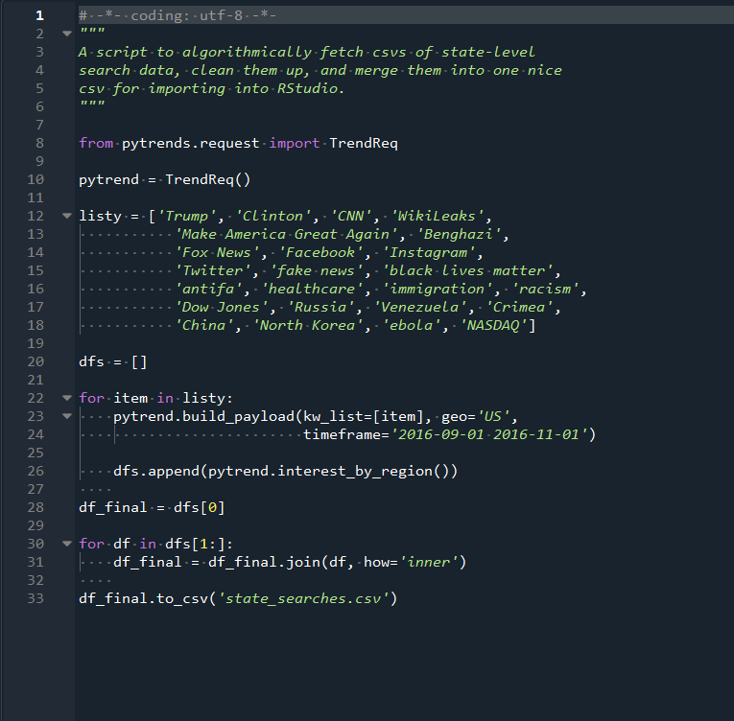
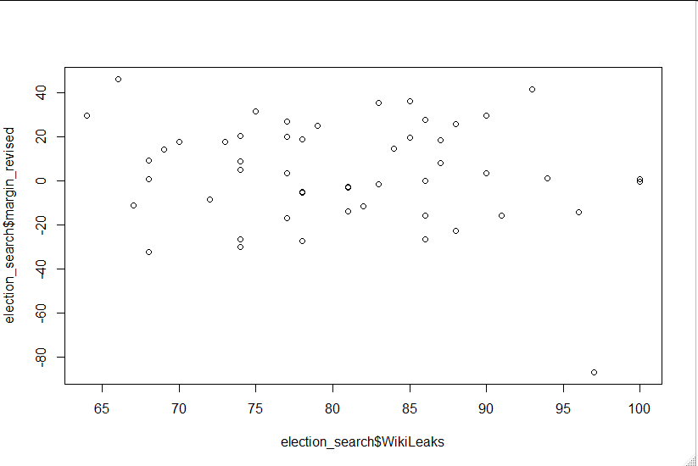
Some terms seemed more promising than others...

Slide 15
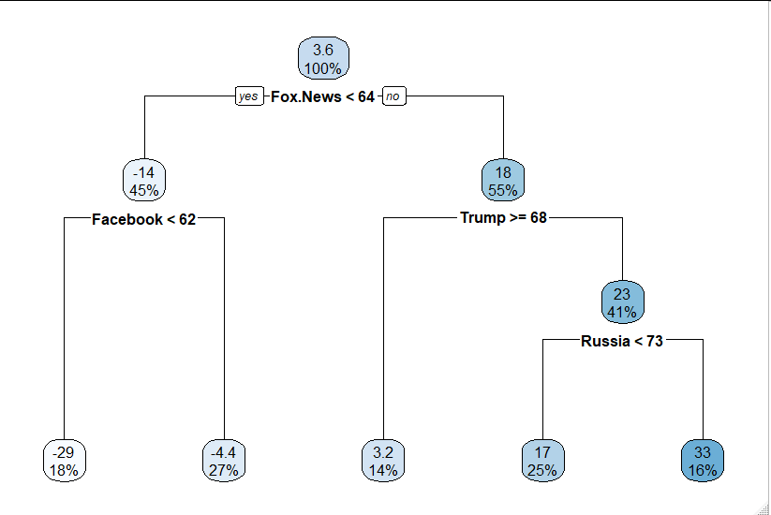
Using trees as a means of “forward” variable selection.

Slide 16
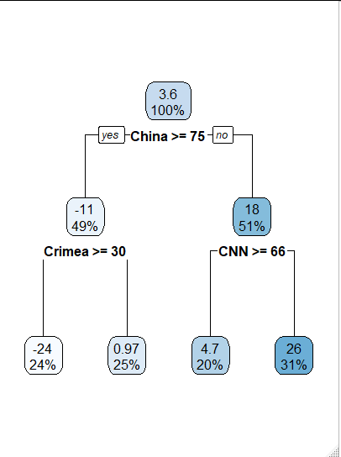
Seems obvious. What if we exclude those from the available variables in the tree-making?

Slide 17
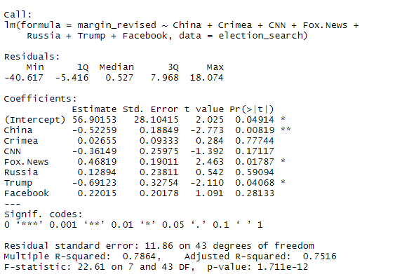
Making a linear model with these variables...

Slide 18
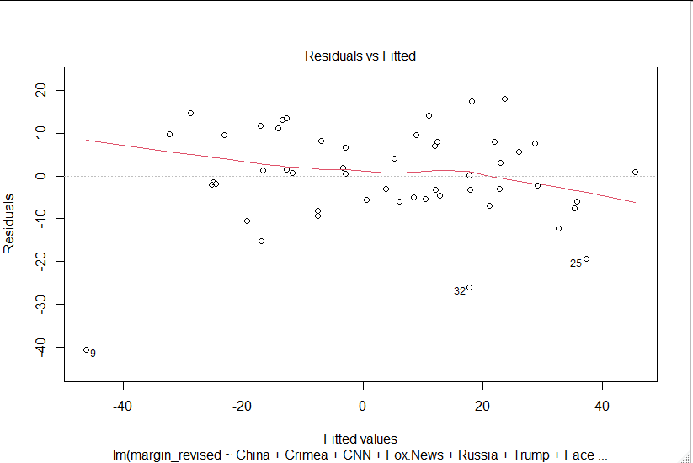
There’s some outliers! (DC, Mississippi, and New Mexico)

Slide 19
Why do this?
After identifying potentially important variables, we can train a model on “non-swing” states and then test its accuracy in predicting voter margins in swing states.
This gives us a sense of which variables may be valuable in a 2020 model. However, it’ll be harder to “train” a model in that context!
Perhaps a logistic approach may be more effective? How about training on predicted voter margins for more predictable states? Might seem redundant.

Slide 20
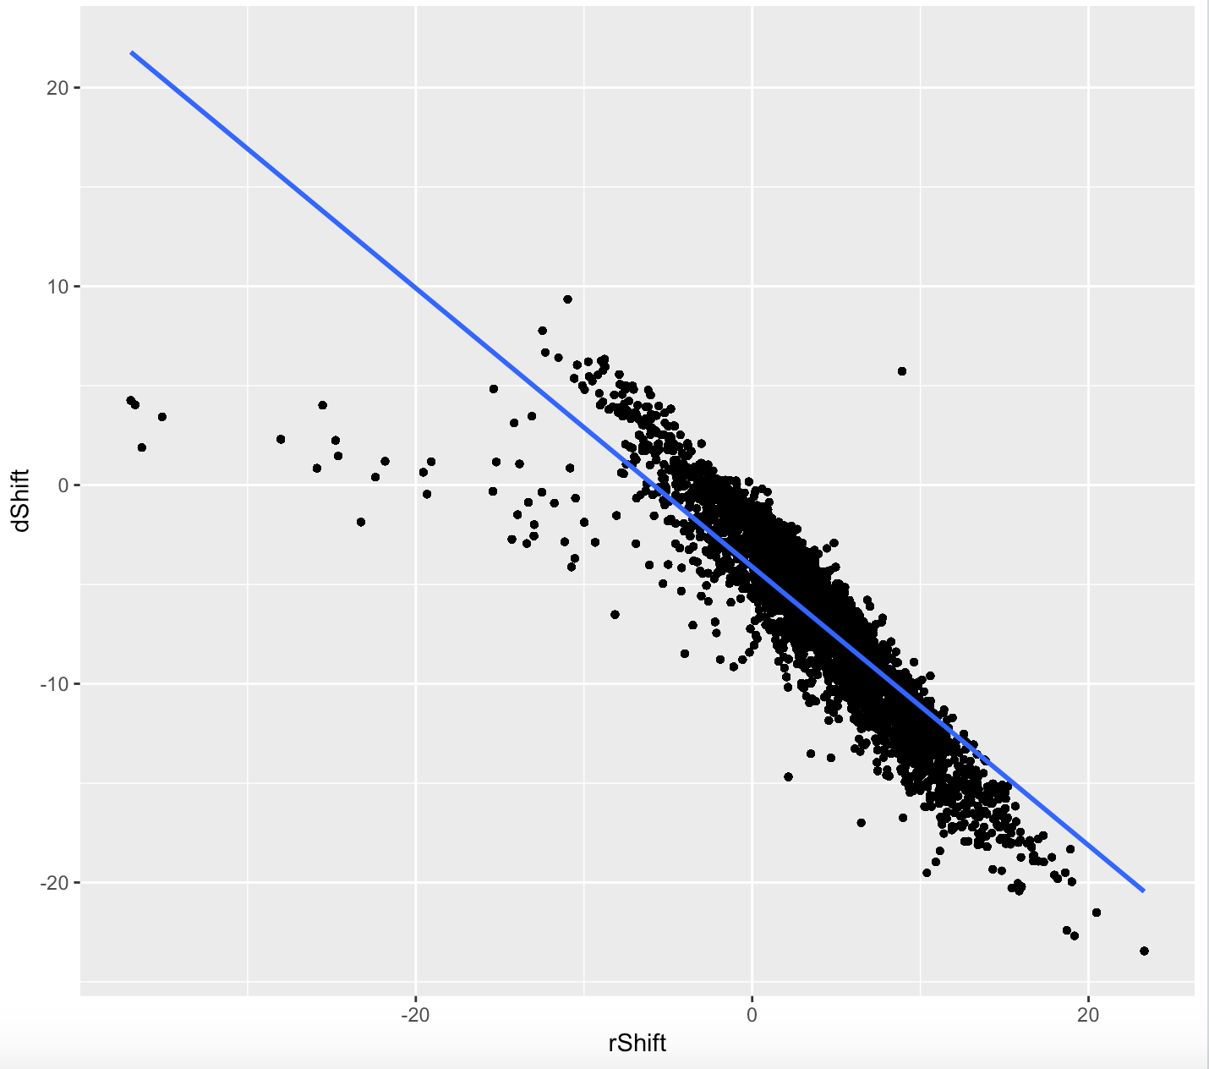
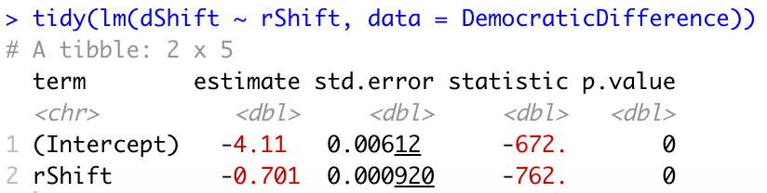
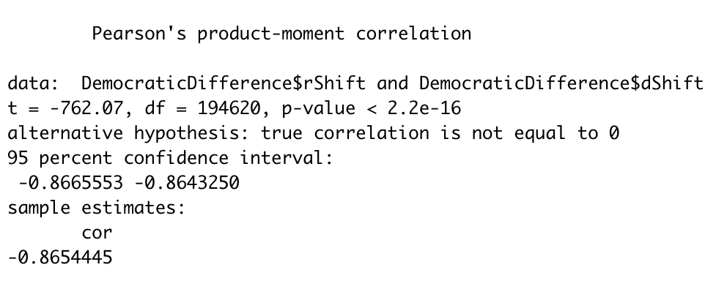
Actionable Results

Slide 21
Shift towards Red?
I decided to plot two variables, dShift and rShift, which are the percentage shifts between 2016 and 2012 votes for Democrats and Republicans, respectively. A positive value indicates an increase in support for that party.
For every percentage increase in rShift, dShift will decrease by 0.701 percent. The correlation is strong with an r value of -0.8654.
The intercept of -4.11 means that even when rShift is at 0, dShift is still negative, which could suggest voters are shifting away from the Democratic party and more towards the Republican side.

Slide 22
Regression Model:
lm(President ~ House + State), example data -
President:
Change in Ratio of votes between 2012 - 2016
Corresponding House data:
Change in Ratio of votes between 2010 - 2014

Slide 23
President
2004 - 2008
2008 - 2012
2012 - 2016
2016 - 2020 (?)
House
2002 - 2006
2006 - 2010
2010 - 2014
2014 - 2018
State
AL/AK/AR/AZ/CA …
(50 states total)
Notes:
Electoral Votes for Prediction:
Democrat: 358
Republican: 180
Electoral Votes for Prediction:
Democrat: 201
Republican: 337
Electoral Votes for Prediction:
Democrat: 235
Republican: 303

Slide 24
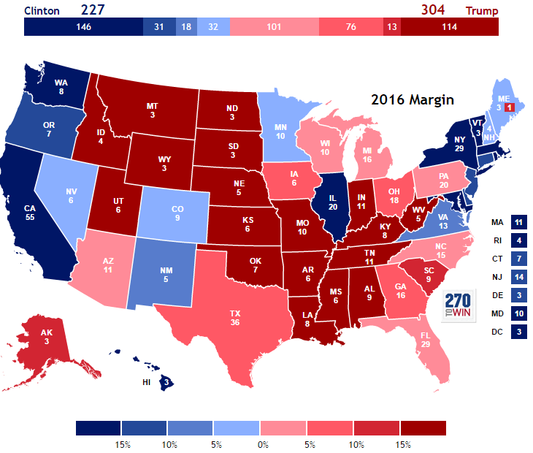
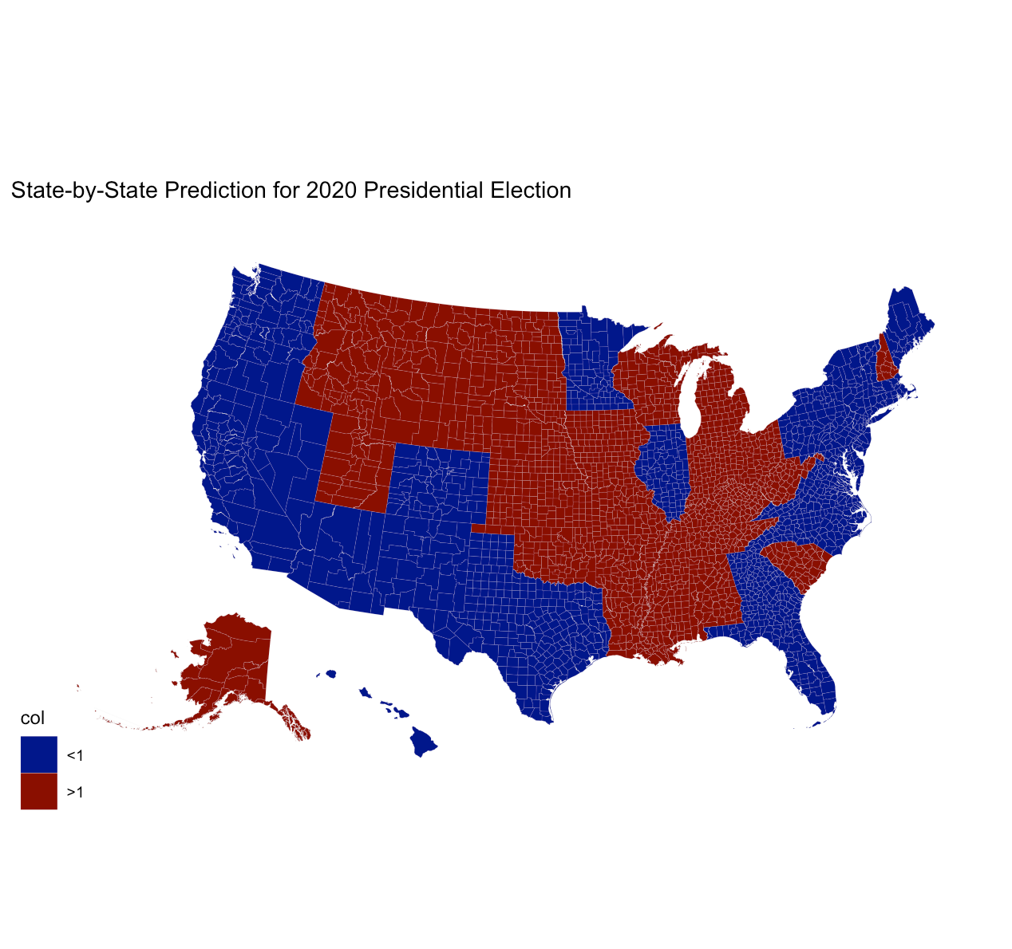
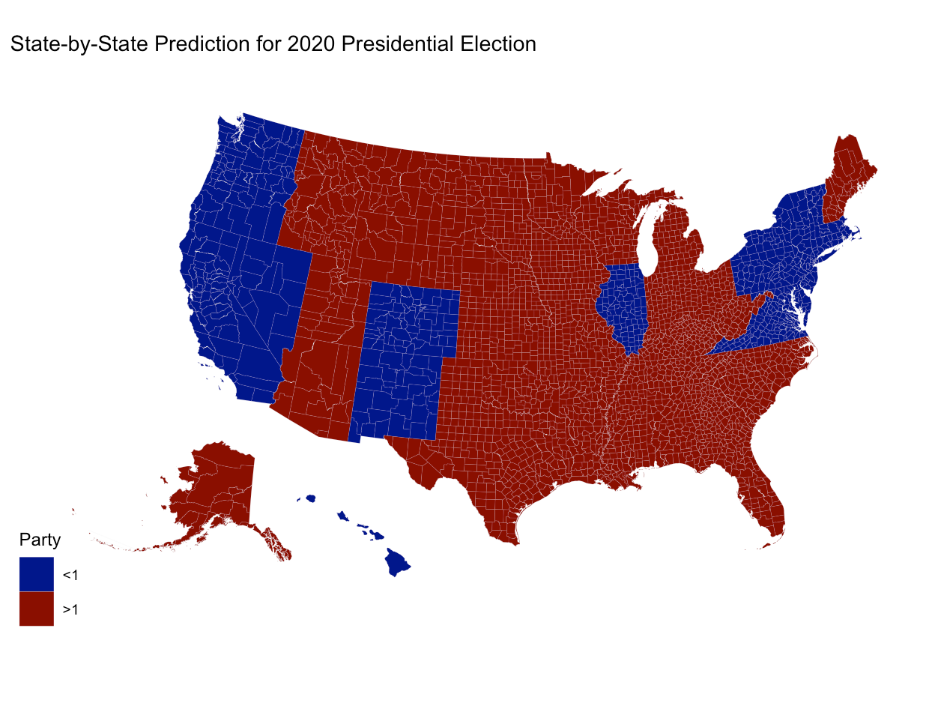
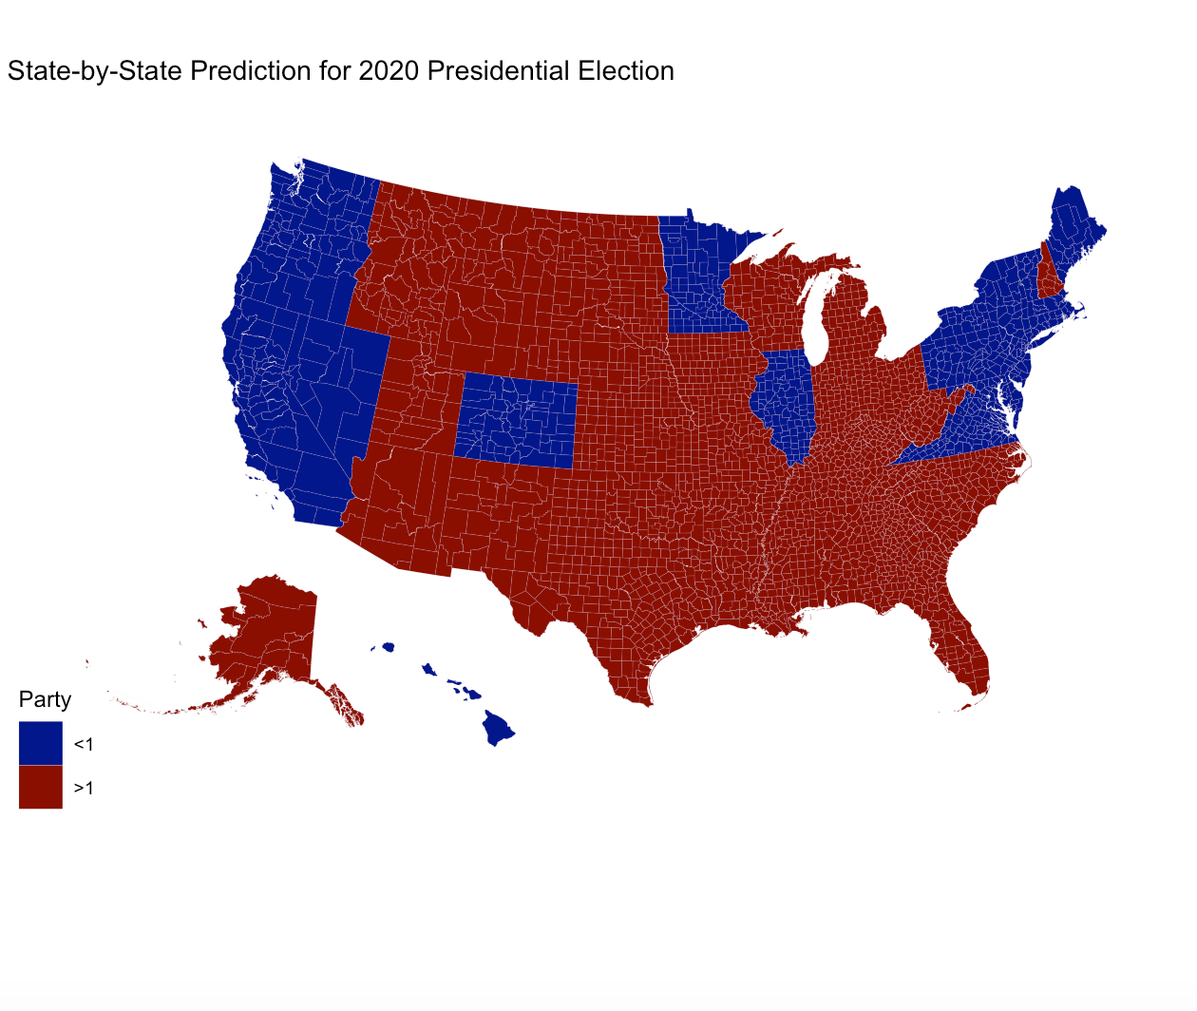
Final Results!
Historical Congress Data
Combined Weighted Result
Internet Search Data
Notes:
AZ
0.980677843466645
1.12090837173459
FALSE
1.03677005477382
TRUE
CO
0.801568700165052
1.11954782421287
FALSE
0.928760349784178
FALSE
FL
0.98573546176494
1.02357500412701
FALSE
1.00087127870977
TRUE
GA
0.981578392170794
1.20747328158013
FALSE
1.07193634793453
TRUE
ME
0.970104472818396
1.07808951190138
FALSE
1.01329848845159
TRUE
MN
0.976414330286784
1.17278726975007
FALSE
1.0549635060721
TRUE
NC
0.987317210394324
1.23269153522607
FALSE
1.08546694032702
TRUE
NM
0.736114043325082
1.39150292812579
FALSE
0.998269597245365
FALSE
PA
0.995812524356454
1.00431025670907
FALSE
0.999211617297502
FALSE
TX
0.979619891923815
1.25261184079542
FALSE
1.08881667147246
TRUE

Slide 25
Three Outcomes -
Historical Congress data:
Democrat: 358
Republican: 180
Combined weighted result:
Democrat: 235
Republican: 303
Internet Search data:
Democrat: 201
Republican: 337

