Slide 1
FEDEX FREIGHT–ALIGNED CASE STUDY
Revenue Quality &
Pricing Optimization
Decision framework
01
Assure
Data quality
02
Diagnose
From shipment-level data quality to targeted pricing action
Revenue leakage
03
Prioritize
Customer × lane
04
Model
Expected revenue
05
Act
Pilot & measure
Prepared for stakeholder discussion
Synthetic data • Publicly grounded operating concepts

Slide 2
02
Executive summary
The case isolates where revenue quality is weak, why it is happening, and how to intervene without defaulting to blanket price increases.
220,000
$75.8M
$1.37M
98.79%
0.921
UNIQUE SHIPMENTS
BILLED REVENUE
IDENTIFIED GAP
PRICING REALIZATION
MODEL R²
WHAT MATTERS
WHAT TO DO
HOW TO DE-RISK
Leakage is concentrated in repeatable commercial and billing mechanisms—not uniformly across the portfolio.
Prioritize high-volume, weak-realization customer × lane cells; route defects and commercial repricing to different owners.
Pilot 20–40 targeted cells for 60–90 days and measure contribution, volume retention, realization and dispute rate.
Recommendation
Build a governed weekly revenue-quality queue and scale only interventions that improve contribution without unacceptable customer or volume impact.
Synthetic portfolio case study • No confidential FedEx Freight data
2

Slide 3
03
End-to-end analytical architecture
A controlled path from raw operational data to a decision that can be measured after implementation.
01
02
03
04
05
RAW SOURCES
DATA QUALITY
KPI LAYER
DIAGNOSIS
ACTION
Shipment • customer • contract • lane • class • accessorial • fuel • cost
→
Deduplicate • recover IDs • repair weight • validate class
→
Realization • revenue/CWT • gap • contribution
→
Root cause • customer × lane • anomaly scoring
→
Pricing scenario • pilot • post-action measurement
CONTROL PRINCIPLE
Preserve raw data and repair lineage. A pricing recommendation is not valid unless the source data, contract logic and root-cause evidence reconcile.
Synthetic portfolio case study • No confidential FedEx Freight data
3

Slide 4
04
Data quality is a financial control
The pipeline deliberately starts with flawed data so the revenue-quality conclusion can be tested for auditability and robustness.
BEFORE
AFTER
Duplicate rows
420
→
0
Missing weights
653
→
0
Non-positive weights
90
→
0
Invalid freight class
352
→
0
Missing customer ID
281
→
0
ETL RULES
RESULT
Latest-ingestion deduplication • governed customer-name mapping • hierarchical weight imputation • density-based nearest-class repair.
Zero remaining defects for the five tested controls; raw source remains unchanged for audit.
Synthetic portfolio case study • No confidential FedEx Freight data
4

Slide 5
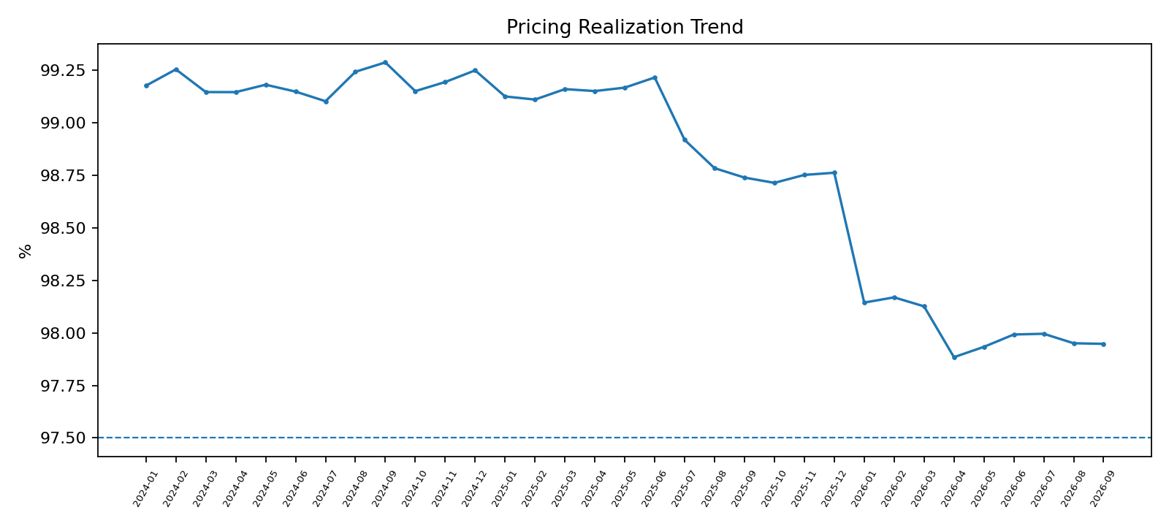
05
Portfolio revenue quality
The portfolio looks healthy in aggregate; the business value comes from isolating concentrated pockets of leakage.
98.79%
$1.37M
36,562
$-102.8M
PRICING REALIZATION
REVENUE GAP
FLAGGED SHIPMENTS
CONTRIBUTION
INTERPRETATION
An enterprise average near 99% can still hide recurring underpricing in specific customers, lanes, freight classes or accessorial processes.
MANAGEMENT QUESTION
Which gaps are material, repeatable and recoverable—and which are legitimate commercial concessions?
Synthetic portfolio case study • No confidential FedEx Freight data
5

Slide 6
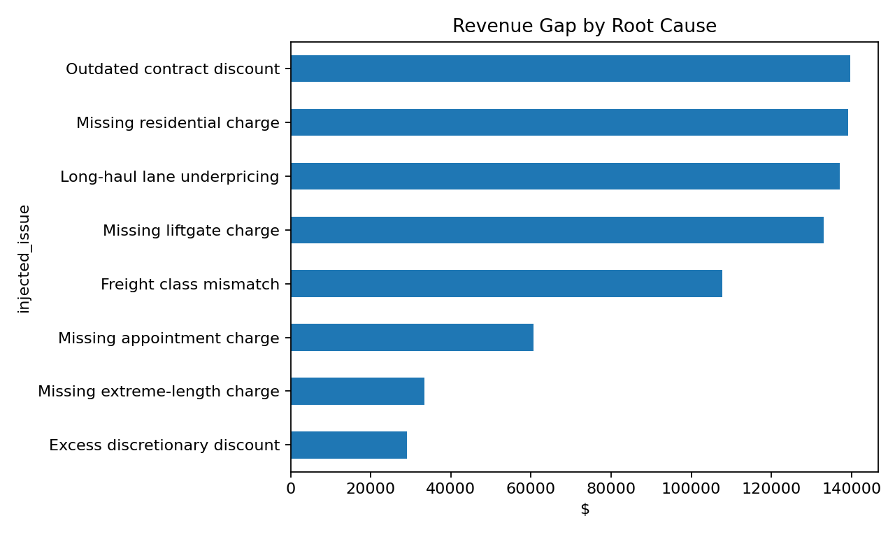
06
Root-cause view: not all leakage should be treated the same
Commercial pricing issues and revenue-assurance defects require different owners, controls and remediation.
Action routing
Commercial pricing
Outdated discount • long-haul / lane gap
Pricing + Finance
Revenue assurance
Missing accessorial • class mismatch
Billing + Operations
Governance
Approved concessions vs. unintended leakage
Pricing leadership
Prioritization
Materiality × recurrence × recoverability
Revenue Quality
Synthetic portfolio case study • No confidential FedEx Freight data
6

Slide 7
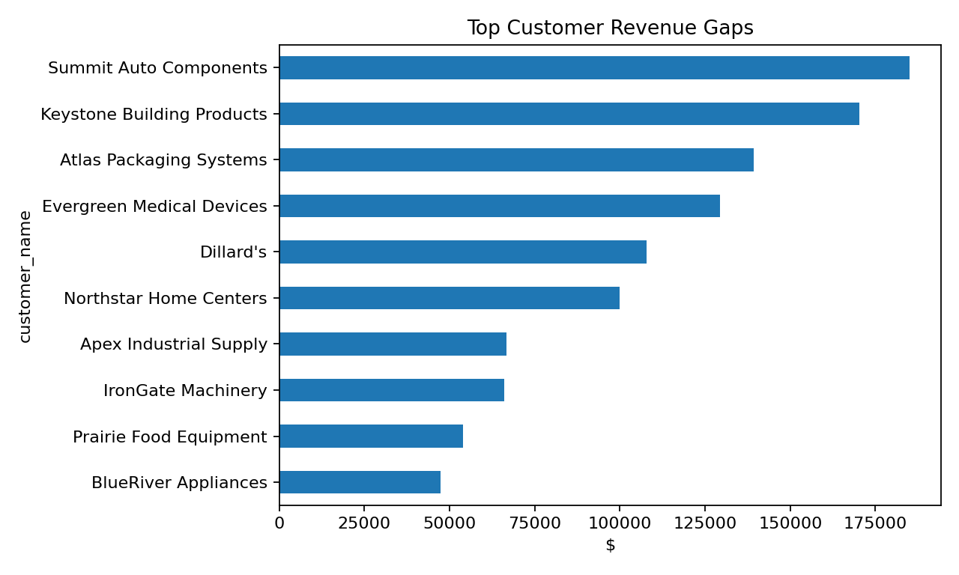
07
Prioritize at the customer × lane level
The intervention unit should be granular enough to preserve healthy business while targeting repeatable weak economics.
Customer × lane decision matrix
STRONG
ECONOMICS
Selective
growth
Protect
WEAK
ECONOMICS
Review /
deprioritize
PRICING
PRIORITY
LOW VOLUME
HIGH VOLUME
PRIORITY LOGIC
Focus first on high-volume cells with weak realization and sufficient recurrence to support a reliable intervention.
Synthetic portfolio case study • No confidential FedEx Freight data
7

Slide 8
08
Expected-revenue model: triage, not autonomous pricing
Machine learning ranks suspicious economics; governed pricing logic and analyst review determine the action.
0.921
$52
Production decision funnel
HOLDOUT R²
HOLDOUT MAE
1
Model score
Identify potential under-recovery
TRAINING DESIGN
2
Evidence check
Contract / rate / billing validation
Train on near-normal realization so the model learns healthy shipment economics rather than reproducing known leakage.
3
Root cause
Commercial vs. operational defect
4
Approval
Pricing / Finance / account constraints
FEATURE SET
Weight • distance • freight class • pallets • density • fuel • customer • origin • destination • service level.
Action
Pilot, monitor, scale or stop
5
Synthetic portfolio case study • No confidential FedEx Freight data
8

Slide 9
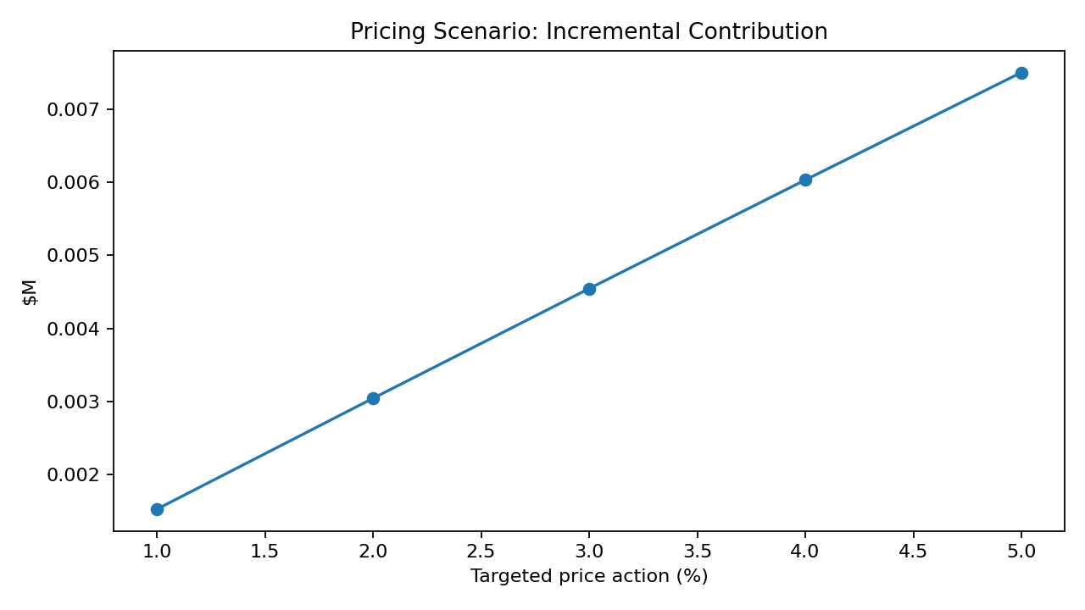
09
Pricing scenarios: optimize contribution, not headline rate
Targeted price actions are evaluated against expected volume response; elasticity remains an assumption until estimated from actual behavior.
5%
-4.25%
MODELED ACTION
AVG. VOLUME RESPONSE
MODELED UPSIDE
Incremental contribution across selected customer × lane cells: $7,500.
DECISION GUARDRAIL
Before any production recommendation: estimate elasticity empirically, review contracts, exclude strategically sensitive accounts and monitor disputes.
Synthetic portfolio case study • No confidential FedEx Freight data
9

Slide 10
10
90-day pilot and measurement plan
The recommendation becomes credible only when the intervention is measured against a counterfactual and customer outcomes.
0–2 WEEKS
3–6 WEEKS
7–12 WEEKS
DAY 90
Validate
Intervene
Measure
Decide
Reconcile contracts, billing logic and root-cause evidence. Select 20–40 target cells + matched controls.
Implement approved pricing / billing controls. Freeze measurement definitions and exception handling.
Track realization, revenue/CWT, contribution, volume retention, dispute rate and exceptions.
Scale, modify or stop by issue type and customer segment based on realized contribution.
Pilot scorecard
✓
Pricing realization
✓
Revenue / CWT
✓
Contribution
✓
Shipment volume
✓
Customer retention
✓
Dispute / exception rate
Synthetic portfolio case study • No confidential FedEx Freight data
10

Slide 11
11
Stakeholder recommendation
Operationalize a revenue-quality control loop that separates detection, diagnosis, action and measurement.
1
GOVERN
Create a weekly customer × lane revenue-quality queue with contract/rating lineage.
2
ROUTE
Send billing/accessorial defects to Revenue Assurance; send commercial gaps to Pricing + Finance.
3
PILOT
Use targeted cohorts rather than portfolio-wide increases; protect healthy lanes and accounts.
4
MEASURE
Scale only when incremental contribution survives volume, retention and dispute-rate checks.
5
REFRESH
Re-estimate elasticity and thresholds quarterly; monitor model drift and exception patterns.
Decision: pilot targeted revenue-quality interventions; do not use the model as an autonomous pricing engine.
Synthetic portfolio case study • No confidential FedEx Freight data
11

Slide 12
12
Appendix | scope, assumptions and disclosure
Designed to be credible in a stakeholder conversation without implying access to proprietary carrier data.
DATA DISCLOSURE
CUSTOMER NAMES
All shipment, contract, price, cost, elasticity and customer-behavior values are synthetic. No confidential FedEx Freight data is used.
Dillard’s appears only as a historical public reference; its economics here are synthetic. Other customer names are fictional.
PUBLIC GROUNDING
MODEL LIMITATION
The operating concepts align to public FedEx materials on freight rating, class/weight/accessorial inputs and pricing accuracy. This deck is not an official FedEx presentation.
The expected-revenue model prioritizes review. Production pricing requires governed contracts, empirically estimated elasticity, approval controls and customer context.
Presentation design
FedEx-inspired purple/orange visual language used for this portfolio case study; official logo assets are intentionally not reproduced.
Synthetic portfolio case study • No confidential FedEx Freight data
12

