Slide 1
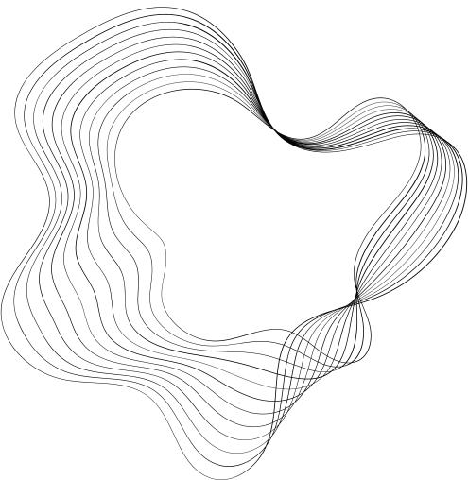

ELL409
SPAM OR NOT SPAM DATA GENERATION USING LSTM VAE
TEAM ACUBE

Slide 2

PROBLEM STATEMENT
Email spam detection is crucial for efficient communication.
Real-world spam datasets are limited, leading to challenges in building robust models.
Objective: Generate high-quality synthetic spam and not spam data to augment real datasets.

Slide 3
PROPOSED SOLUTION
Train an LSTM-based Variational Autoencoder (VAE).
Generate synthetic spam and not spam data using the trained model.
Train a mail classifier using SVM and classify the generated mails.
Evaluate quality using reconstruction accuracy and KL divergence.

Slide 4
DATASET OVERVIEW
Source: Kaggle’s "Spam or Not Spam Dataset".
Dataset contains:
Spam emails: 500
Not spam emails: 2500
Preprocessing steps:
Tokenization
Vocabulary creation
Text-to-sequence conversion
Data split: 80% training, 20% testing.

Slide 5
PREPROCESSING WORKFLOW
Text Cleaning:
Lowercasing, removing punctuation, and numbers.
Tokenization:
Splitting text into individual words.
Stopword Removal:
Removing stopwords, single letter words and domain-specific terms (“url”).
Ungrammatical Words Removal:
Handle ungrammatical words using a Spell Checker.
Sequence Conversion:
Converting words to numerical indices.
Padding:
Uniform sequence lengths for model input.

Slide 6
LSTM VARIATIONAL AUTOENCODER (VAE)
Encoder:
Uses LSTM to encode input data into a latent space.
Captures temporal dependencies in text data.
Latent Space:
Encodes data as a Gaussian distribution (mean and variance).
Decoder:
Uses LSTM to reconstruct data from latent representations.
Loss Function:
Reconstruction Loss: Measures how well the model reconstructs the input.
KL Divergence: Ensures latent space approximates a Gaussian distribution.
Advantages of VAE:
Generates diverse outputs.
Learns meaningful latent representations.

Slide 7
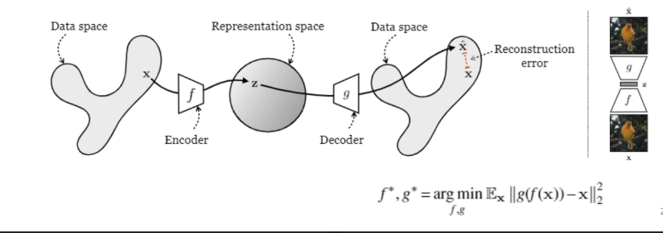
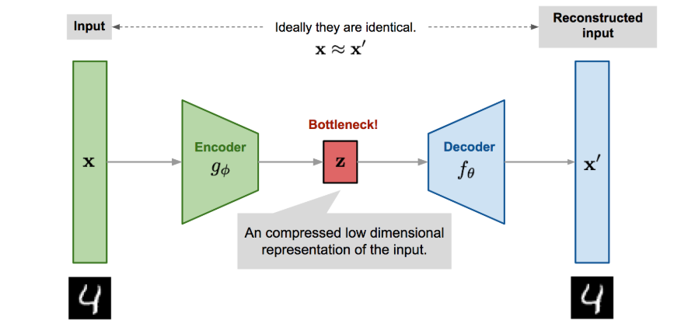
VARIATIONAL AUTOENCODER (VAE)

Slide 8

MODEL TRAINING
Training Details:
Optimizer: Adam.
Batch Size: 32.
Learning Rate: 0.001.
Metrics:
Reconstruction Loss: Measures accuracy of reconstructed sequences.
KL Divergence: Evaluates how well latent space matches Gaussian distribution.
Challenges:
Balancing reconstruction loss and KL divergence.
Avoiding overfitting.

Slide 9
SYNTHETIC DATA GENERATION
Process:
Sample latent vector from Gaussian distribution.
Decode latent vector into text sequence using the trained decoder.
Generate data for both spam and not spam labels.
Evaluation of Quality:
Assess fluency and coherence of generated text.
Use classifier performance to validate usefulness of synthetic data.

Slide 10
MODEL EVALUATION
Metrics:
Reconstruction Accuracy: Measures the similarity between input and output.
KL Divergence: Evaluates the quality of the latent space representation.
Results:
Average Reconstruction Loss: 0.021.
Average KL Divergence Loss: 0.001.
Significance:
High reconstruction accuracy demonstrates effective learning.
Low KL divergence ensures meaningful latent space.

Slide 11
CLASSIFIER DETAILS
Algorithm: Support Vector Machine (SVM) with RBF kernel.
Feature Extraction:
Used TF-IDF vectorizer.
Minimum document frequency: 3.
Training:
Hyperparameters optimized: C=10, gamma=1.
Evaluation Metrics:
Precision, Recall, F1-Score on validation and synthetic test sets.
Significance:
SVM ensures robust classification with a clear margin between spam and not spam.\n

Slide 12
PROBLEMS FACED DURING THE PROJECT
Dataset Challenges:
Limited size of the dataset.
Imbalanced classes.
Preprocessing Issues:
Handling noisy and ungrammatical text.
Building a meaningful vocabulary.
Model Training Challenges:
Tuning hyperparameters for optimal performance.
Balancing reconstruction and KL divergence losses.
Synthetic Data Generation Issues:
Ensuring diversity and coherence of generated text.
Validating quality effectively.

Slide 13
CONCLUSION
Successfully generated synthetic spam and not spam data using LSTM VAE.
Demonstrated improvement in classifier performance with synthetic data.
Framework adaptable to other domains with limited datasets.

Slide 14

THANK YOU
Project Team Members-
Ayush Kumar Gupta
Arpit Anil Agrawal
Arnav Raj

