Slide 1
The Rise of Hate Crimes in the United States
Presented by Project Team 8
Cristalle Pronier
Shivam Patel
Michael Malig
Deepak Gupta
2007-2017 Data Analysis

Slide 2
Project Overview
The United States has seen a significant increase in hate crimes with 2017 seeing a 17% increase over the prior year, despite crime as a whole on the decline. Across the country, hate crimes occur in varying forms across a multitude of places. Using the FBI crime data explorer API, our goal is to measure the rate of these hate crimes within the United States over the past decade and analyze them to better understand how and where they are likely to occur.

Slide 3

How Does the Federal Bureau of Investigations define a Hate Crime?
A hate crime is a traditional offense like murder, arson, or vandalism with an added element of bias. For the purposes of collecting statistics, the FBI has defined a hate crime as a “criminal offense against a person or property motivated in whole or in part by an offender’s bias against a race, religion, disability, sexual orientation, ethnicity, gender, or gender identity.” Hate itself is not a crime—and the FBI is mindful of protecting freedom of speech and other civil liberties.

Slide 4
Research Questions
What is the annual trend of hate crimes from 2007 – 2017?
How has hate crime bias changed over the years?
What are the most frequent offense types in hate crimes?
How have offense types changed over the years?
Where do hate crimes occur most frequently?
What are the top states in which hate crimes occur?
What types of locations hold the highest number of hate crimes?
What is the monthly fluctuation of hate crime rates?
How does monthly fluctuation change when compared by year?

Slide 5

Main Data Sources and Tools
FBI Hate-Crime data 2017 (crime incidents records for 1997 – 2017 )
http://s3-us-gov-west-1.amazonaws.com/cg-d4b776d0-d898-4153-90c8-8336f86bdfec/hate_crime.zip
US Govt portal
https://api.usa.gov/crime/fbi/sapi/
Endpoints used to collect additional inputs for state's total crime and population data
/api/participation/agencies/{ori}
/api/summarized/agencies/{ori}/offenses/{since}/{until}
/api/estimates/states/{state}/{since}/{until}
API info available at https://crime-data-explorer.fr.cloud.gov/api
Pandas and Matplotlib used for data analysis and graph plotting

Slide 6
Data Preparation & Cleaning
FBI’s hate crime data:
Read csv file into a pandas dataframe, deleted records prior to 2007.
Dropped non-useful columns and renamed a few columns
Columns containing bias description, offence name and crime location contained ~ 100 unique values as combination of multiple categories, split into individual category columns and major groups formed for analysis.
Incident date column converted to datetime -month for seasonal analysis.
State’s yearly population estimates and total crime numbers:
collected as json response through API calls, saved into python dictionaries and converted to pandas dataframes.
Data from both the above sources merged for analysis after appropriate reshaping.

Slide 7
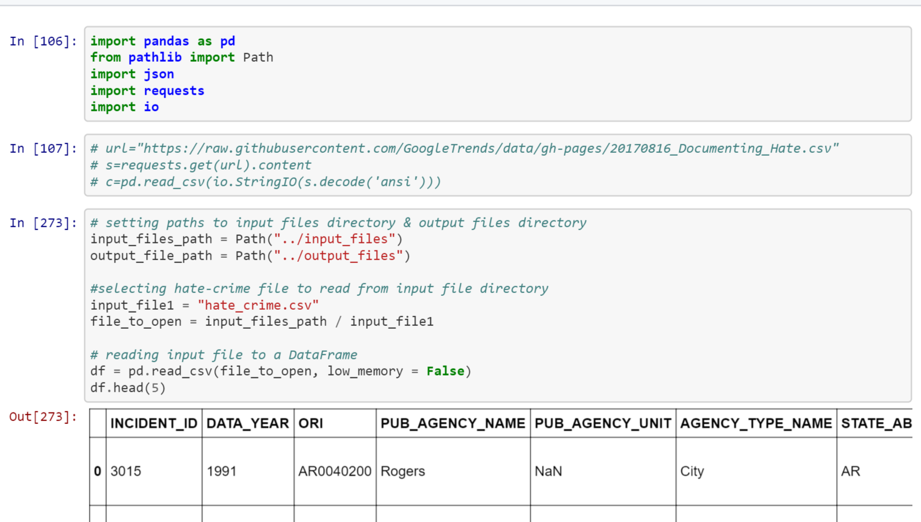

Slide 8
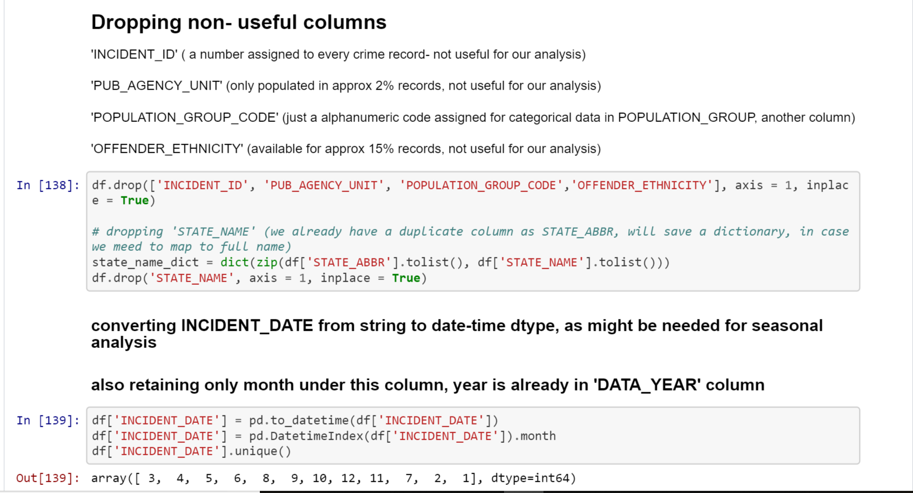

Slide 9
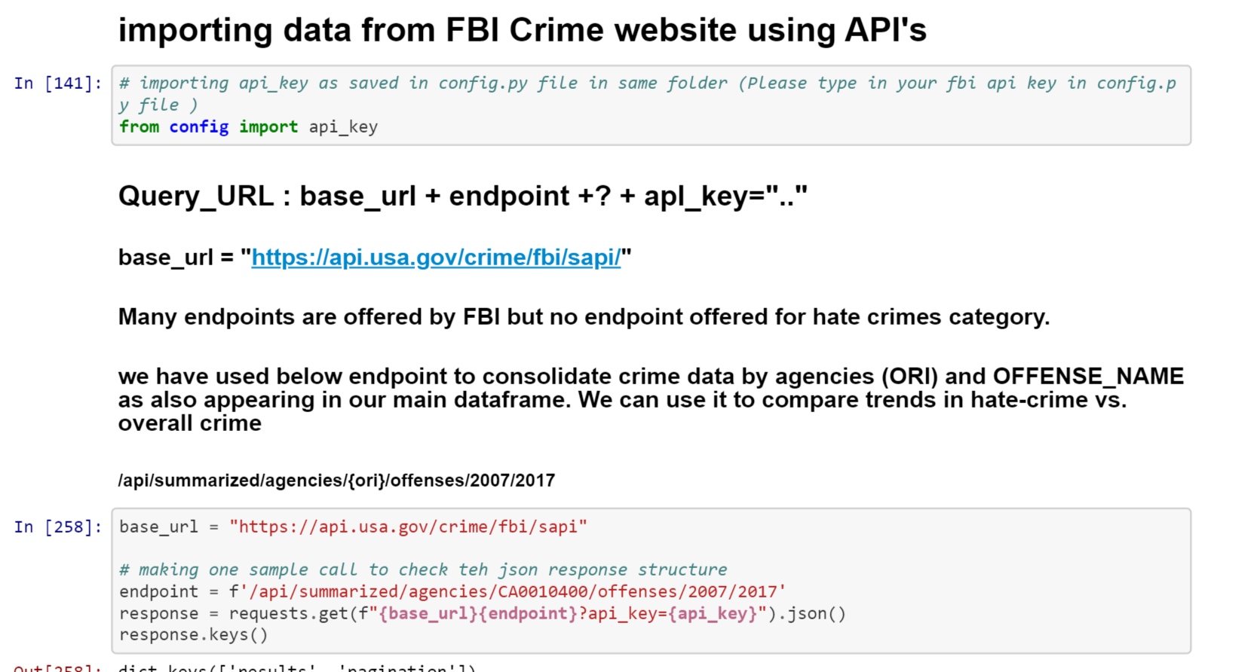

Slide 10
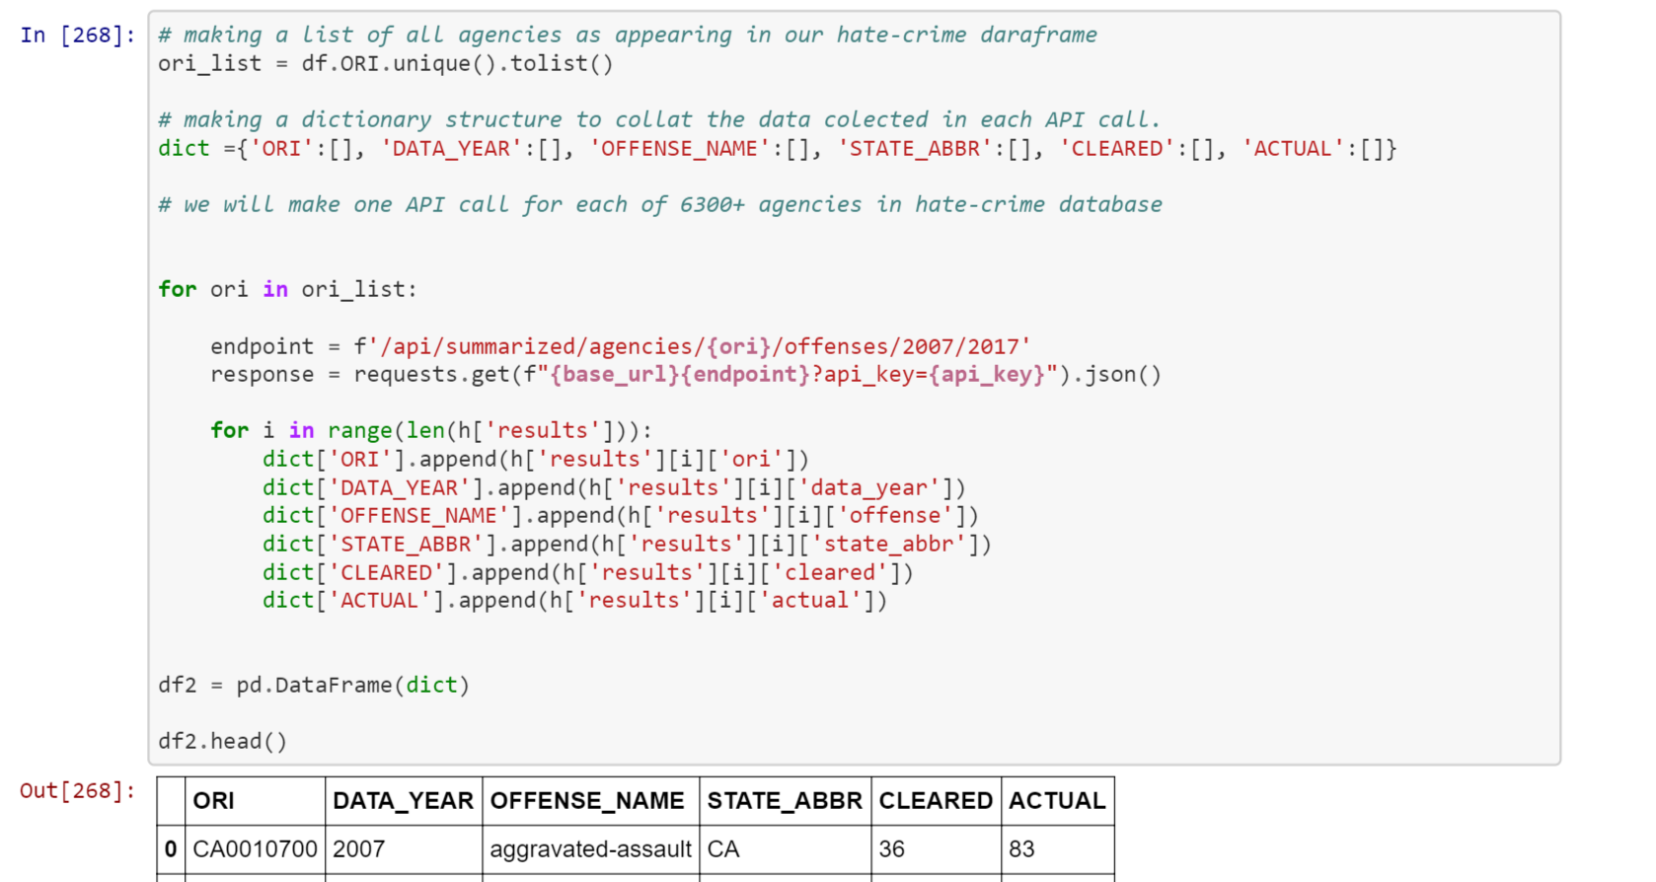

Slide 11
What is the annual trend of hate crimes from 07 – 17? Examining aggregate totals and victim demographics
Presented by Shivam

Slide 12
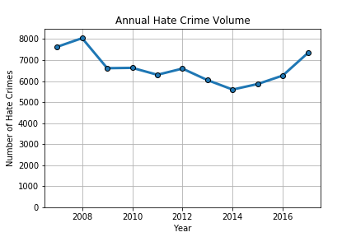
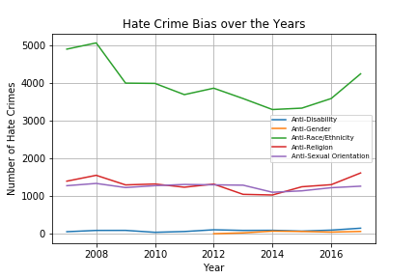
Looking at Annual Hate Crime Volume and Bias Types
How has hate crime bias changed over the years?
Notes:
Over the 10 year period, we saw a drop in annual hate crimes report.
From 2008-2014 we see that the number of reported hate crimes were decreasing.
From 2014, there is a increase in reported hate crimes which were likely due to the The start of the Trump Era, revisions to categorizing hate crimes by the Uniform Crime Reporting Program, and the trend

Slide 13
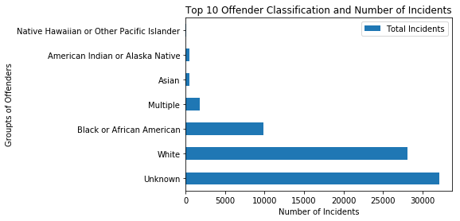
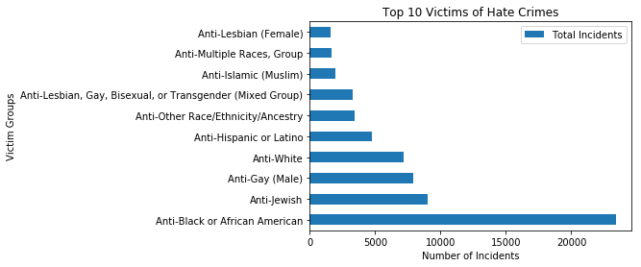
Looking at Annual Hate Crime Volume and Bias Types
Who were the Top 10 victims and Top 10 offenders?

Slide 14
What are the most frequent offenses in hate crimes? Examining criminal offense types of hate crimes
Presented by Cristalle

Slide 15
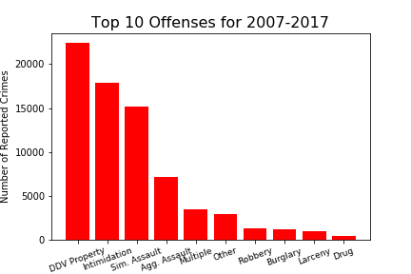
Looking at the Most Frequent Offense Types
Original dataset contained 47 unique offenses
Recoded the smallest categories into “Other”
Recoded records with more than one category as “Multiple”
The majority of hate crime involves damage/destruction of property, intimidation and assault.

Slide 16
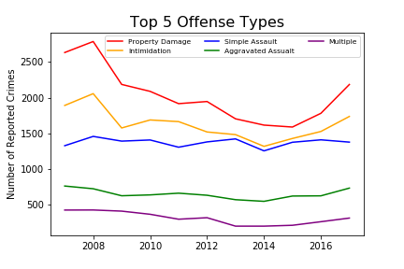
Examining the Top Five Offenses
Property damage is the largest overall and highest recent increase.
Four of the top five types saw an increase in 2017.
The top two offenses most closely mirror the overall numbers and drive the trend.
While simple assault saw a leveling off, aggravated assault rose (often includes weapons).

Slide 17
Where do hate crimes occur most frequently? Looking at geographical locations and location types
Presented by Deepak

Slide 18
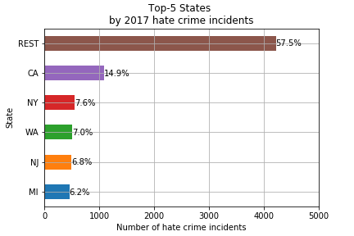
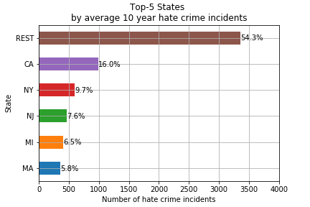
Hate Crime Occurrence by State*
California leads all states in hate crimes over the 10 year period

Slide 19
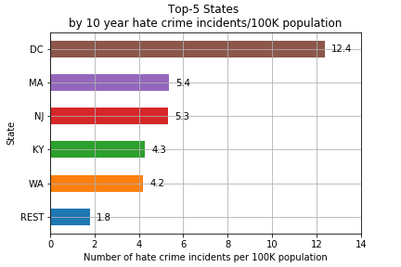
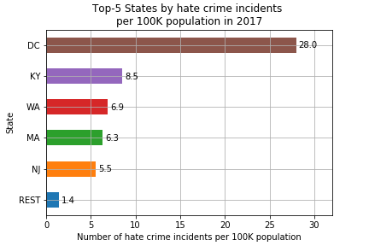
Hate Crime Occurrences with Adjustment for State Population
Washington DC leads all states over the 10 year period after accounting for state population sizes

Slide 20
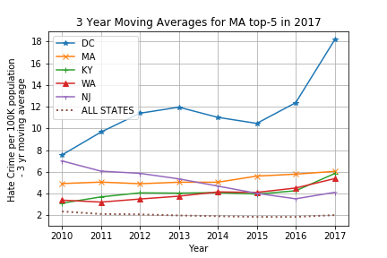
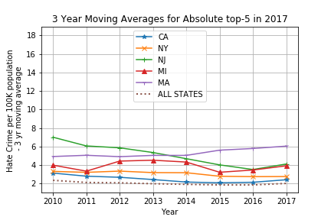
Moving Averages of Top 5 States
Washington DC’s upward trend is considerably higher than all other states
California’s hate crime rate is very close to the country’s average rate

Slide 21
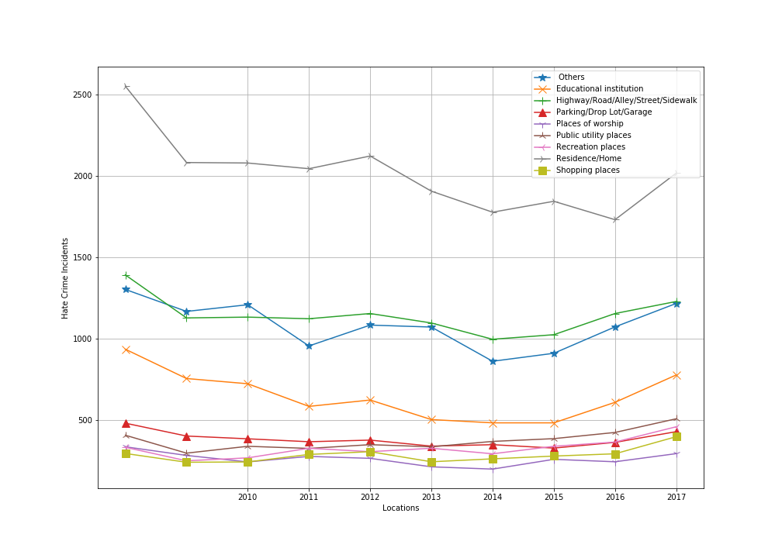
Hate Crimes by Location
The location of hate crime occurrences have not changes much of the last 10 years.
The Residence/Home is the most common area for hate crimes to occur with highways and educational institutions following behind.

Slide 22
What is the monthly fluctuation of hate crimes rates? Looking at seasonal trends in hate crimes
Presented by Michael

Slide 23
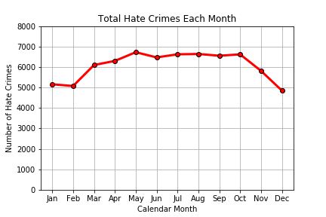
Seasonal Trends in Hate Crimes
Occurrences will generally see an increase as the year progresses. Reaching a high during the early parts of summer.
The aggregate totals show that May is the peak month of hate crimes in recent years.
Hate Crimes are marginally lower during the holiday season (Nov - Feb)

Slide 24
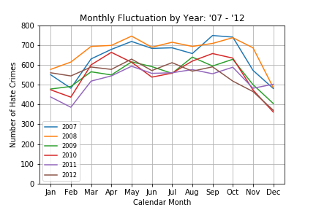
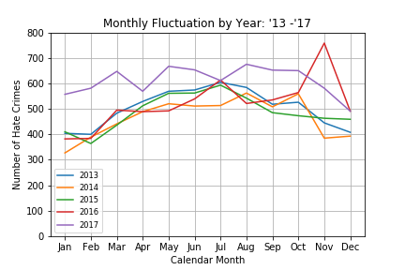
Monthly Changes by Year 2007-2017
Each year seems to follow the same trendline with the exception of a few monthly spikes
Most significant monthly increase occurred Nov 2016 and subsequently the largest monthly decrease on Dec 2016

Slide 25
Findings Discussion
After showing an overall decrease after 2008, hate crimes are at a high point in 2017.
A majority of hate crimes hold Anti-Race/Ethnicity related motivations with religion and sexual-orientation sharing an even percentage after.
Most hate crime offences involve property damage or threat of violence
The largest concentration of hate crimes occur in largely populated areas such as California and New York
Hate crimes occur in the Residence/Home more than any other location
The monthly seasonal trend shows that hate crimes occur less often during the holiday season

Slide 26
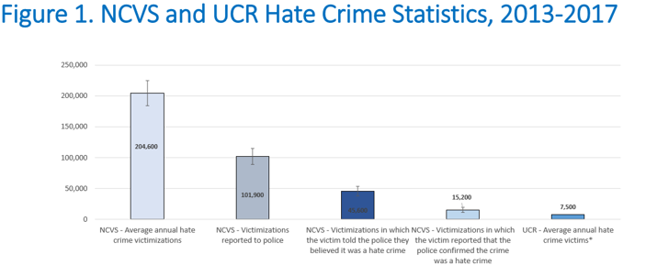
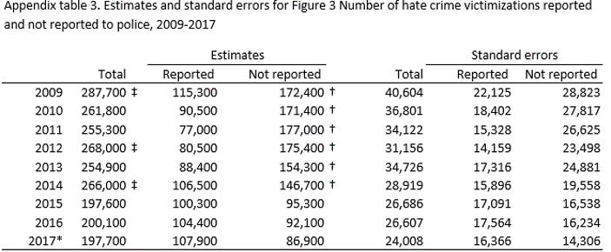
Limitations & Thinking Forward
Under reporting by victims of crime is a common limitation in all crime data. Removing barriers to reporting is essential to capturing the real number of incidents.
Hate crime data is reported by thousands of law enforcement agencies using more than one tool (FBI reports that those using the Excel tool report significantly less than the integrated software using NIBRS (National Incident-Based Reporting System).
The FBI is pushing NIBRS compliance across the country by 2021 (currently 43%)
Approx 15% of agencies part of FBI UCR program, are not reporting hate crimes separately to FBI.
NCVS survey report shows that hate crimes are on decrease and reporting to public agencies is on increase. Hence use of only FBI 2017 report to conclude rise in Hate Crimes is not valid.

Slide 27
Resources & References
FBI most recent hate crime data: https://ucr.fbi.gov/hate-crime/2017
For information about crime reporting from the Bureau of Justice Statistics: https://www.bjs.gov/index.cfm?ty=dcdetail&iid=301
Details on NIBRS data collection and reporting (will become future standard): https://www.fbi.gov/services/cjis/ucr/nibrs
California 2017 Hate Crimes Report: https://openjustice.doj.ca.gov/resources/publications
California Preventing Hate Crimes Brochure: https://oag.ca.gov/sites/all/files/agweb/pdfs/civilrights/ENG_Preventing_Hate_Crimes_Brochure_PL_INT_ADA.pdf

Slide 28
Questions & Comments
Thank you!
Team Project 8 is made up of these number ninjas:
Deepak “The CS Sage” Gupta
Michael “The Visualization Wizard” Malig
Shivam “The Data Detective” Patel
Cristalle “The Social Scientist” Pronier

