Slide 1
The Rise of Hate Crimes in the United States
2007-2017 Data Analysis
Presented by Project Team 8
Cristalle Pronier
Shivam Patel
Michael Malig
Deepak Gupta

Slide 2
Project Overview
The United States has seen a significant increase in hate crimes with 2017 seeing a 17% increase over the prior year, despite crime as a whole on the decline. Across the country, hate crimes occur in varying forms across a multitude of places. Using the FBI crime data explorer API, our goal is to measure the rate of these hate crimes within the United States over the past decade and analyze them to better understand how and where they are likely to occur.

Slide 3
Research Questions
1. What is the trend of hate crimes from 2007 – 2017?
a. Trend of demographic groups committing hate crimes
b. Trend of demographic groups victimized by hate crimes
2. What is the trend of offense types that include hate crimes?
3. Where are hate crimes most likely to occur?
a. What states hold the highest percentage of hate crimes?
b. What locations have a higher chance for a hate crime to occur?
4. What is the fluctuation of hate crimes rates on a monthly basis?

Slide 4
Data High Level Summary
Need to pool together our thoughts

Slide 5
Data Acquisition
Deepak will provide text

Slide 6
Data Preparation & Cleaning
Deepak will provide text
Screenshots of notebook following to show some of the initial coding work

Slide 7
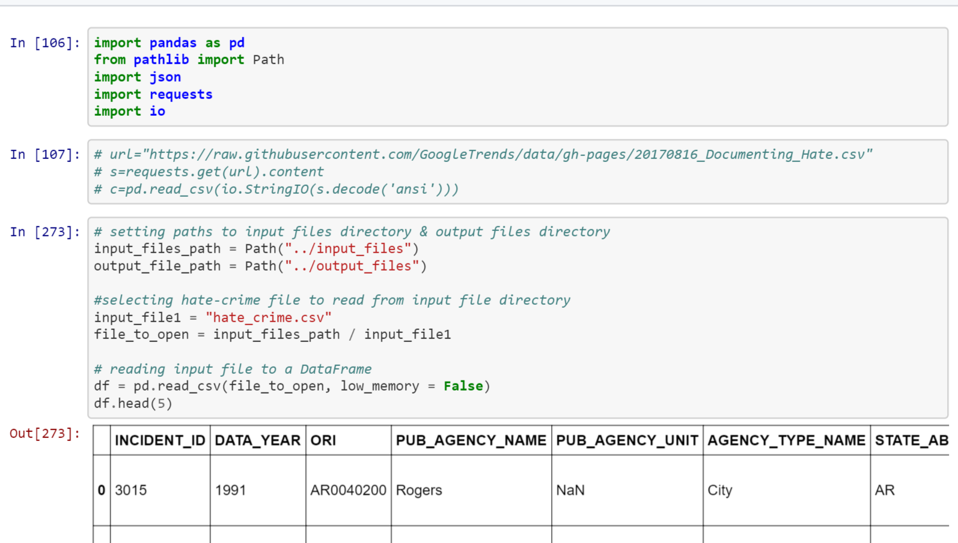

Slide 8
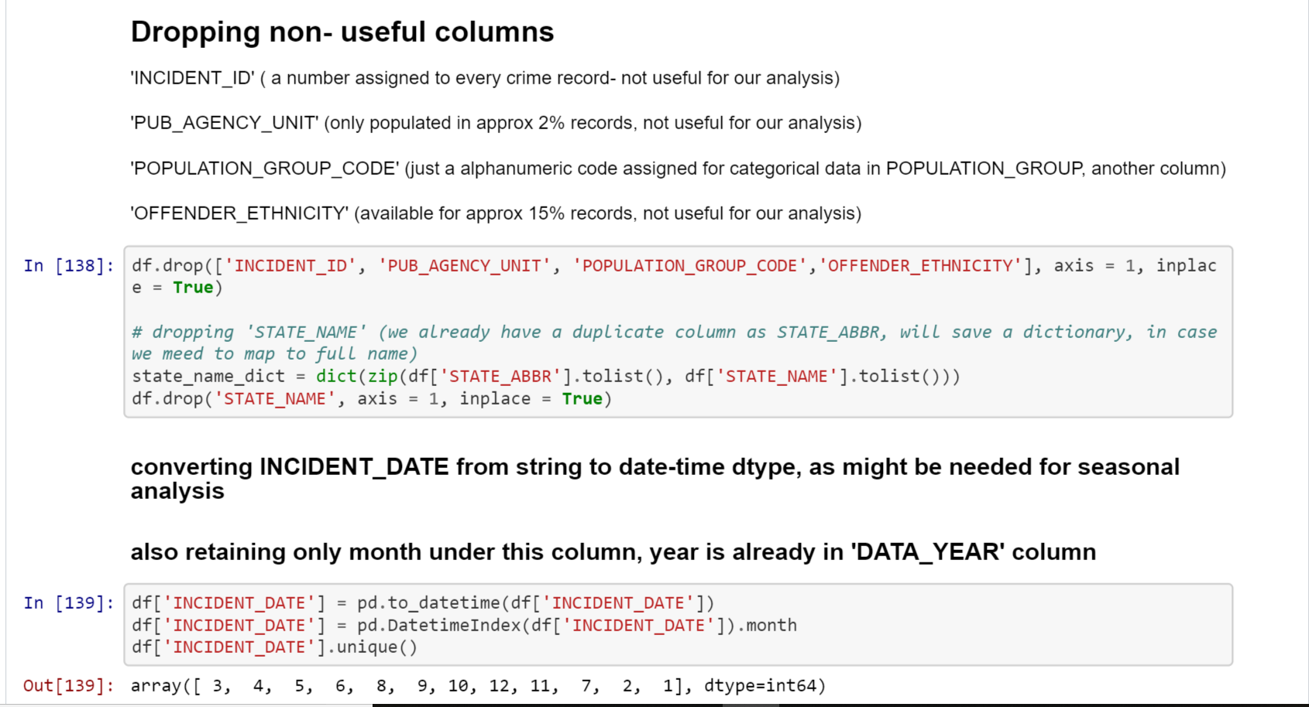

Slide 9
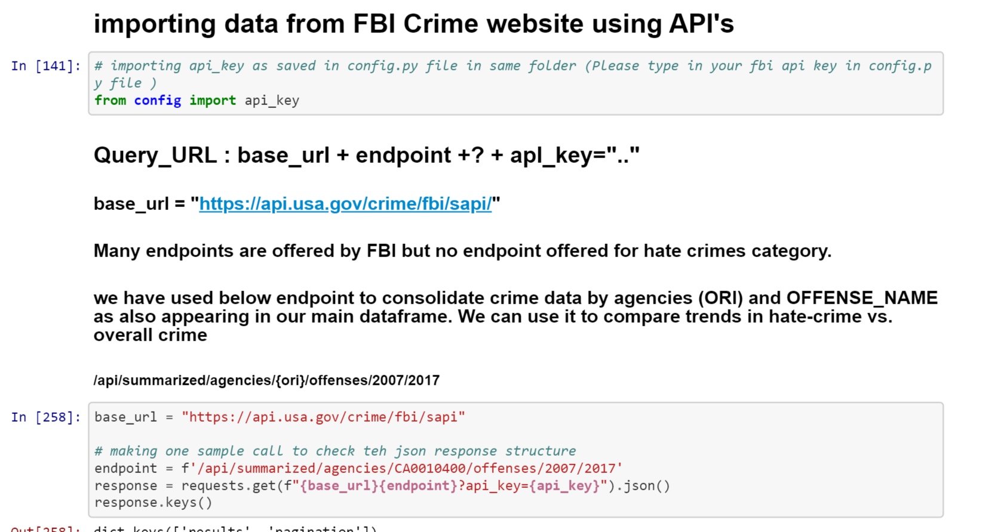

Slide 10
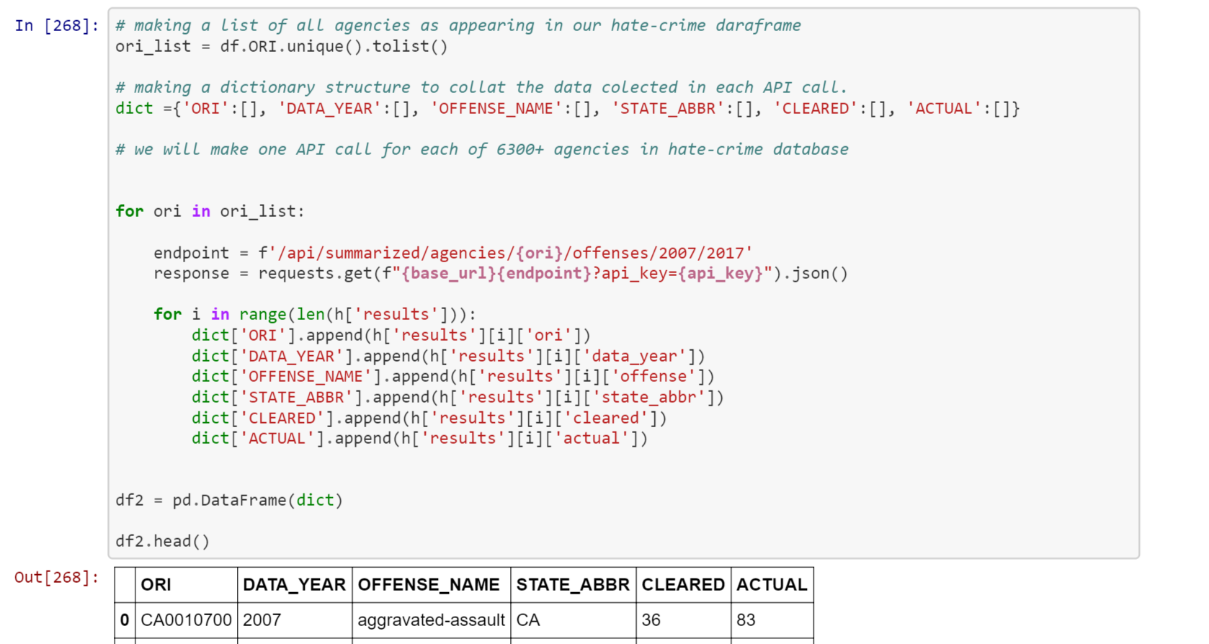

Slide 11
Question 1: What is the trend of hate crimes from 2007 – 2017? Examining demographics of perpetrators and victims
Presented by Shivam

Slide 12
*Need Shivam’s graphs

Slide 13
Question 2: What is the trend of offense types? Examining criminal offense types of hate crimes
Presented by Cristalle

Slide 14
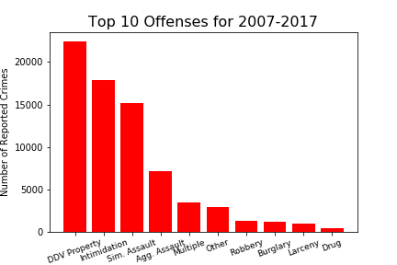
Looking at the Most Frequent Offense Types
Original dataset contained 47 unique offenses
Recoded the smallest categories into “Other”
Recoded records with more than one category as “Multiple”
The majority of hate crime involves damage/destruction of property, intimidation and assault.

Slide 15
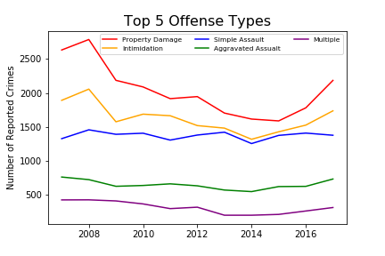
Examining the Top Five Offenses
Property damage is the largest overall and highest recent increase.
Four of the top five types saw an increase in 2017.
The top two offenses most closely mirror the overall numbers and drive the trend.
While simple assault saw a leveling off, aggravated assault rose (often includes weapons).

Slide 16
Question 3: Where are hate crimes most likely to occur? Looking at geographical locations and location types
Presented by Deepak

Slide 17
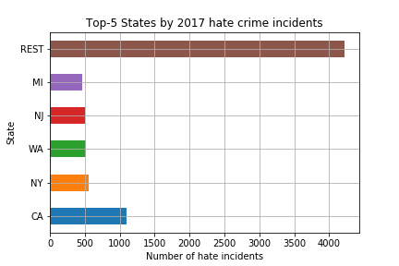
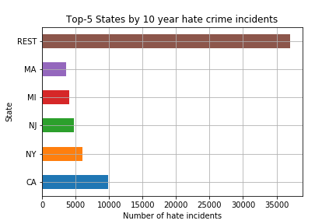
States with the Highest Number of Hate Crimes*
*Not adjusted for population size

Slide 18
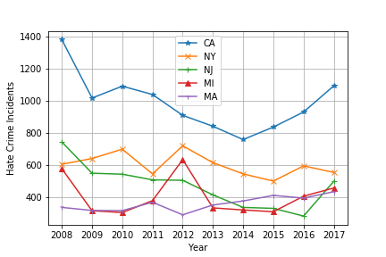
Hate Crime by Top States 2008-2017

Slide 19
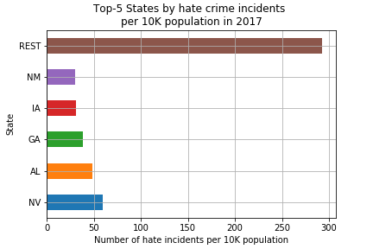
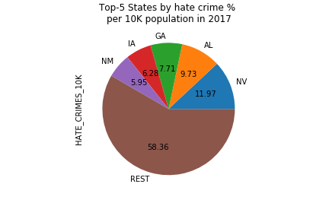
States with the Highest Number of Hate Crimes per 10,000 Population

Slide 20
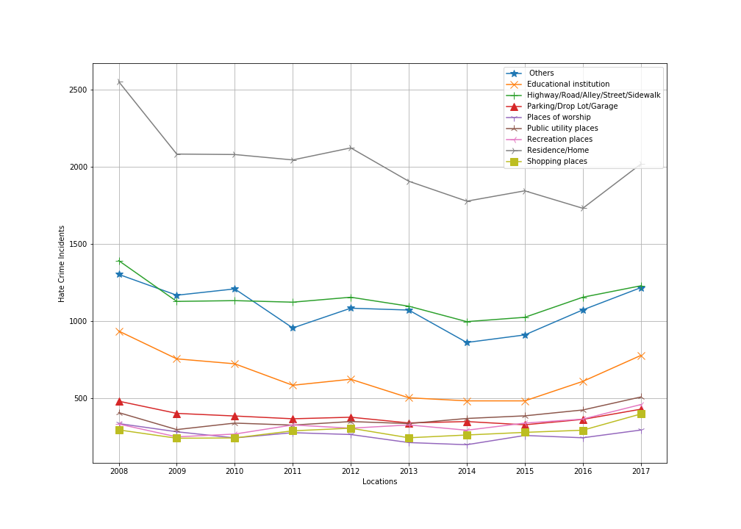
Where do Hate Crimes Occur? Hate Crimes by Location Type

Slide 21
Question 4: What is the fluctuation of hate crimes rates on a monthly basis?
Presented by Michael

Slide 22
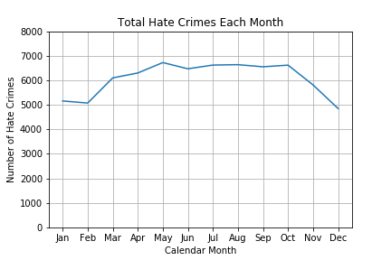
Seasonal Trends in Hate Crimes
Hate Crimes rise during the summer times and lower towards the end of the year
Hate Crimes occur in May more than any other month of the year
Hate Crimes are significantly lower during the holiday season (Nov - Feb)

Slide 23
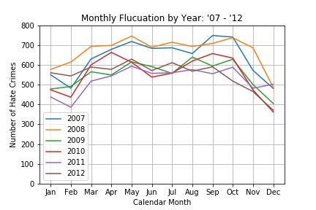
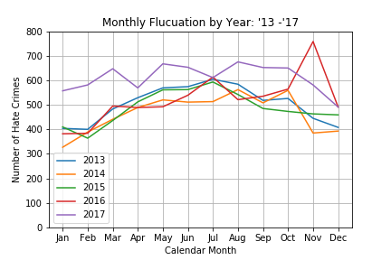
Monthly Changes Through 2007-2017
Hate Crimes saw an overall decrease across all months after 2007-2008
Hate Crimes saw their most significant monthly spike from Oct - Nov 2016

Slide 24
Findings Discussion
Do we need this?

Slide 25
Limitations & Thinking Forward
Under reporting by victims of crime is a common limitation in all crime data. Removing barriers to reporting is essential to capturing the real number of incidents.
Hate crime data is reported by thousands of law enforcement agencies using more than one tool (FBI reports that those using the Excel tool report significantly less than the integrated software using NIBRS (National Incident-Based Reporting System).
The FBI is pushing NIBRS compliance across the country by 2021 (currently 43%)

Slide 26
Resources & References
FBI most recent hate crime data: https://ucr.fbi.gov/hate-crime/2017
For information about crime reporting from the Bureau of Justice Statistics: https://www.bjs.gov/index.cfm?ty=dcdetail&iid=301
Details on NIBRS data collection and reporting (will become future standard): https://www.fbi.gov/services/cjis/ucr/nibrs
California 2017 Hate Crimes Report: https://openjustice.doj.ca.gov/resources/publications
California Preventing Hate Crimes Brochure: https://oag.ca.gov/sites/all/files/agweb/pdfs/civilrights/ENG_Preventing_Hate_Crimes_Brochure_PL_INT_ADA.pdf

Slide 27
Questions & Comments
Thank you!
Team Project 8 is made up of these number ninjas:
Deepak “The CS Sage” Gupta
Michael “The Visualization Wizard” Malig
Shivam “The Data Detective” Patel
Cristalle “The Social Scientist” Pronier

