Slide 1

Application Development and Hardware-Software Integration
Mid Evaluation : BTech. Project
Presented by:
Aaditya Deshpande (210003027)
Devansh Gupta(210003028)
Indian Institute of Technology Indore
Supervisor
Dr. Ankur miglani
Associate professor
Mechanical engineering department

Slide 2
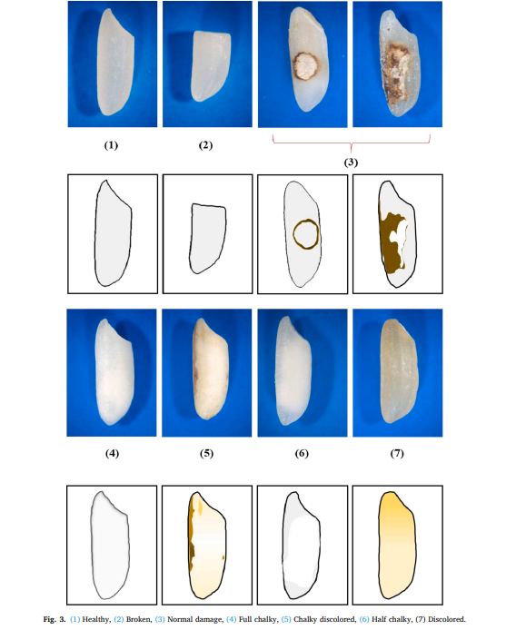
Introduction
Rice Adulteration
Classification of Damages
Leveraging Machine Learning
Accessibility to the common man
Fig 1: Classes of damages in rice grain
Notes:
Add photos of both machines

Slide 3
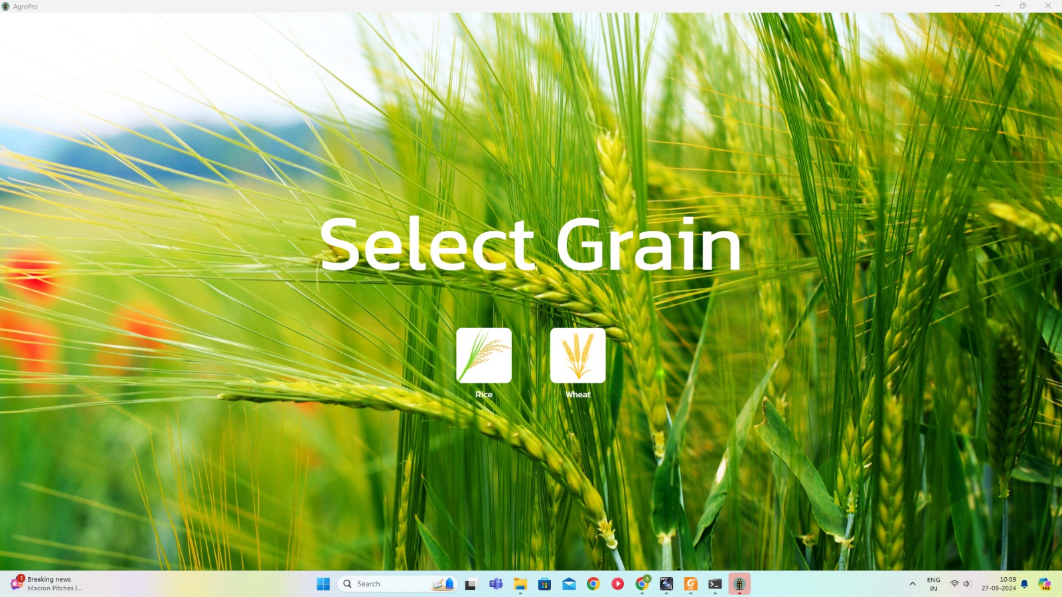
Objectives
To create an end-to-end Android application that can host the trained ML model for the classification of rice as Basmati or Non-Basmati.
To integrate the grain-pro software into the existing machine to classify the damage in the rice grain.
Fig 2: GrainPro software

Slide 4



Methodology
Classify rice as Basmati and Non-Basmati based on parameters provided by FSSAI.
Milled Basmati Rice should have
Length > 6.61mm
Breadth < 2.00mm
Aspect Ratio (Length/Breadth) >= 3.5
Android Studio and Kotlin.
Zero cloud / third-party dependency.
ML model in the Android application package.

Slide 5

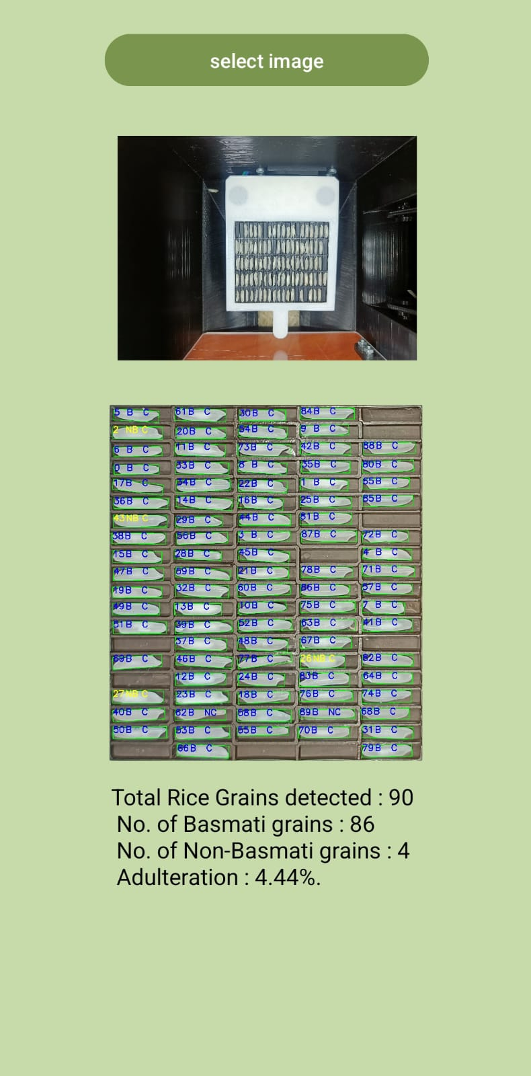
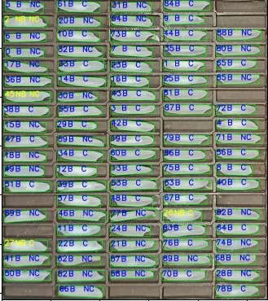
Current Progress
Android application development is completed.
Fig 3: Initial landing view to select the grid image
Fig 4: Output displayed
Fig 5: Processed image saved to the device
Notes:
Add ScreenShots of the app working

Slide 6
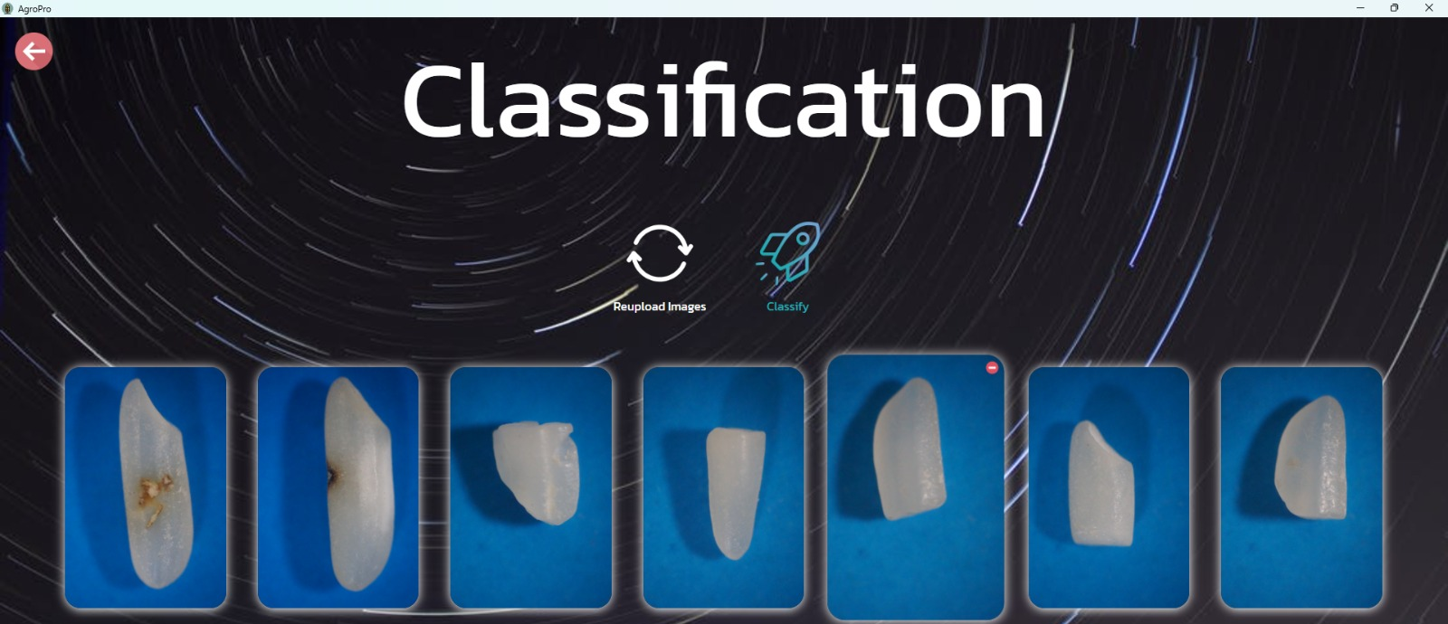
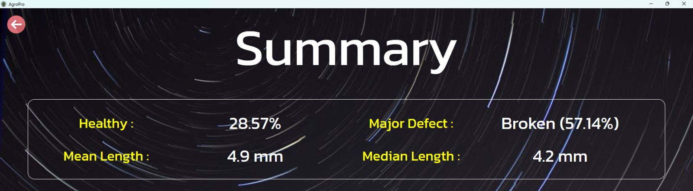
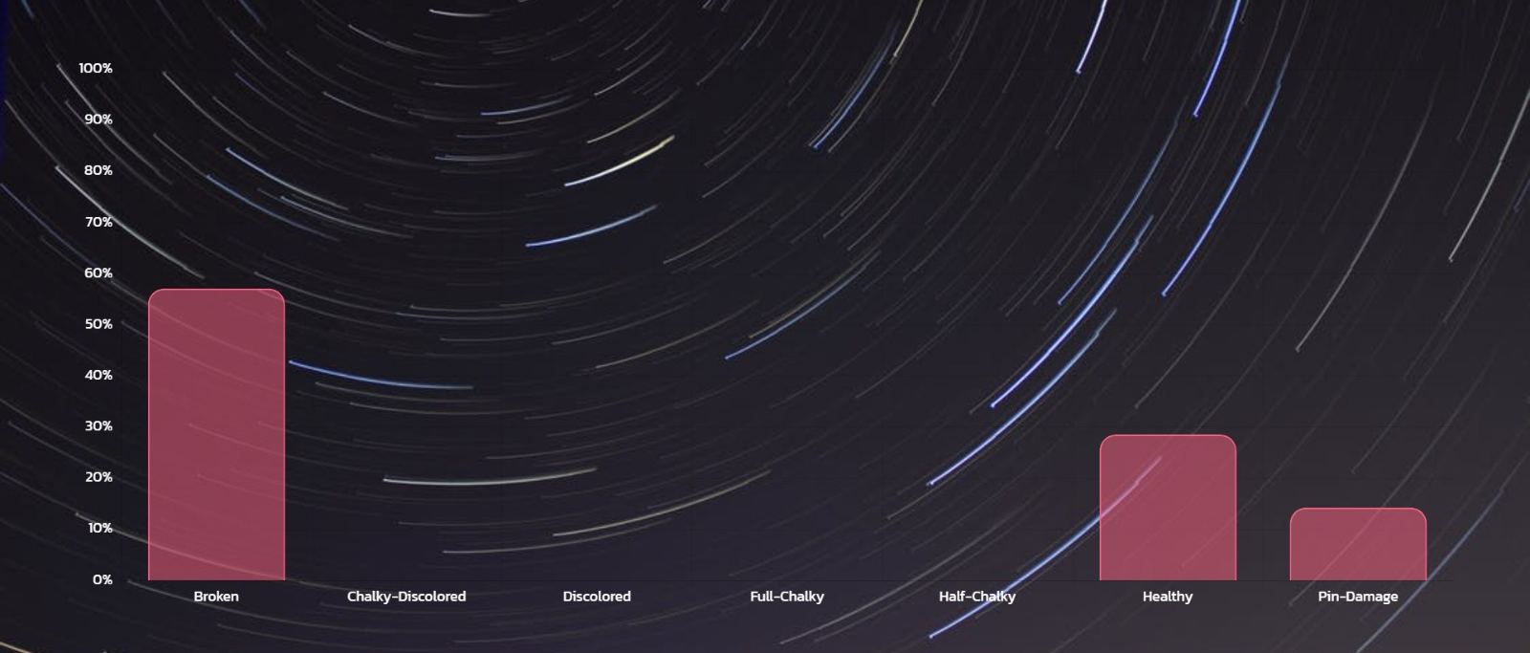
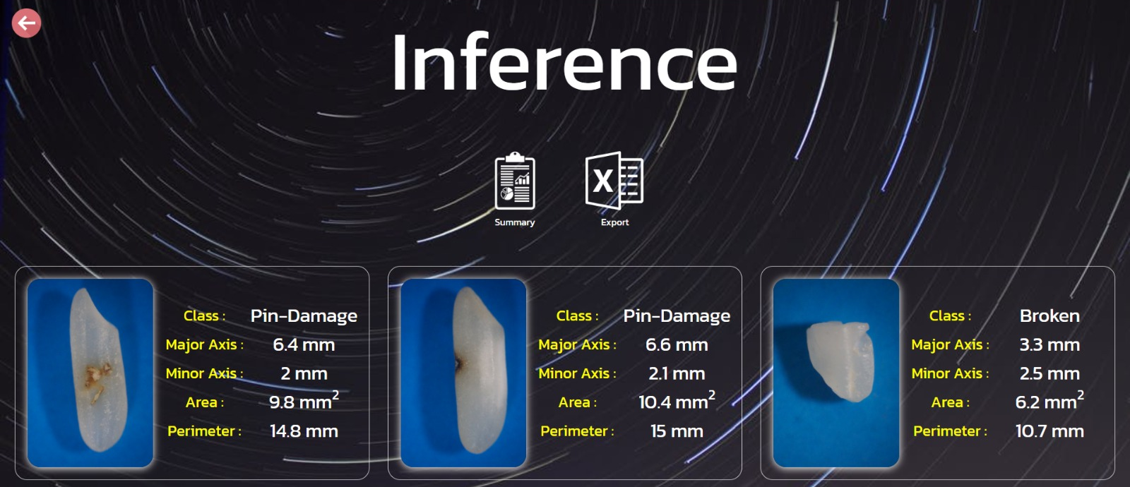
Future Work
Software integration for the Classification of damage.
Fig 6: Classification and inferencing with GrainPro
Fig 7: Summary of the Inferences

Slide 7
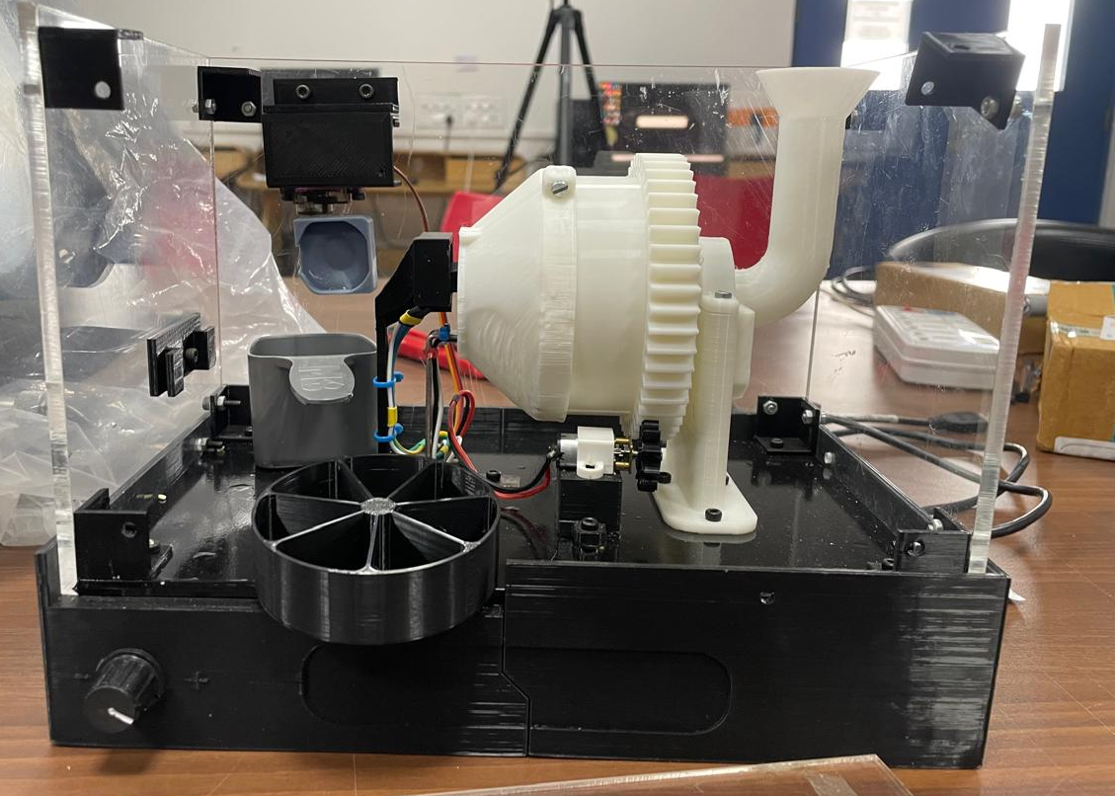
Future Work
Development of Closed Loop system.
Raspberry pi-camera system
Grain Pro Software
Arduino-motor system
Dispensing the grain into the right compartment
Random sample of Single rice grain
Fig 8: Random grain sampler and dispenser
Fig 9: Proposed closed loop system

Slide 8
Timeline
August 2024
Analysis of existing model and cloud based web- application
September 2024
ML model preparation and android application development
November 2024 Building a closed loop system, integrating GrainPro Software with Hardware.
October 2024 Publishing android application on Google Play Store Analysis of Grain Pro Software

Slide 9
References
https://amitdhavale.pythonanywhere.com/
https://github.com/ultralytics/ultralytics/tree/main
https://www.sciencedirect.com/science/article/pii/S0168169922001284
https://ai.google.dev/edge/litert/android
https://github.com/gupta-devansh/Grainpro-Android

Slide 10
THANK YOU!

