Slide 1
Lending Club Case Study
Group Members
1 – Palash Gupta(Group facilitator)
2 – Nithy

Slide 2
Problem Statement
Like most other lending companies, lending loans to ‘risky’ applicants is the largest source of financial loss (called credit loss). Credit loss is the amount of money lost by the lender when the borrower refuses to pay or runs away with the money owed. In other words, borrowers who default cause the largest amount of loss to the lenders. In this case, the customers labelled as 'charged-off' are the 'defaulters'.

Slide 3
Analysis Approach
If one is able to identify these risky loan applicants, then bad loans can be reduced thereby cutting down the amount of credit loss. Identification of such applicants using EDA is the aim of this case study.

Slide 4
Dataset Used
The loan dataset contains the complete loan data for all loans issued through the time period 2007 to 2011.

Slide 5
Conclusions from Univariate Analysis of Numerical Columns

Slide 6
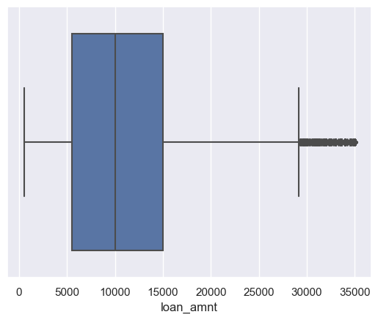
Conclusion 1
Most of the loan amount lies in range of 5000-15000

Slide 7
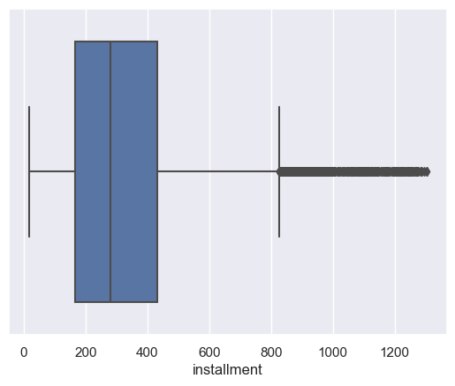
Conclusion 2
Installments lies in the range of 200-420

Slide 8
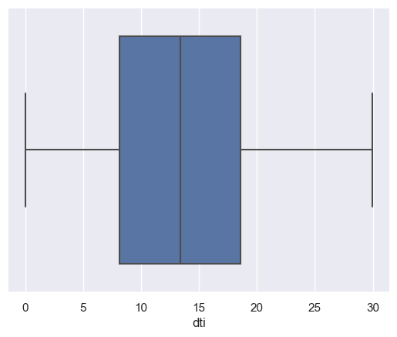
Conclusion 3
DTI lies in the range of 8-19.

Slide 9
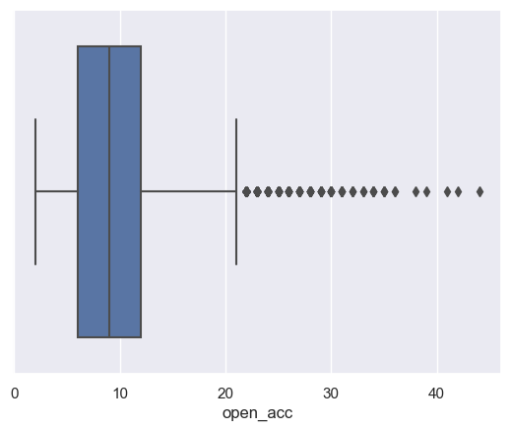
Conclusion 4
open_acc lies in range of 6-12.

Slide 10
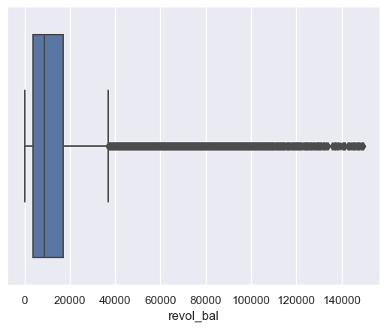
Conclusion 5
Revol_bal lies in the range of 2000-19000.

Slide 11
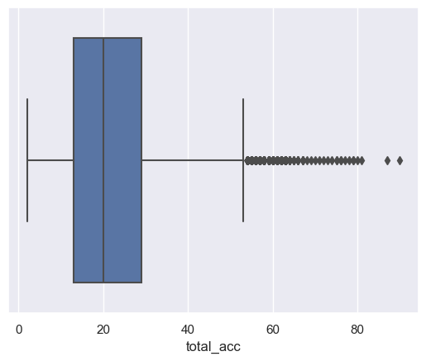
Conclusion 6
total_acc lies in the range of 15-28.

Slide 12
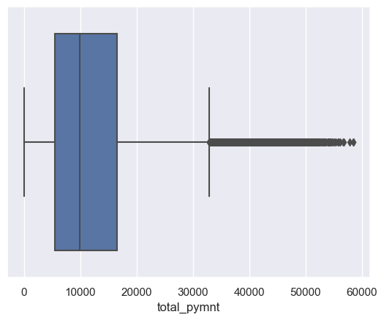
Conclusion 7
total_payment lies in the range of 7000-18000.

Slide 13
Conclusions from Univariate Analysis of Categorical columns

Slide 14
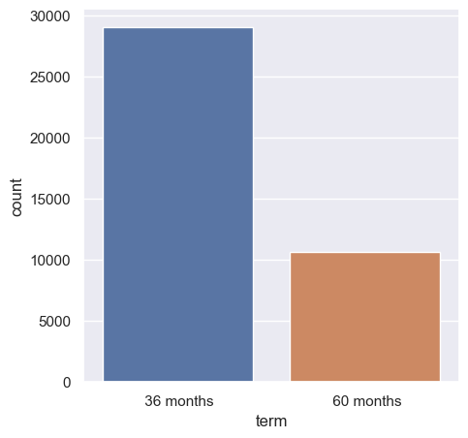
Conclusion 1
Most number of loans are taken for a tenure of 36 months.

Slide 15
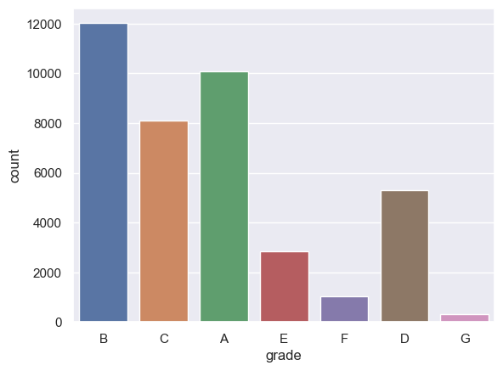
Conclusion 2
Persons belonging to grade B takes the most number of loans and person belonging to grade G take least number of loans

