Slide 1


Database Processing CS 451 / 551
Lecture 9:
Query Processing I
Suyash Gupta
Assistant Professor
Distopia Labs and ORNG
Dept. of Computer Science
(E) suyash@uoregon.edu
(W) gupta-suyash.github.io

Slide 2
Assignment 1 is Out! Deadline: Oct 29, 2024 at 11:59pm Midterm: Oct 31, 2024 (in class)

Slide 3
Sample Midterm Questions
Q1. Is column-store ever a better model than PAX?
Column-store is always better.
PAX is always better.
Column-store is better when 90% of the queries are OLAP.
Column-store is better when 90% of the queries are OLTP.

Slide 4
Sample Midterm Questions
Q1. Is column-store ever a better model than PAX?
Column-store is always better.
PAX is always better.
Column-store is better when 90% of the queries are OLAP.
Column-store is better when 90% of the queries are OLTP.

Slide 5
Sample Midterm Questions
Q2. Adam decides to build a two-level hierarchical index where level 1 is a sparse index and level 2 is a B+-tree. Adam makes the following statements about his design:
Level 1 as sparse index can reside fully in memory.
Level 2 supports O(log N) search.
Keys in the sparse index map to the B+-tree, which helps in efficient traversal of the tree.
His design offers better lookup complexity than O(log N).
Which of the statements are false?
2+3+4 (b) 3+4 (c) 1+4 (d) 1+2+4

Slide 6
Sample Midterm Questions
Q2. Adam decides to build a two-level hierarchical index where level 1 is a sparse index and level 2 is a B+-tree. Adam makes the following statements about his design:
Level 1 as sparse index can reside fully in memory.
Level 2 supports O(log N) search.
Keys in the sparse index map to the B+-tree, which helps in efficient traversal of the tree.
His design offers better lookup complexity than O(log N).
Which of the statements are false?
2+3+4 (b) 3+4 (c) 1+4 (d) 1+2+4

Slide 7
Query Processing

Slide 8
What is meant by Query Processing
Any activity that is related to extracting data from the database.

Slide 9
What is meant by Query Processing
Any activity that is related to extracting data from the database.
We can sub-divide query processing into three tasks:
Parsing and translation.
Optimization.
Evaluation.

Slide 10
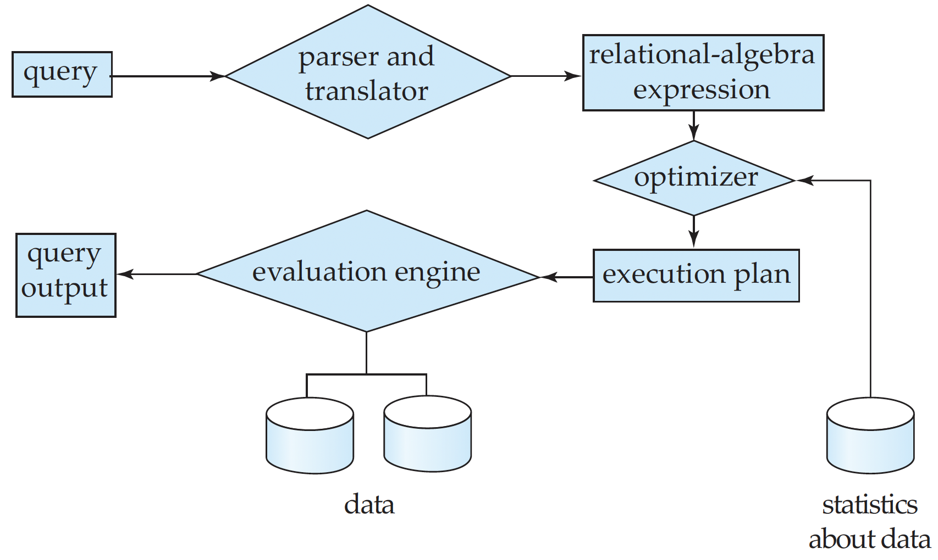
What is meant by Query Processing
*Diagram from Database Systems Concepts book.

Slide 11
Parser
Parsing helps to translate the query into a usable form.

Slide 12
Parser
Parsing helps to translate the query into a usable form.
SQL is suitable for human to write queries, but not suited for system’s internal representation of a query.

Slide 13
Parser
Parsing helps to translate the query into a usable form.
SQL is suitable for human to write queries, but not suited for system’s internal representation of a query.
Relational algebra is a more suited representation.

Slide 14
Parser
Parsing helps to translate the query into a usable form.
SQL is suitable for human to write queries, but not suited for system’s internal representation of a query.
Relational algebra is a more suited representation.
So, the first step for the system, on receiving a query is to translate it into an understandable format.

Slide 15
Parser
Does this remind you of some other component that you have used/heard?

Slide 16
Parser
Does this remind you of some other component that you have used/heard?
Compilers!
A compiler also includes a parser to parse your programs.

Slide 17
Parser
Does this remind you of some other component that you have used/heard?
Compilers!
A compiler also includes a parser to parse your programs.
To generate an understandable format, query parser needs to:
Check the syntax of the user’s query.
Verify that the relation names appearing in the query are names of the relations in the database, and
Many more tasks…
Post this, the system constructs a parse-tree representation of the query.

Slide 18
Parser
We are not covering parsing as it is part of standard compilers course!

Slide 19
What are the challenges with Parsing a Query

Slide 20
What are the challenges with Parsing a Query
Say, we have the following query:
select salary from instructor where salary < 75000;
What is the relational algebra translation for this query?

Slide 21
What are the challenges with Parsing a Query
Say, we have the following query:
select salary from instructor where salary < 75000;
What is the relational algebra translation for this query?
𝝈_{salary<7500} (π_{salary} (instructor));

Slide 22
What are the challenges with Parsing a Query
Say, we have the following query:
select salary from instructor where salary < 75000;
What is the relational algebra translation for this query?
𝝈_{salary<7500} (π_{salary} (instructor)); Can there be another translation?

Slide 23
What are the challenges with Parsing a Query
Say, we have the following query:
select salary from instructor where salary < 75000;
What is the relational algebra translation for this query?
𝝈_{salary<7500} (π_{salary} (instructor)); Can there be another translation?
π_{salary} (𝝈_{salary<7500} (instructor));

Slide 24
Query Evaluation
You have the parsed query in a relational algebra format, so what next?

Slide 25
Query Evaluation
You have the parsed query in a relational algebra format, so what next?
You need to evaluate the query (compute the result of the query).

Slide 26
What are the challenges with Evaluating a Query

Slide 27
What are the challenges with Evaluating a Query
Say, we selected the following relational algebra translation for the earlir query.
𝝈_{salary<7500} (π_{salary} (instructor));
How will execute this query?

Slide 28
What are the challenges with Evaluating a Query
Say, we selected the following relational algebra translation for the earlir query.
𝝈_{salary<7500} (p_{salary} (instructor));
How will execute this query?
Search every tuple in instructor to find tuples with salary less than 75000.

Slide 29
What are the challenges with Evaluating a Query
Say, we selected the following relational algebra translation for the earlir query.
𝝈_{salary<7500} (p_{salary} (instructor));
How will execute this query?
Search every tuple in instructor to find tuples with salary less than 75000.
Say you have a B⁺-tree index on salary, we can use that index to locate the tuples.

Slide 30
Evaluation Plan
Query translation should specify two things:
The corresponding relational-algebra expression
Annotate it with instructions stating how to evaluate each operation.
Annotations can state the algorithm to be used, or one or more indices to use.

Slide 31
Evaluation Plan
Query translation should specify two things:
The corresponding relational-algebra expression
Annotate it with instructions stating how to evaluate each operation.
Annotations can state the algorithm to be used, or one or more indices to use.
Evaluation Primitive:
A relational algebra operation annotated with instructions on how to evaluate it.
Query-Execution plan:
A sequence of primitive operations that help to evaluate a query.

Slide 32
A simple query Evaluation Plan
π_{salary}
𝝈_{salary<7500 ;} use index 1
instructor;
→ Here, index 1 could be an index on salary; internally numbered as 1.

Slide 33
Cost Optimization
Different evaluation plans for a given query can have different costs.

Slide 34
Cost Optimization
Different evaluation plans for a given query can have different costs.
You cannot expect users to write queries in a way that it results in the most efficient evaluation plan.
Responsibility of the DBMS to construct a query evaluation plan that minimizes the cost of query evaluation.
This task is called as query optimization.

Slide 35
How to Measure cost of a Query?
Recall that the cost to access data from disk is the most expensive as disk accesses are slow compared to in-memory operations.
Cost of Query Evaluation plan =
Number of block transfers from disk + Number of disk seeks.
Say;
D → Time to transfer a block from disk.
A → Block access time (Seek time + Rotational Latency)
To transfer b blocks and perform s disk seeks would take = b*D + s*A

Slide 36
How to Measure cost of a Query?
Several other factors also contribute to query cost:
Writes are twice expensive as reads. Why?

Slide 37
How to Measure cost of a Query?
Several other factors also contribute to query cost:
Writes are twice expensive as reads. Why?
Because disk systems read sectors back after they are written to verify that the write was successful.

Slide 38
How to Measure cost of a Query?
Several other factors also contribute to query cost:
Writes are twice expensive as reads. Why?
Because disk systems read sectors back after they are written to verify that the write was successful.
You may have to even estimate the cost of writing the final result of an operation back to the disk.

Slide 39
Scans and Searching
We will now spend time on estimating the cost of search and scans.
What are the important factors to consider when estimating the cost of a search or scan?

Slide 40
Scans and Searching
We will now spend time on estimating the cost of search and scans.
What are the important factors to consider when estimating the cost of a search or scan?
Is the search on a primary key?
Is the search equal to primary key?
Do you have access to indexes on primary key?
Do you have access to secondary indexes?

Slide 41
File Scans: Linear Search
Let’s assume we have a query like the following:
select * from instructors;
This is going to scan over all the records in the table.
A query similar to scan is where you have to search a key and you do not have any index → You are forced to perform linear search.
So, what do you think is the cost of this query?

Slide 42
File Scans: Linear Search
Given,
D → Time to transfer a block from disk.
A → Block access time (Seek time + Rotational Latency)
Say, you have to transfer b blocks.
What is the cost of linear search or scan?

Slide 43
File Scans: Linear Search
Given,
D → Time to transfer a block from disk.
A → Block access time (Seek time + Rotational Latency)
Say, you have to transfer b blocks.
What is the cost of linear search or scan?
A + b * D
One initial seek (A) to reach the correct block/sector.
Then, transferring b blocks.

Slide 44
Equality Search on Primary Key
Let’s assume we have a query like the following:
select * from instructors where id = 10;
The difference between this query and the previous query is that this query wants us to search a specific record.
Further, assume that the attribute “id” is the primary key.
And, suppose we have a B⁺-tree index built over the attribute “id”.

Slide 45
Equality Search on Primary Key
Let’s assume we have a query like the following:
select * from instructors where id = 10;
The difference between this query and the previous query is that this query wants us to search a specific record.
Further, assume that the attribute “id” is the primary key.
And, suppose we have a B⁺-tree index built over the attribute “id”.
So, what do you think is the cost of this query?

Slide 46
Equality Search on Primary Key
Let’s assume the height of the tree total levels from root to leaf) = h.
Given,
D → Time to transfer a block from disk.
A → Block access time (Seek time + Rotational Latency)
What is the cost of Equality Search on Primary Key?

Slide 47
Equality Search on Primary Key
Let’s assume the height of the tree total levels from root to leaf) = h.
Given,
D → Time to transfer a block from disk.
A → Block access time (Seek time + Rotational Latency)
What is the cost of Equality Search on Primary Key?
(h+1) * (A + D)
Why this?

Slide 48
Equality Search on Primary Key
These are worst-case cost estimates and the assumption is that the B⁺-tree is large and cannot be stored in-memory.
So, every node in the B⁺-tree has to be fetched from the disk.

Slide 49
Equality Search on Primary Key
These are worst-case cost estimates and the assumption is that the B⁺-tree is large and cannot be stored in-memory.
So, every node in the B⁺-tree has to be fetched from the disk.
All the keys in a B⁺-tree are at the leaf nodes. So,
First, you need to traverse all the way to leaf node.
During this traversal, you will access B⁺-tree nodes to determine which path to take.
Fetching each of these nodes is a disk access and requires seek time.
And, then once you reach the desired node, you need to also fetch the actual record.

Slide 50
Equality Search on Primary Key
 | 13
Root
 | 6 |  | 8
 | 25
Internal nodes
 | 3 |  | 5
 | 6
 | 8 |  | 12
 | 13 |  | 20
 | 25
Leaf nodes
3 | Joffrey | 18 | 600
5 | Voldemort | 70 | 400
6 | Scarecrow | 30 | 150
8 | Anakin | 20 | 200
12 | Kang | 20 | 500
13 | Gru | 45 | 100
20 | Thanos | 100 | 400
25 | Joker | 66 | 200
File

Slide 51
Equality Search on Non-Key
Let’s assume we have a query like the following:
select * from instructors where age = 45;
The difference between this query and the previous query is that this query wants us to search a specific record on a non-key.
Here, the attribute “age” is not the primary key.
So, what is the challenge with estimating the cost of this query?

Slide 52
Equality Search on Non-Key
B⁺-tree index is built over the primary key attribute.
For non-key attributes, we do not have an available index.
So, we need to fetch multiple records and blocks as the index is not much useful.

Slide 53
Equality Search on Non-Key
Let’s assume the height of the tree total levels from root to leaf) = h.
Given,
D → Time to transfer a block from disk.
A → Block access time (Seek time + Rotational Latency)
b → Number of blocks to fetch
What is the cost of Equality Search on Non-Key?

Slide 54
Equality Search on Non-Key
Let’s assume the height of the tree total levels from root to leaf) = h.
Given,
D → Time to transfer a block from disk.
A → Block access time (Seek time + Rotational Latency)
b → Number of blocks to fetch
What is the cost of Equality Search on Non-Key?
(h+1) * (A+D) + b * D

Slide 55
Equality Search on Non-Key
(h+1) * (A+D) + b * D
Most of the equation looks same, but Why b*D?

Slide 56
Equality Search on Non-Key
(h+1) * (A+D) + b * D
Most of the equation looks same, but Why b*D?
Because, we do not know which block the data that we want resides, so we need to access multiple blocks till we find the one.
The good thing is as all blocks are stored contiguously, so no extra seek time!

Slide 57
Equality Search on Secondary Key
Let’s assume we have a query like the following:
select * from instructors where age = 45;
But, now assume we have a second index on the attribute “age”.
Further, assume that our secondary index is also a B⁺-tree.
So, what is cost of this query?

Slide 58
Equality Search on Secondary Key
Let’s assume the height of the tree total levels from root to leaf) = h.
Given,
D → Time to transfer a block from disk.
A → Block access time (Seek time + Rotational Latency)
What is the cost of Equality Search on Secondary Key?
(h+1) * (A + D)
Why is this same as Equality Search on Primary Key?

Slide 59
Equality Search on Secondary Key
The cost is same as equality on primary key because we have a B⁺-tree and we are doing an exact match!
No extra blocks accessed.

Slide 60
Equality Search on Secondary Non-Key
Let’s assume we have a query like the following:
select * from instructors where salary = 10000;
But, now assume that we have a
Primary index on “Id”.
Secondary index on “age”.
But, no index for “salary”.
So, what is cost of this query?

Slide 61
Equality Search on Secondary Non-Key
Let’s assume the height of the tree total levels from root to leaf) = h.
Given,
D → Time to transfer a block from disk.
A → Block access time (Seek time + Rotational Latency)
n → Number of records to fetch
What is the cost of Equality Search on Non-Key?
(h+n) * (A+D)
Why “n”?

Slide 62
Equality Search on Secondary Non-Key
Recall that data on the disk is stored sequentially according to the primary index.
If you are going to access the data according to the primary index, you will incur seek cost only once.

Slide 63
Equality Search on Secondary Non-Key
Recall that data on the disk is stored sequentially according to the primary index.
If you are going to access the data according to the primary index, you will incur seek cost only once.
When you search with the help of a secondary index, you lose the benefit of sequential data access.

Slide 64
Equality Search on Secondary Non-Key
Recall that data on the disk is stored sequentially according to the primary index.
If you are going to access the data according to the primary index, you will incur seek cost only once.
When you search with the help of a secondary index, you lose the benefit of sequential data access.
As you are searching on a secondary non-key, something for which index does not exist, then you will be fetching random blocks → seek cost.

Slide 65
Comparative Search on Primary Key
Let’s assume we have the following queries:
select * from instructors where id < 10;
select * from instructors where id <= 10;
For these queries, we need to decide whether we want to use a B+-tree index or linear scan.
Why do we need to decide?

Slide 66
Comparative Search on Primary Key
Let’s assume we have the following queries:
select * from instructors where id < 10;
select * from instructors where id <= 10;
For these queries, we need to decide whether we want to use a B⁺-tree index or linear scan.
Why do we need to decide?

Slide 67
Comparative Search on Primary Key
Let’s assume we have the following queries:
select * from instructors where id < 10;
select * from instructors where id <= 10;
For these queries, we need to decide whether we want to use a B⁺-tree index or linear scan.
Why do we need to decide?
Because linear scan will often result in cheaper estimate as we have to get all the values less or less than equal to the primary key.

Slide 68
Comparative Search on Primary Key
Let’s assume we have the following queries:
select * from instructors where id > 10;
select * from instructors where id >= 10;
For these queries, we will make use of a B+-tree index , followed by a file scan.
Why do we need to decide?

Slide 69
Comparative Search on Primary Key
Let’s assume we have the following queries:
select * from instructors where id > 10;
select * from instructors where id >= 10;
For these queries, we will make use of a B+-tree index, followed by a file scan.
Why do we need to decide?
Because the last record to access is the end of the file.
What is the cost?

Slide 70
Comparative Search on Primary Key
Cost same as equality on non-key.
Let’s assume the height of the tree total levels from root to leaf) = h.
Given,
D → Time to transfer a block from disk.
A → Block access time (Seek time + Rotational Latency)
b → Number of blocks to fetch
What is the cost of Equality Search on Non-Key?
(h+1) * (A+D) + b * D

