Slide 1


Introduction to Databases CS 451 / 551
Lecture 6:
Hashing
Suyash Gupta
Assistant Professor
Distopia Labs and ORNG
Dept. of Computer Science
(E) suyash@uoregon.edu
(W) gupta-suyash.github.io

Slide 2
Assignment 1 is Out! Deadline: Oct 29, 2024 at 11:59pm Start collaborating with your groups! Midterm: Oct 31, 2024 (in class)

Slide 3
Unordered Indexing
Until now, we studied ordered indexes, such as clustered indexes and trees.
Next, we will look at unordered indexes → Hash indexes.

Slide 4
Hashing
Three key components of a hash index:
A hash table, which stores all the keys.
A function that helps to map the key to hash table.
An hashing algorithm
x
h(x)
A key
A function that maps a key
Hash Table

Slide 5
Types of Hashing
Two types of hashing schemes:
Static Hashing → Size of hash map is fixed; cannot be increased.
Dynamic Hashing → Size of hash map can increase as needed.
Essentially as your databases increases over time, you can accommodate more data.

Slide 6
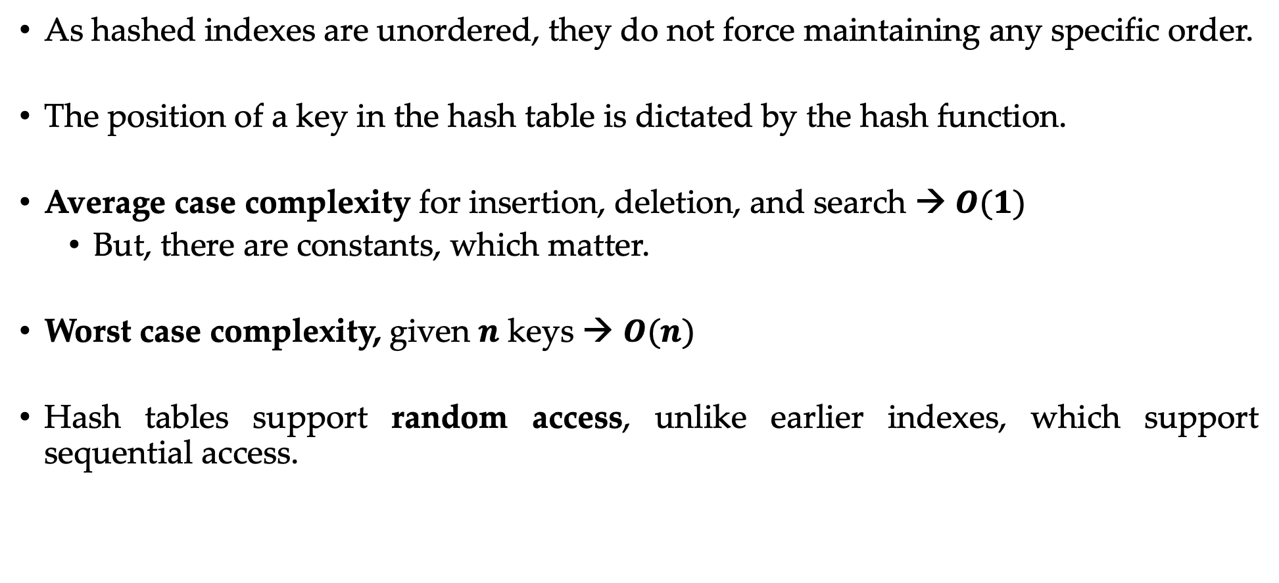
Complexity of Hashing
As hashed indexes are unordered, they do not force maintaining any specific order.
The position of a key in the hash table is dictated by the hash function.
Average case complexity for insertion, deletion, and search → $O(1)$
But, there are constants, which matter.
Worst case complexity, given $n$ keys → $O(n)$
Hash tables support random access, unlike earlier indexes, which support sequential access.

Slide 7
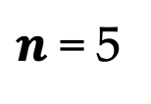

Static Hashing
Say, we know that in our database there will be 5 records.
So, we select a hash function and create a hash table (array) of size 5.
Hash Table
File Storage
13 | Gru | 45 | 100
0
1
2
3
4
13 | Gru | 45 | 100
$$h\left(x\right)=key \% n=\left(13\right)\% n$$
$n$ = 5

Slide 8

Static Hashing
Say, we know in our database there will be 5 records.
So, we select a hash function and create a hash table (array) of size 5.
Hash Table
File Storage
4 | Voldemort | 70 | 400
0
1
2
3
4
13 | Gru | 45 | 100
4 | Voldemort | 70 | 400
$$\left(4\right)\% n$$
$n$ = 5

Slide 9
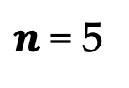

Static Hashing
Say, we know in our database there will be 5 records.
So, we select a hash function and create a hash table (array) of size 5.
Hash Table
File Storage
20 | Thanos | 100 | 400
0
1
2
3
4
13 | Gru | 45 | 100
4 | Voldemort | 70 | 400
20 | Thanos | 100 | 400
$$\left(20\right)\% n$$
$n$ = 5

Slide 10
Challenges for Static Hashing
Fixed number of Keys
Duplicate Keys
Collisions
Disk Access Cost

Slide 11
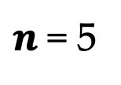
Challenges for Static Hashing
Fixed number of Keys → You should know the total size of the database in the future, and it cannot grow any further!
For example, this hash table can only store 5 keys and if in the future your database gets a 6th record, you need to reorganize → change hash table → too expensive!
Hash Table
0
1
2
3
4
$n$ = 5

Slide 12

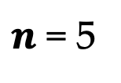
Challenges for Static Hashing
Unique Keys → How to store and search for duplicate keys?
Hash function would map duplicate keys to the same location.
Overwrite pointer to existing record?
How do you search for an existing record with duplicate keys?
File Storage
20 | Scarecrow | 30 | 200
0
1
2
3
4
13 | Gru | 45 | 100
4 | Voldemort | 70 | 400
20 | Thanos | 100 | 400
$$\left(20\right)\% n$$
$n$ = 5

Slide 13

Challenges for Static Hashing
No Collisions → Perfect hashing function that ensures there are no collisions.
Hash function may end up assigning the same location to two or more records.
File Storage
5 | Jeoffrey | 18 | 600
0
1
2
3
4
13 | Gru | 45 | 100
4 | Voldemort | 70 | 400
20 | Thanos | 100 | 400
$$\left(5\right)\% n$$
$n$ = 5

Slide 14
Challenges for Static Hashing
Disk Access Cost and Lack of opportunities for Pre-fetching.
Fetching a single record (point query) is fast. But, say I want to fetch a range of records. These records could be spread across the disk → multiple blocks!
No longer sequential access. Moreover, File Manager cannot even predict!

Slide 15
Design Decisions for Static Hashing
Good Hash Function:
Maps a large set of keys to a small array.
Dilemma b/w using a fast hash function vs. a hash function with low collisions.
Hashing Algorithm:
How to handle key collisions when they occur?
Dilemma b/w allocating a large table to prevent collisions vs. setting up rules that allow storing duplicate and colliding keys!

Slide 16
Hash Functions
Given an input key, it return an integer representation of that key.
Essentially, you can use hash function to convert an arbitrary byte array into a fixed-length code.
We want a hash function that is both fast and has a low collision rate.
Notice that we are allowing collisions as we desire fast hashing!
Alternatively, you can use a cryptographic hash function, like SHA256.
No collisions!
Extremely secure → NIST recommended
Extremely slow!

Slide 17
Hash Functions
Fortunately, we don’t have to create a hash functions!
CRC-64 (1975)
Used in networks for error detection
MurmurHash (2008)
Fast, general-purpose hash function.
Google CityHash (2011)
Fast for keys of short length.
Facebook XXHash (2012)
State-of-the-art
Google FarmHash (2014)
Better version of CityHash; reduced collisions

Slide 18
Hash Schemes Performance
If you want to test the performance of various hash functions, or play with different hash functions, check out SMHasher.

Slide 19
Static Hashing Algorithms
We will be looking at two common algorithms:
Linear Probe Hashing
Cuckoo Hashing
These algorithms are also termed as open addressing:
Essentially, the key may not be in the location where the hash function points.
More advanced algorithms (not part of this course)
Robinhood hashing
Hopscotch hashing
Swiss Tables

Slide 20
Linear Probe Hashing
Simplest hashing algorithm → resolves collision by searching for next empty slot.
Requires a fixed-size giant array (smaller the size, more collisions).
Hash table’s load factor (like a threshold) determines when the table is too full.
No new key should be added, otherwise collisions → allocate new table!
Inserting a key:
Use your hash function to find a slot (position).
If the location is empty, store the key in that slot.
Otherwise, start sequential scanning from that location.
When you find an empty slot, insert your key in that slot.
Deletion and Search:
Same as insertion.

Slide 21
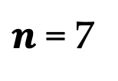

Linear Probe Hashing
Hash Table
File Storage
0
1
2
3
4
5
6
$$h\left(key\right)\% 7$$
$n$ = 7

Slide 22


Linear Probe Hashing
Hash Table
File Storage
10 | Gru | 45 | 100
0
1
2
3
4
5
6
10
10 | Gru | 45 | 100
$$\left(10\right)\% 7$$
$n$ = 7

Slide 23


Linear Probe Hashing
Hash Table
File Storage
7 | Voldemort | 70 | 400
0
1
2
3
4
5
6
7
10
10 | Gru | 45 | 100
7 | Voldemort | 70 | 400
$$\left(7\right)\% 7$$
$n$ = 7

Slide 24


Linear Probe Hashing
Hash Table
File Storage
17 | Anakin | 45 | 300
0
1
2
3
4
5
6
7
10
10 | Gru | 45 | 100
7 | Voldemort | 70 | 400
$$\left(17\right)\% 7$$
$n$ = 7

Slide 25

Linear Probe Hashing
Hash Table
File Storage
17 | Anakin | 45 | 300
0
1
2
3
4
5
6
7
10
10 | Gru | 45 | 100
7 | Voldemort | 70 | 400
$$\left(17\right)\% 7$$
$n$ = 7

Slide 26

Linear Probe Hashing
Hash Table
File Storage
17 | Anakin | 45 | 300
0
1
2
3
4
5
6
7
10
17
10 | Gru | 45 | 100
7 | Voldemort | 70 | 400
17 | Anakin | 45 | 300
$$\left(17\right)\% 7$$
$n$ = 7

Slide 27

Linear Probe Hashing
Hash Table
File Storage
24 | Joker | 60 | 300
0
1
2
3
4
5
6
7
10
17
10 | Gru | 45 | 100
7 | Voldemort | 70 | 400
17 | Anakin | 45 | 300
$$\left(24\right)\% 7$$
$n$ = 7

Slide 28
Linear Probe Hashing
Hash Table
File Storage
24 | Joker | 60 | 300
0
1
2
3
4
5
6
7
10
17
10 | Gru | 45 | 100
7 | Voldemort | 70 | 400
17 | Anakin | 45 | 300
$$\left(24\right)\% 7$$
$n$ = 7

Slide 29
Linear Probe Hashing
Hash Table
File Storage
24 | Joker | 60 | 300
0
1
2
3
4
5
6
7
10
17
10 | Gru | 45 | 100
7 | Voldemort | 70 | 400
17 | Anakin | 45 | 300
$$\left(24\right)\% 7$$
$n$ = 7

Slide 30

Linear Probe Hashing
Hash Table
File Storage
24 | Joker | 60 | 300
0
1
2
3
4
5
6
7
10
17
24
10 | Gru | 45 | 100
7 | Voldemort | 70 | 400
17 | Anakin | 45 | 300
24 | Joker | 60 | 300
$$\left(24\right)\% 7$$
$n$ = 7

Slide 31


Linear Probe Hashing
Hash Table
File Storage
5 | Thanos | 100 | 500
0
1
2
3
4
5
6
7
10
17
24
10 | Gru | 45 | 100
7 | Voldemort | 70 | 400
17 | Anakin | 45 | 300
24 | Joker | 60 | 300
$$\left(5\right)\% 7$$
$n$ = 7

Slide 32

Linear Probe Hashing
Hash Table
File Storage
5 | Thanos | 100 | 500
0
1
2
3
4
5
6
7
10
17
24
10 | Gru | 45 | 100
7 | Voldemort | 70 | 400
17 | Anakin | 45 | 300
24 | Joker | 60 | 300
$$\left(5\right)\% 7$$
$n$ = 7

Slide 33


Linear Probe Hashing
Hash Table
File Storage
5 | Thanos | 100 | 500
0
1
2
3
4
5
6
7
10
17
24
5
10 | Gru | 45 | 100
7 | Voldemort | 70 | 400
17 | Anakin | 45 | 300
24 | Joker | 60 | 300
5 | Thanos | 100 | 500
$$\left(5\right)\% 7$$
$n$ = 7

Slide 34
Searching in Linear Probe Hashing
Follow the same algorithm as you are trying to insert.
If the slot is empty, key not found.
If the slot is full, then continue to next slot.
Stop when you reach an empty slot or have covered all the slots.

Slide 35

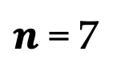
Deleting in Linear Probe Hashing
How can we delete a record?
Say, we want to delete the record 10, which maps to slot 3.
Hash Table
0
1
2
3
4
5
6
7
10
17
24
5
10 | Gru | 45 | 100
$$\left(10\right)\% 7$$
$n$ = 7

Slide 36
Deleting in Linear Probe Hashing
How can we delete a record?
Say, we want to delete the record 10, which maps to slot 3.
Can we set slot 3 to empty?
Hash Table
0
1
2
3
4
5
6
7
17
24
5
10 | Gru | 45 | 100
$$\left(10\right)\% 7$$
$n$ = 7

Slide 37
Deleting in Linear Probe Hashing
On deleting a record, setting a slot to empty is dangerous!
Other keys could have also mapped to the same slot, but due to the slot being full, they were in subsequent locations.
By emptying the slot, you are indicating that other keys also do not exist!
Two possible solutions:
Rearrangement
Tombstones

Slide 38
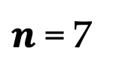
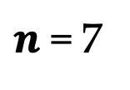
Deletions: Rearrangement
Once a key is deleted, you can rehash all the keys again.
Any key that was supposed to be mapped to the same slot can now take place.
Too expensive! No database does this.
Hash Table
Hash Table
0
1
2
3
4
5
6
7
10
17
24
5
0
1
2
3
4
5
6
7
17
24
5
$n$ = 7
$n$ = 7

Slide 39

Deletions: Tombstones
Once a key is deleted, you place a tombstone for that key in that slot.
Tombstone informs any future query that the specific key does not exist.
However, other keys may still exist!
Hash Table
Hash Table
0
1
2
3
4
5
6
7
10
17
24
5
0
1
2
3
4
5
6
7
17
24
5
For each tombstone, you need to maintain the list of keys that have been deleted!
$n$ = 7
$n$ = 7

Slide 40
Duplicate Keys in Linear Probe Hashing
How do you handle duplicate (non-unique) keys?
Two ways:
Maintain a list of values
Just simply allow adding redundant keys

Slide 41
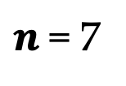

Duplicate Keys: List of Values
Hash Table
0
1
2
3
4
5
6
7
10
5
Lists of Values
10 | Gru | 45 | 100
10 | Voldemort | 70 | 400
5 | Anakin | 45 | 300
5 | Joker | 60 | 300
5 | Thanos | 100 | 500
$n$ = 7

Slide 42
Duplicate Keys: Allow Redundant Keys
Hash Table
0
1
2
3
4
5
6
7
5
10
5
5
10
$n$ = 7

Slide 43
Cuckoo Hashing
Why the name cuckoo?
Like the bird cuckoo, if we do not find a free slot for a key, we may kick out an existing key!
In cuckoo hashing, we use multiple hash functions to find free slots to store the key.
Each hash function may give us a slot to place and if any of those slots is free, we store the key!
If no slot is free, evict an existing key!

Slide 44


Cuckoo Hashing: Insertion
Hash Table
0
1
2
3
4
5
6
$$h1\left(key\right)$$
$$h2\left(key\right)$$
$n$ = 7

Slide 45



Cuckoo Hashing: Insertion
10 | Gru | 45 | 100
Hash Table
$$h1\left(10\right)$$
0
1
2
3
4
5
6
$$h2\left(10\right)$$
Randomly select a slot, say it selects slot 3 for storing key 10.
$n$ = 7

Slide 46

Cuckoo Hashing: Insertion
10 | Gru | 45 | 100
Hash Table
$$h1\left(10\right)$$
0
1
2
3
4
5
6
10
$$h2\left(10\right)$$
$n$ = 7

Slide 47




Cuckoo Hashing: Insertion
5 | Anakin | 25 | 400
Hash Table
$$h1\left(10\right)$$
0
1
2
3
4
5
6
10
$$h2\left(10\right)$$
$$h1\left(5\right)$$
$$h2\left(5\right)$$
$n$ = 7

Slide 48

Cuckoo Hashing: Insertion
5 | Anakin | 25 | 400
Hash Table
$$h1\left(10\right)$$
0
1
2
3
4
5
6
10
5
$$h2\left(10\right)$$
$$h1\left(5\right)$$
$$h2\left(5\right)$$
As slot 3 is occupied, we select slot 5 to store key 5.
$n$ = 7

Slide 49



Cuckoo Hashing: Insertion
18 | Joker | 66 | 300
Hash Table
$$h1\left(10\right)$$
0
1
2
3
4
5
6
10
5
$$h2\left(10\right)$$
$$h1\left(5\right)$$
$$h2\left(5\right)$$
$$h1\left(18\right)$$
$$h2\left(18\right)$$
$n$ = 7

Slide 50

Cuckoo Hashing: Insertion
18 | Joker | 66 | 300
Hash Table
$$h1\left(10\right)$$
0
1
2
3
4
5
6
10
5
$$h2\left(10\right)$$
$$h1\left(5\right)$$
$$h2\left(5\right)$$
$$h1\left(18\right)$$
Say, it decides to kick key 5
$$h2\left(18\right)$$
$n$ = 7

Slide 51
Cuckoo Hashing: Insertion
18 | Joker | 66 | 300
Hash Table
$$h1\left(10\right)$$
0
1
2
3
4
5
6
10
18
$$h2\left(10\right)$$
$$h1\left(5\right)$$
$$h2\left(5\right)$$
$$h1\left(18\right)$$
Say, it decides to kick key 5
$$h2\left(18\right)$$
$n$ = 7

Slide 52
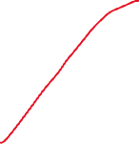

Cuckoo Hashing: Insertion
18 | Joker | 66 | 300
Hash Table
$$h1\left(10\right)$$
0
1
2
3
4
5
6
10
18
$$h2\left(10\right)$$
$$h1\left(5\right)$$
$$h2\left(5\right)$$
$$h1\left(18\right)$$
So, we need to rehash key 5, and only remaining slot is the slot occupied by key 10
$$h2\left(18\right)$$
$$h1\left(5\right)$$
$n$ = 7

Slide 53
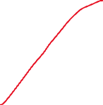
Cuckoo Hashing: Insertion
18 | Joker | 66 | 300
Hash Table
$$h1\left(10\right)$$
0
1
2
3
4
5
6
5
18
$$h2\left(10\right)$$
$$h1\left(5\right)$$
$$h2\left(5\right)$$
$$h1\left(18\right)$$
So, kick out key 10!
$$h2\left(18\right)$$
$$h1\left(5\right)$$
$n$ = 7

Slide 54


Cuckoo Hashing: Insertion
18 | Joker | 66 | 300
Hash Table
$$h1\left(10\right)$$
0
1
2
3
4
5
6
10
5
18
$$h2\left(10\right)$$
$$h1\left(5\right)$$
$$h2\left(5\right)$$
$$h1\left(18\right)$$
And now, rehash key 10
$$h2\left(18\right)$$
$$h1\left(5\right)$$
$n$ = 7
$$h1\left(10\right)$$

Slide 55
Challenges with Cuckoo Hashing
So what are the challenges with cuckoo hashing?
Insertions are expensive → We need to do rehashing!
We can get stuck into an infinite loop.
To exit the infinite loop, add more hash functions, or increase size of table, or maintain some list.

Slide 56
Dynamic Hashing
The biggest challenge for static hashing remains to be fixed size of hash table.
Alternatively, use dynamic hashing algorithms:
Chained Hashing
Extensible Hashing
Linear Hashing

Slide 57
Chained Hashing
For each slot in the hash table, there is a linked list of buckets.
Essentially, collisions are resolved by placing all keys with the same slot into same linked list.
Searching for a key requires scanning the linked list till you find the key or have reached end of the list.

Slide 58

Chained Hashing
Hash Table
0
1
2
3
4
5
6
Simple hash function
$$h\left(key\right)=key \% n=(key) \% 7$$
$n$ = 7

Slide 59

Chained Hashing
Hash Table
10 | Gru | 45 | 100
0
1
2
3
4
5
6
$$\left(10\right)\% 7$$
10
$n$ = 7

Slide 60


Chained Hashing
Hash Table
7 | Voldemort | 70 | 400
0
1
2
3
4
5
6
7
$$\left(7\right)\% 7$$
10
$n$ = 7

Slide 61

Chained Hashing
Hash Table
17 | Anakin | 45 | 300
0
1
2
3
4
5
6
7
$$\left(17\right)\% 7$$
10 | 17
$n$ = 7

Slide 62

Chained Hashing
Hash Table
24 | Joker | 60 | 300
0
1
2
3
4
5
6
7
$$\left(24\right)\% 7$$
10 | 17 | 24
$n$ = 7

Slide 63
Searching in Chained Hashing
Use the hash function to reach the specific slot, and then scan the linked list till you find the key or have reached end of the list.
For example, on searching 17, you would first reach slot 3, and then scan the list for slot 3 and find it is as the second entry in the linked list.

Slide 64
Challenges with Chained Hashing
What is the key challenge with chained hashing?
If a lot of keys are hashed to the same slot, then
You have a massively large linked list, and
Searching a key comes expensive → same cost as linear scan.

Slide 65
Extensible Hashing
Solves the problem of massively large linked lists.
Requires linked lists to be split, when size crosses a threshold.
Requires observing each key in a bit format.
When you hash a key, you get a numeric (base-10 or base-16) representation.
You can convert that base-10 to binary format (base-2).
For example: 4 can be represented as 100 in a 3-bit representation.

Slide 66


Extensible Hashing
Initially, your hash map is 1-bit, and you have some fixed number of buckets for each bit → Say 3 buckets.
Buckets
Hash Bits
0
1

Slide 67


Extensible Hashing
Assume on passing the key 13 through a hash function, the binary representation is 00011.
Buckets
00011
Hash Bits
0
1

Slide 68
Extensible Hashing
Another key 7, after passing it through a hash function, let the binary representation be 10011.
Buckets
00011
Hash Bits
0
1
10011

Slide 69
Extensible Hashing
This way, all keys with binary representation starting from 0 go to buckets for bit 0, and vice versa for buckets for bit 1.
Buckets
00011
Hash Bits
0
1
10011

Slide 70
Extensible Hashing
Let's assume all the buckets for bit 1 are full.
Buckets
00011
01010
Hash Bits
0
1
10011
11000
10110

Slide 71




Extensible Hashing
So, now we need to split the buckets for bit 1. This will require expanding the bit representation from 1-bit to 2-bits.
Buckets
00011
01010
Hash Bits
00
01
10
11
10011
10110
11000

Slide 72




Extensible Hashing
Notice that all the 2-bit representations starting with bit-0 continue pointing to the old buckets.
Buckets
00011
01010
Hash Bits
00
01
10
11
10011
10110
11000

Slide 73
Extensible Hashing
Next, assume we received a key 18, and on passing it through the hash function, the binary representation is 10010.
Buckets
00011
01010
Hash Bits
00
01
10
11
10011
10110
10010
11000

Slide 74






Extensible Hashing
Observe that all the buckets for bits 10 are full → Need to split again buckets for 10.
Now, 3-bits.
Buckets
Hash Bits
00011
01010
000
001
010
011
100
101
110
111
10011
10010
10110
11000

Slide 75
Linear Hashing
Extensible hashing works well, but we perform the splitting lazily when the buckets for some bit(s) are full.
What if we allow splitting to happen eagerly in the hope that in the future we would anyways need to split.
Linear hashing performs eager and random splitting.
We call the splitting random because you may end up splitting empty buckets.
Note: there is no longer tracking of buckets via binary representation.
What we need is a split pointer that tells where did the last split took place.
Every n-th split introduces a new hash function.

Slide 76




Linear Hashing
Initially say our hash function is:
$$h1\left(key\right)=key \% n=key \% 4$$
Buckets
Split Pointer
Bucket Pointers
0
1
2
3

Slide 77




Linear Hashing
Say our buckets look like this:
$$h1\left(key\right)=key \% 4$$
Buckets
8
20
Split Pointer
Bucket Pointers
0
1
2
3
5
9
13
6
7
11

Slide 78
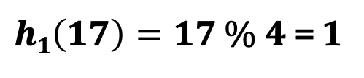
Linear Hashing
Let’s insert a key = 17:
$h1\left(17\right)=17 \% 4$ = 1
Buckets
8
20
Split Pointer
Bucket Pointers
0
1
2
3
5
9
13
6
7
11

Slide 79
Linear Hashing
Let’s insert a key = 17:
$h1\left(17\right)=17 \% 4$ = 1
Buckets
8
20
Split Pointer
Bucket Pointers
0
1
2
3
5
9
13
17
6
The bucket is full, so we create a new bucket and link.
7
11

Slide 80
Linear Hashing
Let’s insert a key = 17:
$h1\left(17\right)=17 \% 4$ = 1
Buckets
8
20
Split Pointer
Bucket Pointers
0
1
2
3
5
9
13
17
6
This situation has caused an overflow, so we need to split!
7
11

Slide 81
Linear Hashing
Let’s insert a key = 17:
$h1\left(17\right)=17 \% 4$ = 1
Buckets
8
20
Split Pointer
Bucket Pointers
0
1
2
3
5
9
13
17
6
My split pointer is at 0, so I will split bucket 0.
7
11

Slide 82

Linear Hashing
Let’s insert a key = 17:
$h1\left(17\right)=17 \% 4$ = 1
Buckets
8
20
Split Pointer
Bucket Pointers
0
1
2
3
4
5
9
13
17
6
My split pointer is at 0, so I will split bucket 0, and add a new bucket pointer.
7
11
8
20

Slide 83
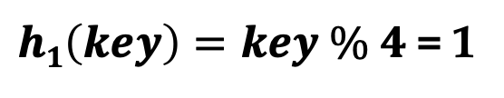

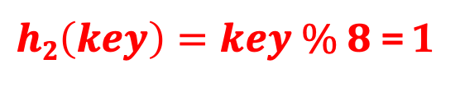
Linear Hashing
Let’s insert a key = 17:
$h1\left(key\right)=key \% 4$ = 1
Buckets
$h2\left(key\right)=key \% 8$ = 1
8
Split Pointer
Bucket Pointers
0
1
2
3
4
5
9
13
17
6
Introduce a new hash function and Rehash the keys in original bucket 0.
8 % 8 = 0
20 % 8 = 4
7
11
20

Slide 84
Linear Hashing
Let’s insert a key = 17:
$h1\left(key\right)=key \% 4$ = 1
Buckets
$h2\left(key\right)=key \% 8$ = 1
8
Split Pointer
Bucket Pointers
0
1
2
3
4
5
9
13
17
6
Move the split pointer
7
11
20

Slide 85
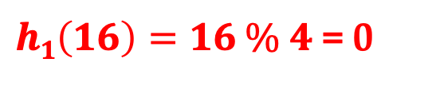
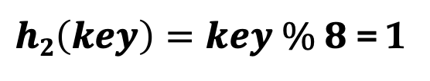
Linear Hashing
Let’s insert a key = 16:
$h1\left(16\right)=16 \% 4$ = 0
Buckets
$h2\left(key\right)=key \% 8$ = 1
8
Split Pointer
Bucket Pointers
0
1
2
3
4
5
9
13
17
6
First try the hash function h₁(key).
7
11
20

Slide 86
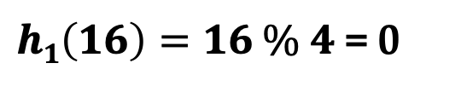
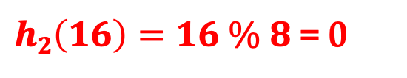
Linear Hashing
Let’s insert a key = 16:
$h1\left(16\right)=16 \% 4$ = 0
Buckets
$h2\left(16\right)=16 \% 8$ = 0
8
Split Pointer
Bucket Pointers
0
1
2
3
4
5
9
13
17
6
As 0 is above the split pointer, so we need to run the next hash function.
7
11
20

Slide 87
Linear Hashing
Let’s insert a key = 16:
$h1\left(16\right)=16 \% 4$ = 0
Buckets
$h2\left(16\right)=16 \% 8$ = 0
8
16
Split Pointer
Bucket Pointers
0
1
2
3
4
5
9
13
17
6
As 0 is above the split pointer, so we need to run the next hash function.
7
11
20

Slide 88
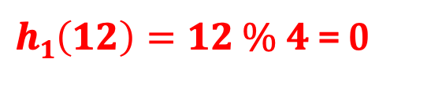
Linear Hashing
Let’s insert a key = 12:
$h1\left(12\right)=12 \% 4$ = 0
Buckets
$h2\left(key\right)=key \% 8$ = 1
8
16
Split Pointer
Bucket Pointers
0
1
2
3
4
5
9
13
17
6
First try the hash function h₁(key).
7
11
20

Slide 89
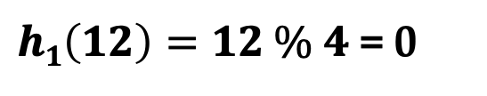
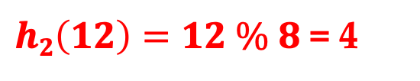
Linear Hashing
Let’s insert a key = 12:
$h1\left(12\right)=12 \% 4$ = 0
Buckets
$h2\left(12\right)=12 \% 8$ = 4
8
16
Split Pointer
Bucket Pointers
0
1
2
3
4
5
9
13
17
6
As 0 is above the split pointer, so we need to run the next hash function.
7
11
20

Slide 90
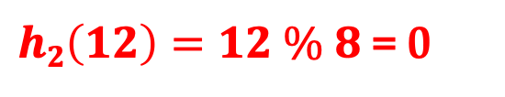
Linear Hashing
Let’s insert a key = 12:
$h1\left(12\right)=12 \% 4$ = 0
Buckets
$h2\left(12\right)=12 \% 8$ = 0
8
16
Split Pointer
Bucket Pointers
0
1
2
3
4
5
9
13
17
6
As 0 is above the split pointer, so we need to run the next hash function.
7
11
20
12

