Slide 1


Introduction to Databases CS 451 / 551
Lecture 5:
Searching and Indexing: Part 2
Suyash Gupta
Assistant Professor
Distopia Labs and ORNG
Dept. of Computer Science
(E) suyash@uoregon.edu
(W) gupta-suyash.github.io

Slide 2
Assignment 1 is Out! Deadline: Oct 29, 2024 at 11:59pm Start collaborating with your groups! Midterm: Oct 31, 2024 (in class)

Slide 3
Last Class
We discussed sequential indexes: sparse, dense, multi-level.
What are the challenges with these indexes?
A lot of file reorganization is needed when adding or deleting a record.
Can we avoid the reorganization? Yes, but
Then records are no longer mapped sequentially on the disk.
Can we do better?

Slide 4
How to determine a Good Index?
A good index should help to search a record fast!
Characteristics of a good index:
Access Types: Supports accessing a particular record (point query) and/or records within a specified range (range query).
Access Time: Time to find a particular record.
Insertion Time: Time to insert a new record in the index (includes time to find the right place to insert).
Deletion Time: Time to delete a new record in the index (includes time to find the item to be deleted).
Space Overhead: The space consumed by the index.

Slide 5
A More desirable Index Structure
Should ensure minimal reorganization.
Should support sequential data access from disk.

Slide 6
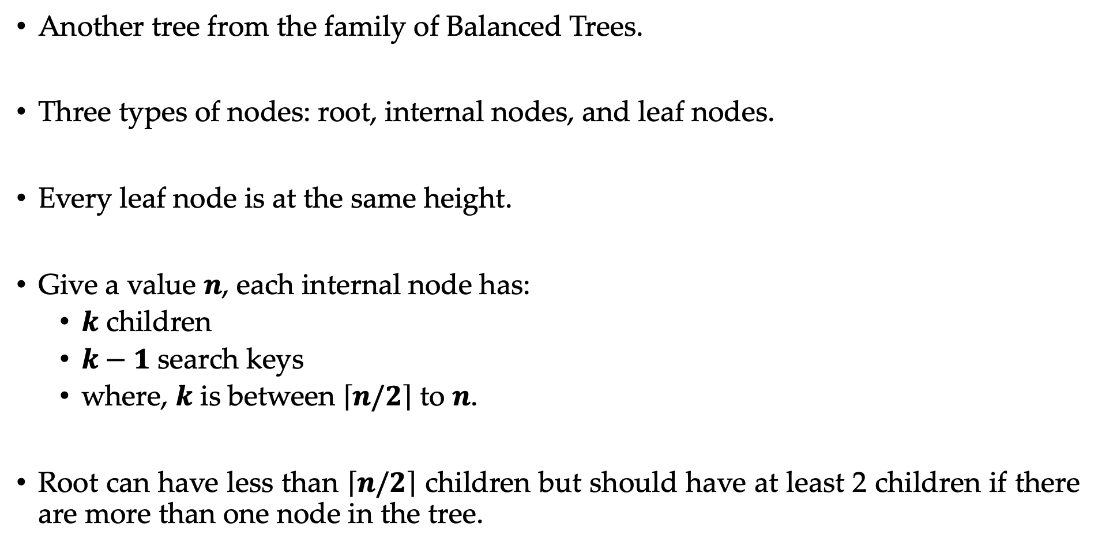
B⁺-Tree
Another tree from the family of Balanced Trees.
Three types of nodes: root, internal nodes, and leaf nodes.
Every leaf node is at the same height.
Give a value $n$, each internal node has:
$k$ children
$k−1$ search keys
where, $k$ is between $\left\lceil n/2\right\rceil$ to $n$.
Root can have less than $\left\lceil n/2\right\rceil$ children but should have at least 2 children if there are more than one node in the tree.

Slide 7
B⁺-Tree Leaf Node Structure
 | 7 |  | 13
Pointer to the next leaf
5 | Voldemort | 70 | 400
7 | Anakin | 20 | 200
12 | Kang | 20 | 500
13 | Gru | 45 | 100
20 | Thanos | 100 | 400
Internal nodes also have similar structure, except they point to other tree nodes

Slide 8
B⁺-Tree At a Glance
 | 13
Root
 | 6 |  | 8
 | 25
Internal nodes
 | 3 |  | 5
 | 6
 | 8 |  | 12
 | 13 |  | 20
 | 25
Leaf nodes
3 | Joffrey | 18 | 600
5 | Voldemort | 70 | 400
6 | Scarecrow | 30 | 150
8 | Anakin | 20 | 200
12 | Kang | 20 | 500
13 | Gru | 45 | 100
20 | Thanos | 100 | 400
25 | Joker | 66 | 200
B⁺ Tree with ID used for indexing
File

Slide 9
Searching data in B⁺-Tree
Notice that the keys are stored in B+ tree in a sorted manner.
We claim that the data is stored in B+ tree in sorted order because if you perform an in-order traversal, then you will get a sorted list.

Slide 10
Searching data in B⁺-Tree
Let’s run an in-order traversal, where we will only output data in the leaf nodes.
 | 13
 | 6 |  | 8
 | 25
 | 3 |  | 5
 | 6
 | 8 |  | 12
 | 13 |  | 20
 | 25

Slide 11
Searching data in B⁺-Tree
Let’s run an in-order traversal, where we will only output data in the leaf nodes.
 | 13
 | 6 |  | 8
 | 25
 | 3 |  | 5
 | 6
 | 8 |  | 12
 | 13 |  | 20
 | 25

Slide 12
Searching data in B⁺-Tree
Let’s run an in-order traversal, where we will only output data in the leaf nodes.
 | 13
 | 6 |  | 8
 | 25
 | 3 |  | 5
 | 6
 | 8 |  | 12
 | 13 |  | 20
 | 25

Slide 13
Searching data in B⁺-Tree
Let’s run an in-order traversal, where we will only output data in the leaf nodes.
 | 13
 | 6 |  | 8
 | 25
 | 3 |  | 5
 | 6
 | 8 |  | 12
 | 13 |  | 20
 | 25

Slide 14
Searching data in B⁺-Tree
Let’s run an in-order traversal, where we will only output data in the leaf nodes.
 | 13
 | 6 |  | 8
 | 25
 | 3 |  | 5
 | 6
 | 8 |  | 12
 | 13 |  | 20
 | 25

Slide 15

Searching data in B⁺-Tree
Let’s run an in-order traversal, where we will only output data in the leaf nodes.
 | 13
 | 6 |  | 8
 | 25
 | 3 |  | 5
 | 6
 | 8 |  | 12
 | 13 |  | 20
 | 25

Slide 16

Searching data in B⁺-Tree
Let’s run an in-order traversal, where we will only output data in the leaf nodes.
 | 13
 | 6 |  | 8
 | 25
 | 3 |  | 5
 | 6
 | 8 |  | 12
 | 13 |  | 20
 | 25

Slide 17
Searching data in B⁺-Tree
Let’s run an in-order traversal, where we will only output data in the leaf nodes.
 | 13
 | 6 |  | 8
 | 25
 | 3 |  | 5
 | 6
 | 8 |  | 12
 | 13 |  | 20
 | 25

Slide 18
Searching data in B⁺-Tree
Let’s run an in-order traversal, where we will only output data in the leaf nodes.
 | 13
 | 6 |  | 8
 | 25
 | 3 |  | 5
 | 6
 | 8 |  | 12
 | 13 |  | 20
 | 25

Slide 19

Searching data in B⁺-Tree
Let’s run an in-order traversal, where we will only output data in the leaf nodes.
 | 13
 | 6 |  | 8
 | 25
 | 3 |  | 5
 | 6
 | 8 |  | 12
 | 13 |  | 20
 | 25

Slide 20

Searching data in B⁺-Tree
Let’s run an in-order traversal, where we will only output data in the leaf nodes.
 | 13
 | 6 |  | 8
 | 25
 | 3 |  | 5
 | 6
 | 8 |  | 12
 | 13 |  | 20
 | 25

Slide 21
Searching data in B⁺-Tree
Let’s run an in-order traversal, where we will only output data in the leaf nodes.
 | 13
 | 6 |  | 8
 | 25
 | 3 |  | 5
 | 6
 | 8 |  | 12
 | 13 |  | 20
 | 25

Slide 22
Searching data in B⁺-Tree
Let’s run an in-order traversal, where we will only output data in the leaf nodes.
 | 13
 | 6 |  | 8
 | 25
 | 3 |  | 5
 | 6
 | 8 |  | 12
 | 13 |  | 20
 | 25

Slide 23

Searching data in B⁺-Tree
Let’s run an in-order traversal, where we will only output data in the leaf nodes.
 | 13
 | 6 |  | 8
 | 25
 | 3 |  | 5
 | 6
 | 8 |  | 12
 | 13 |  | 20
 | 25

Slide 24

Searching data in B⁺-Tree
Let’s run an in-order traversal, where we will only output data in the leaf nodes.
 | 13
 | 6 |  | 8
 | 25
 | 3 |  | 5
 | 6
 | 8 |  | 12
 | 13 |  | 20
 | 25

Slide 25
Searching data in B⁺-Tree
Let’s run an in-order traversal, where we will only output data in the leaf nodes.
 | 13
 | 6 |  | 8
 | 25
 | 3 |  | 5
 | 6
 | 8 |  | 12
 | 13 |  | 20
 | 25

Slide 26
Searching data in B⁺-Tree
Let’s run an in-order traversal, where we will only output data in the leaf nodes.
 | 13
 | 6 |  | 8
 | 25
 | 3 |  | 5
 | 6
 | 8 |  | 12
 | 13 |  | 20
 | 25

Slide 27
Searching data in B⁺-Tree
Let’s run an in-order traversal, where we will only output data in the leaf nodes.
 | 13
 | 6 |  | 8
 | 25
 | 3 |  | 5
 | 6
 | 8 |  | 12
 | 13 |  | 20
 | 25

Slide 28
Searching data in B⁺-Tree
Let’s run an in-order traversal, where we will only output data in the leaf nodes.
 | 13
 | 6 |  | 8
 | 25
 | 3 |  | 5
 | 6
 | 8 |  | 12
 | 13 |  | 20
 | 25

Slide 29
Searching data in B⁺-Tree
Now, lets try to search a key → Say we want to search key 12.
We need to traverse the tree in the in-order fashion.
Stop traversing if one of the following three cases occur:
Key is found!
You encounter a Key greater than the search key.
You have reached the last key or leaf node of the tree.
 | 13
 | 6 |  | 8
 | 25
 | 3 |  | 5
 | 6
 | 8 |  | 12
 | 13 |  | 20
 | 25

Slide 30
Searching data in B⁺-Tree
Now, lets try to search a key → Say we want to search key 12.
We need to traverse the tree in the in-order fashion.
Stop traversing if one of the following three cases occur:
Key is found!
You encounter a Key greater than the search key.
You have reached the last key or leaf node of the tree.
 | 13
 | 6 |  | 8
 | 25
 | 3 |  | 5
 | 6
 | 8 |  | 12
 | 13 |  | 20
 | 25

Slide 31

Searching data in B⁺-Tree
Now, lets try to search a key → Say we want to search key 12.
We need to traverse the tree in the in-order fashion.
Stop traversing if one of the following three cases occur:
Key is found!
You encounter a Key greater than the search key.
You have reached the last key or leaf node of the tree.
 | 13
12 < 13
 | 6 |  | 8
 | 25
 | 3 |  | 5
 | 6
 | 8 |  | 12
 | 13 |  | 20
 | 25

Slide 32


Searching data in B⁺-Tree
Now, lets try to search a key → Say we want to search key 12.
We need to traverse the tree in the in-order fashion.
Stop traversing if one of the following three cases occur:
Key is found!
You encounter a Key greater than the search key.
You have reached the last key or leaf node of the tree.
 | 13
 | 6 |  | 8
 | 25
12 > 8
 | 3 |  | 5
 | 6
 | 8 |  | 12
 | 13 |  | 20
 | 25

Slide 33

Searching data in B⁺-Tree
Now, lets try to search a key → Say we want to search key 12.
We need to traverse the tree in the in-order fashion.
Stop traversing if one of the following three cases occur:
Key is found!
You encounter a Key greater than the search key.
You have reached the last key or leaf node of the tree.
 | 13
 | 6 |  | 8
 | 25
Check all keys in
this leaf node.
 | 3 |  | 5
 | 6
 | 8 |  | 12
 | 13 |  | 20
 | 25

Slide 34
Searching data in B⁺-Tree
What we just did was a Point Query, where I wanted to search a specific item.
Say we want to search a range of keys (Range Query) → Keys from 12 to 24.
We need to traverse the tree in the in-order fashion to reach the first key in the range, that is, first leaf node.
Then, perform linearly scan → follow the leaf pointers till you hit the last key or a key greater than the range.
 | 13
 | 6 |  | 8
 | 25
 | 3 |  | 5
 | 6
 | 8 |  | 12
 | 13 |  | 20
 | 25

Slide 35
Searching data in B⁺-Tree
What we just did was a Point Query, where I wanted to search a specific item.
Say we want to search a range of keys (Range Query) → Keys from 12 to 24.
We need to traverse the tree in the in-order fashion to reach the first key in the range, that is, first leaf node.
Then, perform linearly scan → follow the leaf pointers till you hit the last key or a key greater than the range.
 | 13
 | 6 |  | 8
 | 25
 | 3 |  | 5
 | 6
 | 8 |  | 12
 | 13 |  | 20
 | 25

Slide 36
Searching data in B⁺-Tree
What we just did was a Point Query, where I wanted to search a specific item.
Say we want to search a range of keys (Range Query) → Keys from 12 to 24.
We need to traverse the tree in the in-order fashion to reach the first key in the range, that is, first leaf node.
Then, perform linearly scan → follow the leaf pointers till you hit the last key or a key greater than the range.
 | 13
12 < 13
 | 6 |  | 8
 | 25
 | 3 |  | 5
 | 6
 | 8 |  | 12
 | 13 |  | 20
 | 25

Slide 37
Searching data in B⁺-Tree
What we just did was a Point Query, where I wanted to search a specific item.
Say we want to search a range of keys (Range Query) → Keys from 12 to 24.
We need to traverse the tree in the in-order fashion to reach the first key in the range, that is, first leaf node.
Then, perform linearly scan → follow the leaf pointers till you hit the last key or a key greater than the range.
 | 13
 | 6 |  | 8
 | 25
12 > 8
 | 3 |  | 5
 | 6
 | 8 |  | 12
 | 13 |  | 20
 | 25

Slide 38
Searching data in B⁺-Tree
What we just did was a Point Query, where I wanted to search a specific item.
Say we want to search a range of keys (Range Query) → Keys from 12 to 24.
We need to traverse the tree in the in-order fashion to reach the first key in the range, that is, first leaf node.
Then, perform linearly scan → follow the leaf pointers till you hit the last key or a key greater than the range.
 | 13
 | 6 |  | 8
 | 25
Check all keys in
this leaf node.
 | 3 |  | 5
 | 6
 | 8 |  | 12
 | 13 |  | 20
 | 25

Slide 39
Searching data in B⁺-Tree
What we just did was a Point Query, where I wanted to search a specific item.
Say we want to search a range of keys (Range Query) → Keys from 12 to 24.
We need to traverse the tree in the in-order fashion to reach the first key in the range, that is, first leaf node.
Then, perform linearly scan → follow the leaf pointers till you hit the last key or a key greater than the range.
 | 13
 | 6 |  | 8
 | 25
Jump to next leaf
 | 3 |  | 5
 | 6
 | 8 |  | 12
 | 13 |  | 20
 | 25

Slide 40
Searching data in B⁺-Tree
What we just did was a Point Query, where I wanted to search a specific item.
Say we want to search a range of keys (Range Query) → Keys from 12 to 24.
We need to traverse the tree in the in-order fashion to reach the first key in the range, that is, first leaf node.
Then, perform linearly scan → follow the leaf pointers till you hit the last key or a key greater than the range.
 | 13
 | 6 |  | 8
 | 25
13 is in range [12,24]
 | 3 |  | 5
 | 6
 | 8 |  | 12
 | 13 |  | 20
 | 25

Slide 41
Searching data in B⁺-Tree
What we just did was a Point Query, where I wanted to search a specific item.
Say we want to search a range of keys (Range Query) → Keys from 12 to 24.
We need to traverse the tree in the in-order fashion to reach the first key in the range, that is, first leaf node.
Then, perform linearly scan → follow the leaf pointers till you hit the last key or a key greater than the range.
 | 13
 | 6 |  | 8
 | 25
20 is in range [12,24]
 | 3 |  | 5
 | 6
 | 8 |  | 12
 | 13 |  | 20
 | 25

Slide 42
Searching data in B⁺-Tree
What we just did was a Point Query, where I wanted to search a specific item.
Say we want to search a range of keys (Range Query) → Keys from 12 to 24.
We need to traverse the tree in the in-order fashion to reach the first key in the range, that is, first leaf node.
Then, perform linearly scan → follow the leaf pointers till you hit the last key or a key greater than the range.
 | 13
 | 6 |  | 8
 | 25
Jump to next leaf
 | 3 |  | 5
 | 6
 | 8 |  | 12
 | 13 |  | 20
 | 25

Slide 43
Searching data in B⁺-Tree
What we just did was a Point Query, where I wanted to search a specific item.
Say we want to search a range of keys (Range Query) → Keys from 12 to 24.
We need to traverse the tree in the in-order fashion to reach the first key in the range, that is, first leaf node.
Then, perform linearly scan → follow the leaf pointers till you hit the last key or a key greater than the range.
 | 13
 | 6 |  | 8
 | 25
But 25 is out of range,
So terminate search
 | 3 |  | 5
 | 6
 | 8 |  | 12
 | 13 |  | 20
 | 25

Slide 44
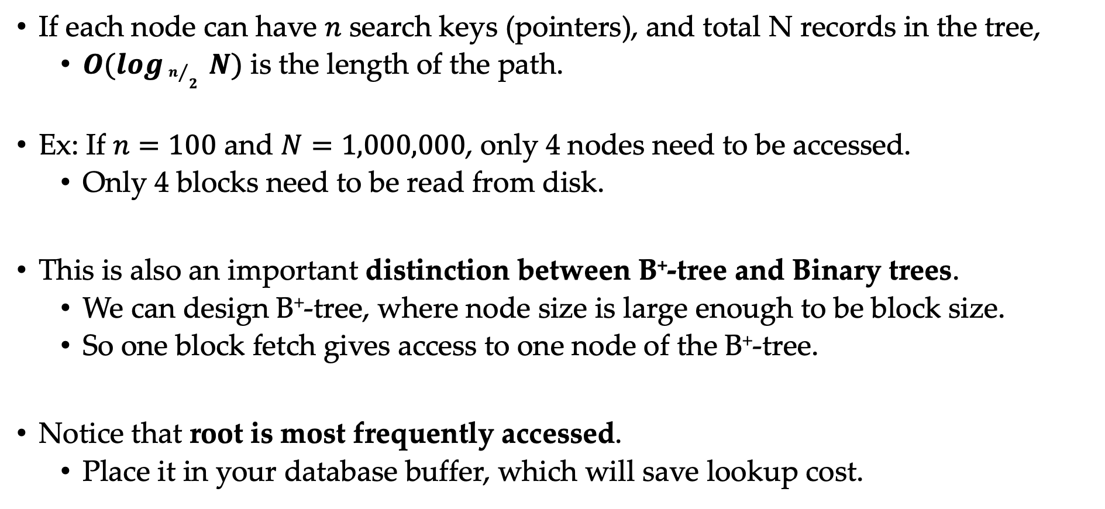
Search Complexity of B⁺-Tree
If each node can have $n$ search keys (pointers), and total N records in the tree,
$O(logn/2 N)$ is the length of the path.
Ex: If $n=100$ and $N=1,000,000$, only 4 nodes need to be accessed.
Only 4 blocks need to be read from disk.
This is also an important distinction between B⁺-tree and Binary trees.
We can design B⁺-tree, where node size is large enough to be block size.
So one block fetch gives access to one node of the B⁺-tree.
Notice that root is most frequently accessed.
Place it in your database buffer, which will save lookup cost.

Slide 45
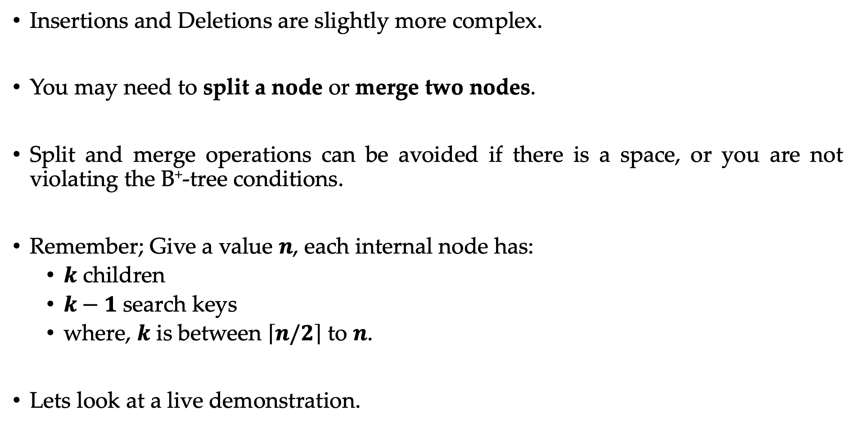
Insertions and Deletions in B⁺-Tree
Insertions and Deletions are slightly more complex.
You may need to split a node or merge two nodes.
Split and merge operations can be avoided if there is a space, or you are not violating the B⁺-tree conditions.
Remember; Give a value $n$, each internal node has:
$k$ children
$k−1$ search keys
where, $k$ is between $\left\lceil n/2\right\rceil$ to $n$.
Lets look at a live demonstration.

Slide 46
Insertions and Deletions in B⁺-Tree
30, 12, 56, 45, 18, 16, 10, 14, 8, 6, 90, 83, 67, 76, 49, 78,
56, 49, 67, 83, 78, 90, 18, 30, 76,

Slide 47

Insertions and Deletions Complexity
If each node can have $n$ search keys (pointers), and total N records in the tree,
$O(logn/2 N)$ is the number of I/O operations needed.
Notice that insertion and deletion complexity is still same as search!
This is the worst case complexity, on average fewer I/O operations are required.

Slide 48
Can we use B⁺-tree for File organization?
Till now, we used B+-tree for designing an index for our file.
How about we use it to even organize our files.
The leaf nodes of the B+-tree can store actual records.
If each leaf has same size as the disk block, then one disk block I/O fetches necessary records.

Slide 49
Self Reading Task
Difference between B-tree and B⁺-tree.
Disadvantages of B-tree when compared to B⁺-tree?

Slide 50
Bitmap Indices
Often, some attributes have only a small set of possible values.
Course with grades Pass or Fail.
Daily Attendance: Present or Absent
For some attributes, we can create groups for their values.
Faculty Title: Assistant Prof., Associate Prof., Professor
Salary Payscale: L1 ( < 100); L2 ( 100 - 300); L3 (300 – 500); L4 ( > 500)
Constructing Bitmap indices is useful for such attributes.
Each value is represented with the help of a bitmap.
Each record needs a sequential identifier.
The size of the bitmap is equal to number of records.
One bitmap for each value!

Slide 51
Bitmap Indices
Assume that the following is our table:
We can construct bitmaps for Grade and Payscale.
ID | Name | Grade | Payscale
1 | Voldemort | P | L1
2 | Anakin | P | L2
3 | Kang | F | L1
4 | Gru | F | L2
5 | Thanos | P | L4
6 | Joker | F | L3
7 | Jeoffrey | P | L1
Bitmap for Grade
Bitmap for Payscale
L1
P
L2
L3
F
L4

Slide 52
Bitmap Indices
Assume that the following is our table:
We can construct bitmaps for Grade and Payscale.
ID | Name | Grade | Payscale
1 | Voldemort | P | L1
2 | Anakin | P | L2
3 | Kang | F | L1
4 | Gru | F | L2
5 | Thanos | P | L4
6 | Joker | F | L3
7 | Jeoffrey | P | L1
Bitmap for Grade
Bitmap for Payscale
L1
1
P
1
L2
0
L3
0
F
0
L4
0

Slide 53
Bitmap Indices
Assume that the following is our table:
We can construct bitmaps for Grade and Payscale.
ID | Name | Grade | Payscale
1 | Voldemort | P | L1
2 | Anakin | P | L2
3 | Kang | F | L1
4 | Gru | F | L2
5 | Thanos | P | L4
6 | Joker | F | L3
7 | Jeoffrey | P | L1
Bitmap for Grade
Bitmap for Payscale
L1
1 | 0
P
1 | 1
L2
0 | 1
L3
0 | 0
F
0 | 0
L4
0 | 0

Slide 54
Bitmap Indices
Assume that the following is our table:
We can construct bitmaps for Grade and Payscale.
ID | Name | Grade | Payscale
1 | Voldemort | P | L1
2 | Anakin | P | L2
3 | Kang | F | L1
4 | Gru | F | L2
5 | Thanos | P | L4
6 | Joker | F | L3
7 | Jeoffrey | P | L1
Bitmap for Grade
Bitmap for Payscale
L1
1 | 0 | 1
P
1 | 1 | 0
L2
0 | 1 | 0
L3
0 | 0 | 0
F
0 | 0 | 1
L4
0 | 0 | 0

Slide 55
Bitmap Indices
Assume that the following is our table:
We can construct bitmaps for Grade and Payscale.
ID | Name | Grade | Payscale
1 | Voldemort | P | L1
2 | Anakin | P | L2
3 | Kang | F | L1
4 | Gru | F | L2
5 | Thanos | P | L4
6 | Joker | F | L3
7 | Jeoffrey | P | L1
Bitmap for Grade
Bitmap for Payscale
L1
1 | 0 | 1 | 0
P
1 | 1 | 0 | 0
L2
0 | 1 | 0 | 1
L3
0 | 0 | 0 | 0
F
0 | 0 | 1 | 1
L4
0 | 0 | 0 | 0

Slide 56
Bitmap Indices
Assume that the following is our table:
We can construct bitmaps for Grade and Payscale.
ID | Name | Grade | Payscale
1 | Voldemort | P | L1
2 | Anakin | P | L2
3 | Kang | F | L1
4 | Gru | F | L2
5 | Thanos | P | L4
6 | Joker | F | L3
7 | Jeoffrey | P | L1
Bitmap for Grade
Bitmap for Payscale
L1
1 | 0 | 1 | 0 | 0
P
1 | 1 | 0 | 0 | 1
L2
0 | 1 | 0 | 1 | 0
L3
0 | 0 | 0 | 0 | 0
F
0 | 0 | 1 | 1 | 0
L4
0 | 0 | 0 | 0 | 1

Slide 57
Bitmap Indices
Assume that the following is our table:
We can construct bitmaps for Grade and Payscale.
ID | Name | Grade | Payscale
1 | Voldemort | P | L1
2 | Anakin | P | L2
3 | Kang | F | L1
4 | Gru | F | L2
5 | Thanos | P | L4
6 | Joker | F | L3
7 | Jeoffrey | P | L1
Bitmap for Grade
Bitmap for Payscale
L1
1 | 0 | 1 | 0 | 0 | 0
P
1 | 1 | 0 | 0 | 1 | 0
L2
0 | 1 | 0 | 1 | 0 | 0
L3
0 | 0 | 0 | 0 | 0 | 1
F
0 | 0 | 1 | 1 | 0 | 1
L4
0 | 0 | 0 | 0 | 1 | 0

Slide 58
Bitmap Indices
Assume that the following is our table:
We can construct bitmaps for Grade and Payscale.
ID | Name | Grade | Payscale
1 | Voldemort | P | L1
2 | Anakin | P | L2
3 | Kang | F | L1
4 | Gru | F | L2
5 | Thanos | P | L4
6 | Joker | F | L3
7 | Jeoffrey | P | L1
Bitmap for Grade
Bitmap for Payscale
L1
1 | 0 | 1 | 0 | 0 | 0 | 1
P
1 | 1 | 0 | 0 | 1 | 0 | 1
L2
0 | 1 | 0 | 1 | 0 | 0 | 0
L3
0 | 0 | 0 | 0 | 0 | 1 | 0
F
0 | 0 | 1 | 1 | 0 | 1 | 0
L4
0 | 0 | 0 | 0 | 1 | 0 | 0

Slide 59
When are Bitmap Indices useful?
Say we have the following query:
select * from cs_employees
where grade = ‘P’;
Is Bitmap index useful for this query?
Not much,
You will scan the bitmap index.
For every record where grade is equal to P, you will fetch it from the disk.
So, you did not have to fetch every record.
However, records are stored sequentially in blocks on the disk, so you may end up fetching a lot of blocks with not required blocks!

Slide 60
When are Bitmap Indices useful?
Say we have another query:
select * from cs_employees
where grade = ‘P’ and payscale = ‘L1’;
Is Bitmap index useful for this query?
Significantly more,
We have bitmap indices on both grade and pay attributes.
So first, we will take an intersection of these bitmaps and then fetch!
Bitmap for Grade
Bitmap for Payscale
Intersection Bitmap
So only two records are fetched!
P
1 | 1 | 0 | 0 | 1 | 0 | 1
L1
1 | 0 | 1 | 0 | 0 | 0 | 1
1 | 0 | 0 | 0 | 0 | 0 | 1

