Slide 1


Introduction to Databases CS 451 / 551
Lecture 3:
Storage
Suyash Gupta
Assistant Professor
Distopia Labs and ORNG
Dept. of Computer Science
(E) suyash@uoregon.edu
(W) gupta-suyash.github.io

Slide 2
Assignment 1
Assignment 1 will be released today on course webpage:
https://gupta-suyash.github.io/cs451-fall24.html
Deadline: October 29, 2024 at 11:59pm.
Start planning, talk to your group members.
If you don’t have a group yet, today is your last day to form/join a group.
We will no longer create groups for you.
We will discuss Assignment 1 in the next class.
Feel free to read Lstore paper → We will discuss in the class.

Slide 3
Physical View
Until now we studied the logical or a user’s view of the data.
Next, we look at the physical view of the data.
How is data stored?
What are the physical media to store data?
What data structures help in faster access?

Slide 4
Storage Hierarchy
Cache
Primary Storage
Main Memory
Decreasing Cost
Flash Memory
Increasing Size
Secondary Storage
Magnetic Disk
Optical Disk
Tertiary Storage
Magnetic Tapes

Slide 5
Storage Hierarchy
Always inside your computer.
Too small to store the full database.
Data loss when power turns off.
Still valuable as the CPU aims to
frequently loads them up with
recent data to avoid data misses.
A good application or system design targets cache hits.
Often, there are several levels of
main memory: L1, L2, and L3.
Cache
Main Memory
Flash Memory
Magnetic Disk
Optical Disk
Magnetic Tapes

Slide 6
Storage Hierarchy
Cache
Main Memory
USB stick or external memory.
No data loss on turning off power.
Flash Memory
Magnetic Disk
Optical Disk
Magnetic Tapes

Slide 7
Storage Hierarchy
Cache
Main Memory
Flash Memory
Useful for long-term storage of the database.
At the time of processing, CPU moves data from magnetic disk to the main memory.
Magnetic Disk
Optical Disk
Magnetic Tapes

Slide 8
Storage Hierarchy
Cache
Main Memory
Flash Memory
Magnetic Disk
Optical Disk
Older storage media; not common everywhere.
Magnetic Tapes

Slide 9
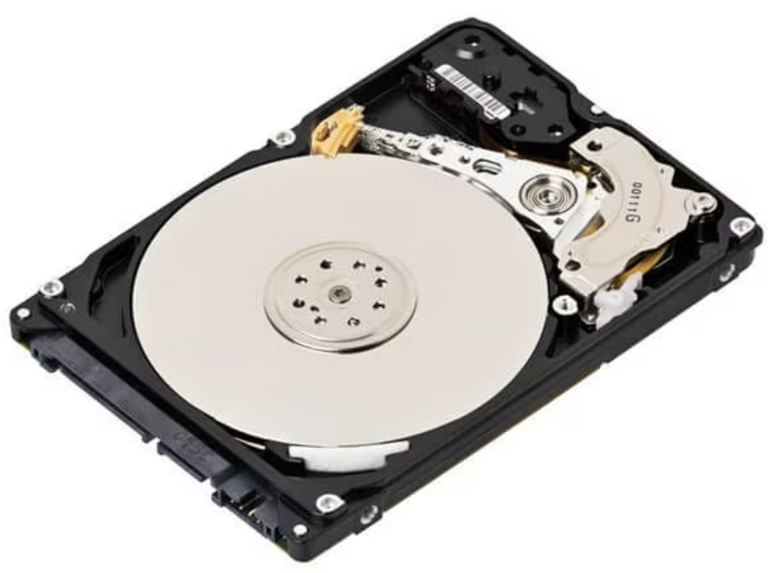
Magnetic Disks
Magnetic disks are where large databases reside; databases can span multiple disks.
Each disk is divided into platters → each platter has multiple tracks → each track has multiple sectors.
Platters sit on a spindle, which rotates at some speed (say 1500 rpm).
Sector is the smallest unit of information that can be read or written.
About 512 Bytes.
Platters
Read/Write head
Spindle
Read/Write Arm

Slide 10
Magnetic Disks
Read-write head stores the information on a sector magnetically as reversals of the direction of magnetization.
Read-write head does not touch the disk, but is kept as close as possible to increase writing density.
Disk controller is a software (stored on disk case) that interfaces between actual disk h/w and the computer system.
It accepts high-level commands to read/write to a sector.
Attaches a checksum to each sector when the data is written.
On reading a sector, computes its checksum, and matches against stored checksum.
If checksums don’t match → Data corruption!

Slide 11
Disk Performance Metrics
Access Time – Time difference between when a read/write request is issued to when data transfer begins.
Seek Time + Rotational Latency
Seek Time → Time to position the read-write arm to correct track.
Rotational latency → Time to reach the correct sector under the read-write head.
Data Transfer rate → The rate at which data can be retrieved from a disk.
Measured after the first sector is accessed.
Mean Time To Failure (MTTF) → The average amount of time a device runs continuously without any failure.

Slide 12
RAID
Disks are slow to read/write the data!
How can we speed up?
Redundant Arrays of Independent Disks (RAID)
Multiple disks instead of one.
Can read or write to the disks in parallel.
Can improve reliability by duplicating same data to multiple disks
Also known as replication
Guards against failures!
Increases Mean Time to Failure

Slide 13
How do Modern Databases Look Like?
There are databases which are quite small → up to 50 GB!
Some of these you can even store in main-memory!
For example: 2009 English Wikipedia was just 20GB!
Then there are other databases which can be stored in Flash drives (SSDs).
Slower than main-memory but faster than HDDs (magnetic disks)
But, several other databases require petabytes of space.
Facebook image database!
You would need multiple disks!

Slide 14
Disk vs. OS Terminology
From disk perspective, we store data on platters → tracks → sectors.
From OS perspective, we store data in blocks or pages.
One block can span multiple sectors!
In this class, we will assume each block has same size as a sector.
Blocks and pages are synonyms!
More technically → Blocks is used as the terminology for data on disk and page is used when data is in main memory (RAM).

Slide 15
What is meant by next block?
You want to read some blocks from disk. How should you proceed?
Find the first block address you are interested.
Move the read/write arm to specific platter and then to correct track.
Then move the read/write head to correct sector.
Now, where do you read the next block? Which sector?
You want to read or write fast! Not increase seek time + rotational latency!

Slide 16
What is meant by next block?
Lets define next block to read
Read sectors on same track.
Then same track number on next platter (same cylinder, a logical concept)
Then next track on adjacent cylinder.
Track 0, Sector 0
Platter 1
Track 1, Sector 0
Track 0, Sector 1
Track 0, Sector 0
Platter 2
Track 1, Sector 0
Track 0, Sector 1

Slide 17
What is meant by next block?
This is how we even store database files on disk!
Files are stored sequentially on disk.
Allows us to fetch using the notion of next block.
Sequential scan also allows pre-fetching!
Read a large amount of data ahead of time even if we need only one block.
Hope that future reads will be cheap → data available in memory.

Slide 18
Disk and System Communication
File system manager, a component of OS manages interaction with disk.
Keeps track which page is where on disk.
Read a page from the disk.
Write a page to the disk.
Higher levels basically send requests to the file system manager.
They ask filesystem to allocate or deallocate logical pages.
Read or write data to pages.
Remember higher levels do not know anything about how pages are managed or how the database is stored!
SQL Client
File System Manager
Database Stored on Disk

Slide 19
Disk and System Communication
Thus, File system manager needs to provide access to pages as fast as possible!
It needs to ensure that pages are stored sequentially on this disk.
It should be able to pre-fetch pages to fulfill requirements fast!
Any pre-fetched pages are pushed to the memory so that future reads can be served from the memory itself.
SQL Client
File System Manager
Database Stored on Disk

Slide 20
Mapping Tables to Disk
Page 3
Page 4
Page 2
z
Page 1
File 1
File 1
Page 1
Page 3
Database
File 2
Page 2
Page 4
File 3
Database spans multiple files.
Each file consists of multiple pages.
Each page is physically stored on a disk sector.

Slide 21
Mapping Tables to Disk
name | age | title
Voldemort | 70 | Assoc Prof
Anakin | 20 | Assoc Prof
Kang | 20 | Prof
Gru | 45 | Asst Prof
Thanos | 100 | Prof
Voldemort | 70 | Assoc Prof
Each record is stored in a page. We are assuming one page per record.
cs-employees
Each table consists of several records/rows.

Slide 22
Mapping Records to File
So how do we place records on a file.
We need to determine the size of the record to know how many blocks it needs.
Not every record is exactly one block size!
Records can be divided into two groups:
Fixed-length records
Record Size can be determined from the schema.
Variable-length records
Size of some attributes can only be determined at runtime.

Slide 23
Fixed-Length Records
create table cs_employees
( name char(23),
age int,
salary numeric(8,2)
);
Say, the following is the schema of our table.
Total size of a record = 23 Bytes + 4 Bytes + 8 Bytes = 35 Bytes.
How do we store in the memory?
Reserve first 35 Bytes for Record 1, next 35 Bytes for Record 2, and so on.
record 0
Voldemort | 70 | 400
Anakin | 20 | 200
Kang | 20 | 500
Gru | 45 | 100
Thanos | 100 | 400
record 1
record 2
record 3
record 4
cs-employees

Slide 24
Problems with Fixed-Length Records
Unless block size is a multiple of 35 Bytes, some records will need to be stored in another block.
So two blocks need to be fetched for accessing each record.

Slide 25
Problems with Fixed-Length Records
Deleting a record creates a problem of space management!
Way 1:
On deleting the record, move all the succeeding records up.
Shift one space in the memory.
Simple solution!
Bad performance.
Large number of records moved.
record 0
Voldemort | 70 | 400
Anakin | 20 | 200
Gru | 45 | 100
Thanos | 100 | 400
record 1
record 3
record 4
cs-employees
On deleting record 2 and moving 3 and 4 up.

Slide 26
Possible Solution for Fixed-Length Records
Way 2: Insert a new record in the space of deleted record.
Hard to track, which all spaces are available.
record 0
Voldemort | 70 | 400
Anakin | 20 | 200
Joker | 66 | 700
Gru | 45 | 100
Thanos | 100 | 400
record 1
record 5
record 3
record 4
cs-employees
New record 5, inserted in space of record 2.

Slide 27
Free List for Fixed-Length Records
Make use of file header.
File header stores all the meta (important) information about the file.
We can maintain a free-list: store here information about first deleted record.
Then this record points to next deleted record.
Voldemort | 70 | 400
Anakin | 20 | 200
Gru | 45 | 100
record 0
record 1
record 3
cs-employees
Free-list, tracked through header.

Slide 28
Variable-Length Records
create table cs_employees
( name varchar(100),
age int,
salary numeric(8,2)
);
Say, the following is the schema of our table.
The maximum size for varchar is 100 Bytes, but a name could be smaller.
We can say that each record has size (100 Bytes + 4 Bytes + 8 Bytes) = 112 Bytes.
But record 0 has size only 18 Bytes? Why waste so much space?
record 0
Voldemort | 70 | 400
Anakin | 20 | 200
Kang | 20 | 500
Gru | 45 | 100
Thanos | 100 | 400
record 1
record 2
record 3
record 4
cs-employees

Slide 29
Representing Variable-Length Records
For each variable-length record, store an (offset, length) pair.
Offset → The position in the representation.
Length → The size of variable-length field.

Slide 30
Representing a Record
Voldemort | 70 | 400
Anakin | 20 | 200
Kang | 20 | 500
Gru | 45 | 100
Thanos | 100 | 400
create table cs_employees
( name varchar(100),
age int,
salary numeric(8,2)
);
Length
Null Bitmap stored in 1 Byte
Position
17, 9 | 70 | 400 |  | Voldemort
Bytes
0
4
8
16
17
26

Slide 31
Mapping Records to Disk Blocks
We assumed that one record per disk block.
Often, multiple records per block.
How to store or find a record in a block?
Each block has a header that tracks number of records and free space.
Block Header
Records
Size
#Entries |  |  |  |  | Free Space
Location

Slide 32
Mapping Records to Disk Blocks
We assumed that one record per disk block.
Often, multiple records per block.
How to store or find a record in a block?
Each block has a header that tracks number of records and free space.
Block Header
Records
Size
#Entries |  |  |  |  | Free Space
Location

Slide 33
Mapping Records to File
So we have mapped records to a block/page.
But we still have not mapped them to files.
Different ways of organizing records to a file:
Heap File organization
Sequential File organization
Hashing File organization

Slide 34
Heap File Organization
Any record can be placed anywhere in the file.
No ordering of records.
One file per relation.

Slide 35
Sequential File Organization
Allowing quickly searching records.
Records are stored in sorted order based on some search key.
Search key does not need to be a primary key.
Records are linked via pointers for access and stored physically in search-key order.
5 | Voldemort | 70 | 400
7 | Anakin | 20 | 200
12 | Kang | 20 | 500
13 | Gru | 45 | 100
20 | Thanos | 100 | 400
Search Key

Slide 36
Sequential File Organization
Sorted Order creates challenges.
Deleting a record leaves a space and pointer needs to be remapped.
Say we want to delete record 7.
5 | Voldemort | 70 | 400
7 | Anakin | 20 | 200
12 | Kang | 20 | 500
13 | Gru | 45 | 100
20 | Thanos | 100 | 400
5 | Voldemort | 70 | 400
12 | Kang | 20 | 500
13 | Gru | 45 | 100
20 | Thanos | 100 | 400

Slide 37
Sequential File Organization
How about insertion.
Say we want to insert a record 6.
This case is easy as we have an open gap in the file.
5 | Voldemort | 70 | 400
12 | Kang | 20 | 500
13 | Gru | 45 | 100
20 | Thanos | 100 | 400
5 | Voldemort | 70 | 400
6 | Joker | 60 | 300
12 | Kang | 20 | 500
13 | Gru | 45 | 100
20 | Thanos | 100 | 400

Slide 38
Sequential File Organization
How about inserting a record when there is no open gap?
Say we want to insert a record 14.
We need to insert the new record in an overflow block and re-map pointers.
5 | Voldemort | 70 | 400
6 | Joker | 60 | 300
12 | Kang | 20 | 500
13 | Gru | 45 | 100
20 | Thanos | 100 | 400
5 | Voldemort | 70 | 400
6 | Joker | 60 | 300
12 | Kang | 20 | 500
13 | Gru | 45 | 100
20 | Thanos | 100 | 400
14 | Sauron | 900 | 800

Slide 39
Sequential File Organization
If the overflow block ends up having too many records → File Reorganization
Too expensive to reorganize complete file.

Slide 40
Database Buffers
DBMS aims to minimize the access between disk and memory.
If your database is larger than your main memory (generally the case), it needs to be stored on disk.
Disks are slow → Main memory is fast!
So we have a buffer manager, which manages what blocks should be present in a part of memory termed as buffer.
Buffer manager is like virtual memory manager in OS.
Tries to pre-fetch blocks → predicts what blocks will be needed in future to save access time.

Slide 41
Database Buffers
When database asks for a block from buffer manager:
If block already present in the buffer → It forwards the pointer to the block.
If block is not present in the buffer
It discards some existing block to make space.
Fetches the required block from disk.
Forwards the pointer to the block.
How to discard a block.
If the block in the buffer has been updated, that is, the version on disk is stale, then replace the version on disk with the updated version.
If the block in the buffer has no new updates, then simply discard.

Slide 42
Database Buffers
Which block to discard → Buffer Replacement Policies
Least Recently Used (LRU)
Same as the OS LRU policy.
The block least recently accessed is discarded first.
Toss Immediate Policy
If you can determine a block will not be used again, discard it.
select * from cs_employees natural join department;
Here, once a tuple of cs_employees is accessed, it can be discarded

