Slide 1


Large Scale Systems CS 410 / 510
Lecture 17:
Consensus across the Globe
Suyash Gupta
Assistant Professor
Distopia Labs and ORNG
Dept. of Computer Science
(E) suyash@uoregon.edu
(W) gupta-suyash.github.io

Slide 2
Assignment 4 is Out!
Assignment 4 is due on June 2, 2025 at 11:59pm PST.
Please start working with your groups.

Slide 3
Presentations
Each group will present their MiniSpanner on June 4, 2025 in class.
The class will start 10min earlier on 8:20am to accommodate all the groups.
Each group will get 25-30min to present their progress.

Slide 4
Reading Material
For this class and next lecture:
Read Chapters 3-4 from Fault-Tolerant Distributed Transactions on Blockchain.

Slide 5
Last Class
Last class we looked at:
Parallelizing Consensus
RCC

Slide 6
Optimizing PBFT
Today, our goal is to continue optimizing PBFT.
Until now, we added to PBFT:
Pipelining
Out-of-Order Message Processing
Speculation
Parallelism

Slide 7
PBFT Protocol
Client
Leader
Replica
Replica
Replica
Client
Request
Pre-Prepare
Prepare
Commit
Reply

Slide 8
What can we do next?

Slide 9
What can we do next?
We can apply clustering in consensus to reduce some costs.

Slide 10









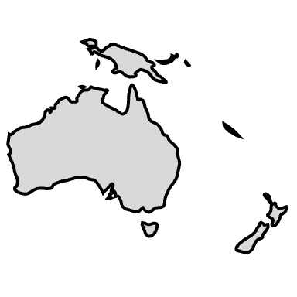
Where are replicas located?

Slide 11
Impact of Replicas Deployment
What is the impact of running consensus among these replicas that are located all over the globe?

Slide 12
Impact of Replicas Deployment
What is the impact of running consensus among these replicas that are located all over the globe?
High Latency
Low throughput

Slide 13
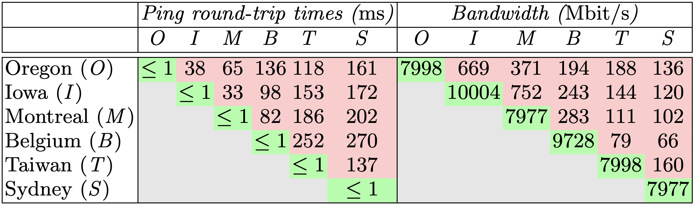

Impact of Replicas Deployment
An experiment showing cost of deploying replicas across the globe on Google Cloud.
High!
Low!

Slide 14
Geo-scale BFT Consensus
GeoBFT [VLDB’20] reduces the cost of PBFT consensus by clustering replicas.
System is fully-replicated, but all clusters work independently.

Slide 15
GeoBFT Protocol Overview
Local Replication
Inter-cluster Sharing
Ordering and Execution
Each cluster runs PBFT to select, locally replicate, and certify a client request.
Primary at each cluster shares the certified client request with other clusters.
Order the certified requests, execute them, and inform local clients.

Slide 16
GeoBFT Protocol Overview
Goals of GeoBFT:
Take Topology into consideration.
Run Parallel Consensus at each cluster.
Ensure cheap inter-cluster communication.

Slide 17
GeoBFT Protocol Overview
Client 1
T₁
P_{C1}
Local PBFT Consensus on T₁
R_{1,1}
Cluster 1
C₁
R_{1,2}
R_{1,3}
Client 2
T₂
P_{C2}
Local PBFT Consensus on T₂
Cluster 2
C₂
R_{2,1}
R_{2,2}
R_{2,3}
Local Request
Local Replication
Global
Sharing
Local
Sharing
Reply

Slide 18
Local Replication
Run any consensus protocol of your choice → PBFT, PoE
Ensure each cluster has n = 3f+1 replicas, where at most f replicas are Byzantine.
Once a cluster has committed its request, it needs to exchange requests with other clusters → Full replication.

Slide 19
Inter-Cluster Communication

Slide 20
Inter-Cluster Communication
P_{C1}
P_{C2}
R_{2,1}
R_{2,2}
R_{2,3}
Global Phase
Local Phase
The Primary P_{C1} sends a certificate that includes the client request and commit messages from n-f replicas of Cluster C₁ .

Slide 21
Inter-Cluster Communication
Make the leader create a certificate, which proves that n-f replicas committed the request.
Leder sends the certificate to f+1 replicas.
The f+1 replicas forward the received certificate to everyone in their cluster.

Slide 22
Ordering and Execution

Slide 23
Ordering and Execution
GeoBFT orders requests deterministically.
For i < j, requests of Cluster C_{i} are executed before requests of cluster C_{j}.
For example: requests of C₁ are executed before C₂ .

Slide 24
Challenges for GeoBFT

Slide 25
Challenges for GeoBFT
Replication Factor.
Malicious leader.
Lack of Requests.
Cluster Failure and Sizes.

Slide 26
Replication Factor

Slide 27
Replication Factor
PBFT’s replication factor → n = 3f+1 replicas.
GeoBFT requires n = 3f+1 replicas per cluster.
Assume 4 clusters and each with 4 replicas:
PBFT → n = 16, f = 5.
GeoBFT → Maximum 4 failures and at most one failure per cluster.

Slide 28
Malicious Leader

Slide 29
Malicious Leader
What if the malicious leader impact inter-cluster communication.:
Does not send certificate to all clusters.
Does not send certificate to f+1 replicas in each cluster.

Slide 30
Malicious Leader
What if the malicious leader impact inter-cluster communication.:
Does not send certificate to all clusters.
Does not send certificate to f+1 replicas in each cluster.
Detect the malicious behavior
Epoch based design like in RCC.
Request replacement of the malicious leader by broadcasting the request to every replica in the cluster of malicious leader.

Slide 31
Lack of Requests
Not every cluster will always have some request to send?

Slide 32
Lack of Requests
Not every cluster will always have some request to send?
Send a No-op certificate → certificate created with the help of other replicas.

Slide 33
Cluster Size and Failure
Do all clusters need to be of same size?

Slide 34
Cluster Size and Failure
Do all clusters need to be of same size?
No, clusters can have different sizes.

Slide 35
Cluster Size and Failure
Do all clusters need to be of same size?
No, clusters can have different sizes.
Can a full cluster fail?

Slide 36
Cluster Size and Failure
Do all clusters need to be of same size?
No, clusters can have different sizes.
Can a full cluster fail?
GeoBFT cannot handle a cluster failure.

Slide 37
What else can we do next to GeoBFT?

Slide 38
What else can we do next to GeoBFT?
How about we apply the logic of sharding?
Each shard manages distinct data items.
Two types of transactions:
Intra-shard → Support parallel processing.
Inter-shard → Require communication among the shards.

Slide 39
RingBFT Consensus
RingBFT [EDBT’22] reduces the cost of PBFT consensus by sharding replicas.
System is no longer fully-replicated.

Slide 40
RingBFT Consensus
RingBFT [EDBT’22] reduces the cost of PBFT consensus by sharding replicas.
System is no longer fully-replicated.
RingBFT suggests going around the shards in a ring with processing the transaction at each step.
Order the transaction locally.
If a inter-shard transaction → forward the Read-Write sets and updates to the next shard in the ring.
The direction of ring never changes.

Slide 41
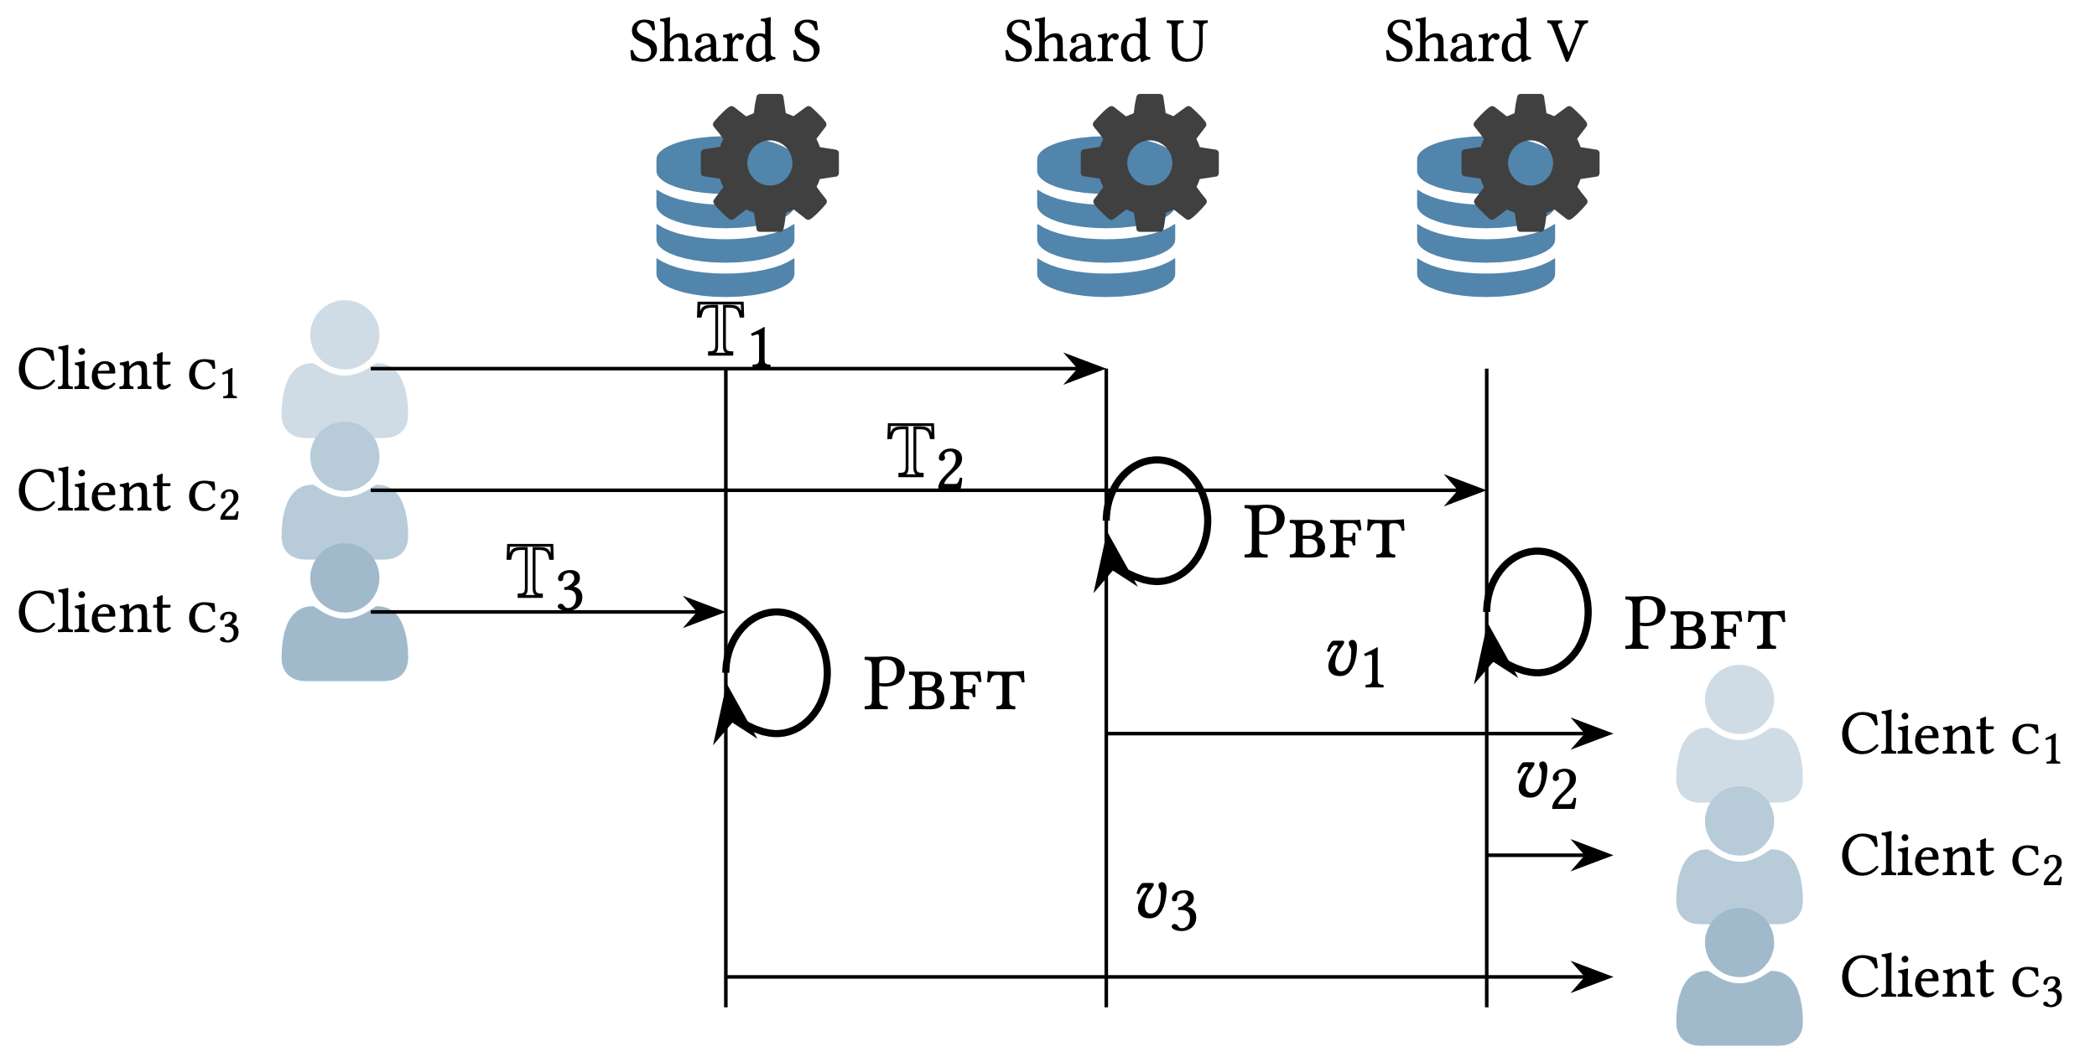
RingBFT Intra-Shard Consensus

Slide 42
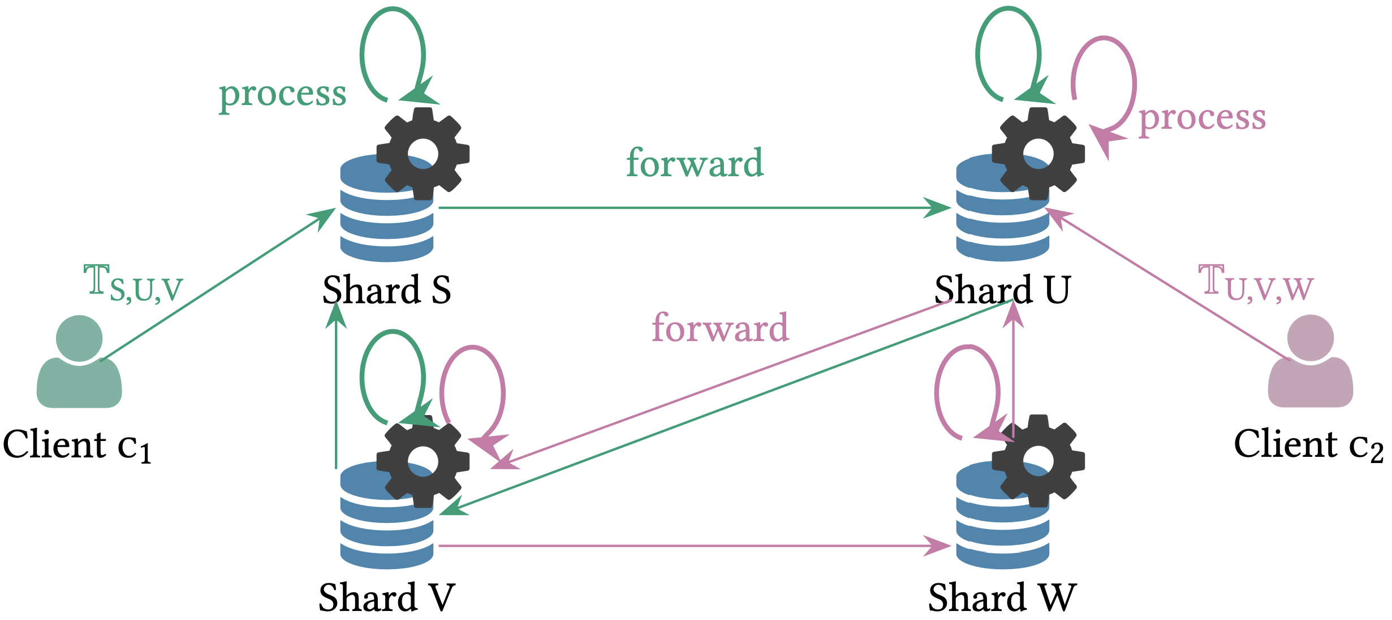
RingBFT Inter-Shard Consensus

Slide 43
RingBFT Inter-Shard Consensus
The goal is to make as many few rotations around the ring as possible.
Each rotation does: Process, Forward, and Re-transmit.
The Ring order is fixed!

