Slide 1


Large Scale Systems CS 410 / 510
Lecture 16:
Parallelizing Consensus
Suyash Gupta
Assistant Professor
Distopia Labs and ORNG
Dept. of Computer Science
(E) suyash@uoregon.edu
(W) gupta-suyash.github.io

Slide 2
Assignment 4 is Out!
Assignment 4 is due on June 2, 2025 at 11:59pm PST.
Please start working with your groups.

Slide 3
Presentations
Each group will present their MiniSpanner on June 4, 2025 in class.
The class will start 10min earlier on 8:20am to accommodate all the groups.
Each group will get 25-30min to present their progress.

Slide 4
Reading Material
For this class and next lecture:
Read Chapters 3-4 from Fault-Tolerant Distributed Transactions on Blockchain.

Slide 5
Last Class
Last class we looked at:
Speculation in Consensus
PoE Protocol

Slide 6
Optimizing PBFT
Today, our goal is to optimize PBFT through parallelism.
How can we introduce parallelism in PBFT apart from out-of-order message processing?

Slide 7
PBFT Protocol
Client
Leader
Replica
Replica
Replica
Client
Request
Pre-Prepare
Prepare
Commit
Reply

Slide 8
Optimizing PBFT
Today, our goal is to optimize PBFT through parallelism.
How can we introduce parallelism in PBFT apart from out-of-order message processing?

Slide 9
Parallelizing PBFT
What if we allow multiple replicas to act as the leader at the same time?
What if we allow all replicas to be the leader!

Slide 10
Parallelizing PBFT
What if we allow multiple replicas to act as the leader at the same time?
What if we allow all replicas to be the leader!
To allow all replicas to act as leaders at the same time, we need to allow them to propose client requests at the same time → run consensus at the same time.
Essentially, we are looking at a protocol where multiple instances of PBFT protocol are running in parallel.

Slide 11
Resilient Concurrent Consensus
RCC [ICDE’21] allows running multiple instances of PBFT in parallel.
Either all replicas can act as leaders or a subset of replicas act as leaders.
Total replicas: n = 3f + 1
Maximum number of Byzantine Replicas: f

Slide 12
RCC Protocol Overview
Parallelism
Ordering
Execution
BFT protocol
Run z parallel BFT
instances.
Create a global order
of all the requests.
Execute the requests
in a global order.
Number of
Instances (z)

Slide 13
RCC Protocol with 2 Leaders
Client 1
T1
Primary
Replica 1
1
2
1
Replica
2
n = 4
f = 1
Client 2
T2
Primary
Replica 2
1
2
Byzantine
Replica
1
2
Request
Pre-Prepare
Prepare
Commit
Reply

Slide 14
Ordering and Execution in RCC
In what order should we execute the requests from all instances?

Slide 15
Ordering and Execution in RCC
In what order should we execute the requests from all instances?
We need a global order of all requests.

Slide 16
Ordering and Execution in RCC
In what order should we execute the requests from all instances?
We need a global order of all requests.
Simplest solution:
Create a deterministic order.
Pre-assign each instance a unique identifier (e.g. 0,1,2,…,z).
Execute all transactions in the ascending/descending order of identifiers.

Slide 17
Out-of-Order + RCC
Say, we enable out-of-order message processing in RCC, how do we order and execute requests now?

Slide 18
Out-of-Order + RCC
Say, we enable out-of-order message processing in RCC, how do we order and execute requests now?
Recall that with out-of-order, transaction 2 can commit before transaction 1.

Slide 19
Out-of-Order + RCC
Say, we enable out-of-order message processing in RCC, how do we order and execute requests now?
Recall that with out-of-order, transaction 2 can commit before transaction 1.
As all instances are working out-of-order, we assume existence of epochs.

Slide 20
Out-of-Order + RCC
Say, we enable out-of-order message processing in RCC, how do we order and execute requests now?
Recall that with out-of-order, transaction 2 can commit before transaction 1.
As all instances are working out-of-order, we assume existence of epochs.
In every epoch, each instance is expected to finish one transaction.
E.g., at the end of first epoch → each instance should finish its first transaction.

Slide 21
Out-of-Order + RCC
Say, we enable out-of-order message processing in RCC, how do we order and execute requests now?
Recall that with out-of-order, transaction 2 can commit before transaction 1.
As all instances are working out-of-order, we assume existence of epochs.
In every epoch, each instance is expected to finish one transaction.
E.g., at the end of first epoch → each instance should finish its first transaction.
But, epochs are forcing lock-step synchrony?

Slide 22
Out-of-Order + RCC
Say, we enable out-of-order message processing in RCC, how do we order and execute requests now?
Recall that with out-of-order, transaction 2 can commit before transaction 1.
As all instances are working out-of-order, we assume existence of epochs.
In every epoch, each instance is expected to finish one transaction.
E.g., at the end of first epoch → each instance should finish its first transaction.
But, epochs are forcing lock-step synchrony?
Allow consensus to keep proceeding but halt execution at epoch boundary.

Slide 23
Key Challenges for RCC
What are the key challenges for RCC?

Slide 24
Key Challenges for RCC
What are the key challenges for RCC?
How to securely order the requests?

Slide 25
Key Challenges for RCC
What are the key challenges for RCC?
How to securely order the requests?
Does failure of one instance causes other instances to stop?

Slide 26
Key Challenges for RCC
What are the key challenges for RCC?
How to securely order the requests?
Does failure of one instance causes other instances to stop?
Can there be continuous ordering of requests?

Slide 27
Key Challenges for RCC
What are the key challenges for RCC?
How to securely order the requests?
Does failure of one instance causes other instances to stop?
Can there be continuous ordering of requests?
How to defend against coordinated attacks?

Slide 28
Multi-Leader Dilemma

Slide 29
Multi-Leader Dilemma
Having multiple leaders and multiple parallel instances can boost throughput!
But now we must deal with multiple Byzantine leaders at the same time.
PBFT → only one leader → at most one Byzantine leader.
RCC → multiple leaders → at most f Byzantine leaders!

Slide 30
Need for Secure Ordering

Slide 31




Need for Secure Ordering
transfer(A,B,m) → if
bal(A) > m
then
bal(A) = bal(A) – m;
bal(B) = bal(B) + m;
Benefit to Bob!
T1: transfer(Alice, Bob, 2)
T2: transfer(Bob, Eve, 1)
Alice
Bob
Eve
3
1
5
0
5
2
0
3
0
2
0
1
Case 1: T1 then T2
Case 2: T2 then T1

Slide 32
Collusion by Malicious Primaries

Slide 33


Collusion by Malicious Primaries
Good Replicas
|A| = f
Good Replica
|C| = 1
Good Replicas
|B| = f
T₁
T₁
T₂
T₂
T₁
T₂
P₁
|M| = f
Liveness in Danger!
P₂
Other f-2
Malicious Replicas

Slide 34
Guaranteeing Secure Ordering

Slide 35
Guaranteeing Secure Ordering
The goal for secure ordering is to ensure that the Byzantine parties cannot predict the order in which requests should get executed.

Slide 36
Guaranteeing Secure Ordering
The goal for secure ordering is to ensure that the Byzantine parties cannot predict the order in which requests should get executed.
Solution: Create a random permutation or sequence of requests.

Slide 37
Guaranteeing Secure Ordering
The goal for secure ordering is to ensure that the Byzantine parties cannot predict the order in which requests should get executed.
Solution: Create a random permutation or sequence of requests.
Protocol:
At the end of each epoch, each replica collects all the committed requests.

Slide 38
Guaranteeing Secure Ordering
The goal for secure ordering is to ensure that the Byzantine parties cannot predict the order in which requests should get executed.
Solution: Create a random permutation or sequence of requests.
Protocol:
At the end of each epoch, each replica collects all the committed requests.
Each replica creates a sequence of these requests.

Slide 39
Guaranteeing Secure Ordering
The goal for secure ordering is to ensure that the Byzantine parties cannot predict the order in which requests should get executed.
Solution: Create a random permutation or sequence of requests.
Protocol:
At the end of each epoch, each replica collects all the committed requests.
Each replica creates a sequence of these requests.
Each replica hashes this sequence.

Slide 40
Guaranteeing Secure Ordering
The goal for secure ordering is to ensure that the Byzantine parties cannot predict the order in which requests should get executed.
Solution: Create a random permutation or sequence of requests.
Protocol:
At the end of each epoch, each replica collects all the committed requests.
Each replica creates a sequence of these requests.
Each replica hashes this sequence.
Calls a function that randomly reorders the sequence based on a seed (hash).

Slide 41
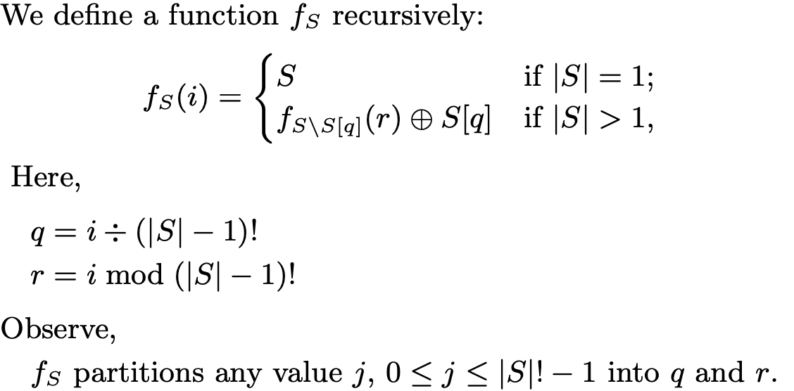
Guaranteeing Secure Ordering

Slide 42
Preventing Malicious Collusion

Slide 43
Preventing Malicious Collusion
Detection:
To detect a collusion attack, we cannot rely on the same principles of detecting a malicious leader.

Slide 44
Preventing Malicious Collusion
Detection:
To detect a collusion attack, we cannot rely on the same principles of detecting a malicious leader.
Detecting a malicious leader → If f+1 replicas complain.
Collusion Attack → No more than f replicas are complaining about the same leader.

Slide 45
Preventing Malicious Collusion
Detection:
To detect a collusion attack, we cannot rely on the same principles of detecting a malicious leader.
Detecting a malicious leader → If f+1 replicas complain.
Collusion Attack → No more than f replicas are complaining about the same leader.
Solution:
If f+1 replicas complain about multiple leaders, assume a collusion attack.

Slide 46
Preventing Malicious Collusion
Resolution:

Slide 47
Preventing Malicious Collusion
Resolution:
Run the checkpoint protocol to exchange states.
But checkpoint protocol is expensive as full state needs to be exchanged.

Slide 48
Preventing Malicious Collusion
Resolution:
Run the checkpoint protocol to exchange states.
But checkpoint protocol is expensive as full state needs to be exchanged.
Solution:
Run a lightweight checkpoint protocol.
Only exchange requests of the last epoch.

