Slide 1
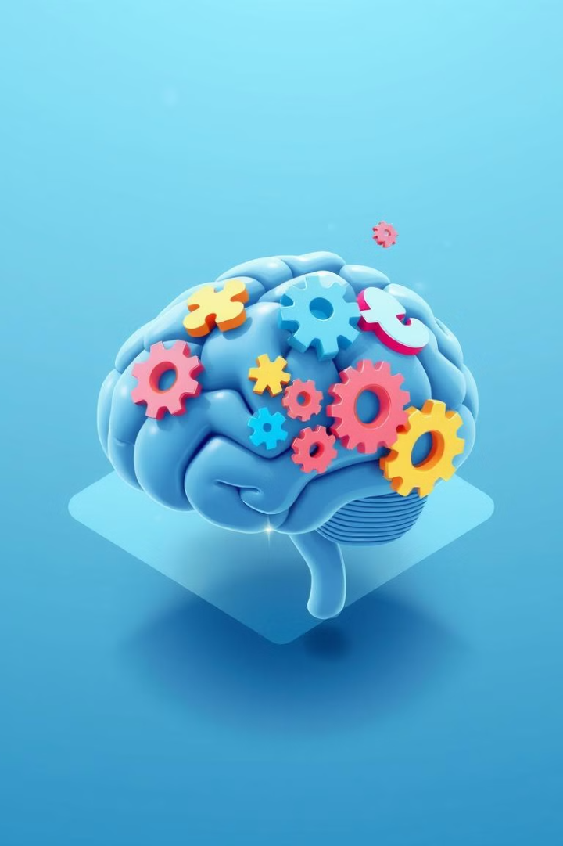

Gamification, Cognitive Psychology, and HCI: An Intertwined Exploration
Gamification
Explores the dynamic intersection of gamification
Cognitive Psychology
Delves into how gamification leverages psychological principles
Human-Computer Interaction (HCI)
Enhances user experience, motivation, and learning
Transformative Power
Surprising statistic about gamification in the digital landscape
Notes:
1

Slide 2
Defining Our Terms: Gamification and HCI
Gamification
Human-Computer Interaction (HCI)
The application of game-design elements and principles in non-game contexts. Examples include point systems, leaderboards, badges, progress bars, and challenges. The goal is to increase user engagement, motivation, enjoyment, and learning.
A multidisciplinary field focused on the design, evaluation, and implementation of interactive computing systems for human use. It encompasses usability, accessibility, and user experience.
Notes:
2

Slide 3
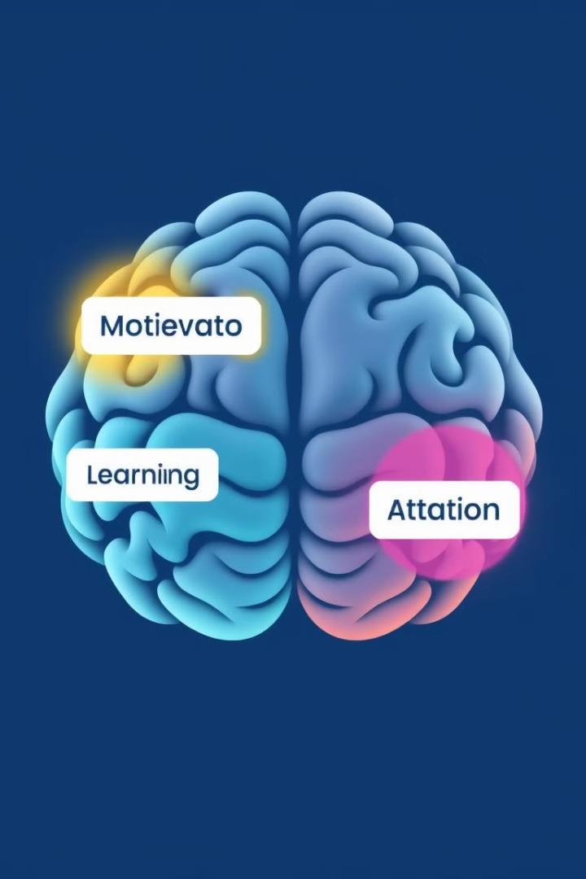
Cognitive Psychology: The Foundation of Gamification
1
Motivation
2
Learning
Intrinsic vs. Extrinsic: Gamification often uses extrinsic rewards to foster initial engagement, but the goal is to cultivate intrinsic motivation (enjoyment, mastery). Self-Determination Theory emphasizes autonomy, competence, and relatedness as key motivators.
Cognitive Load Theory: Minimizing extraneous cognitive load and maximizing germane cognitive load facilitates effective learning. The Spacing Effect enhances retention through distributed learning.
3
Attention
Selective Attention: Gamified elements should capture and maintain user attention without overwhelming them. Change Blindness suggests gradual changes are more easily accepted than abrupt ones.
Notes:
3

Slide 4




The Interplay: How Gamification Leverages Cognitive Psychology in HCI
Motivation
Learning
Attention
Progress bars provide a visual representation of progress, satisfying the need for competence and control. Points and rewards trigger dopamine release, reinforcing desired behaviors, while leaderboards appeal to social comparison and competition.
Tutorials and challenges break down complex tasks into manageable steps, reducing cognitive overload. Immediate and informative feedback enhances learning and skill development.
Game-like aesthetics capture and maintain user attention with visually appealing interfaces and engaging narratives.
Notes:
4

Slide 5
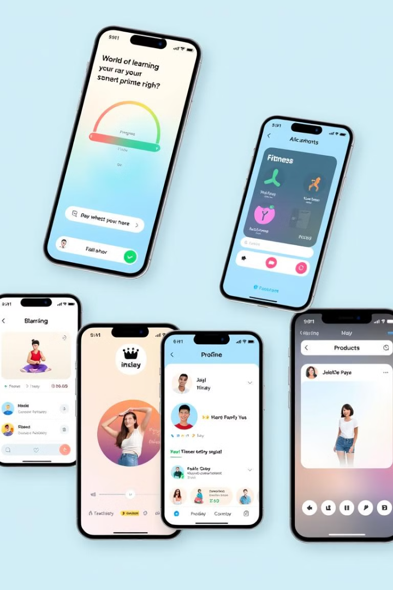
Examples in Action: Gamified HCI Applications
Education
Health & Fitness
Khan Academy utilizes points, badges, and progress tracking to motivate students. Classcraft gamifies classroom management, increasing student engagement and participation.
Fitbit uses badges, challenges, and social features to encourage physical activity. Zombies, Run! turns running into an immersive zombie survival game.
Productivity
Habitica gamifies task management, increasing adherence to goals. Forest helps users focus by planting a virtual tree that dies if they leave the app.
Notes:
5

