Slide 1
Floorplanning

Slide 2
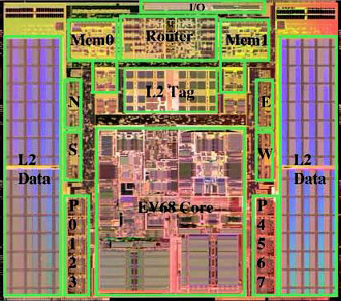
An Example Floorplan
Alpha 21364

Slide 3
Floorplanning
Problem
  Given circuit modules (or cells) and their connections, determine the approximate location of circuit elements
  Consistent with a hierarchical / building block design methodology
  Modules (result of partitioning):
    Fixed area, generally rectangular
    Fixed aspect ratio → hard macro (aka fixed-shaped blocks)
    fixed / floating terminals (pins)
    Rotation might be allowed / denied
    Flexible shape → soft macro (aka soft modules)
(w₁,h₁)
(w_{N},h_{N})
[Bazargan]
Notes:
- Note that the green module in the floorplan shown in the mid-right does not fill its “placeholder”

Slide 4
Floorplanning (cont.)
Objectives:
  Minimize area
  Determine best shape of soft modules
  Minimize total wire length
    to make subsequent routing phase easy
    (short wire length roughly translates into routability)
  Additional cost components:
    Wire congestion (exact routability measure)
    Wire delays
    Power consumption
    System throughput (e.g., CPI of a processor)
Possible additional constraints:
  Fixed location for some modules
  Fixed die, or range of die aspect ratio
[Bazargan]

Slide 5
Floorplanning: Why Important?
Early stage of physical design
  Determines the location of large blocks
  ➔ detailed placement easier (divide and conquer!)
  Estimates of area, delay, power
  ➔ important design decisions
  Impact on subsequent design steps (e.g., routing, heat dissipation analysis and optimization)
L
G
H
D
H
A
J
I
D
C
K
E
C
G
K
I
B
J
B
F
E
L
F
A
Figs: [©Sherwani]
[Bazargan]

Slide 6
Floorplan Classes
Slicing, recursively defined as:
  A module OR
  A floorplan that can be partitioned into two slicing floorplans with a horizontal or vertical cut line
1
3
Slicing
floorplan
2
4
7
6
5
Corresp.
Slicing
tree
1234567
Non-slicing
  Superset of slicing floorplans
  Contains the “wheel” shape too.
167
2345
67
1
234
5
6
7
2
34
3
4
Non-Slicing
floorplan
[©Sarrafzadeh]
[Bazargan]
Notes:
The non-slicing floorplan shown here is the smallest non-slicing floorplan.

Slide 7
Non-slicing Floorplan Example
Hierarchical floorplan of order 5
  Templates
  Floorplan and tree example
L5
R5
2
R5
3
1
4
3
5
6
1
6
2
7
8
7
8
4
5
[©Sarrafzadeh]
[Bazargan]

Slide 8
Floorplanning Algorithms
Components
  “Placeholder” representation
    Usually in the form of a tree
    Slicing class: Polish expression [Otten]
    Non-slicing class: O-tree, Sequence Pair, BSG, etc.
    Just defines the relative position of modules
  Perturbation
    Going from one floorplan to another
    Usually done using Simulated Annealing
  Floorplan sizing
    Definition: Given a floorplan tree, choose the best shape for each module to minimize area
    Slicing: polynomial, bottom-up algorithm
    Non-slicing: NP! Use mathematical programming (exact solution)
  Cost function
    Area, wire-length, ...
[Bazargan]

Slide 9
Bounds on Aspect Ratios
We can also allow several shapes for each block:
For hard blocks, the orientations can be changed:
[Pan]

Slide 10
Area Utilization, Hard and Soft Modules
The hierarchy tree and floorplan
define “place holders” for modules
Area utilization
  Depends on how nicely
  the rigid modules’ shapes are matched
  Soft modules can take different shapes to
  “fill in” empty slots ➔ floorplan sizing
1
2
3
m3
m1
m3
m1
m1
m2
m2
4
m4
m4
7
6
m7
m7
5
m6
m6
m5
m7
m5
m7
m7
Area = 20x22 = 440
Area = 20x19 = 380
[Bazargan]
Notes:
Assuming all modules are soft with absolute flexibility (i.e., fixed area, any aspect ratio), how can you size a floorplan?

Slide 11
Bounds on Aspect Ratios
If there is no bound on the aspect ratios, can we pack everything tightly?
  - Sure!
But we don’t want to layout blocks as long strips, so we require r_{i} ≤ h_{i}/w_{i} ≤ s_{i} for each i.
[Pan]

Slide 12
Floorplan Sizing for Slicing Floorplans
Bottom-up process
Has to be done per floorplan perturbation
Requires O(n) time.
  n is the total number of shapes of all the modules
V
H
L
R
T
B
b_{i}
a_{i}
b_{i}+y_{j}
b_{i}
y_{j}
max(b_{i}, y_{j})
y_{j}
a_{i}
x_{j}
x_{j}
a_{i}+ x_{j}
max(a_{i}, x_{j})
[©Sarrafzadeh]
[Bazargan]

Slide 13
Sizing Slicing Floorplans
Simple case:
  All modules are hard macros
  No rotation allowed
  ➔ one shape only
3
1
2
4
7
6
5
17x16
1234567
9x15
167
2345
8x16
m3
m1
9x7
67
1
234
8x11
5
m2
m4
8x8
7x5
m6
6
7
2
34
4x11
m7
m5
4x7
5x4
4x8
3
4
3x6
4x5
[Bazargan]
Notes:
Does the exact order in which we perform the sizing matter?
No. As long as it’s a bottom-up order, the exact order doesn’t matter (e.g., [34] can be sized before or after [67])
When doing the bottom-up sizing, can we determine the location of the bottom-left corner of each block?

Slide 14


Sizing Slicing Floorplans (cont.)
What if modules have more than one shape?
If area only concern:
  Module A has shapes 4x6, 7x8, 5x6, 6x4, 7x4,
  which ones should we pick?
  Module A has shapes 4x6, 5x5, 6x4,
  which ones should we pick?
Dominant points
  Shape (x₁, y₁) dominates (x₂, y₂)
  if x₁ ≤ x₂ and y₁ ≤ y₂.
A
B
γ
p
q
α dominates p
α
β dominates r
β
r
β dominates q
[Bazargan]
Notes:
Can area alone be a factor in eliminating a shape? (e.g., 4x6, 5x5)

Slide 15
Sizing Slicing Floorplans: Poor Implementation
a1
a2
A
B
a3
4x6
5x5
6x4
b1
b1
b1
b1
a1
a2
a3
2x7
6x7
7x7
8x7
a1
a2
b2
b2
b2
a3
b2
3x4
7x6
8x5
9x4
a1
a2
a3
b3
b3
b3
b3
4x2
8x6
9x5
10x4
[Bazargan]
Notes:
Note that the shapes are sorted (decreasing height)
Claim: if you sort the shapes on decreasing height, the widths HAVE TO be in increasing order. Why?
Each dominating width or height will eliminate the elements to the right of an item in a row, or the elements to the bottom of an element in a column.
Why does a1,b1 eliminate a2,b1 and a3,b1?
Note that the resulting shapes are also in inc height / dec width order
What if we are dealing with a horizontal cut?

Slide 16
Sizing Slicing Floorplans: REAL computation
a1
a2
A
B
a3
4x6
5x5
6x4
b1
b1
a1
2x7
6x7
a1
a2
b2
b2
b2
a3
b2
3x4
7x6
8x5
9x4
b3
4x2
[Bazargan]
Notes:
Note that the shapes are sorted (decreasing height)
Claim: if you sort the shapes on decreasing height, the widths HAVE TO be in increasing order. Why?
Each dominating width or height will eliminate the elements to the right of an item in a row, or the elements to the bottom of an element in a column.
Why does a1,b1 eliminate a2,b1 and a3,b1?
Note that the resulting shapes are also in inc height / dec width order
What if we are dealing with a horizontal cut?

Slide 17
Slicing Floorplan Sizing Algorithm
Procedure Vertical_Node_Sizing
Input: Two sorted lists L = { (a₁, b₁), ... , (a_{s},b_{s}) },
R = { (x₁, y₁), ... , (x_{t}, y_{t}) }
where a_{i} < a_{j}, b_{i} > b_{j}, for all i < j; x_{i} < x_{j}, y_{i} > y_{j} for all i < j
Output: A sorted list H = { (c₁, d₁), ... , (c_{u},d_{u}) }
where u ≤ s + t - 1, c_{i} < c_{j}, d_{i} > d_{j} for all i < j
begin
H := φ
i := 1, j := 1, k = 1
while (i ≤ s) and (j ≤ t) do
begin
(c_{k}, d_{k}) := (a_{i} + x_{j}, max(b_{i}, y_{j}))
H := H ∪ { (c_{k}, d_{k}) }
k := k + 1
if max(b_{i}, y_{j}) = b_{i} then i := i + 1
if max(b_{i}, y_{j}) = y_{j} then j := j + 1
end
end
[©Sarrafzadeh]
[Bazargan]
Notes:
What happens if bi == yj? Would the algorithm still work correctly?
What change do we have to make to do horizontal node sizing? Can we keep the sorting order?

Slide 18
Slicing Floorplan Sizing
Input: floorplan tree, modules shapes
Start with sorted shapes lists of modules
In a bottom-up fashion, perform:
  Vertical_Node_Sizing
  AND
  Horizontal_Node_Sizing
When get to the root node, we have a list of shapes. Select the one that is best in terms of area
In a top-down fashion, traverse the floorplan tree and set module locations
[Bazargan]

Slide 19
Find the Best Area
Recursively combining shape curves.
Pick the
best
2
V
1
3
H
1
3
2
[Pan]

Slide 20
Wire Length
For hyperedges:
  Either of complete graph, MST, or Steiner tree
For each edge:
  Euclidian distance sqrt( (x₁-x₂)² + (y₁-y₂)² ).
    Direct lines
  Manhattan distance |x₁ – x₂| + |y₁ – y₂|
    Manhattan: Only horizontal / vertical lines
(a) Steiner tree
(b) minimum spanning tree
(c) complete graph
(length = 13)
(length = 11)
(length = 32)
[©Sherwani]
[Bazargan]

Slide 21
Polish Expression
Tree representation of the floorplan
  Left child of a V-cut in the tree represents
  the left slice in the floorplan
  Left child of an H-cut in the tree represents
  the top slice in the floorplan
Polish expression representation
  A string of symbols obtained by traversing a binary tree in post-order.
3
1
2
4
7
6
5
1
5
7
6
2
3
4
1 7 6 | - 2 3 4 - | 5 - |
[Bazargan]
Notes:
How to uniquely represent a floorplan using a tree?
In a Polish expression, can the last character be an operand? Can the first or the second character be an operator?
If we traverse a Polish expression from left to right, and use a counter to increment when we see an operand and decrease when we get to an operator, what is the physical meaning of such a counter? Can we get to a count value of zero? At the end, what should be the value?
What data structure can we use to convert a Polish expression to a tree?

Slide 22
Normalized Polish Expression
Problem with Polish expressions?
  Multiple representations for some slicing trees
    When more than one cut in one direction cut a floorplan
  Larger solution space
  A stochastic algorithm (e.g., Simulated Annealing) will be more biased towards floorplans with multiple representations
    (More likely to be visited)
4
1
3
3
4
2
1
2
3
4
1
2
1 2 - 3 4 | |
1 2 - 3 | 4 |
[©Sarrafzadeh]
[Bazargan]
Notes:
Is any of the shown trees better?
No. Both generate the same floorplan with the same area (sizing is done in linear time in both cases too).

Slide 23
Normalized Polish Expression (cont.)
Solution?
  Assign priorities to the cuts
  In a top-down tree construction,
    Pick the right-most cut
    Pick the lowest cut
  Result: no two same operators
  adjacent in the Polish expression
  (i.e., no “| |” or “— —”)
4
3
5
1
1
2
2
3
4
1 2 – 5 - 3 | 4 |
5
[Bazargan]
Notes:
We picked this representation, because maybe it’s easier to check.

Slide 24
Simulated Annealing
Idea originated from observations of crystal formations (e.g., in lava)
  A crystal is in a low energy state
  Materials tend to form crystals (global minimum)
  If at the right temperature (i.e., right speed), a molecule will adhere to a crystal formation
Very slowly decrease temperature
  When very hot, molecules move freely
    When a molecule gets to a chunk of crystal,
    it *might* move away due to its high speed
  When colder, molecules slow down
    The probability of moving away from a local optimum decreases
  When the material “freezes”, all molecules are fixed and the material is in minimum energy state
[Bazargan]

Slide 25
Simulated Annealing Algorithm
Components:
  Solution space (e.g., slicing floorplans)
  Cost function (e.g., the area of a floorplan)
    Determines how “good” a particular solution is
  Perturbation rules
  (e.g., transforming a floorplan to a new one)
  Simulated annealing engine
    A variable T, analogous to temperature
    An initial temperature T₀ (e.g., T₀ = 40,000)
    A freezing temperature T_{freez} (e.g., T_{freez}=0.1)
    A cooling schedule (e.g., T = 0.95 * T)
[Bazargan]
Notes:
What properties should the perturbation rules have?
Fast
Cover all the solution space
Not biased towards a particular class of solutions

Slide 26
Simulated Annealing Algorithm
Procedure SimulatedAnnealing
curSolution = random initial solution
T = T₀ // initial temperature
while (T > T_{freez}) do
for i=1 to NUM_MOVES_PER_TEMP_STEP do
nextSol = perturb (curSolution)
Δcost = cost(nextSol) – cost(curSolution)
if acceptMove (Δcost, T) then
curSolution = nextSol // accept the move
T = coolDown (T )
Procedure acceptMove (Δcost, T)
if Δcost < 0 then return TRUE // always accept a good move
else
boltz = e^{-Δcost / k T} // Boltzmann probability function
r = random(0,1) // uniform rand # between 0&1
if r < boltz then return TRUE
else return FALSE
[Bazargan]
Notes:
Think of the boltz exp function as a mapping process that maps delta_cost to [0,1] on the average at the beginning, and to [0,0] at the end. (“on average” is important).
So, when you generate a uniformly random number between [0,1], chances that it is less than “boltz” – i.e., you accept a bad move (on average over that particular temperature) is going to be equal to “boltz”.

Slide 27
Simulated Annealing: Move Acceptance
Good moves are always accepted
Accepting bad moves:
  When T = T₀, bad move acceptance probability ≈ 1
  When T = T_{freez}, Bad move acceptance probability = 0
Boltzmann probability function?!?
  boltz = e^{-Δcost / k T}.
  k is the Boltzmann constant,
  chosen so that all moves at the initial temperature
  are accepted
[Bazargan]

Slide 28
Simulated Annealing: More Insight...
Annealing steps
[Bazargan]

Slide 29
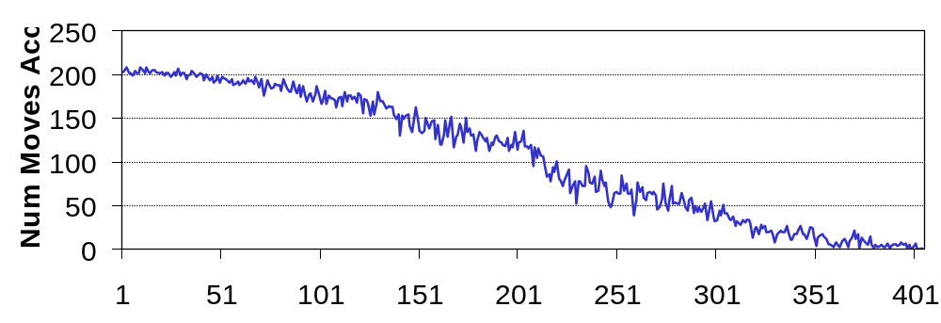
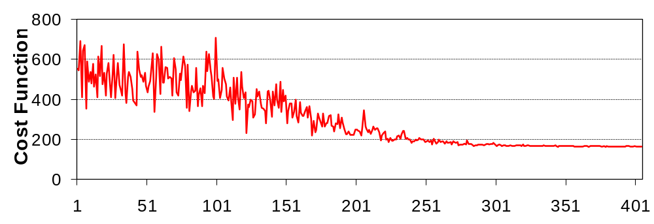
Simulated Annealing: More Insight...
[Bazargan]

Slide 30
Wong-Liu Floorplanning Algorithm
Uses simulated annealing
Normalized Polish expressions represent floorplans
Cost function:
  cost = area + λ totalWireLength
  Floorplan sizing is used to determine area
  After floorplan sizing, the exact location of each module is known, hence wire-length can be calculated
[Bazargan]
Notes:
What will a designer do, if wire length is more important than the area?

Slide 31
Wong-Liu Floorplanning Algorithm (cont.)
Moves:
  OP1: Exchange two operands that have
  no other operands in between
  OP2: Complement a series of operators
  between two operands
  OP3: Exchange adjacent operand and operator if the resulting expression still a normalized Polish exp.
4
3
2
4
3
4
2
4
3
OP1
1
2
OP2
OP3
1
1
2
1
3
12 | 4 – 3 |
12 | 3 – 4 |
12 - 3 – 4 |
12 - 3 4 - |
[©Sarrafzadeh]
[Bazargan]
Notes:
Why these moves?
Can we replace OP2 with a move that flips only one operator?
No. It will violate the normalized condition (if you avoid it, it might prohibit the moves set to reach all solutions)

Slide 32
The Sequence Pair Algorithm
Sequence-Pair is a succinct representation of non-slicing floorplans of rectangles
  Just like Polish Expression for slicing floorplans
Represent a non-slicing floorplan by a pair of sequences of blocks
Using Simulated Annealing to find a good sequence-pair
Can only handle hard blocks
  i.e., cannot do things like shape-curve computation
Essentially macro placement
Techniques for soft block shaping exist (e.g., using Lagrangian Relaxation) but are very slow
[Pan]

Slide 33
Positive step lines
d
e
a
c
b
f

Slide 34
Is this unique?
d
e
a
c
b
f

Slide 35
Not the same as…
d
e
a
c
b
f

Slide 36
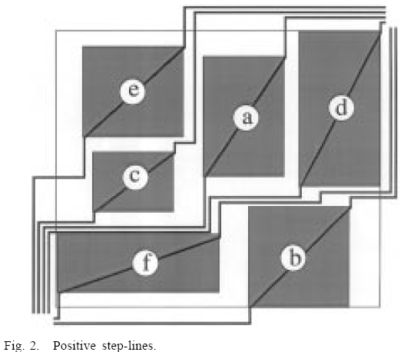
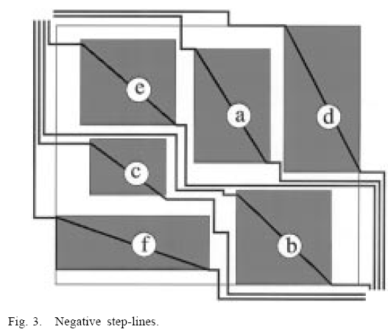
Sequence Pair
Negative step line sequence: fcbead
Positive step line sequence: ecadfb
[or ecafdb in the alternative version]
[Pan]

Slide 37
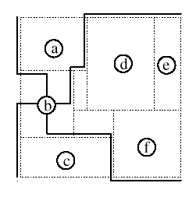
Positive Locus and Negative Locus
Positive Locus
of Block b
Negative Locus
of Block b
[Pan]

Slide 38
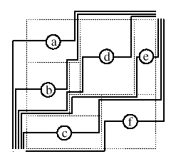
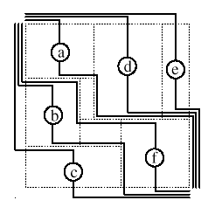
Sequence-Pair
Positive Loci
Negative Loci
Sequence-Pair = (abdecf, cbfade)
[Pan]

Slide 39
Geometric Info of Sequence-Pair
Given a placement and the corresponding sequence-pair (P, N):
a right of b ⇔ a is after b in both P and N.
c
c
a
a
b
b

Slide 40
Geometric Info of Sequence-Pair
Given a placement and the corresponding sequence-pair (P, N):
a above b ⇔ a is before b in P and after b in N
a
a
b
b
c
c

Slide 41
Positive Locus and Negative Locus
Positive Locus
of Block b
above
left
right
below
Negative Locus
of Block b
[Pan]

Slide 42
Geometric Info of Sequence-Pair
Given a placement and the corresponding sequence-pair (P, N):
a right of b ⇔ a is after b in both P and N.
a left of b ⇔ a is before b in both P and N.
a above b ⇔ a is before b in P and after b in N.
a below b ⇔ a is after b in P and before b in N.
[Pan]

Slide 43
Sequence Pair
Negative step line sequence: fcbead
Positive step line sequence: ecadfb
[Pan]

Slide 44
Example
Consider the sequence pair:
(13245,41352)
Any other SP that is also valid for this packing?
3
2
1
5
4
[Pan]

Slide 45
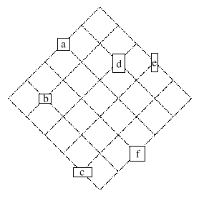
From Sequence-Pair to a Floorplan
Labeled grid for
(abdecf, cbfade)
Given a sequence-pair, the floorplan with smallest area can be found in O(n²) time.
Algorithms of time O(n log log n) or O(n log n) exist. But faster than O(n²) algorithm only when n is quite large.
e
d
a
f
b
c
a
b
d
e
c
f
[Pan]

Slide 46
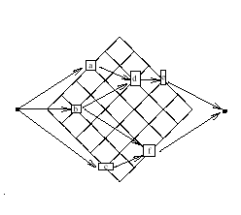
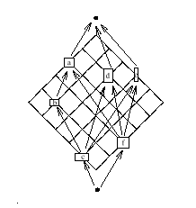
From Sequence-Pair to Placement
Distance from left (bottom) edge can be found using the longest path algorithm on the horizontal (vertical) constraint graph.
Horizontal Constraint Graph
Vertical Constraint Graph
[Pan]

Slide 47
The longest path problem
Layout compaction
  Given a set of blocks, place them in the most compact way possible
  The 2D compaction problem is often solved as a sequence of 1D problems, in the x and y directions
w_{b}
w_{a}
b
a
x_{b} - x_{a} ≥ w_{a}
A set of such “≥” constraints
represents a longest path problem
x_{a}
x_{b}

Slide 48
Example
Horizontal constraint graph
1.2
1.1
1
G_{h}
3
1.1
2
3
1.2
1
2
1.2
1
1.2
1.1
2
1.2
5
5
2
s
4
2.4
1
4
Vertical constraint graph
2.4
1.2
G_{v}
3
2
1
2
1
1
All red edges from the source have zero edge weight
Can also create a sink vertex t, with edges from each
vertex to t, with weight = dimension of the block
represented by the vertex
S represents the left [bottom] edge, t = right [top] edge
5
4
s
Adapted from [Pan]

Slide 49
Solving the longest path problem
Place inputs (with no predecessors) on a queue
Process vertex from head of queue
Add vertex to queue if all inputs processed
Complexity O(V+E)
a
e
2
2
j
8
3
b
f
4
4
l
i
3
11
1
5
c
g
3
3
4
k
d
4
h
2
7

Slide 50
Floorplan Realization
Floorplan realization is the step to construct a floorplan from its representation.
How to construct a floorplan from a sequence pair?
We can make use of the horizontal and vertical constraint graphs (G_{h} and G_{v}).
[Pan]

Slide 51
Floorplan Realization
Whenever we see (…A…B…, …A…B…), add an edge from A to B in G_{h} with weight w_{A}.
Whenever we see (…A…B…, …B…A…), add an edge from B to A in G_{v} with weight h _{B}.
Add a source vertex s to G_{h} and G_{v} pointing, with weight 0, to all vertices without incoming edges.
Finally, find the longest paths from s to every vertex in G_{h} and G_{v} (how?), which are the coordinates of the lower left corner of the module in the packing.
[Pan]

Slide 52
Moves
Three kinds of moves in the annealing process:
  M1: Rotate a module, or change the shape of a
  module
  M2: Interchange 2 modules in both sequences
  M3: Interchange 2 modules in the first sequence
Does this set of move operations ensure reachability? Why?
[Pan]

Slide 53
Pros and Cons of SP
Advantages:
  Simple representation
  All floorplans can be represented.
  The solution space is finite. (How big?)
Disadvantages:
  Redundant representation. The representation is not 1-to-1.
  The size of the constraint graphs, and thus the runtime to construct the floorplan is quadratic
[Pan]

Slide 54
*-Tree Methods
Various methods and representations for nonslicing floorplans
  Bounded slicing grid (BSG) (1996)
  O-tree (1999)
  B*-tree (2000)
  Corner block list (CBL) (2000)
  Transitive closure graph (TCG) (2001)
These represent nonslicing floorplans by strings and use simulated annealing to optimize the layout.

Slide 55
Reexamining the assumptions of floorplanning

Slide 56
Overconstrained Shaping
Why rectangles, L’s, T’s ?
  available granularity is by site spacing, row height
  placers can handle arbitrarily complex region constraints
  hard IP reuse, generated modules benefit from shape freedom
Why non-overlapping ?
  only requirement: total assigned cell area ≤ total resource area
Roundness and shape simplicity are mythical needs
  constructive pin assignment → don’t need roundness
  path timing optimization → may even want disconnected shapes
[Kahng]

Slide 57
This is Okay, Really... (Trust Me)
1.0
0.5,0.5
1.0
Blk A
Blk B
[Kahng]

Slide 58
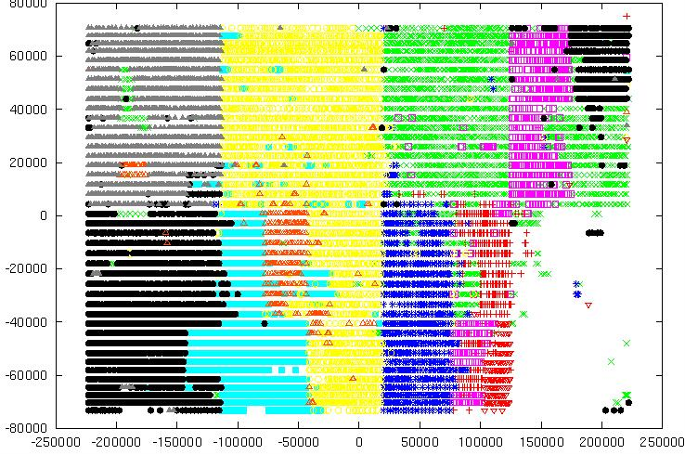
...The Cells Won’t Mind
[Kahng]

Slide 59
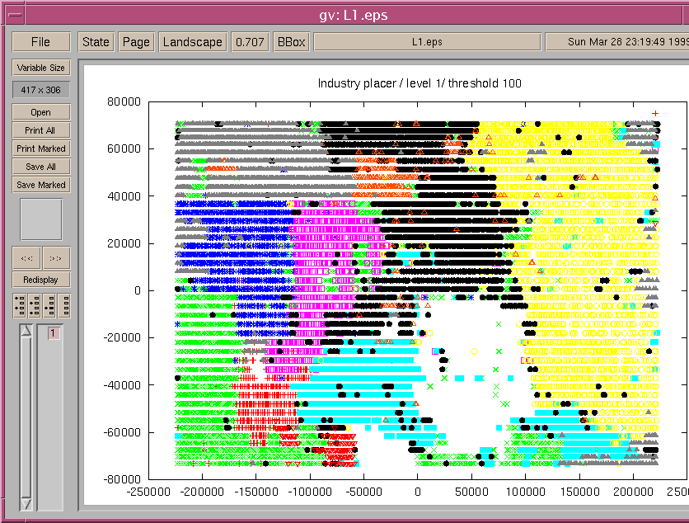
Using Floorplan Information: A Typical “Fluid” Placement
[I. Markov]

Slide 60
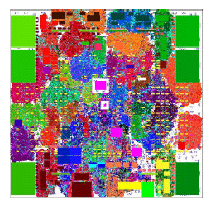
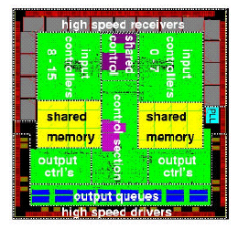
Flat vs. hierarchical placement
Flat
Works well for highly interconnected networks
Hierarchical
Good choice for SoC
Can hybridize the two to get best of both worlds
[Lackey et al., IBM, DAC 03]

Slide 61
Other Objective Functions

Slide 62
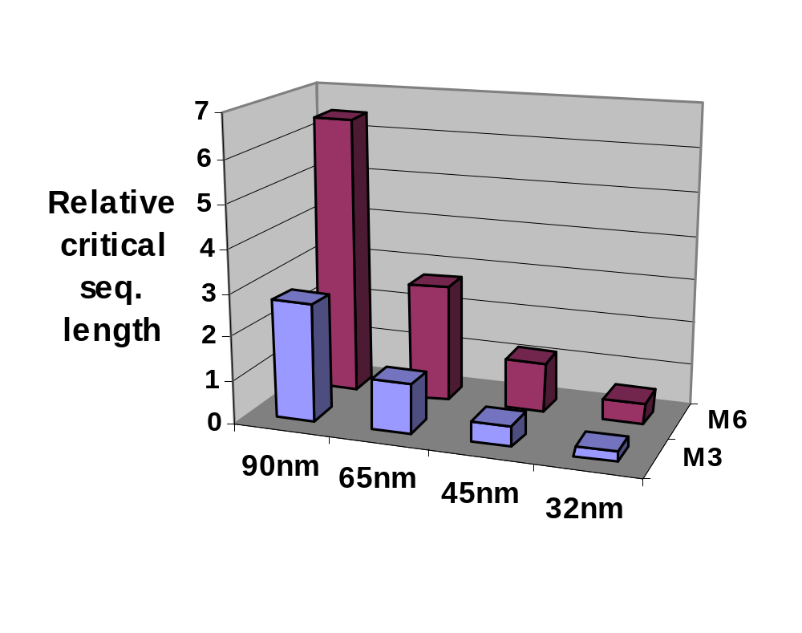
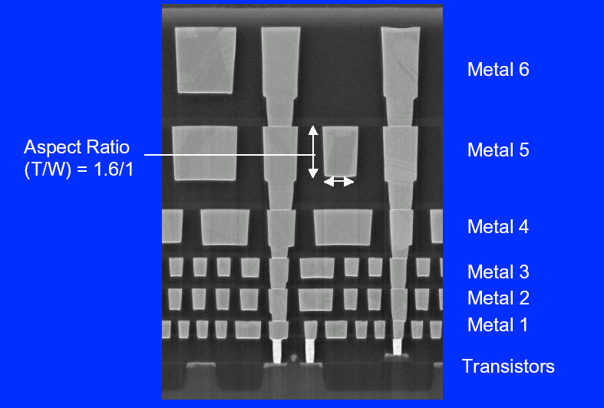
Wire delays
Critical length as a function of technology
  Wire length at which delay = clock period
    Across-chip wire delays > clock period
    ⇒ Multicycle global communication is essential
Chip cross-section
0.43x
[Saxena (Intel), ISPD03]
[Intel]

Slide 63
Wire-pipelining
Interconnect delay is distributed among several clock cycles by inserting flip-flops
Adds area/power overhead
Delay = 0.67ns (70nm)
  [Cong, Proc. IEEE 2001]
Target Frequency : 3GHz
(clock period : 0.33ns)
1cm
1cm
Widely used, e.g., Intel’s Itanium processor

Slide 64
An Example Microarchitectue
EX0
Int Rename
Int Reg File 0
4
2
EX1
MDH
Int scheduler
EX2
4
Reorder Buffer
2
Int Reg File 1
Bpred
FTQ
IFetch
MDH
EX3
4
4
D-cache
EX0
FP Rename
FP Scheduler
FP Reg File
4
2
EX1
8
Bus Interface Unit
41 blocks, 21 latch banks
Numbers below the lines indicate the # of instructions flowing across the line (not bit width)
MDH = Memory Disambiguation Hardware

Slide 65
An Architectural Solution to Interconnect Tyranny
As seen earlier, alternate scaling scenarios also face interconnect tyranny (albeit to differing degrees)
Most promising approach: simplify interconnection complexity architecturally
  Modify wiring histogram shape (i.e. Rent’s parameters) of design
An example: multi-core microprocessors
  Goes counter to traditional approach of increased integration through block size scaling
# wires
wirelength
[Saxena]

Slide 66
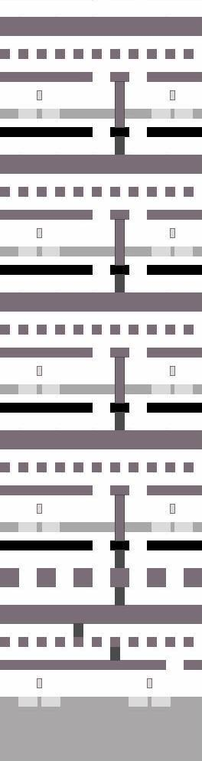
3D integrated circuits
Detailed view
Generalized view
Layer 5
SOI wafers with bulk substrate removed
Layer 4
Inter-layer
bonds
Layer 3
1μm
Layer 2
Bulk wafer
Metal level
of wafer 1
Layer 1
10μm
Device
level 1
Bulk Substrate
500μm
Adapted from
[Das et al., ISVLSI, 2003]

Slide 67
Global Net Length Distribution
Histogram of net length, for various numbers of 3D layers
3D Global Net Distributions
1400
1200
4 Strata
1000
2 Strata
1 Stratum
800
600
Net Density (#/mm)
400
200
0
0
5
10
15
20
25
30
35
Length (mm)

Slide 68
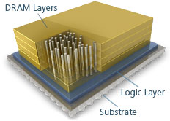

Examples
Micron HMC
AMD HBM
https://www.micron.com/products/hybrid-memory-cube/all-about-hmc
https://www.anandtech.com/show/9266/amd-hbm-deep-dive

