Slide 1

Learn Deeply about Cryptocurrency
Part 2
Deep learning applied to price prediction
Joseph Lee, Eric Ng

Slide 2
Outline
Introduction
Data Preprocessing i.e Denoising, Data Augmentation, Scaling
Problem with Scaling
Trading Bot Framework
Network Architecture
Performance Metrics / Profitability
Closing Words

Slide 3
Introduction
Financial Time Series Forecasting is notoriously difficult
Maybe LSTM can be applied to Financial Markets as a forecasting technique!
We want to use the past prices to predict future prices
Try to predict future daily close prices of Bitcoins and Ethereum

Slide 4
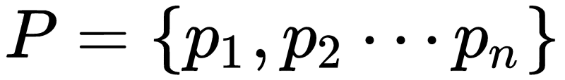
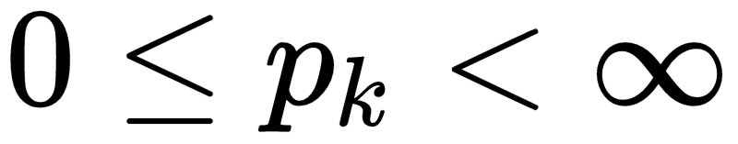
What do we want the Neural Network to Learn?
Consider any arbitrary set of prices:
We wish to learn a function which does the following:
Where j denotes the size of the lookback window
How to find optimal window?
We assume nothing about the underlying Distribution of the price process
Except the fact that
And the prices are autocorrelated (This can be checked)
Is this a good model?

Slide 5
Maybe we can do better!
Assume GDAX (Exchange we are using) traders use technical Indicators
Maybe we can have our Neural Network trade like a professional Trader!
This leads us into the process of data Augmentation

Slide 6
Input Data
Open
High
Low
Close
Volume
Technical Indicators

Slide 7
Technical Indicators
Indicators | Description
MACD | Moving average convergence divergence: displays trend following characteristics and momentum characteristics.
CCI | Commodity channel index: helps to find the start and the end of a trend.
ATR | Average true range: measures the volatility of price.
BOLL | Bollinger Band: provides a relative definition of high and low, which aids in Pattern Recognition
EMA20 | 20 day Exponential Moving Average
MA5/MA10 | 5/10 day Moving Average
ROC | Price rate of change: shows the speed at which a stock’s price is changing

Slide 8
Technical Indicators (cont.)
Indicators | Description
SMI | Stochastic Momentum Index: shows where the close price is relative to the midpoint of the same range.
WVAD | Williams’s Variable Accumulation/Distribution: measures the buying and selling pressure.

Slide 9
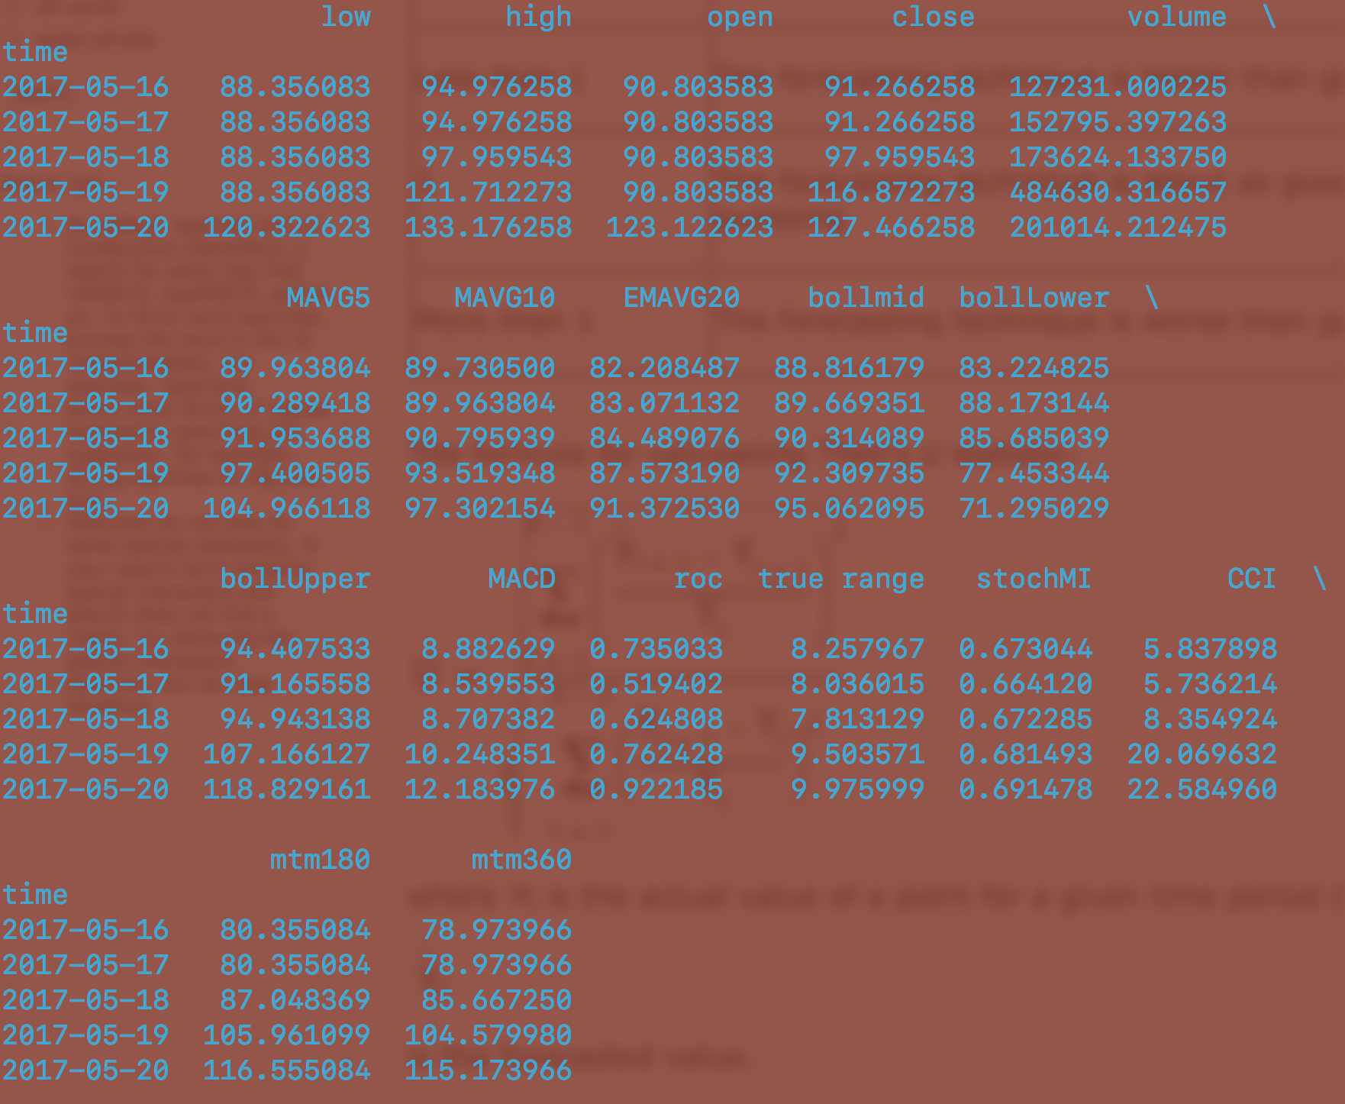
Technical Indicators (cont.)

Slide 10
Denoising using Wavelet Transform
There is a lot of noise in our data
Approach: Smooth the data by eliminating the spikes and leaving only the trends
The wavelet transform works by transforming the data which is in the time domain onto the frequency domain.
This produces high and low frequency coefficients describing the data
We threshold the high frequency coefficients and transform it back into the time domain
This leaves only the low frequency components and therefore the trends in the data
Reference:https://www.mathworks.com/help/wavelet/ug/wavelet-denoising.html
This is accomplish using third party library called pywavelet

Slide 11
Scaling Data
Each time series (high, low, MACD) all take values over different ranges
This poses a problem for our Neural Network
low | high | open | close | volume | MAVG5 | MAVG10 | EMAVG20 | bollmid | bollLower | bollUpper | MACD | roc | true range | stochMI | CCI
4691.37 | 4963.6 | 4931.6 | 4931.59 | 54488.4 | 4700.9 | 4624.66 | 4393.12 | 4547.63 | 4209.41 | 5156.16 | 429.27 | 0.72 | 402.08 | 0.92 | 27.41
14.33 | 581.12 | 548.3 | 541.98 | 683.8 | 576.3 | 579.51 | 583.65 | 579.5 | 498.43 | 580.74 | -125.39 | -0.26 | 6.64 | -0.28 | -24.32
The neural network should not favor any particular column
Also poses issues because of large numbers cause numerical instability

Slide 12
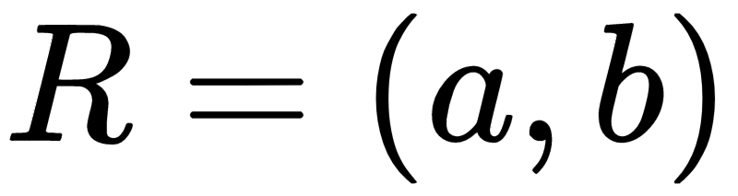
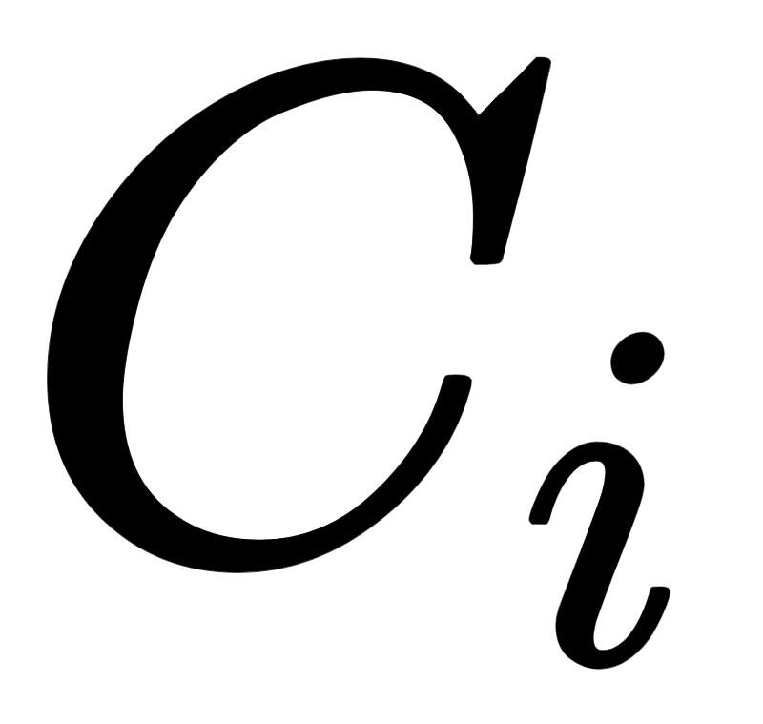

Min Max Scaler
Let be our feature range
In our case the range is going to be -1 to 1
For each column in our dataset
We obtain new columns by apply the following function element-wise to each value in

Slide 13
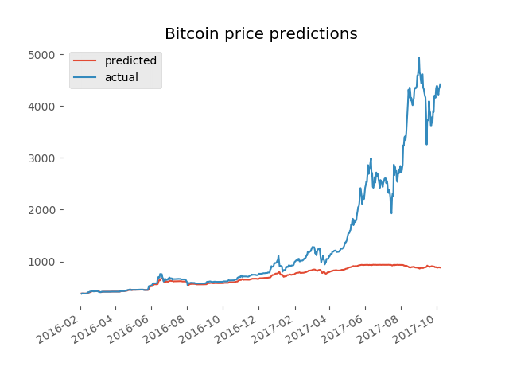
Anyone see the problem?

Slide 14
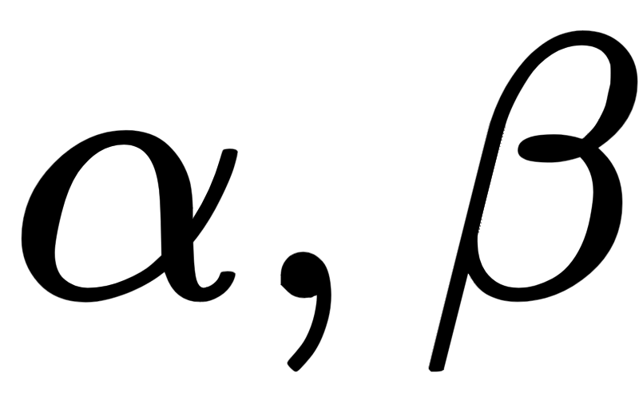
Problem with the Scaler
Min Max Scaler cannot handle values outside of the pre-computed max and min for each column
We handle this by introducing new parameters
These values will be used to estimate a lower and upper bound on what we think future prices will look like.
Inevitably this means we will need to retrain our model
New Scaling equation :

Slide 15
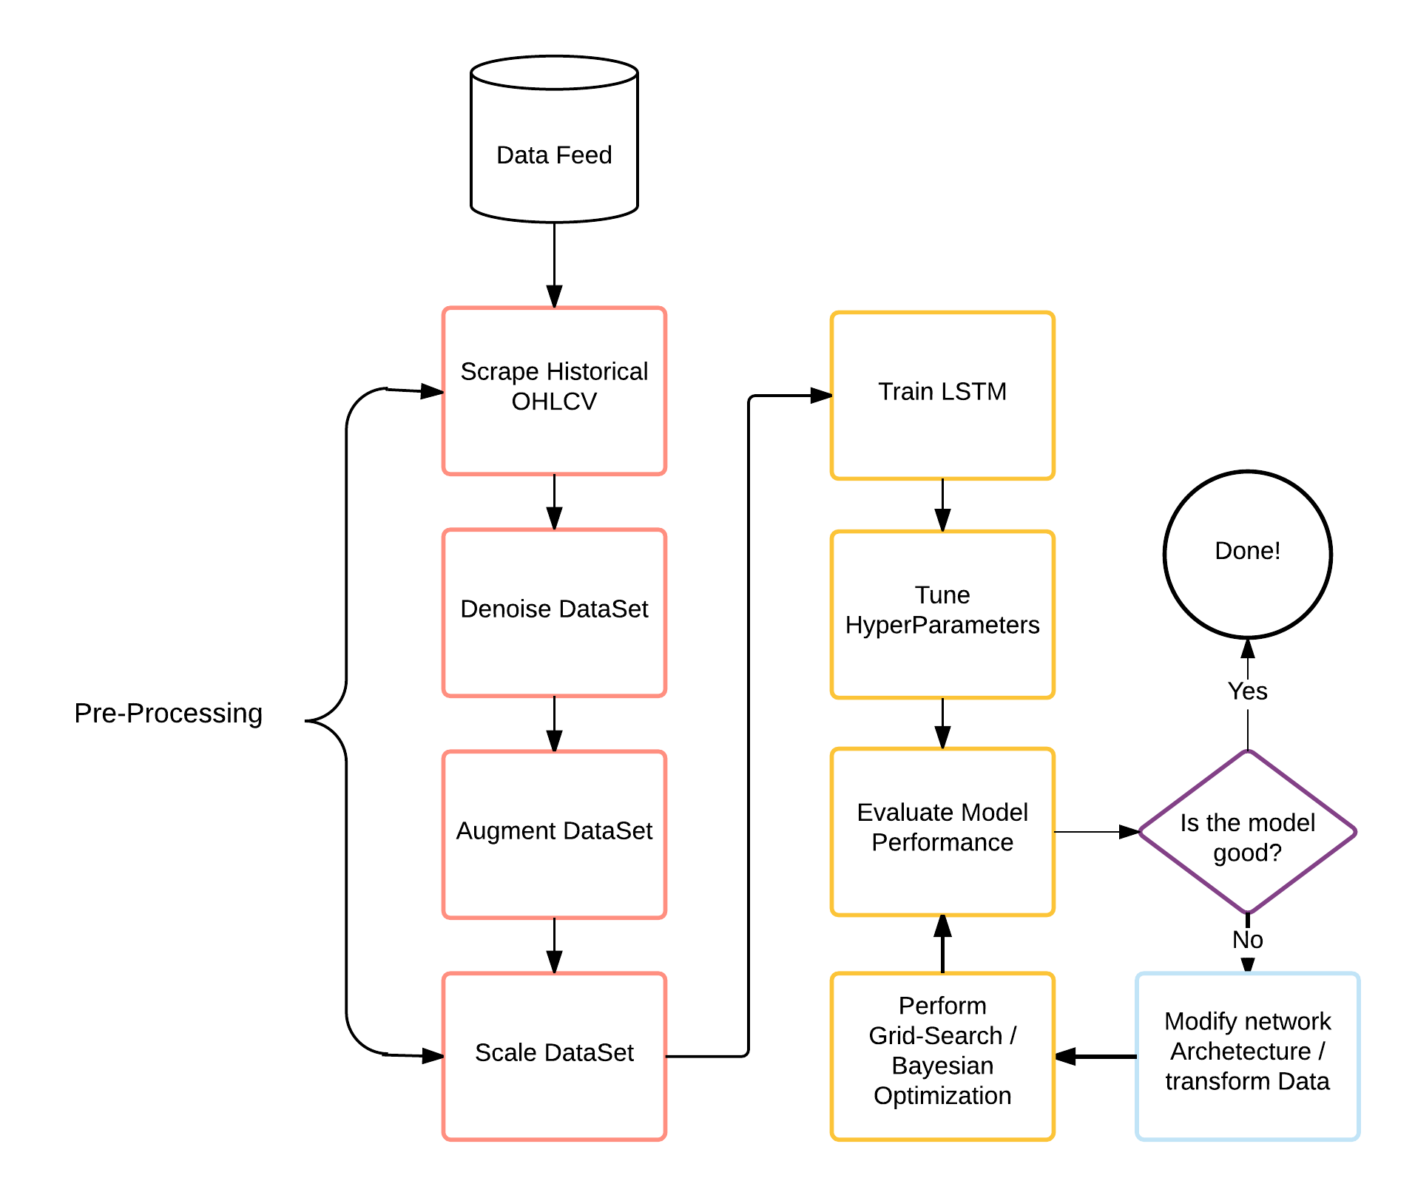
Neural Network
Flowchart

Slide 16
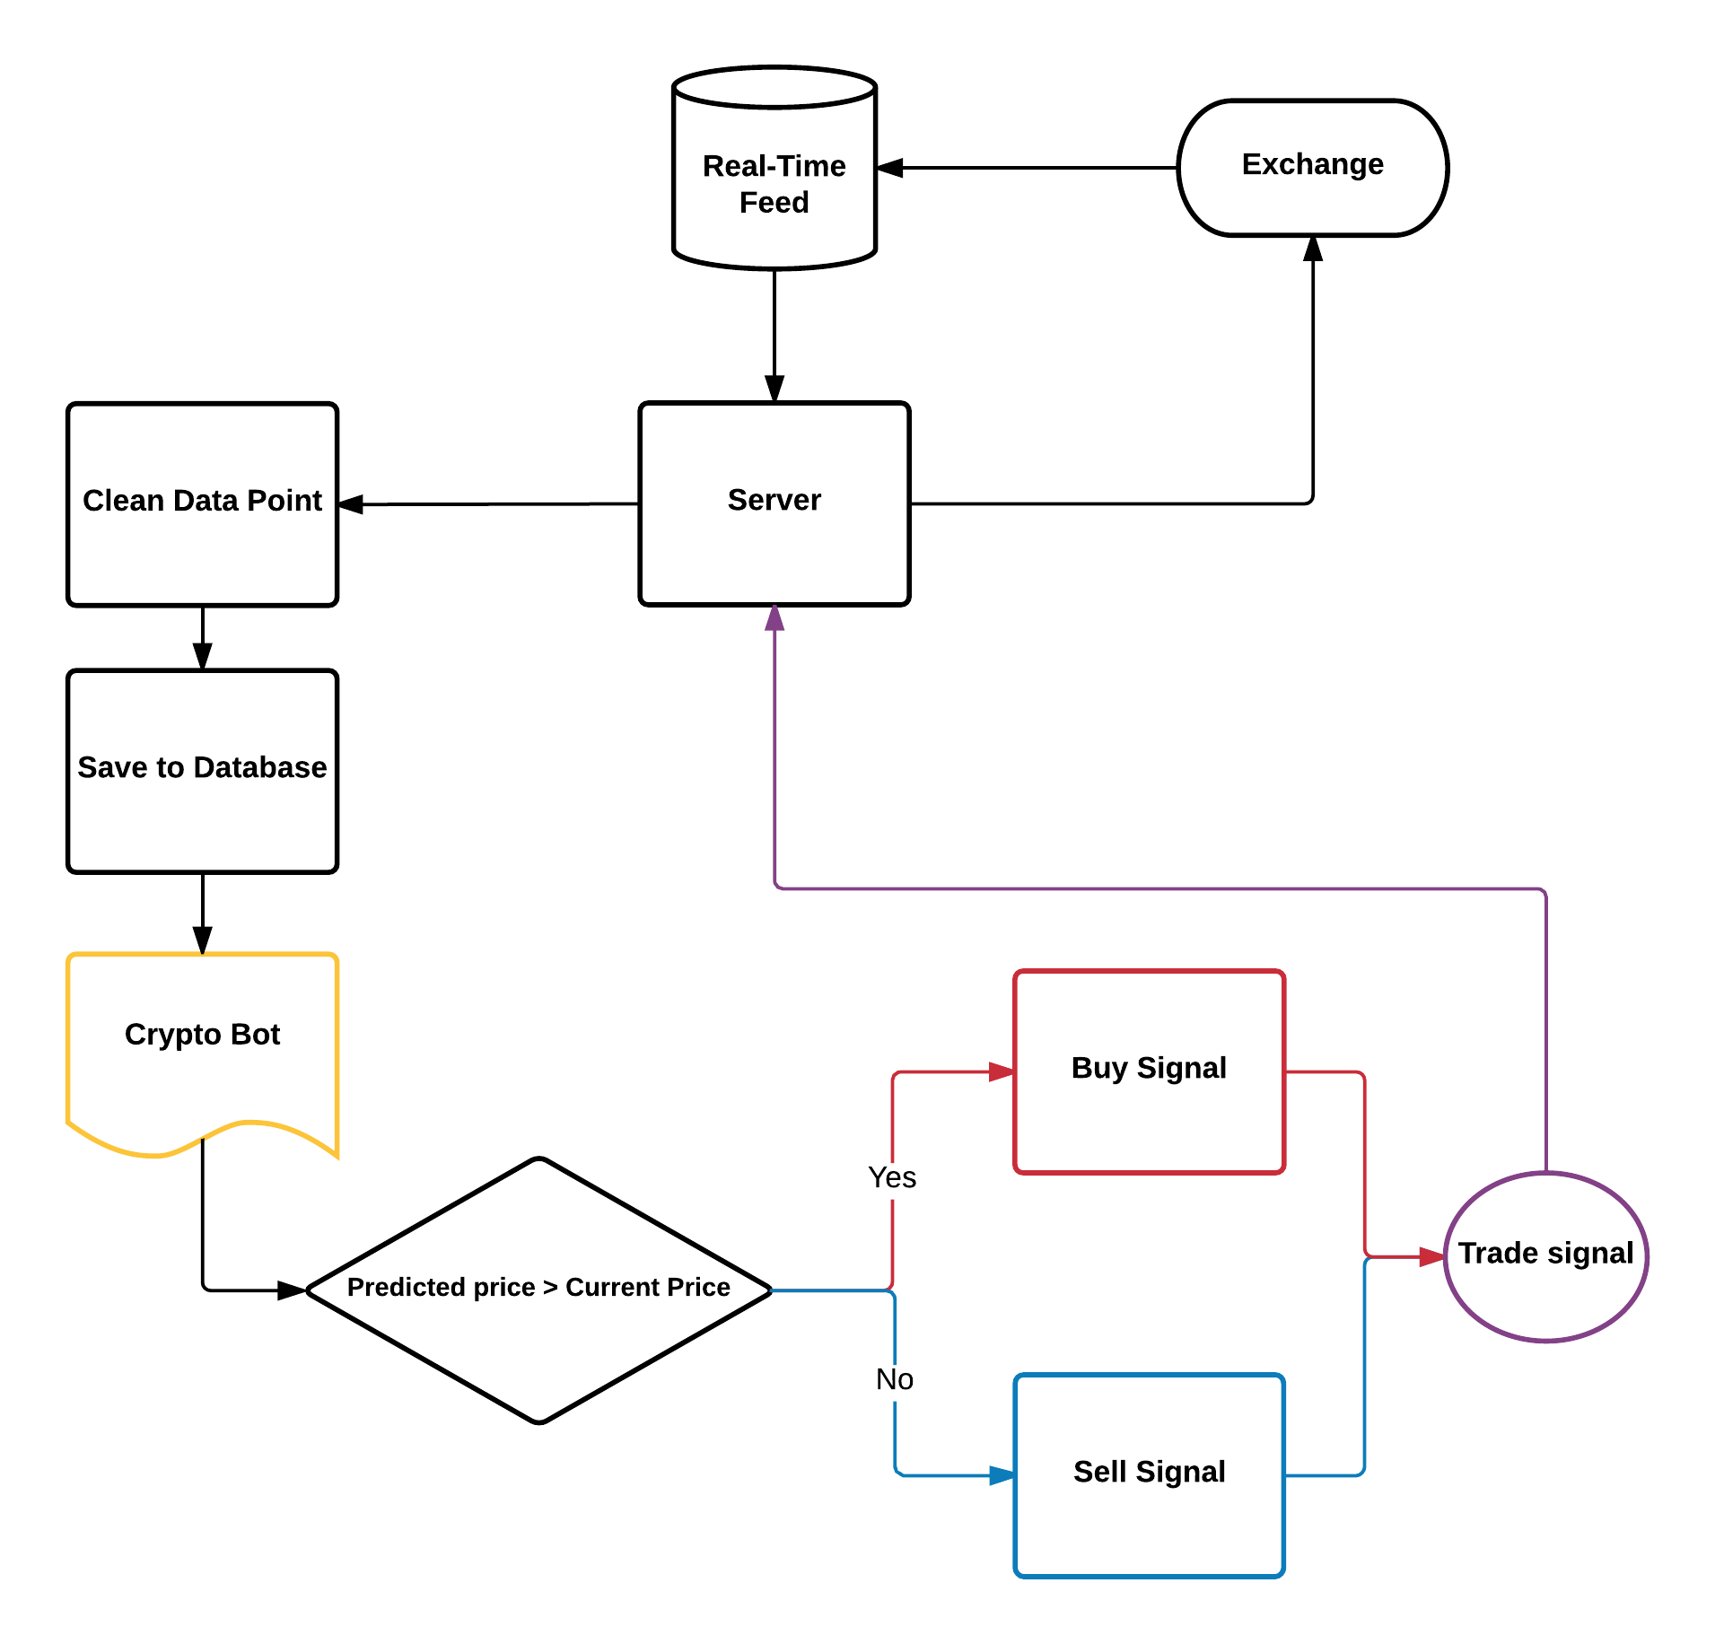
Crypto-Bot
Flow Chart

Slide 17
Optimizer
SGD - Stochastic Gradient Descent
RMS prop
Adagrad
Adadelta
ADAM - Adaptive Momentum
Adamax
Nadam
TFOptimizer - Native TensorFlow Optimizer

Slide 18
Network Architecture
Bitcoin (After many days of tuning)
Lookback window = 2
Layers (Input, LSTM , Dense )
= [1,7]
Neurons = [16, 100 ,1]
Dropout = .3
Epochs = 300
Train between the dates 2016-06-17 - 2017-06-09
Test between the dates 2017-06-10 - 2017-10-07

Slide 19
Network Architecture
Ethereum
Lookback window = 2
Layers (Input, LSTM , Dense )
= [1,7]
Neurons = [16, 100 ,1]
Dropout = .3
Epochs = 600
Train between the dates 2017-05-16 - 2017-08-11
Test between the dates 2017-08-12 - 2017-11-07

Slide 20
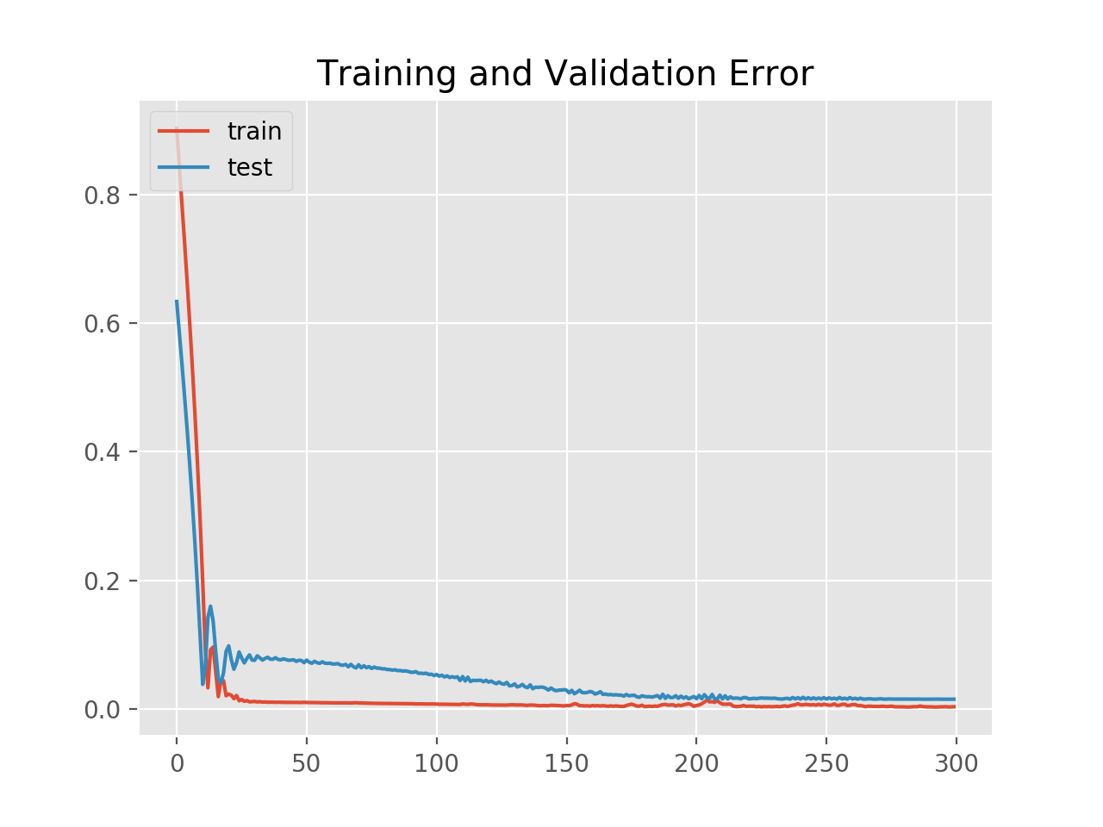
Model Evaluation (Bitcoin)

Slide 21
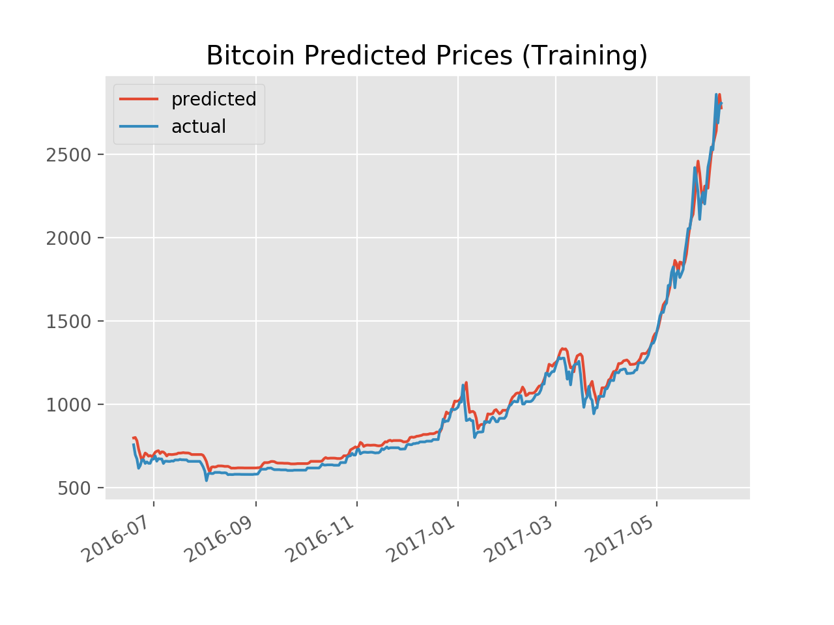
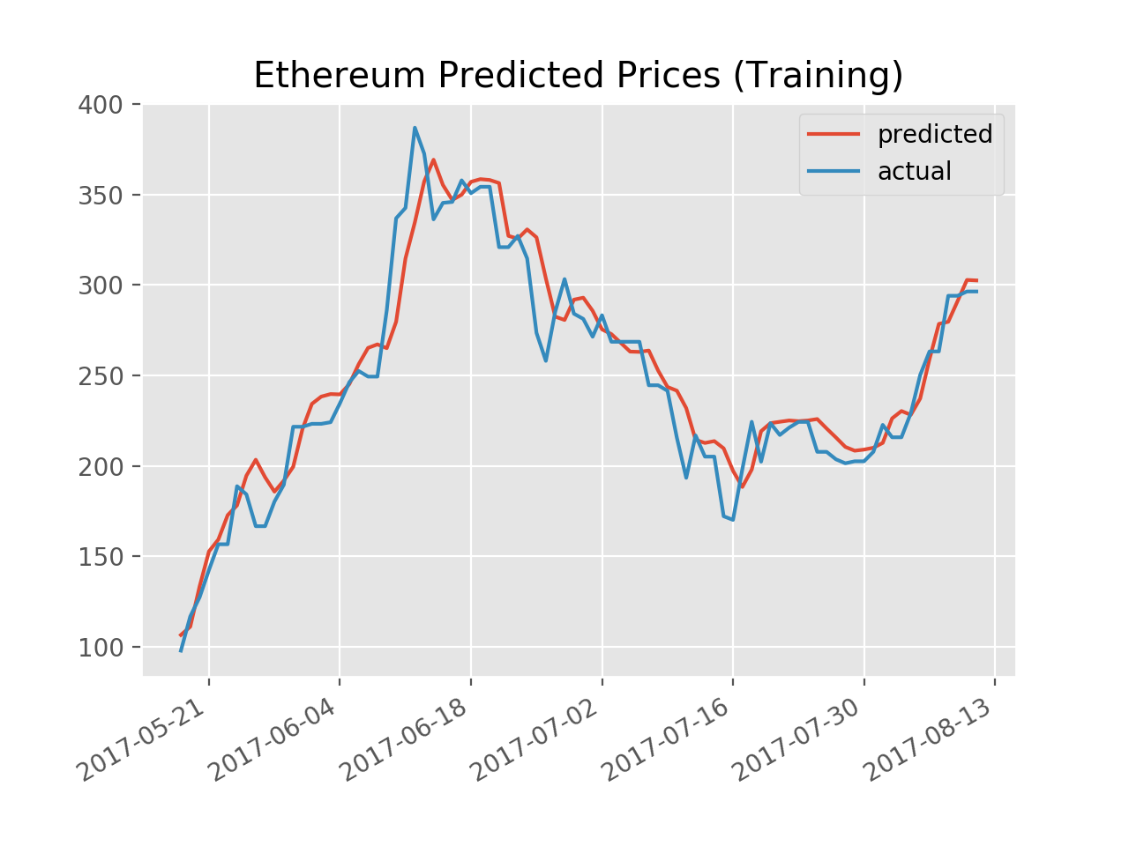
Training

Slide 22
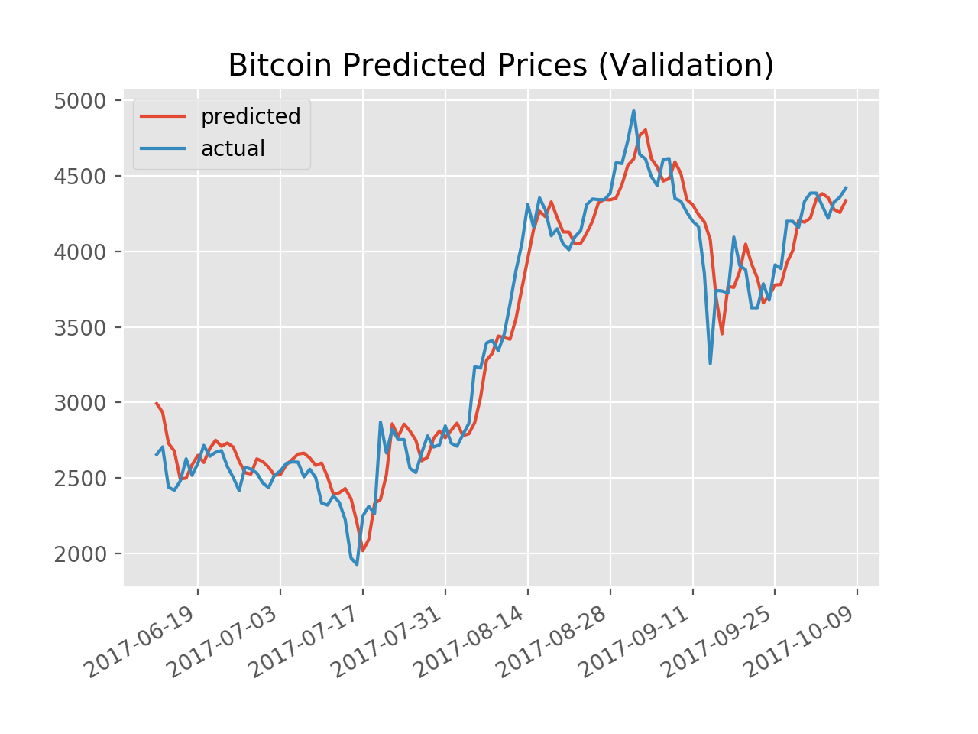
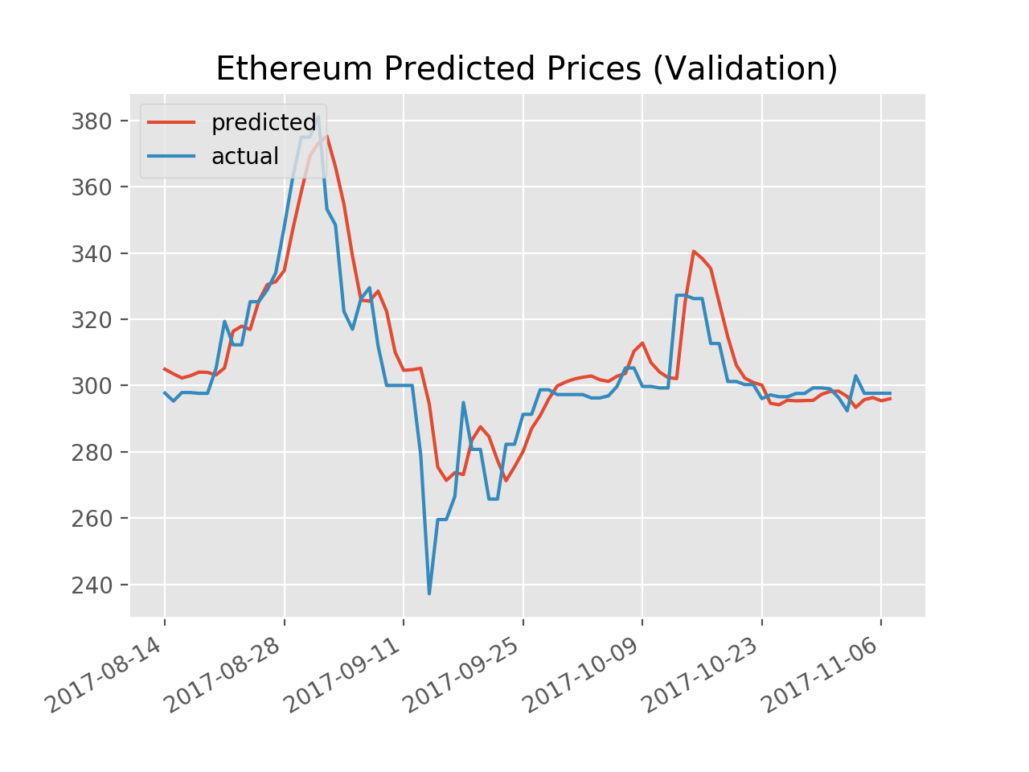
Validation

Slide 23
Performance Metrics for Forecasting
Theil U: Is a relative accuracy measure that compares the forecasted results with the results of forecasting with minimal historical data. It also squares the deviations to give more weight to large errors and to exaggerate errors, which can help eliminate methods with large errors (lower is better)
Pearson Correlation: Linear measure of similarity (higher is better)
Mean Absolute Percent Error: Measures the mean of the absolute difference in errors (lower is better)
All are commonly used to evaluate forecasting techniques

Slide 24
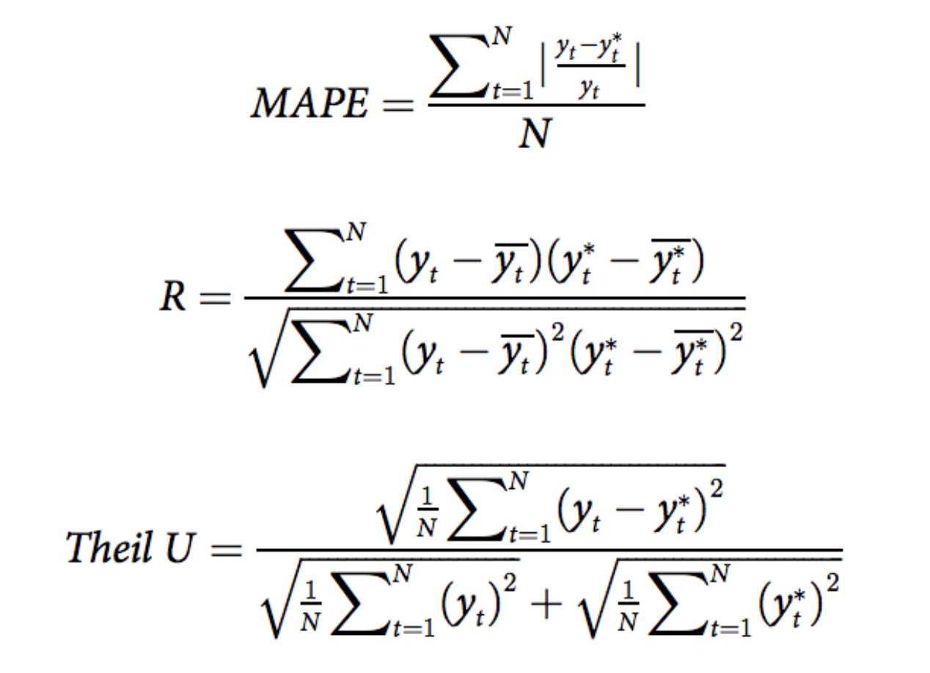
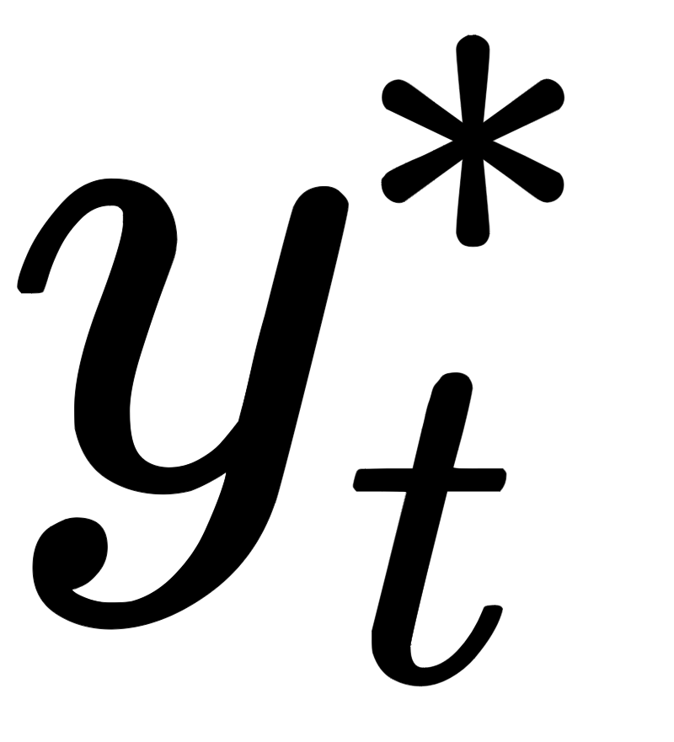

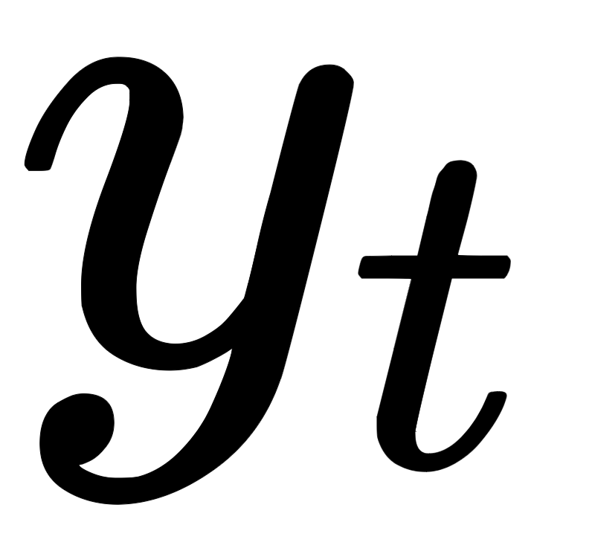
Performance Metrics for Forecasting (cont.)
Is the predicted price at time
Is the actual price at time

Slide 25
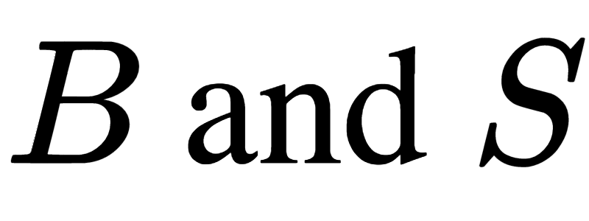
Trading Strategy
If the predicted price for the next day is higher than the current price,
BUY
If the predicted price for the next day is lower than the current price,
SHORT SELL
Let transaction costs for buying and selling be denoted as

Slide 26
Trading Strategy (cont.)
We can write our cumulative rate of return as
Where b is number of times we took a long position
And s is number of times we took a short position
We always close our position the next day so we can open a new position for the following day
Transactions costs is .01% and the costs are the same for both buying and selling

Slide 27
Million Dollar Question: Can this make Money?
Metrics | BTC | ETH
R | 0.975213 | 0.875768
Theil U | 0.002453 | 0.002151
MAPE | 0.045176 | 0.028734
Returns | 53.78% | 16.78%

Slide 28
Are these good Results?

Slide 29
Lessons Learned
The results obtained need to be vetted more rigorously
LSTM performs well even without looking back very far
Using less data actually brought performance gains
Probably because having such a large range hinders performance
LSTM performs better in Non-Stationary Time Series
Volatility does not seem to be huge problem
Hypothesis: LSTM performs best in markets that are volatile and stationary

Slide 30
Improvements / Other areas to Explore?
To reiterate, these are preliminary results
Model did not account for real world scenarios such as Slippage
Question of when to retrain is still up in the air
Perhaps the model can be improved with additional Layers
Use hourly or even minute tick data (Take advantage of smaller price swings)
Try turning this Regression Problem into a Classification Problem
Try using different Scalar
Adding other kinds data may improve performance i.e S&P500
And as always MORE TESTING!

Slide 31
Questions?
Past Performance Is Not Indicative Of Future Results - anonymous

Slide 32
References
Multidimensional LSTM Networks to Predict Bitcoin Price. (2017). Jakob-aungiers.com. Retrieved 29 November 2017, from http://www.jakob-aungiers.com/articles/a/Multidimensional-LSTM-Networks-to-Predict-Bitcoin-Price
Docs.oracle.com. (2017). Oracle Crystal Ball Reference and Examples Guide. [online] Available at: https://docs.oracle.com/cd/E40248_01/epm.1112/cb_statistical/frameset.htm?ch07s02s03s04.html [Accessed 29 Nov. 2017].
Bao, W., Yue, J., & Rao, Y. (2017). A deep learning framework for financial time series using stacked autoencoders and long-short term memory. PLoS ONE, 12(7), e0180944. http://doi.org/10.1371/journal.pone.0180944

