Slide 1

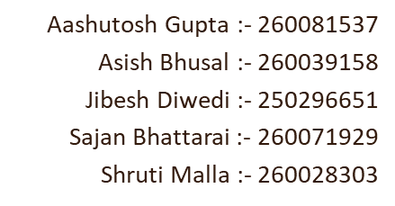
Data Lakes vs. Data Warehouses: Practical Implementation
LDS7005M: Big Data and Cloud Computing
Seminar Lead: Dr Gayathri Karthick
12th May 2026 (Tuesday)
11:00-11:30 AM
Group No: 03
Room No: LX621

Slide 2

Introduction
Organization today generates a large amount of data from various sources such as :-
Website
Mobile application
Transactions
Social media and so on …..
To manage and analyze these data efficiently company use specific architecture such as Data warehouse and Data lake.
Shruti Malla-260028303

Slide 3

Data Lake
A data lakes stores all types of data such as structured, semi structured and unstructured. It uses schema-on-read, meaning data is stored in a raw format and structured only when needed. This makes useful for advanced analytics like machine learning.
Shruti Malla-260028303

Slide 4
Defining Features of data lake
All data Types
Schema-on-Read
Scalabel Storage
Low Cost
Shruti Malla-260028303

Slide 5

Data warehouse
“SINGLE SOURCE OF TRUTH”
It is the place where companies stores a valuable data such as :-
Sales data
Customer data
Employee data
It can be created and use primarily for data reporting and analysis purposes.
Shruti Malla-260028303

Slide 6

Defining Features of data warehouse
Subject- oriented
Time Variant
Integrated
Non-Volatile
Shruti Malla-260028303

Slide 7
Problem Statement
Managing and storing massive quantities of NYC Yellow Taxi trip data efficiently.
Using cloud platforms to process vast amounts of structured taxi data in real time.
Addressing scalability concerns with traditional database systems
Comparison of Data Lakes and Data Warehouses for Taxi Analytics
Reducing storage and processing costs for large data workloads
Providing rapid analytical queries for fare, location, and trip analysis.
Ensure efficient integration of temporal, geographical, and fare-related taxi data.
Improving decision-making with cloud-based big data architectures.
Shruti Malla-260028303

Slide 8

Methodology
Collect the NYC Yellow Taxi dataset, which includes journey, fare, time, and geographic information.
Store the raw dataset in Google Cloud Storage as a Data Lake. Then, process and transform it for structured analytics.
Load processed data to a cloud-based Data Warehouse for querying and reporting.
Conduct analytical queries to investigate journey patterns, tariff trends, and location-based information.
Compare the performance of Data Lake with Data Warehouse based on scalability, storage efficiency, query speed, and cost.
Assess the applicability of cloud infrastructures for large-scale taxi data analytics.
Shruti Malla-260028303

Slide 9
A structured system for BI and reporting, Data Warehouse (Inmon & Kimball) uses schema-on-write to guarantee good data quality and quick query speed.
Large-scale, unstructured data management is constrained by data warehouses.
Big data and machine learning can benefit from Data Lake (James Dixon), which uses schema-on-read to store structured, semi-structured, and unstructured data.
Cloud services like Google Cloud, Microsoft Azure, and Amazon Web Services save costs and increase scalability.
In this project, we analysed the NYC Yellow Taxi dataset using SQL ,Google Cloud, BigQuery and Google Colab.
A move toward hybrid Lakehouse architecture that combines both strategies is suggested by recent studies.
Literature Review
Shruti Malla-260028303

Slide 10
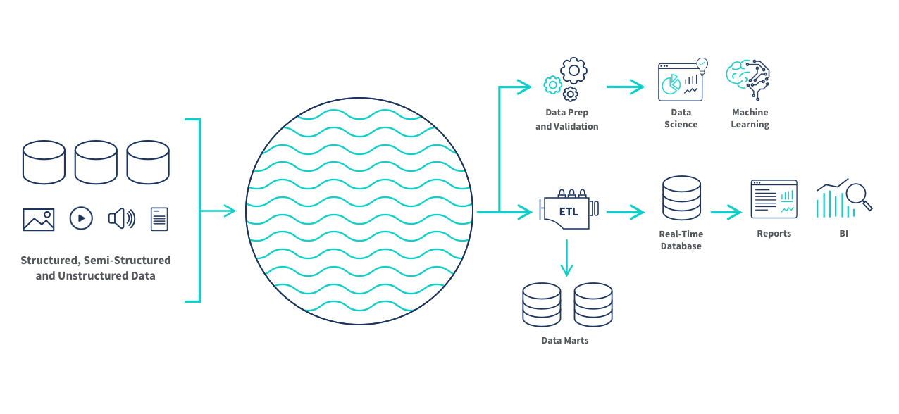
This diagram shows a data lake architecture where structured, semi-structured, and unstructured data are brought together in centralized storage systems for ETL, analytics, machine learning, reporting, and business intelligence.
Data Lake Architecture
(Qlik, 2026)
Figure: Architectural Diagram of Data Lake

Slide 11
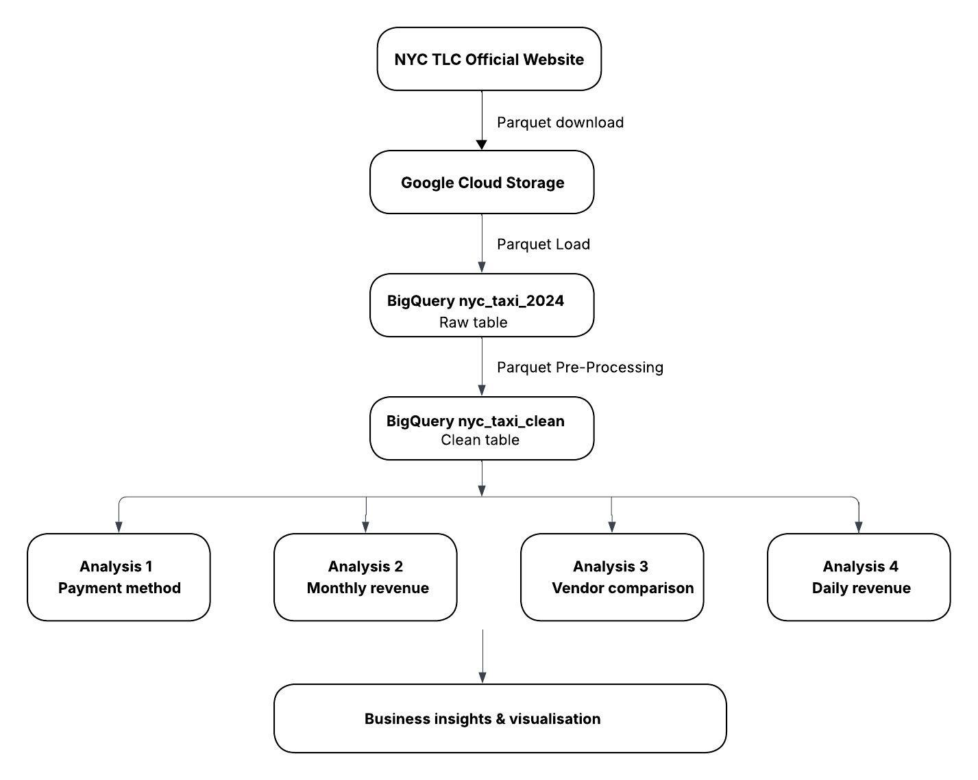
Data Warehouse Architecture
Figure: Architecture Diagram of Data Warehouse

Slide 12
Dataset Overview: 2024 Yellow Taxi Trip Data NYC Open Data
Total Trips
Nearly 3 million
Column
19
Year
2024
Access Level
Public
Key Fields
🕐 Temporal Pickup & drop-off date and time
Dataset Details
ABOUT THIS DATASET The NYC Yellow Taxi Data set consists of structured trip level information related to taxis along with the time, geographical, and fare information of the taxis for large scale analysis. AVAILABLE FORMAT
💰 Fare
Base fare, surcharges,
MTA tax & tips
📍 Spatial
Zone IDs for origin
& destination
💳 Payment
🚗 Trip
Type & total amount
Distance, passengers
& rate code
PARQUET
Source:https://d37ci6vzurychx.cloudfront.net/trip-data/yellow_tripdata_2024-01.parquet

Slide 13

Fully managed zero installation needed
Processes millions of rows in seconds
Free tier 1TB queries free per month
Built-in security with IAM roles
Connects directly to Looker Studio
Scales from gigabytes to petabytes

Slide 14
Data Lake Practical Implementation
Step 1 : Create a new project on google cloud storage.
Step 2 : Configuring GCS Bucket.
Step 3 : Upload Raw Dataset.
Step 4 : Creating Dataset in BigQuery Studio.
Step 5 : External Table Creation.
Step 6 : Running some Queries for Schema Validation.

Slide 15
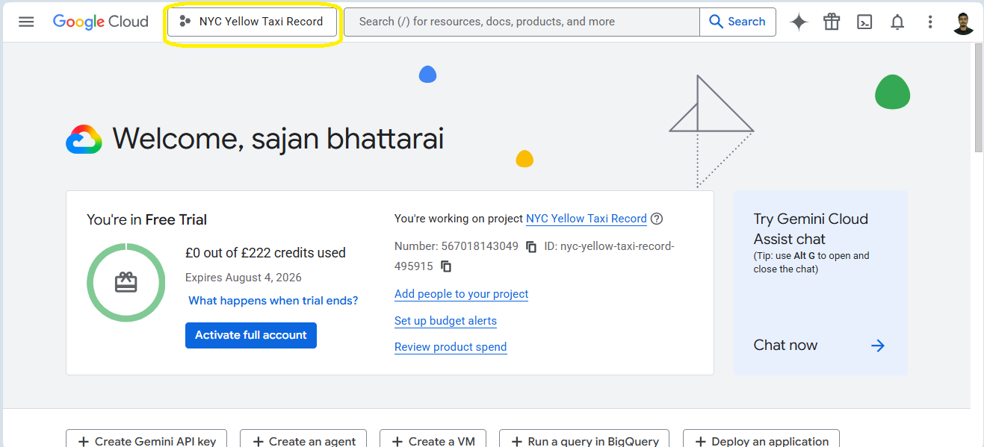
Create a new project on google cloud storage:
Goto Google Cloud Console.
Click Create / Select a project.
Give name NYC Yellow Taxi Record for new project.
Figure 1: New Project Creation In GCS

Slide 16
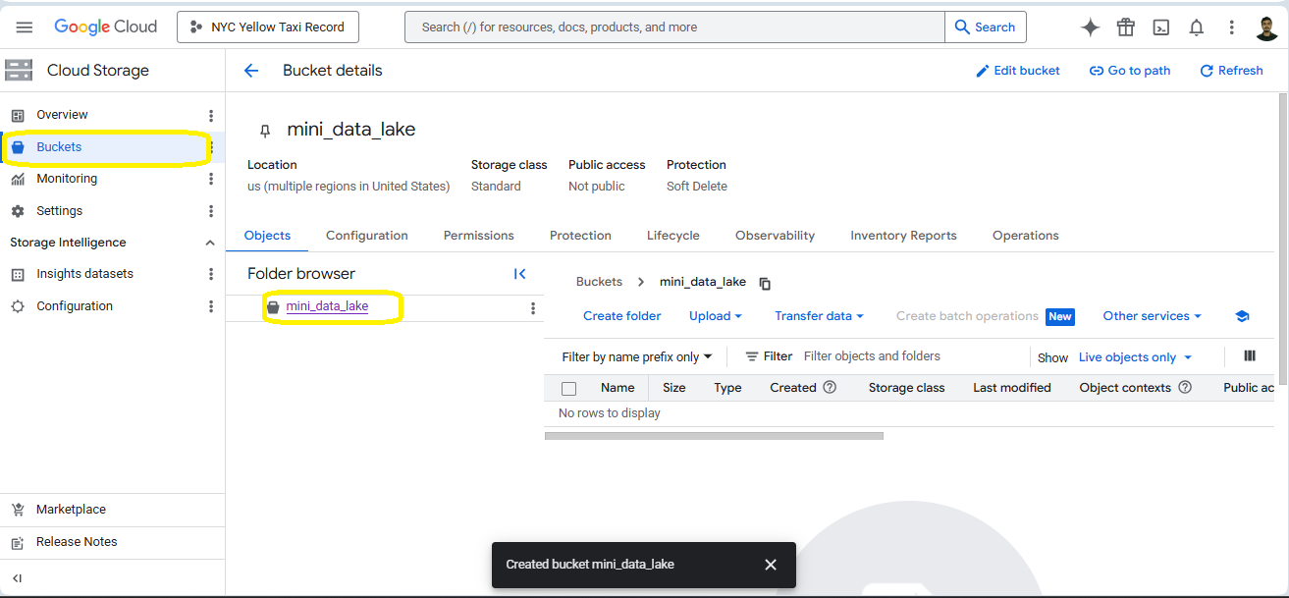
Configuring GCS Bucket
Goto Navigation Bar and Click Bucket Tab
Now create a bucket named mini_data_lake
Figure 2: Bucket(mini_data_lake) creation

Slide 17
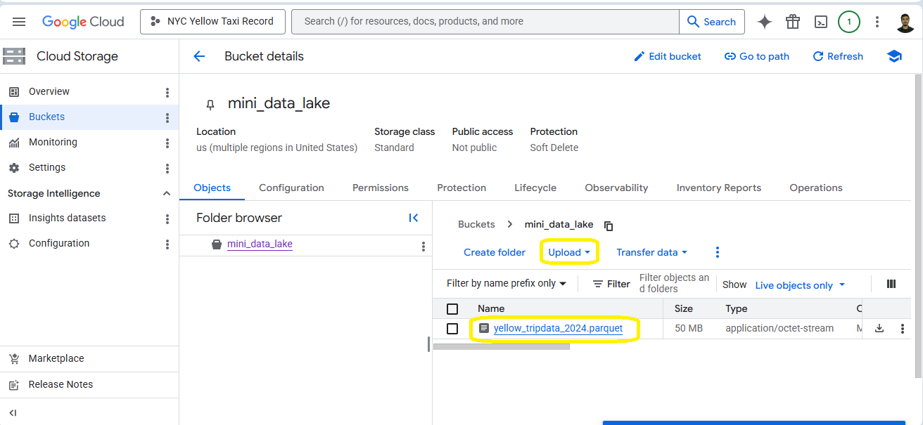
Upload Raw Dataset
Click Upload and select raw dataset(yellow_tripdata_2024.parquet) to upload into bucket.
Figure 3: Dataset upload in bucket

Slide 18
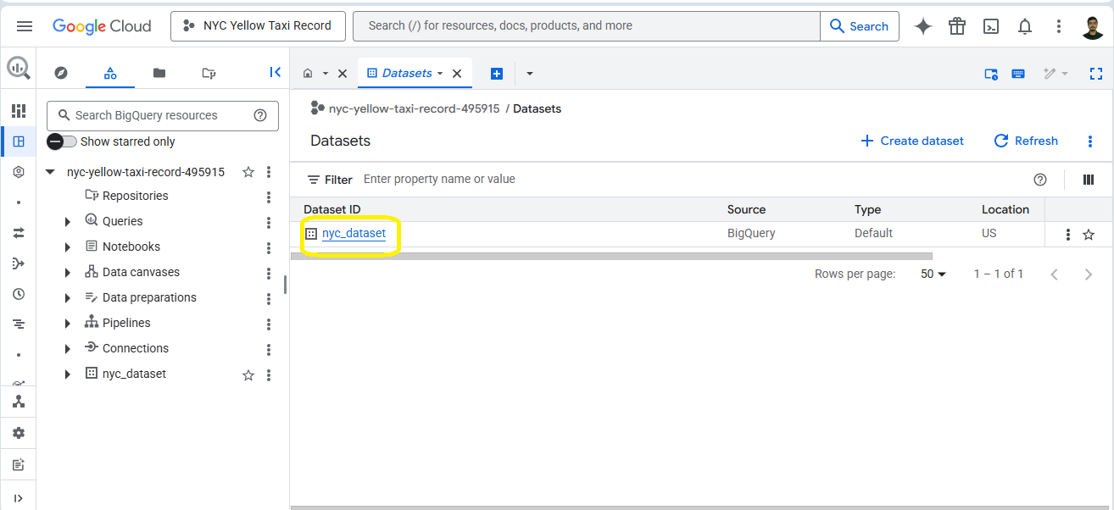
Creating Dataset in BigQuery Studio
Go to Navigation Bar and click BigQuery and then Studio
Inside studio, create Dataset(nyc_dataset) with default configuration.
Figure 4: Dataset Creatiion In BigQuery Studio

Slide 19
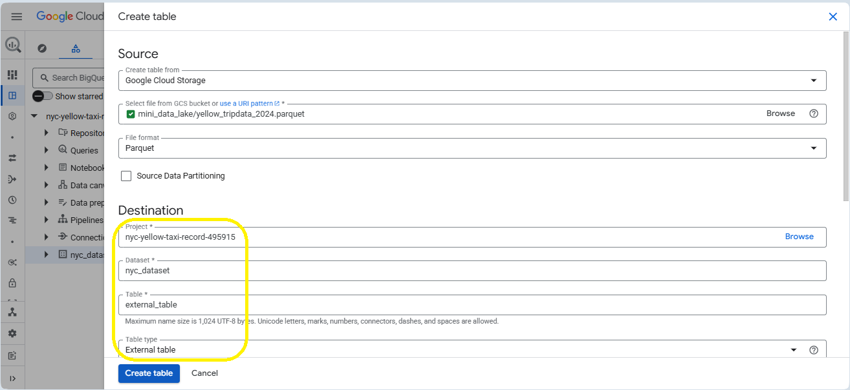
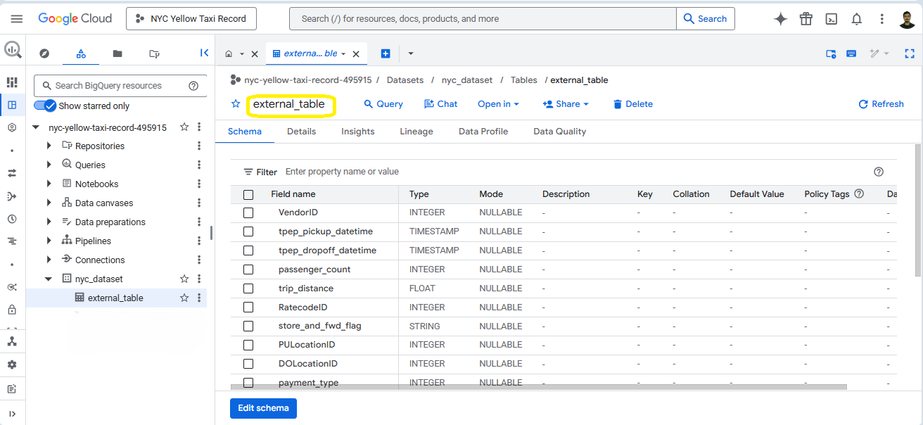
External Table Creation
Inside nyc_dataset, click on create table.
Configure external table as shown in figure and click create.
External Table with name external_table created from yellow_tripdata_2024.parquet dataset.
Figure 5: External Table Configuration
Figure 6: External Table

Slide 20
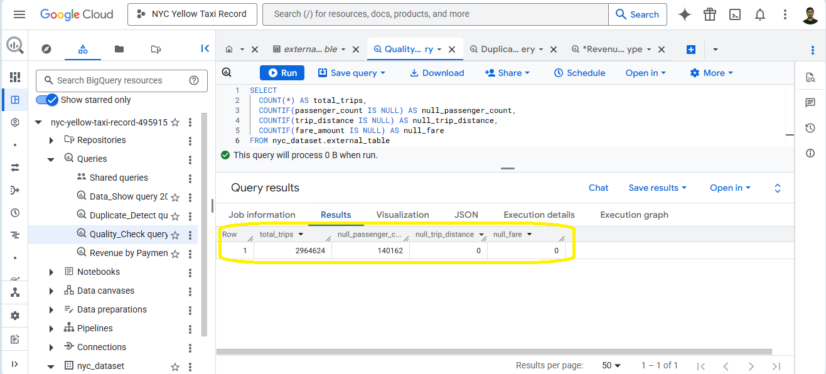
Running some queries on External Table for Schema Validation:
Quality Check Query
The quality check queries in BigQuery help ensure the accuracy of the data set by looking out for missing values, duplicate entries, and any other forms of data inconsistencies.
Quality Check Query
The quality check queries in BigQuery help ensure the accuracy of the data set by looking out for missing values, duplicate entries, and any other forms of data inconsistencies.
Insights:
totoal_trips
null_passengers_counts
null_trip_distance
null_fare
Figure 7: Quality Check with result

Slide 21
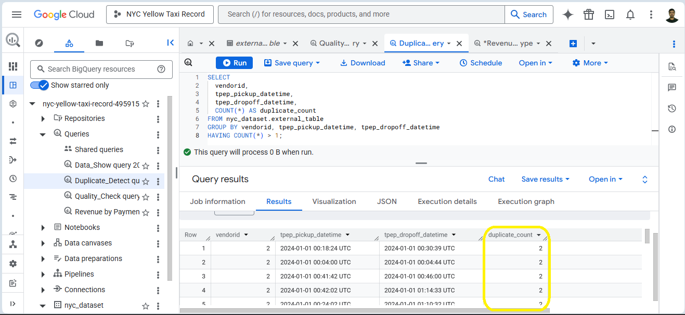
Duplicate Detection Query
Duplicate detection queries in BigQuery identify repeated records within a dataset by checking for multiple rows with the same key fields, helping ensure data accuracy, consistency, and reliable analysis.
Figure 7: Duplicate Detect with result

Slide 22
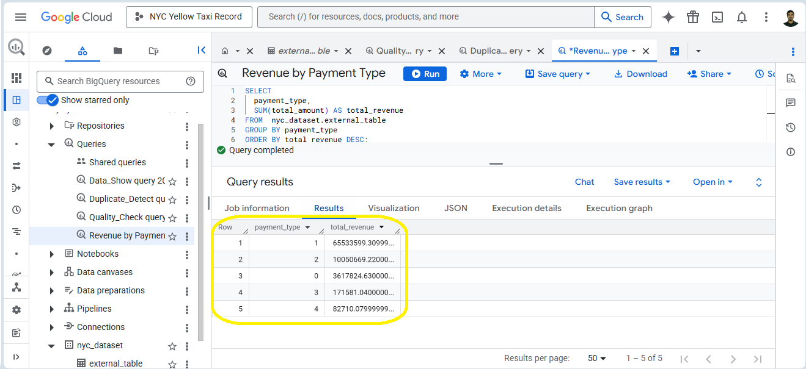
Revenue by Payment Type
This can be used to analyze revenue trends based on payment methods.
Figure 9: Revenue by Payment Type query with result

Slide 23

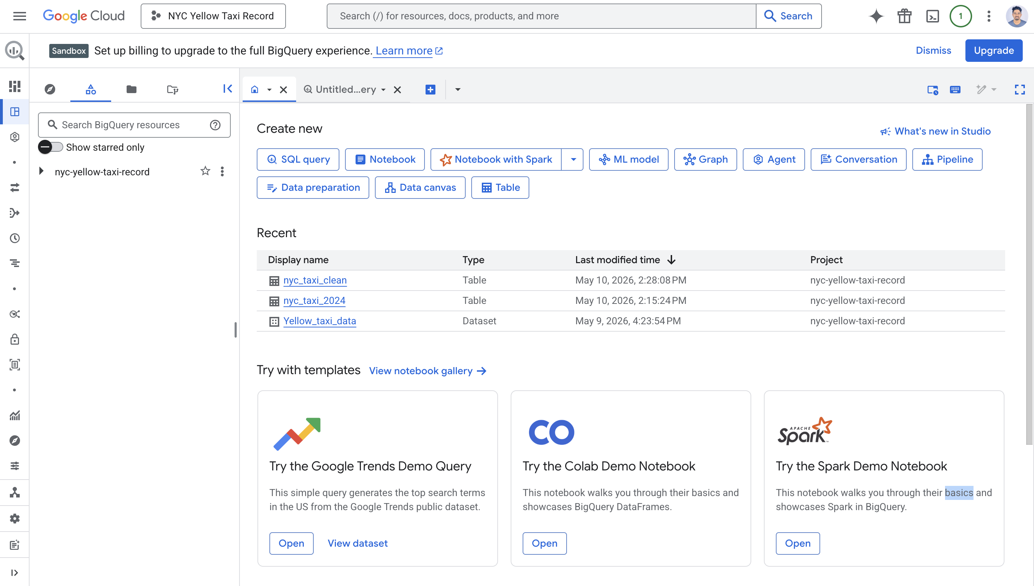
Google BigQuery ​
Why Did We Use It?​
The NYC Taxi dataset was in Parquet format which is a Big Data file type. ​
To load this into BigQuery it first needs to be stored in Cloud Storage as an intermediate step before ingestion.​
Figure: Dashboard

Slide 24
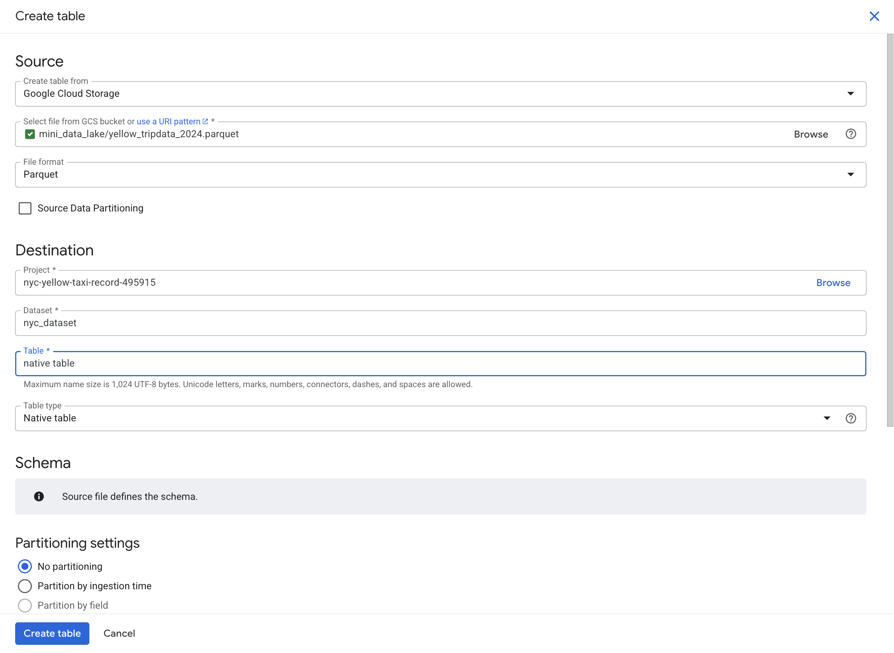
Creating a Native Table​
Step: Create a Native Table in BigQuery
Open the Create Table window in Google BigQuery.
Select Google Cloud Storage as the source.
Choose the uploaded Parquet file: mini_data_lake/yellow_tripdata_2024.parquet
Set the file format as Parquet.
Select the destination project:nyc-yellow-taxi-record-495915
Choose the dataset: nyc_dataset
Keep the table type as Native Table.
Click Create Table to load the dataset into BigQuery.
Fig: Creating Native Table

Slide 25
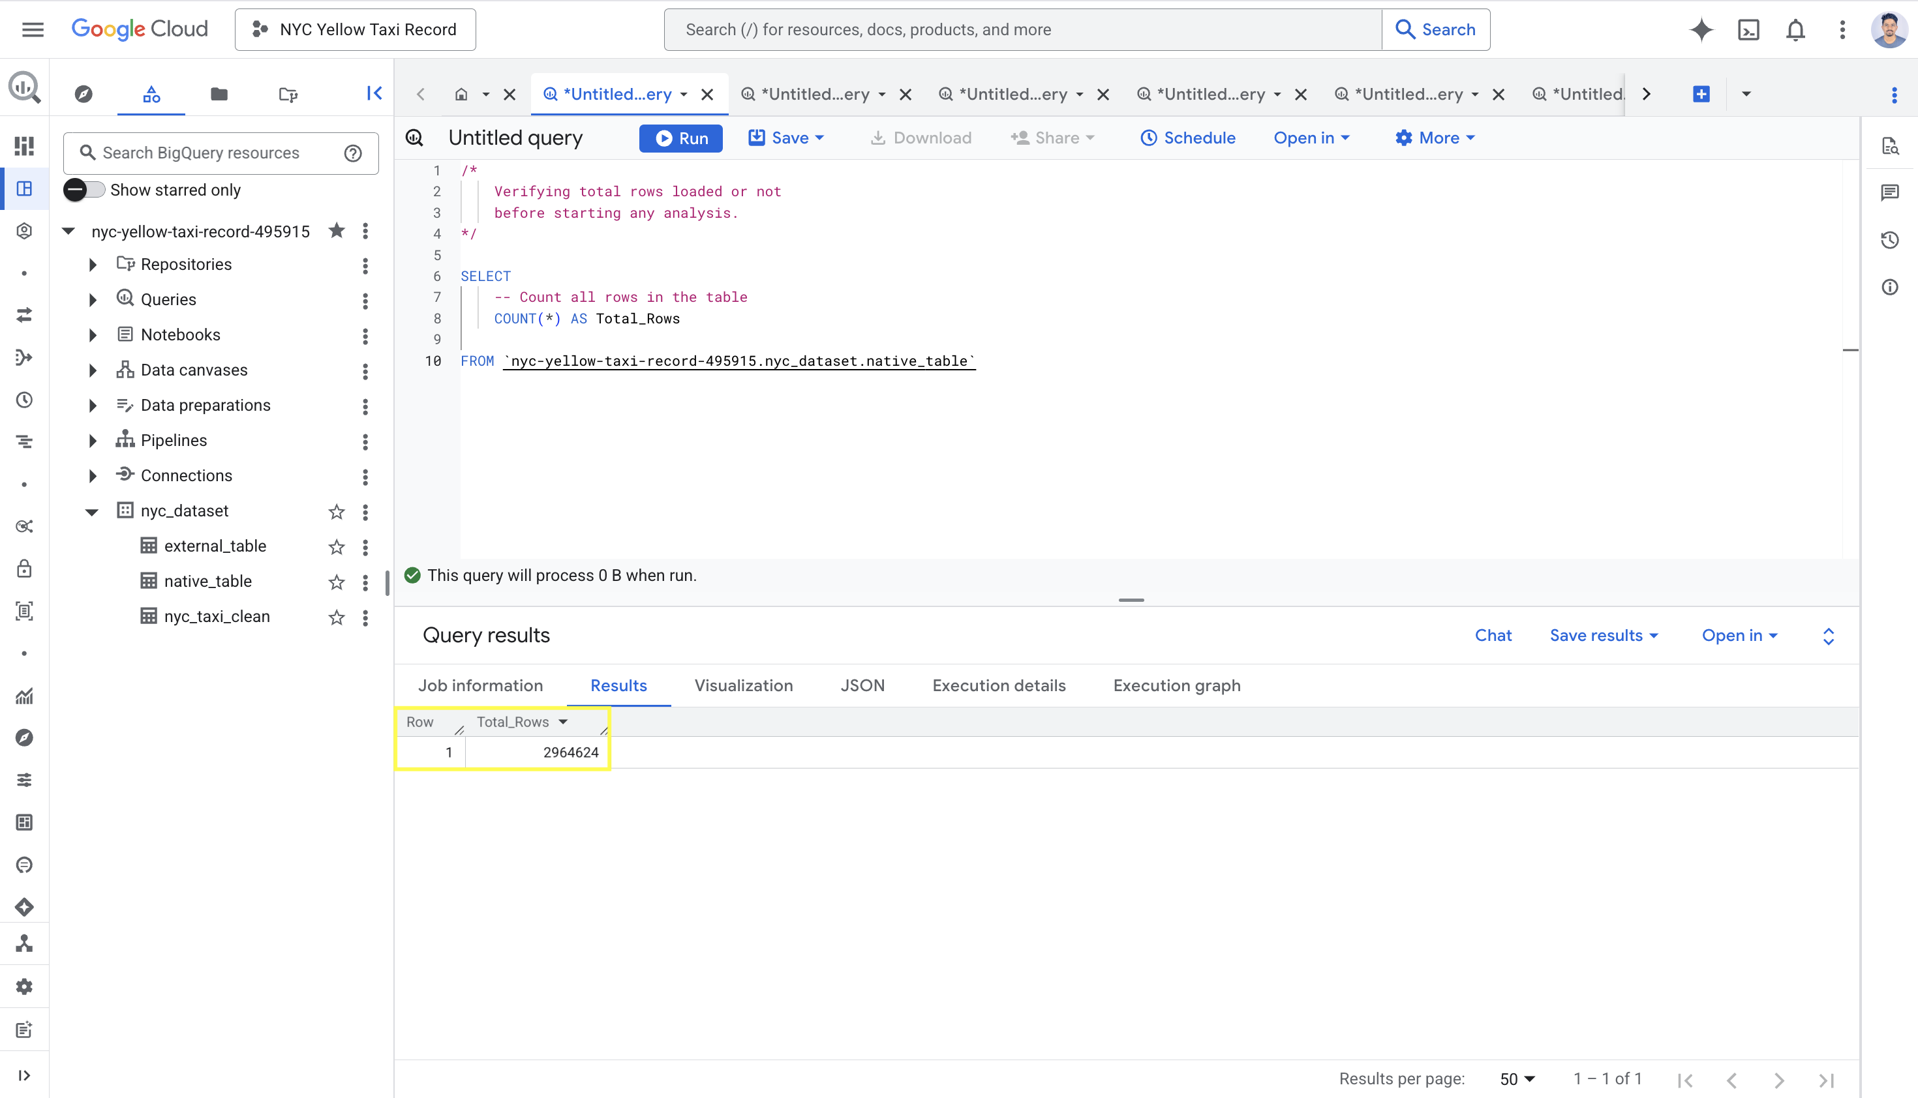
Data Verification
Verifying Data Loaded Correctly
Query Written:
SELECT COUNT(*) AS Total_Rows
FROM nyc-yellow-taxi-record-495915.nyc_dataset.native_table
Output:
Result: 2,964,624 rows loaded
Nearly 3 million transactions
Safe to proceed with analysis
Justifies Big Data architecture
Figure: Data Verification Query

Slide 26
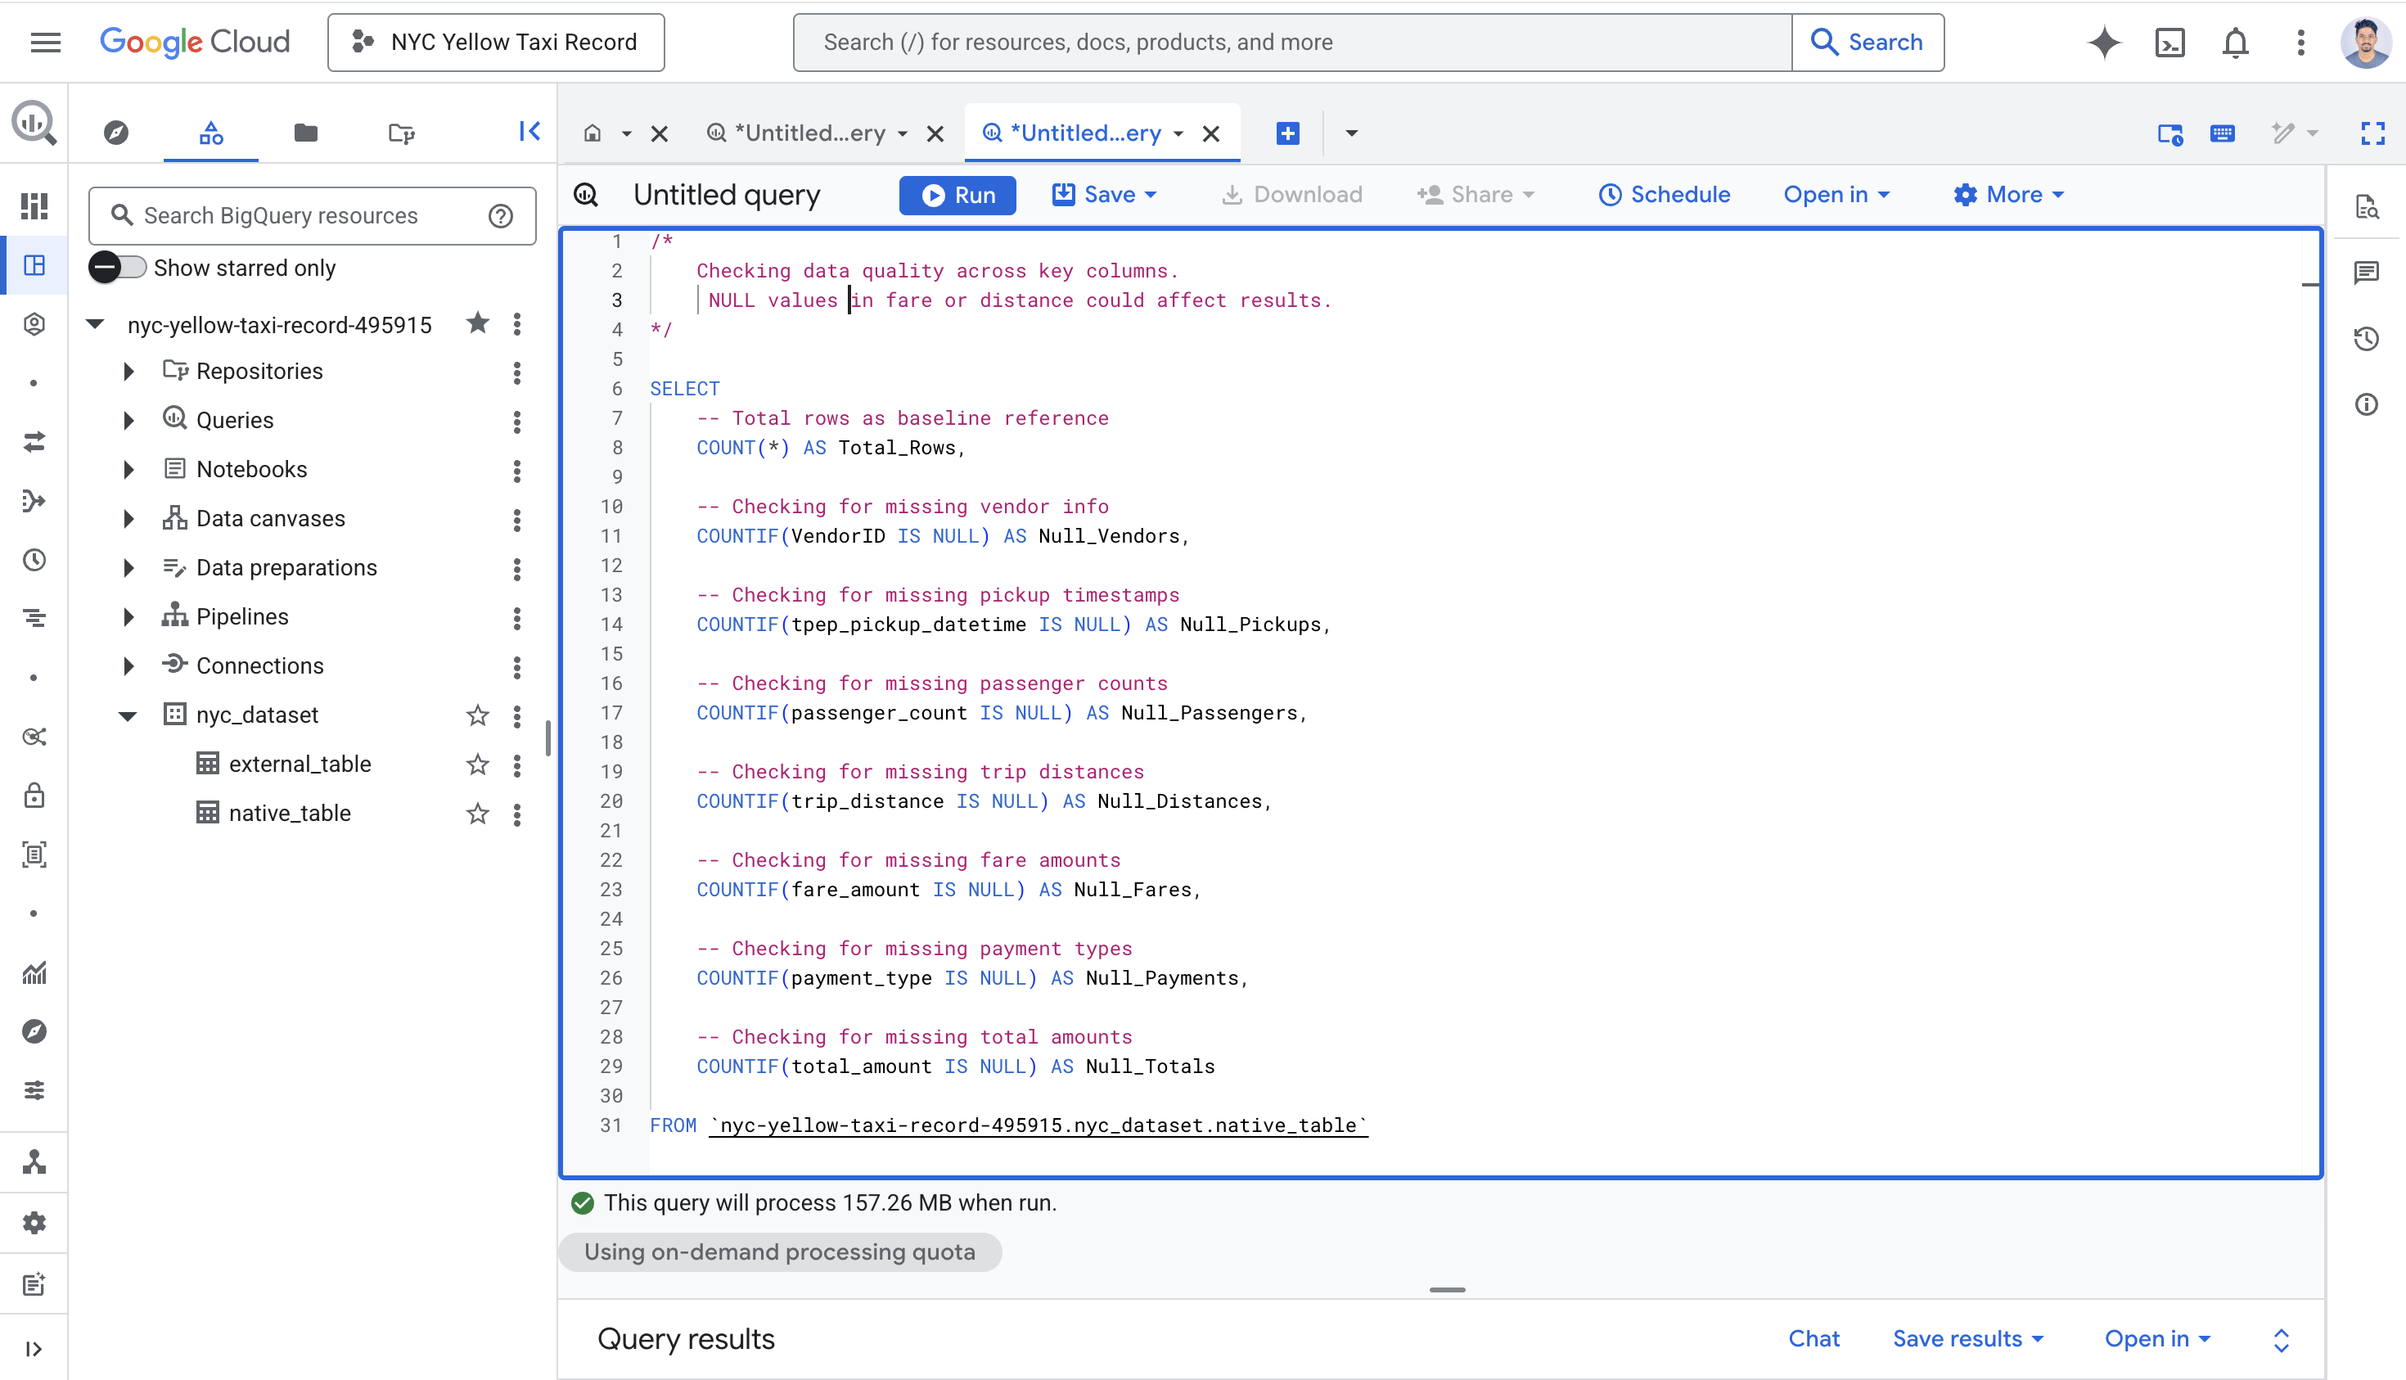
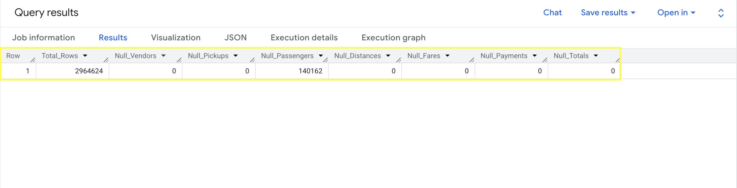
Data Quality Check
Running Data Quality Check Before analysing data I checked for missing values across all key columns. Missing data can lead to inaccurate results and misleading business insights if not addressed early.
Finding:
140,162 rows had missing passenger counts
Requiring data cleaning before analysis
Figure: Data Quality Check

Slide 27
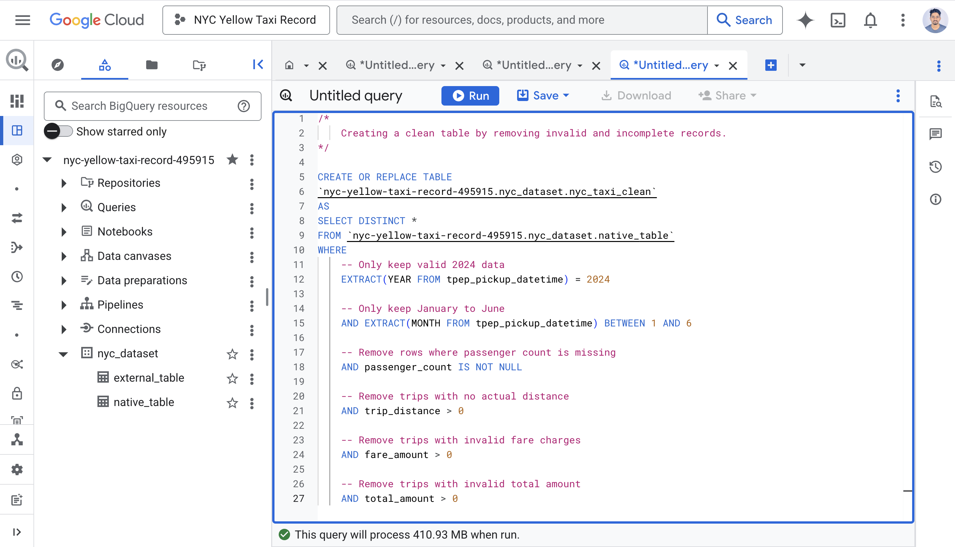
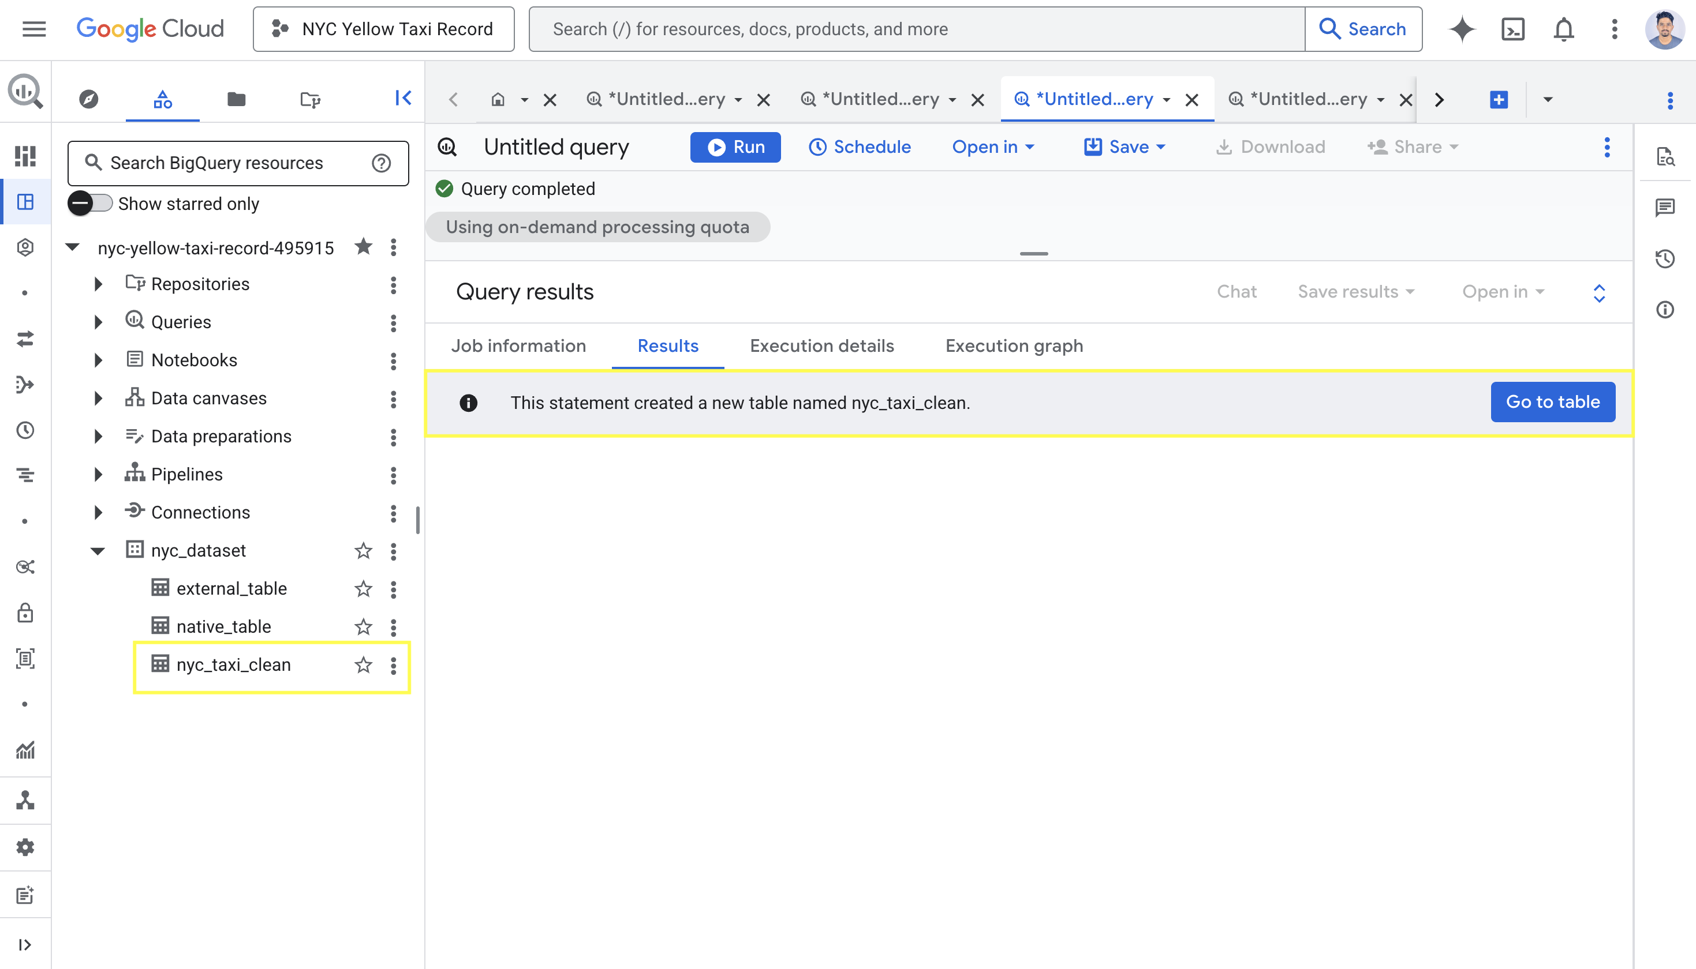
Data Cleaning & Pre-Processing
What Removed:
Rows with missing passenger counts
Trips with zero distance
Trips with invalid fare amounts
Trips with invalid total amounts
Results:
Original rows: 2,964,624
Removed rows: 210,159 (7.1%)
Clean rows: 2,754,465 (92.9%)
New table created: nyc_taxi_clean
This ensures only valid records are used in our analysis
Figure: Query cleaning SQL Code
Figure: Result nyc_taxi_clean created

Slide 28
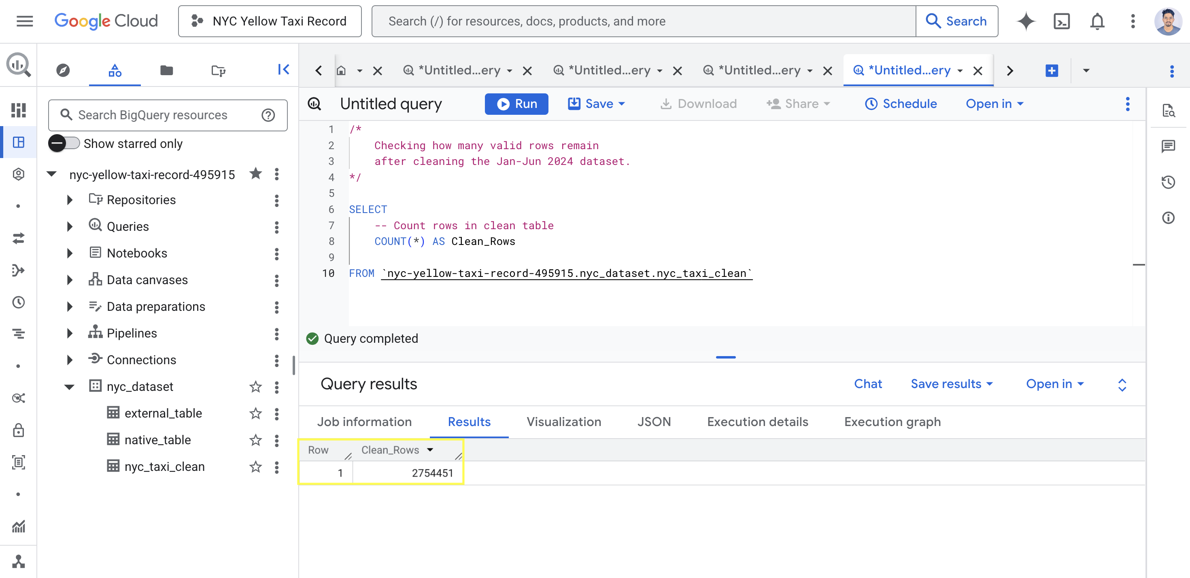
Clean Data Verification
After cleaning verifying how many valid records remained for analysis:
Before Cleaning: 2,964,624 rows
After Cleaning: 2,754,451 rows
Removed: 210,159 rows (7.1%)
What Was Removed:
140,162 missing passenger counts
Invalid zero distance trips
Invalid fare & total amounts
92.9% of data retained confirming dataset is clean and reliable for
analysis
Figure : Data Verification Query

Slide 29

Analysis

Slide 30
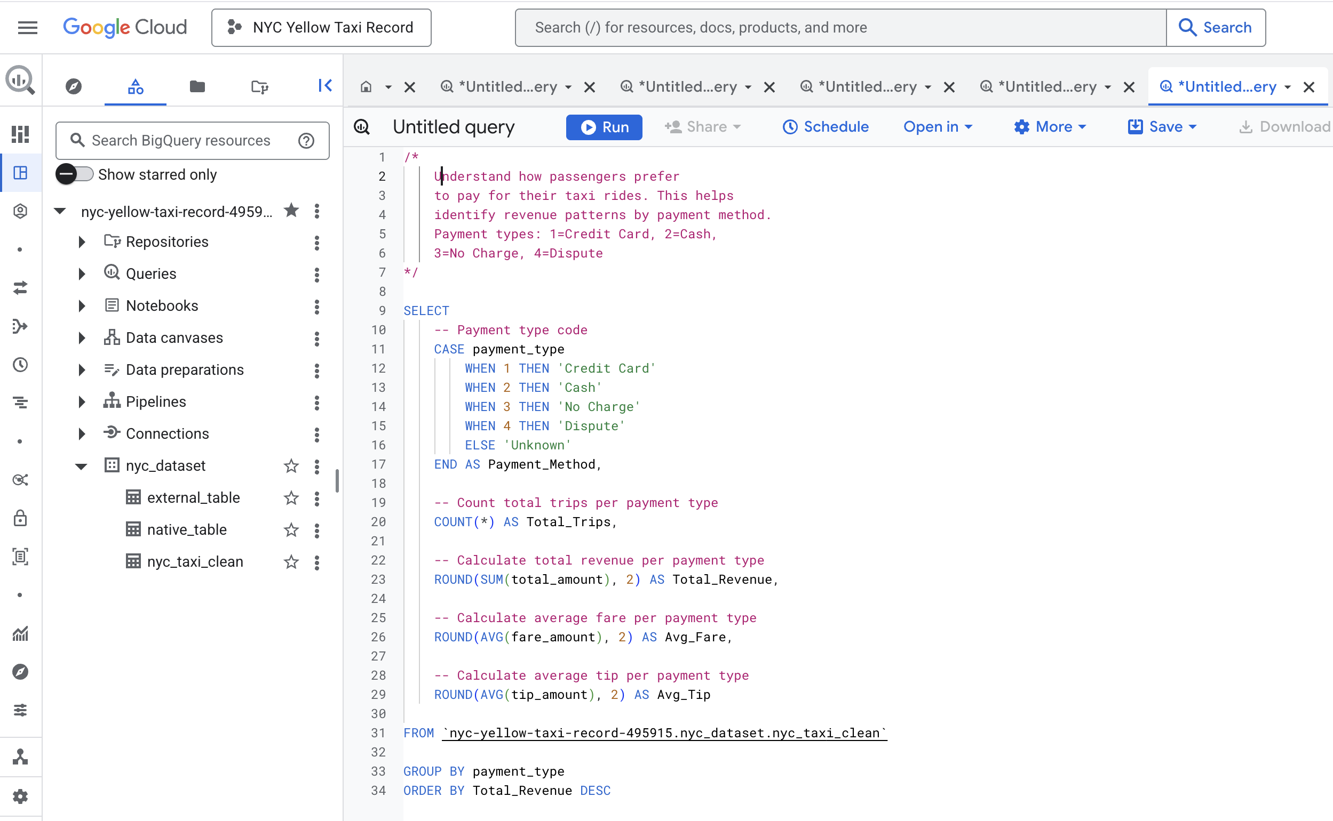
Analysis 1 Revenue by Payment Method
Querying to understand how passengers prefer to pay for their taxi rides.
This helps identify revenue patterns by payment method.
Payment types:
Credit Card
Cash
No Charge
Dispute
Figure: Query payment method SQL Code

Slide 31
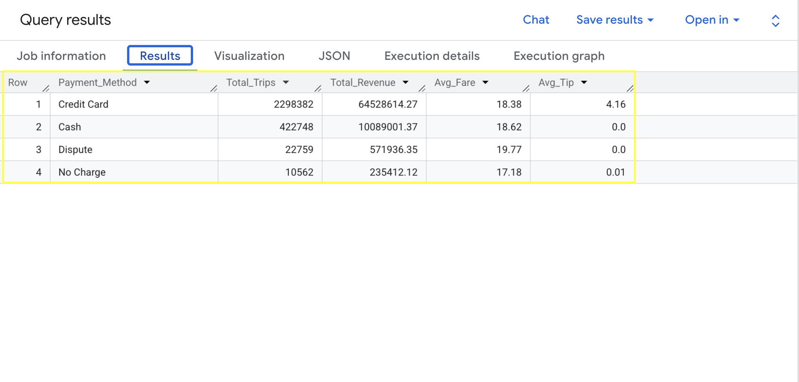
Key Insights:
Credit Card dominates completely
• 2,298,390 trips (84% of all journeys)
• $64,528,784 total revenue generated
• Cashless payments preferred by most riders
Cash still significant
• 422,753 trips (15% of all journeys)
• $10,089,183 total revenue
• Average fare slightly higher than card ($18.62)
Tipping behavior is revealing
• Credit Card average tip: $4.16 per trip
• Cash average tip: $0.00 tips not recorded
• Card users tip 100% more than cash users
Figure: Result Payment Method

Slide 32
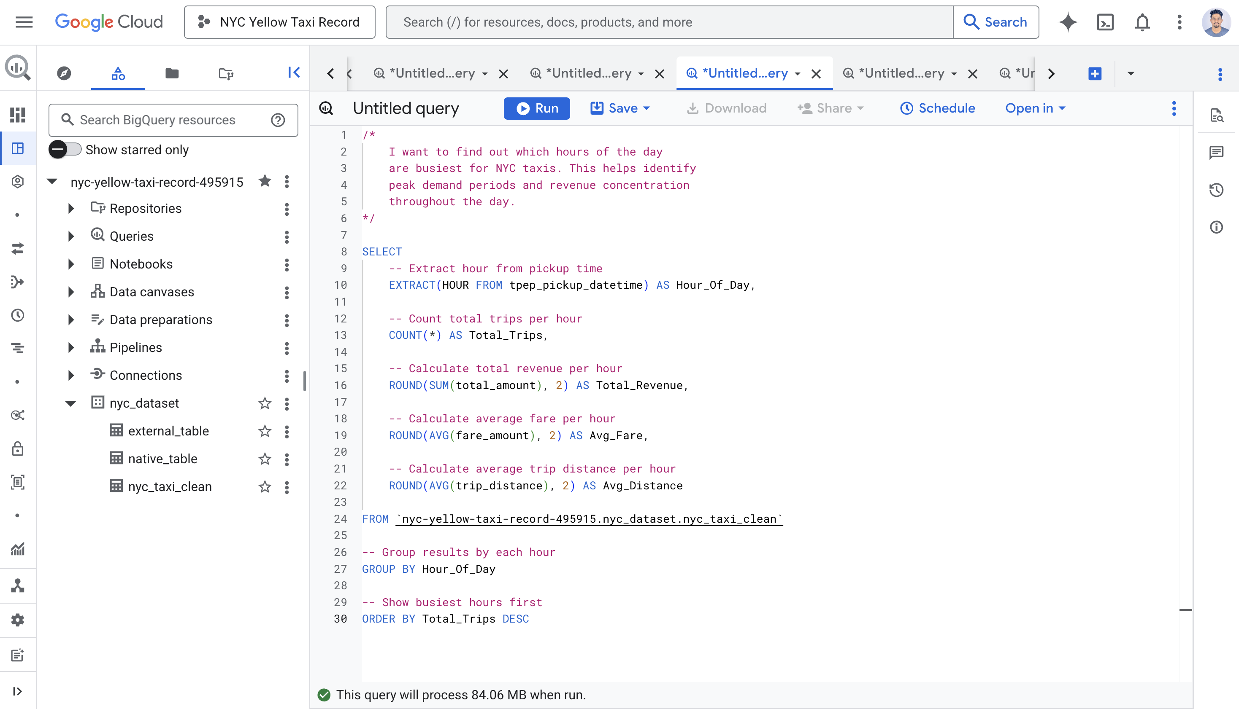
Analysis 2 Busiest Hours
Querying the busiest hours of the day for NYC
taxi operations It helps to analyse peak demand
periods, customer travel patterns and revenue
concentration over the day.
The query determines:
• Number of trips per hour total
• Total revenue earned per hour
• Average fare value
• Average trip length
This analysis helps to understand which time periods
produce the most taxi activity and revenues.
Figure: Query Busiest Hour SQL Code

Slide 33
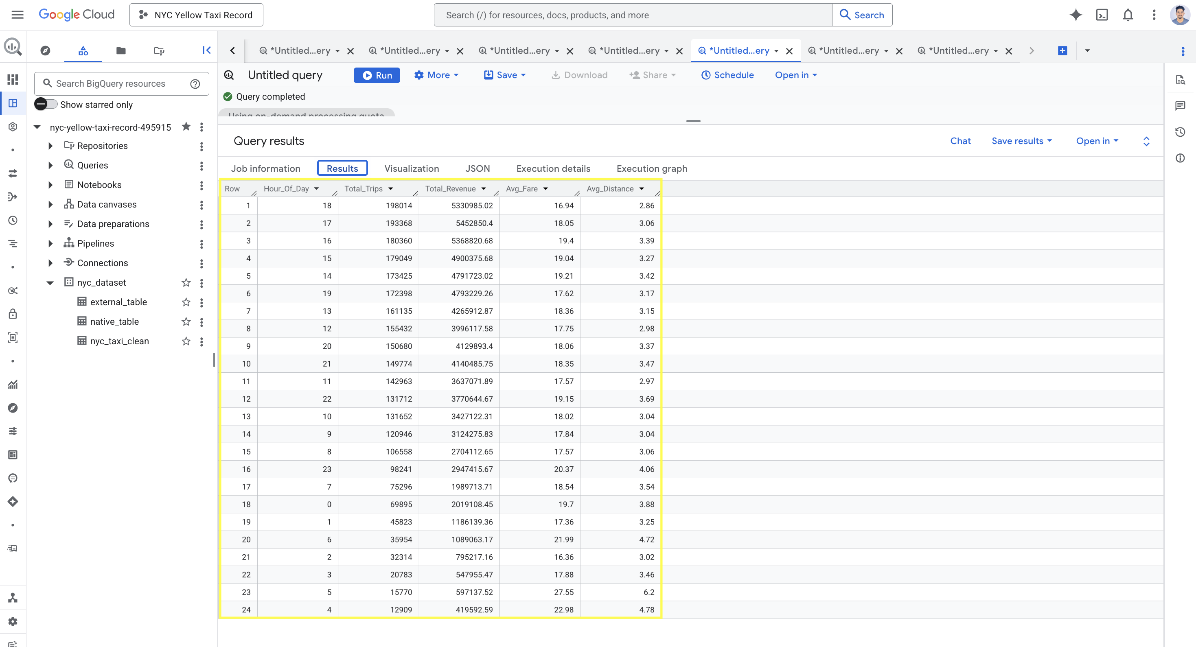
Key Insights:
Evening Rush Hour is Peak Time
6PM (Hour 18) busiest with 198,014 trips
5PM (Hour 17) second busiest 193,368 trips
4PM-7PM generates highest trip volume overall
Early Morning is Most Profitable Per Trip
5AM average fare: $27.55 — highest of all hours
6AM average fare: $21.99 — second highest
Longer distances at night = higher fares
Quietest Period is 4AM-6AM
4AM only 12,909 trips — lowest volume
But highest average fare at $22.98
Airport runs likely driving up average
Figure: Result Busiest Hour

Slide 34
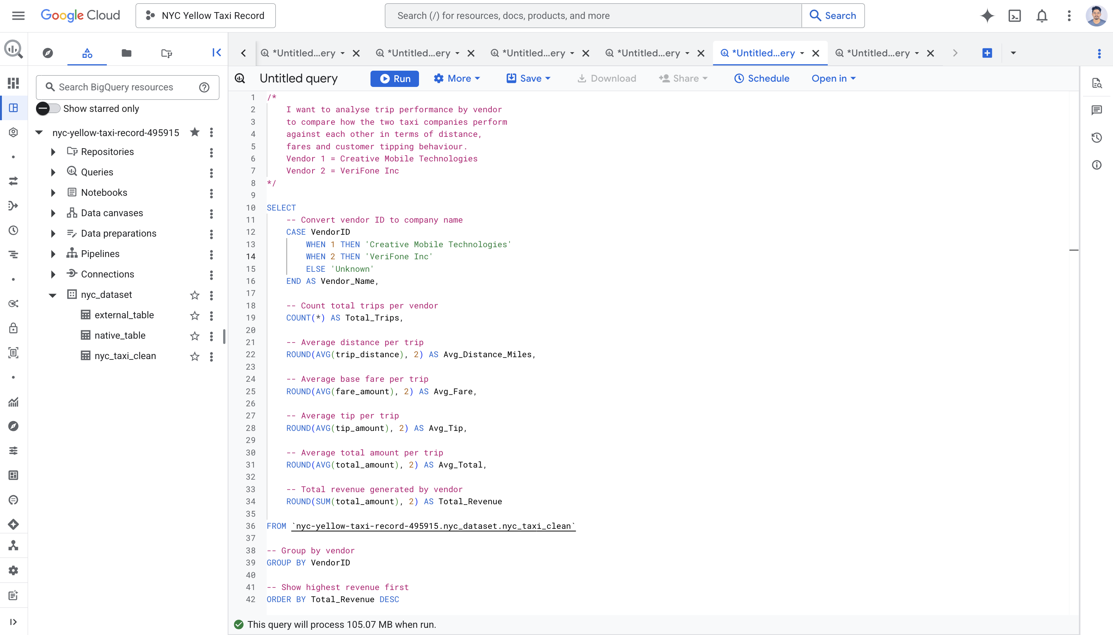
Analysis 3 Vendor Performance Comparison
Querying to compare the performance of the two taxi vendors:
Vendor1 = Creative Mobile Technologies Vendor 2 = VeriFone Inc
The query calculates: • Total trips completed by each vendor • Average trip distance • Average fare amount • Average customer tip amount • Average total trip amount • Total revenue generated by each vendor
This analysis helps identify which taxi company performs better in terms of revenue generation and customer spending patterns.
Figure: Query performance SQL Code

Slide 35
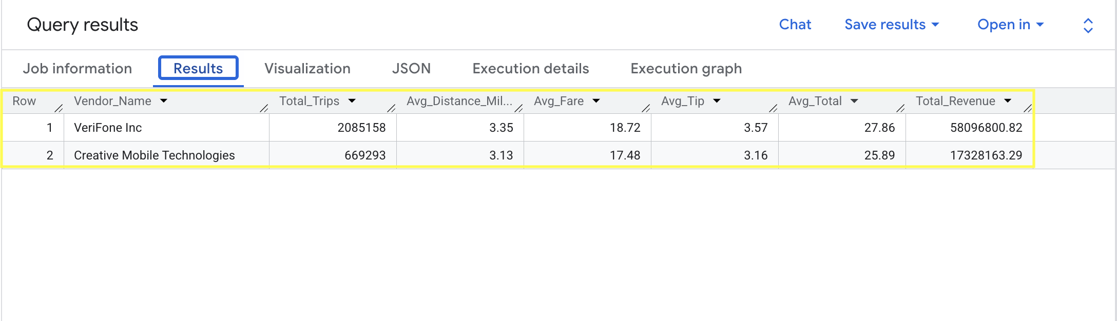
Key Insights
VeriFone dominates 76% market share
VeriFone Inc generated the highest total revenue among both vendors.
VeriFone completed significantly more taxi trips than Creative Mobile Technologies.
Customers gave higher average tips to VeriFone drivers.
Average fare amount and total trip amount were slightly higher for VeriFone Inc.
Both vendors showed similar average trip distances, indicating comparable travel coverage.
Fig: Vendor Performance Results

Slide 36
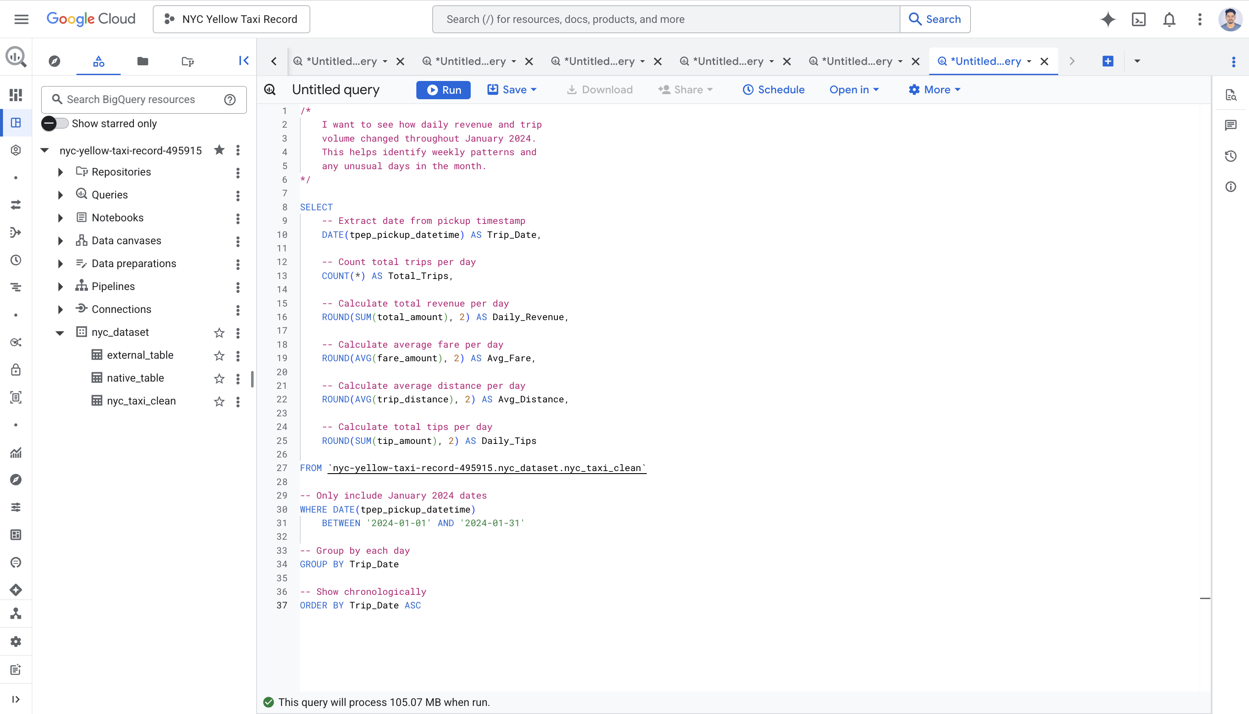
Analysis 4 Daily Revenue Trend
Querying to analyse daily taxi trip activity and revenue trends during January 2024.
This helps identify busy days, weekly travel patterns, and unusual changes in taxi demand throughout the month.
The query calculates:
• Total trips per day • Daily revenue generated • Average fare amount • Average trip distance • Total customer tips collected
Figure: Query Revenue Trend SQL Code

Slide 37
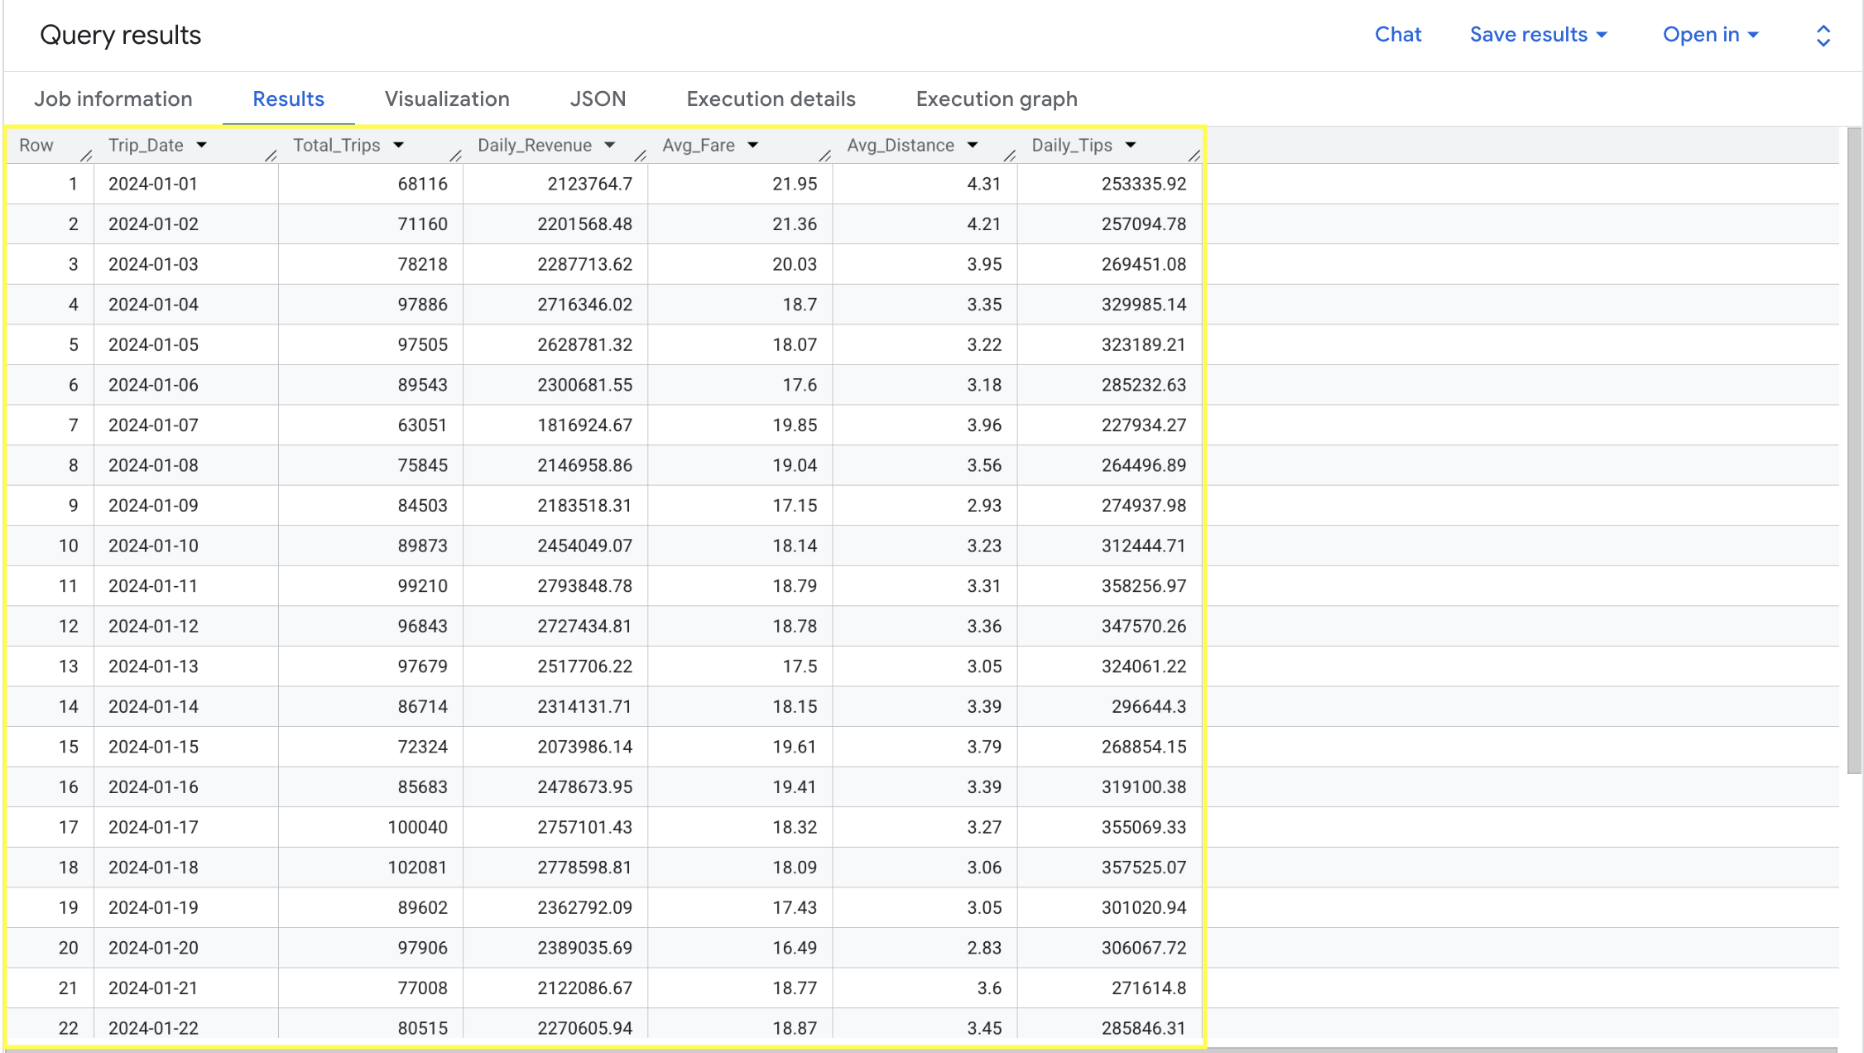
Key Findings
Busiest day: Jan 18 (102,081 trips)
Quietest day: Jan 1 (68,116 trips)
Thursdays consistently strongest day
Sundays consistently weakest day
Clear weekly pattern across month
Business Recommendations:
Reduce supply Sundays & holidays
Increase supply Thursday/Friday peaks
Dynamic pricing on high demand days (NYC TLC, 2024)
Fig: Result Revenue Trend

Slide 38
Data Visualisation using Big query
BigQuery has built-in visualisation tools
Charts generated directly from query results
No additional software needed
Instant visual insights from structured data
Same data can be exported to Looker Studio for advanced dashboards

Slide 39
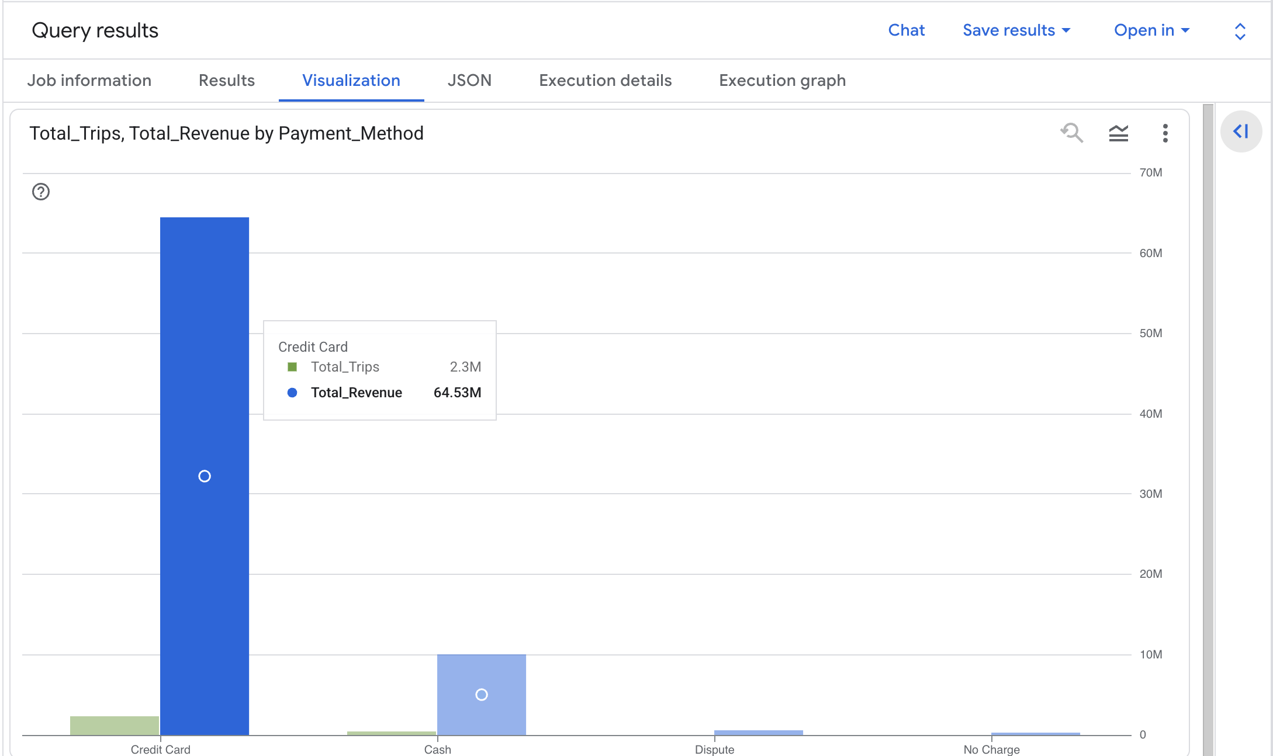
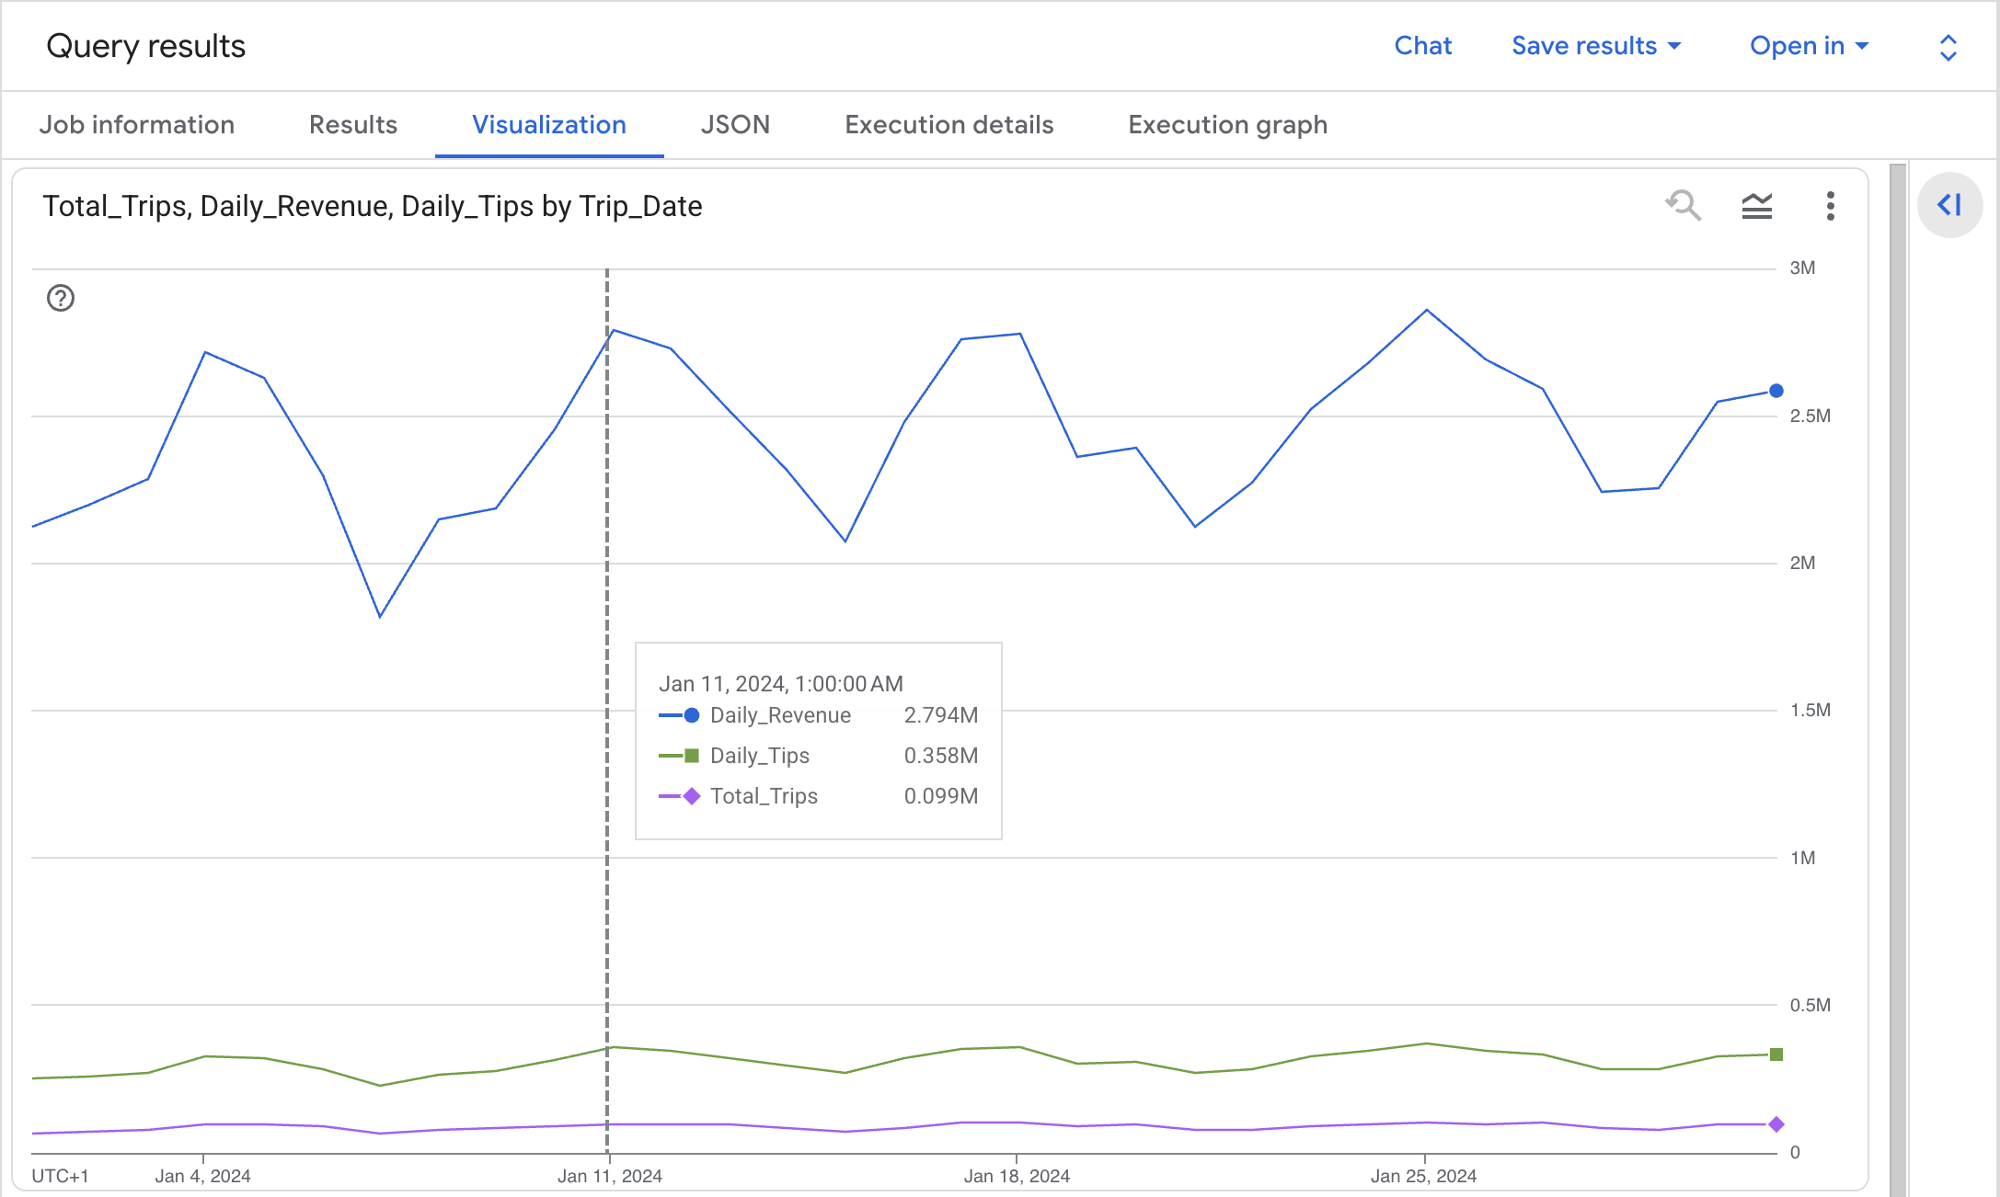
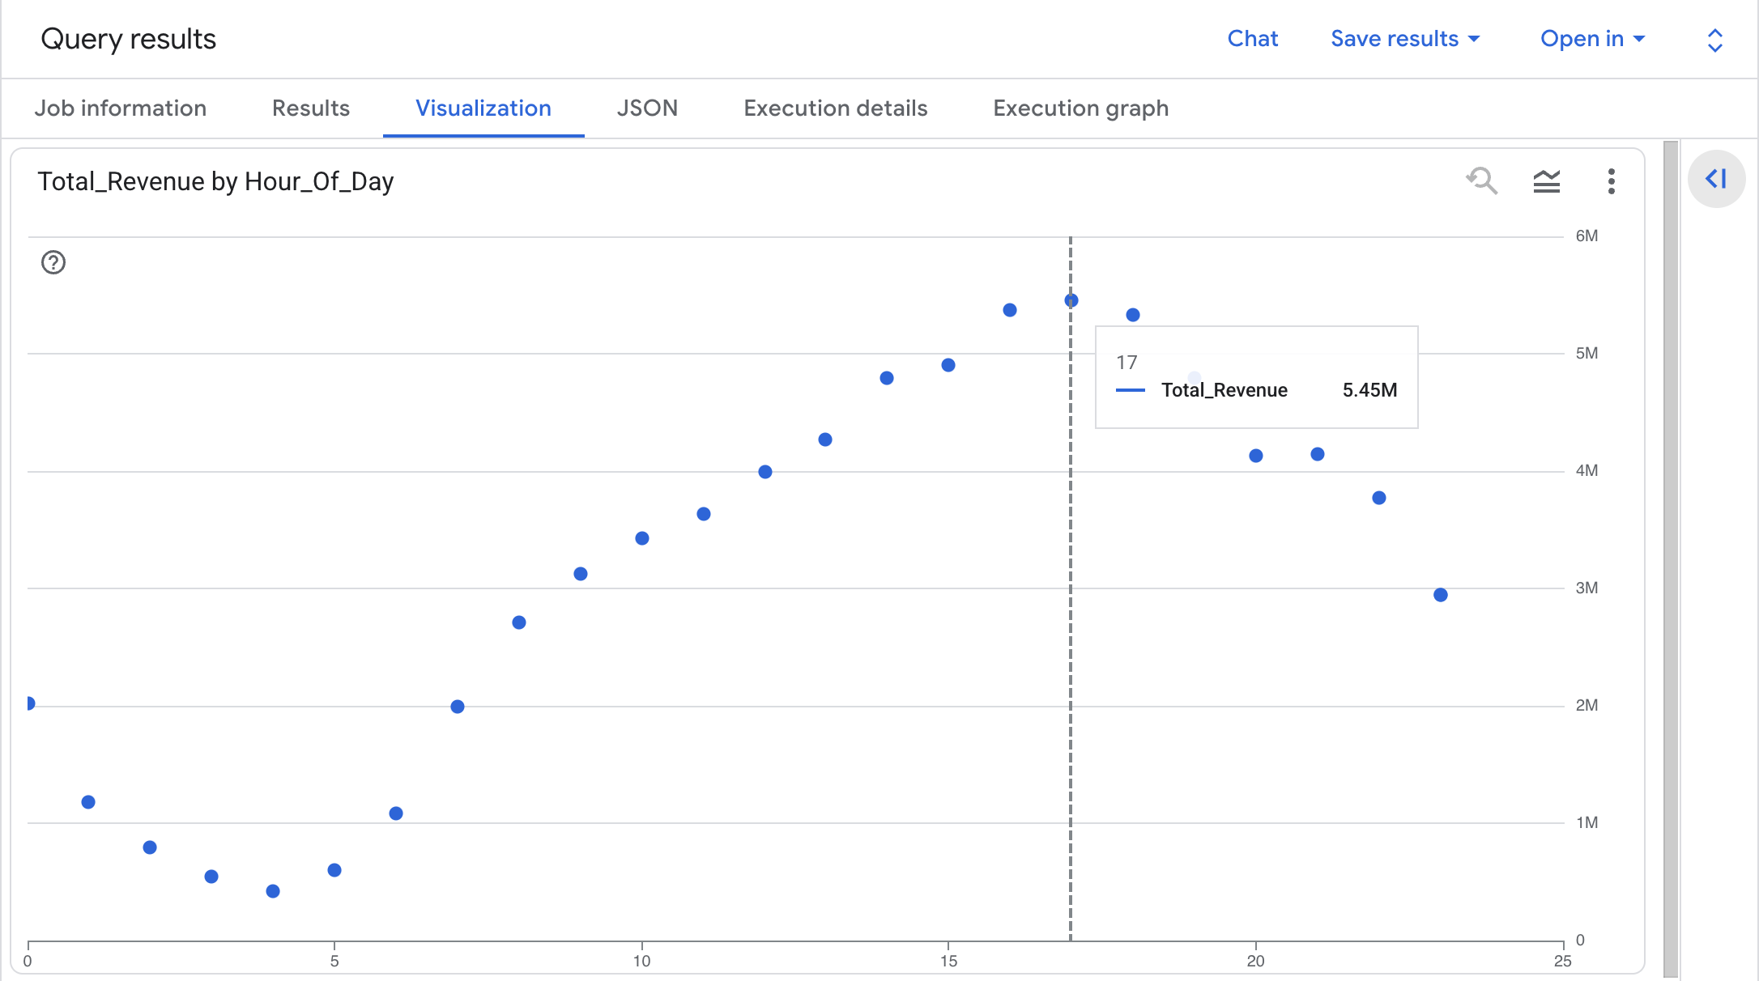
Figure: Visualization Payment Methods
Figure: Visualization Busy Hours
Figure: visualization Daily Revenue

Slide 40
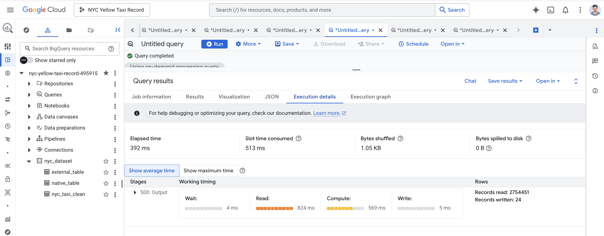
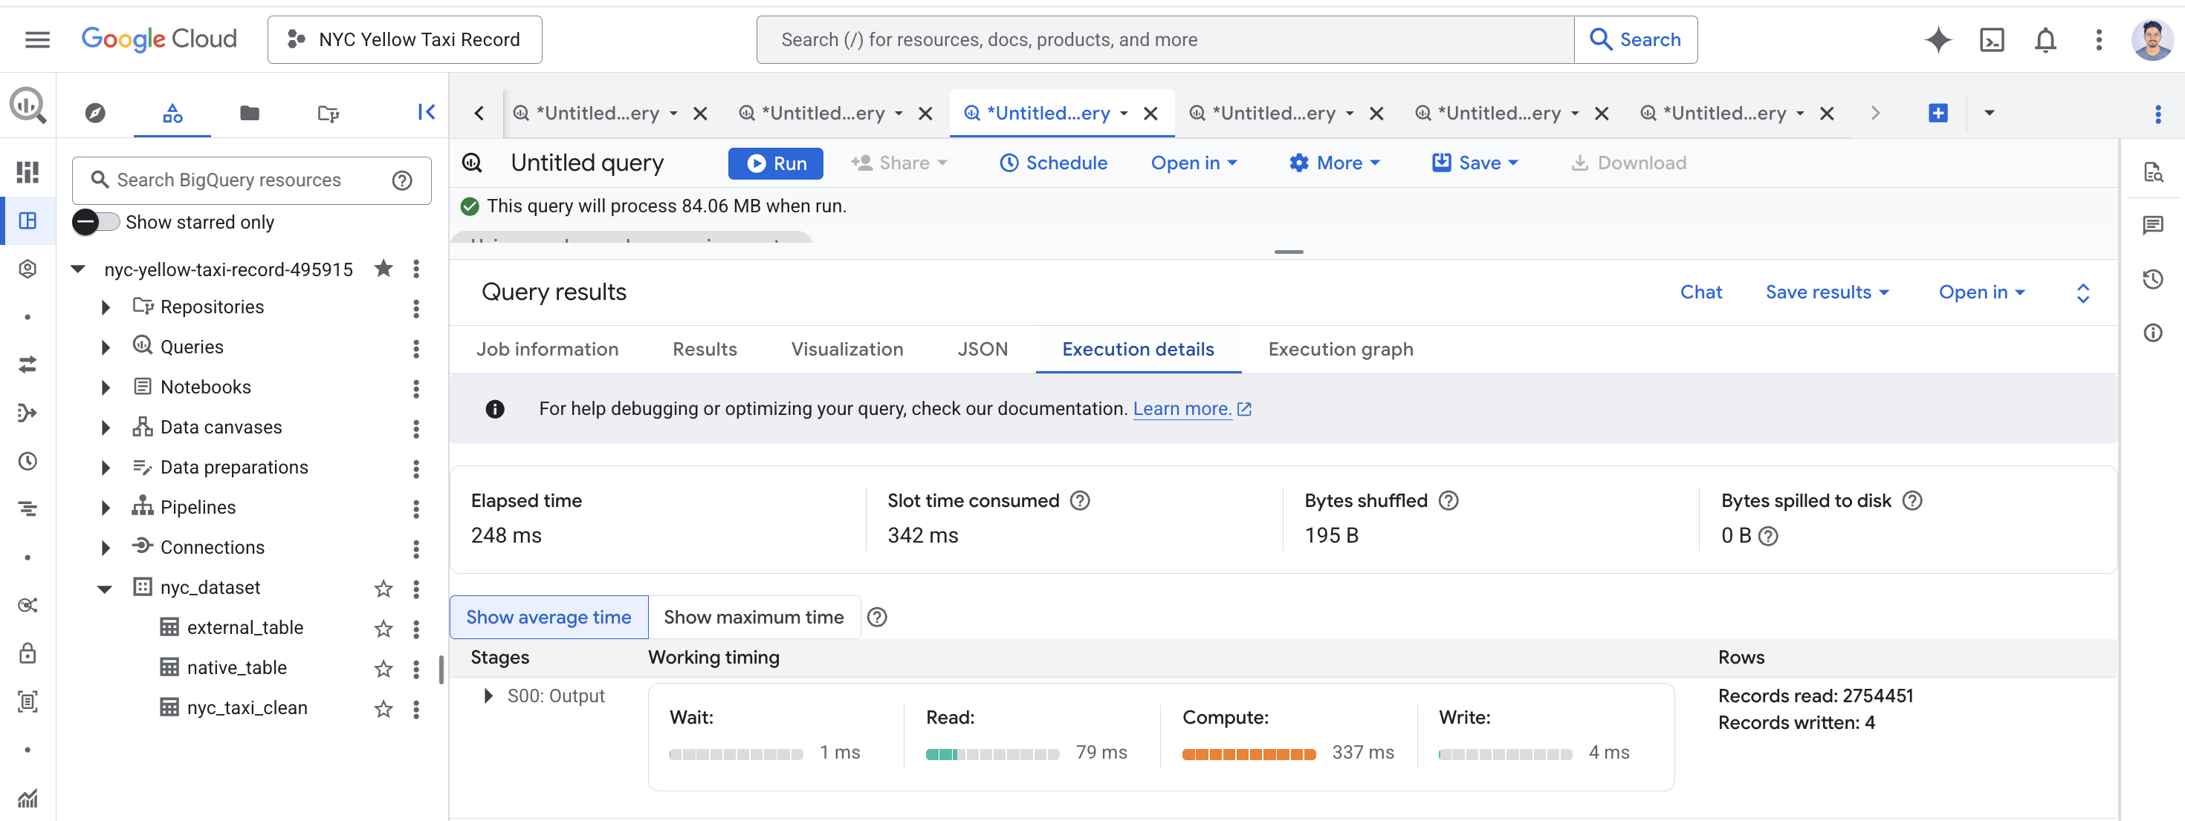
Execution Time
Query 1 (Vendor Performance Analysis)
2 vendor records processed in under 1 second
Query 2 (Hourly Taxi Demand Analysis)
24 hourly records processed in under 1 second
Query 3 (Payment Method Analysis)
4 payment categories analysed in under 1 second
Query 4 (Daily Revenue Trend - January 2024)
31 daily records processed in under 1 second
Figure : Execution time

Slide 41
Data Lake vs Data Warehouse
An analysis of two data architecture systems, comparing their differences in terms of structure, cost, security, and efficiency, and which one to choose under what circumstances.

Slide 42
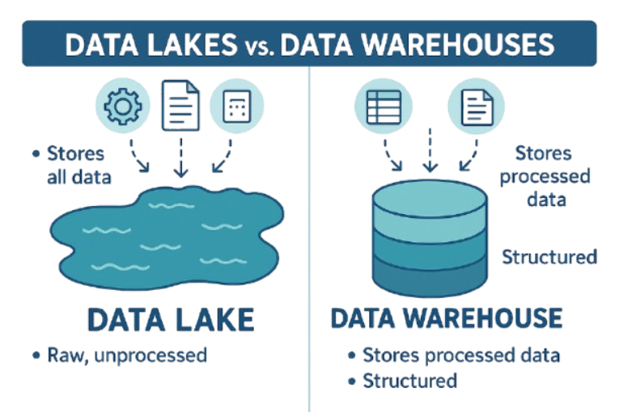
Key Differences
A data lake values flexibility and scalability, whereas a data warehouse emphasizes structured data and quick analysis.
Data Lake
Unstructured or semi-structured data stored
Schema-on-read – schema added during query execution
Target audience: data scientists, engineers
Applications: machine learning, big data analysis
ELT approach
Data Warehouse
Data is pre-structured and pre-processed.
Schema-on-write: Schema defined before storage
Users: Business analysts, managers
Applications: Dashboards, business intelligence, reporting
ETL Approach
Fig.

Slide 43
Cost Comparison
Data Lake on GCS- Cost Optimisation
Data Tiering: Automate the process of moving cold data through Nearline → Coldline → Archive tiers based on lifecycles for optimised storage cost savings.
Optimal File Format: Utilise Parquet/ORC formats to minimise data scanning and optimise query costs in BigQuery.
Minimising Egress Cost: Have your GCS bucket and BigQuery within the same geographic location for no extra egress cost.
Inexpensive APIs: The storage APIs are low-cost but frequent listing can be costly for Class A operations.
Data Warehouse on GCS – Cost Optimization
Pay per use model: Pay per TB scan cost ($6.25 per TB), which means inefficient queries can be expensive.
Fixed rate/Capacity-based model: Better suited for high-frequency and high-volume analysis.
Partition and Clustering: Helps in reducing scanning cost by minimizing scanning of data for each query.
Materialized Views: Pre-aggregated views that avoid complete table scan and reduce computation costs.

Slide 44
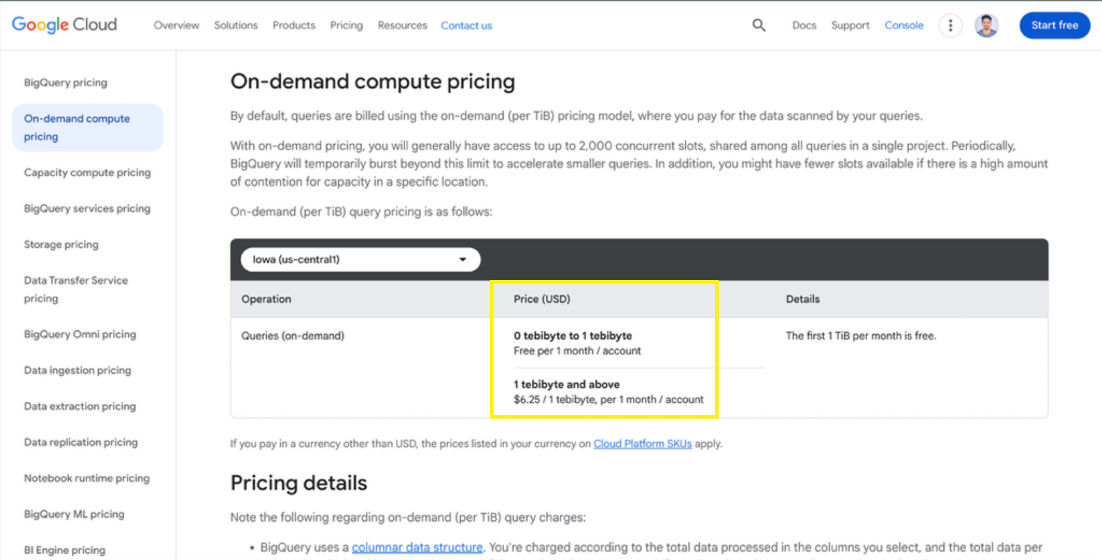
Fig:
Google Cloud BigQuery Analysis Cost Structure

Slide 45
Security features
IAM - A security model that controls who can access cloud computing resources and what they can do on those resources through roles and permissions.
Data Lake – IAM Security:
File and Folder Access at the Object Level
Bucket Permissions for Storage Containers
Least Privilege Roles to Secure Raw Data
Service Account Permissions for ETL/ML Pipelines
Logging File Access Events
Data Warehouse – IAM Security:
Structured data access from dataset/table
Row and column level access control for sensitive data elements
SQL permissions for queries execution
Role based hierarchies for BI/analytical users
Audit of queries executed to monitor data usage

Slide 46
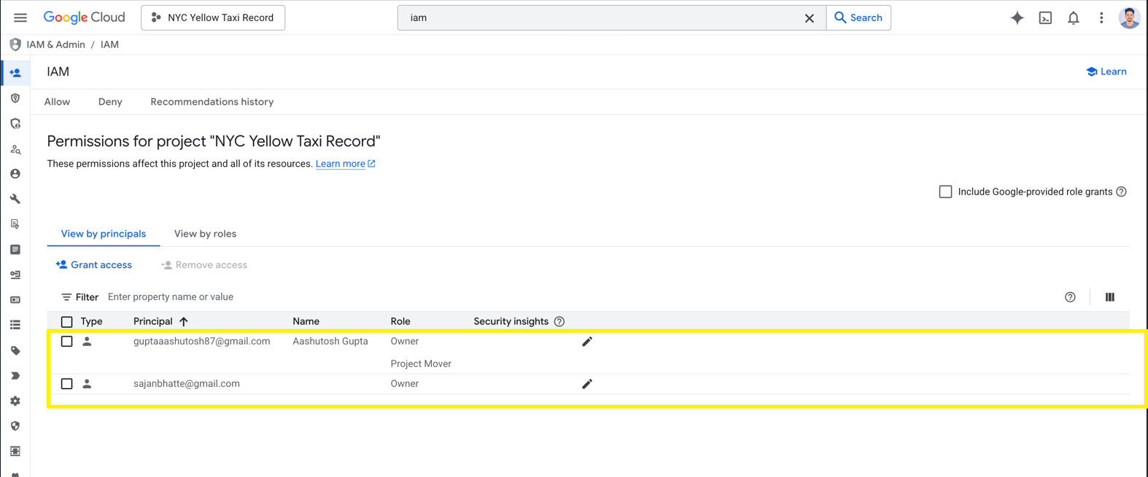
Fig
Google Cloud IAM

Slide 47
Performance & Monitoring
Data Lake:
Storage Layer: Direct queries against .parquet/.csv files located directly in cloud buckets (GCS/S3).
The Heavy Lifting: Each query requires listing files, reading headers, and parsing data structures every single time.
Latency: The data has to be fetched from external storage, causing an extra network hop.
Schema-On-Read: The speed will be constrained due to the database not knowing the data until it starts reading it.
Data Lake:
Storage Approach: The data has been preloaded to the database’s optimized storage.
Columnar Effectiveness: It accesses only the required column, such as the fare amount, while ignoring other columns in the taxi ride.
Discovery Not Required: Internal caching and metadata help; the location of 2024 data is known beforehand.
Efficient Route: Removes network latency since everything stays within the native environment.

Slide 48
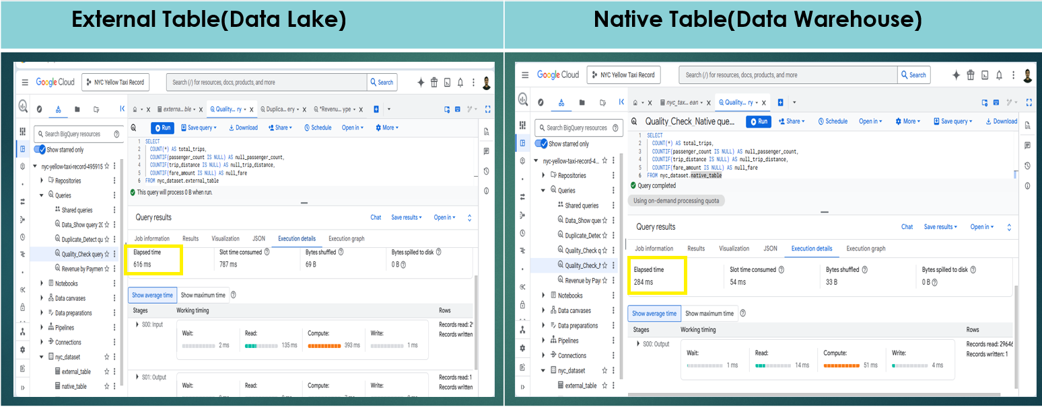
Fig.
Execution Time Comparison

Slide 49


Synthesis: Lake vs Warehouse (What We Found)
Same 2.96 million row NYC Yellow Taxi dataset, two architectures, two very different trade offs.
DATA LAKE
DATA WAREHOUSE
External Table on GCS (Parquet)
Native Table in BigQuery
Schema on read: flexible, schema applied at query time
Raw, semi-structured and structured data co-exist
Lower storage cost
Slower scan: query reads files directly from GCS
Ideal for ML and exploratory analytics
Schema on write data validated and curated on load
Columnar, partitioned, clustered & optimised
Higher storage cost, but managed compute is fast
Native table outperformed external on execution time
Ideal for governed BI, reporting & dashboards
Asish Bhusal 260039158

Slide 50





Key Business Insights from Our Analysis
Four queries on a cleaned 2.75M-row table revealed actionable patterns for NYC TLC.
of trips paid by credit card
$64.5M revenue, $4.16 avg tip
peak demand hour
198,014 trips on a single hour
84%
6 PM
vendor market share
VeriFone Inc dominates over CMT
strongest weekday
Sundays are the weakest
76%
Thu
Recommendation: dynamic pricing in 4–7 PM peaks · supply scheduling on Thu/Fri · contactless-first driver incentives.
Asish Bhusal 260039158

Slide 51



When to Use Which?
There is no universal winner
CHOOSE A DATA LAKE
CHOOSE A DATA WAREHOUSE
CHOOSE A LAKEHOUSE
(e.g. GCS + external tables)
(e.g. BigQuery native tables)
(e.g. BigLake + Apache Iceberg)
Raw, semi-structured or unstructured data
Data-science & ML workloads
Schema evolves frequently
Storage cost is the binding constraint
Exploratory, ad-hoc analytics
Curated, structured, business-critical data
BI dashboards & frequent reporting
Sub-second query latency required
Strong governance & access controls
Predictable, well-known schemas
Both ML and BI on the same data
Want ACID guarantees on object storage
Need to avoid data duplication
Open table formats are a priority
Future-proofing the platform
Asish Bhusal 260039158

Slide 52


The Lakehouse: Convergence of Two Paradigms
Modern architectures dissolve the lake vs warehouse trade-off (Armbrust et al., 2021).
+
DATA LAKE
DATA WAREHOUSE
LAKEHOUSE
Cheap, flexible
object storage
Fast queries, ACID,
governance
Open table formats
on object storage
Why this matters for our project
ACID transactions on cheap object storage , eliminates the lake/warehouse duplication tax
Open table formats (Apache Iceberg, Delta, Hudi) prevent vendor lock-in
Google Cloud's BigLake lets BigQuery query Parquet
Single source of truth ML, BI and ad-hoc SQL on the same files
Asish Bhusal 260039158

Slide 53






Future Work — Extending the Project
Six directions to deeper the analysis and the architecture.
Real-time streaming
Predictive ML
Migrate to Lakehouse
Ingest live trip events via Pub/Sub → Dataflow → BigQuery for sub-minute dashboards.
BigQuery ML to forecast hourly demand and tip likelihood.
Re-platform on BigLake + Apache Iceberg for ACID on the existing Parquet files.
Geospatial analysis
Longitudinal study
Sustainability metrics
Use BigQuery GIS on PULocationID/DOLocationID for hotspot and route-flow maps.
Extend 2019–2024 to quantify the pandemic's lasting impact on NYC ridership.
Estimate trip-level CO₂ and model fleet electrification scenarios for NYC TLC.
Asish Bhusal 260039158

Slide 54

Limitations & Final Conclusion
Limitations of this study
Final conclusion
Single dataset one taxi vendor, one city; findings may not generalise.
Batch only no streaming real time ingestion in scope.
Single cloud Google Cloud only; no cross-provider comparison.
BigQuery sandbox limits constrained partitioning/clustering tests.
Execution time benchmarks ran on a small number of queries.
Both architectures earn their place:
the warehouse (native table) delivered faster, governed BI; the lake (external table) delivered flexibility and cheaper storage.
For NYC TLC's mixed BI + ML roadmap, the Lakehouse is the natural next step ACID guarantees on cheap object storage, no duplication tax.
Asish Bhusal 260039158

Slide 55
References
Armbrust, M., Ghodsi, A., Xin, R. and Zaharia, M. (2021) ‘Lakehouse: A new generation of open platforms that unify data warehousing and advanced analytics’, 11th Conference on Innovative Data Systems Research (CIDR ’21), Online, 11–15 January.
Dixon, J. (2010) ‘Pentaho, Hadoop, and Data Lakes’, James Dixon’s Blog, 14 October. Available at: https://jamesdixon.wordpress.com .
Google Cloud (2026) BigLake documentation. Available at: https://cloud.google.com/biglake/docs .
Inmon, W.H. (2005) Building the data warehouse. 4th edn. Indianapolis: Wiley.
Khine, P.P. and Wang, Z.S. (2018) ‘Data lake: a new ideology in big data era’, ITM Web of Conferences, 17, p. 03025. doi:10.1051/itmconf/20181703025.
Nambiar, A. and Mundra, D. (2022) ‘An overview of data warehouse and data lake in modern enterprise data management’, Big Data and Cognitive Computing, 6(4), 132. doi:10.3390/bdcc6040132.
NYC Taxi and Limousine Commission (2024) TLC trip record data. Available at: https://www.nyc.gov/site/tlc/about/tlc-trip-record-data.page .
Qlik (2026) Data lake architecture. Available at: https://www.qlik.com/us/data-lake/data-lake-architecture (Accessed: 11 May 2026).
Google Cloud (2026) Cloud Storage pricing. Available at: Google Cloud Storage Pricing(Accessed: 10 May 2026).
Google Cloud (2026) BigQuery pricing. Available at: Google BigQuery Pricing(Accessed: 10 May 2026).
Asish Bhusal 260039158

Slide 56


