Slide 1
covid
File created on: 7/16/2022 10:44:27 PM

Slide 2
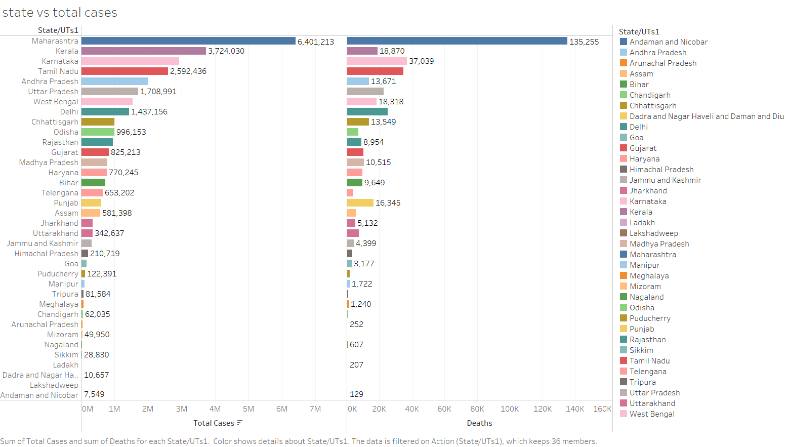

Slide 3
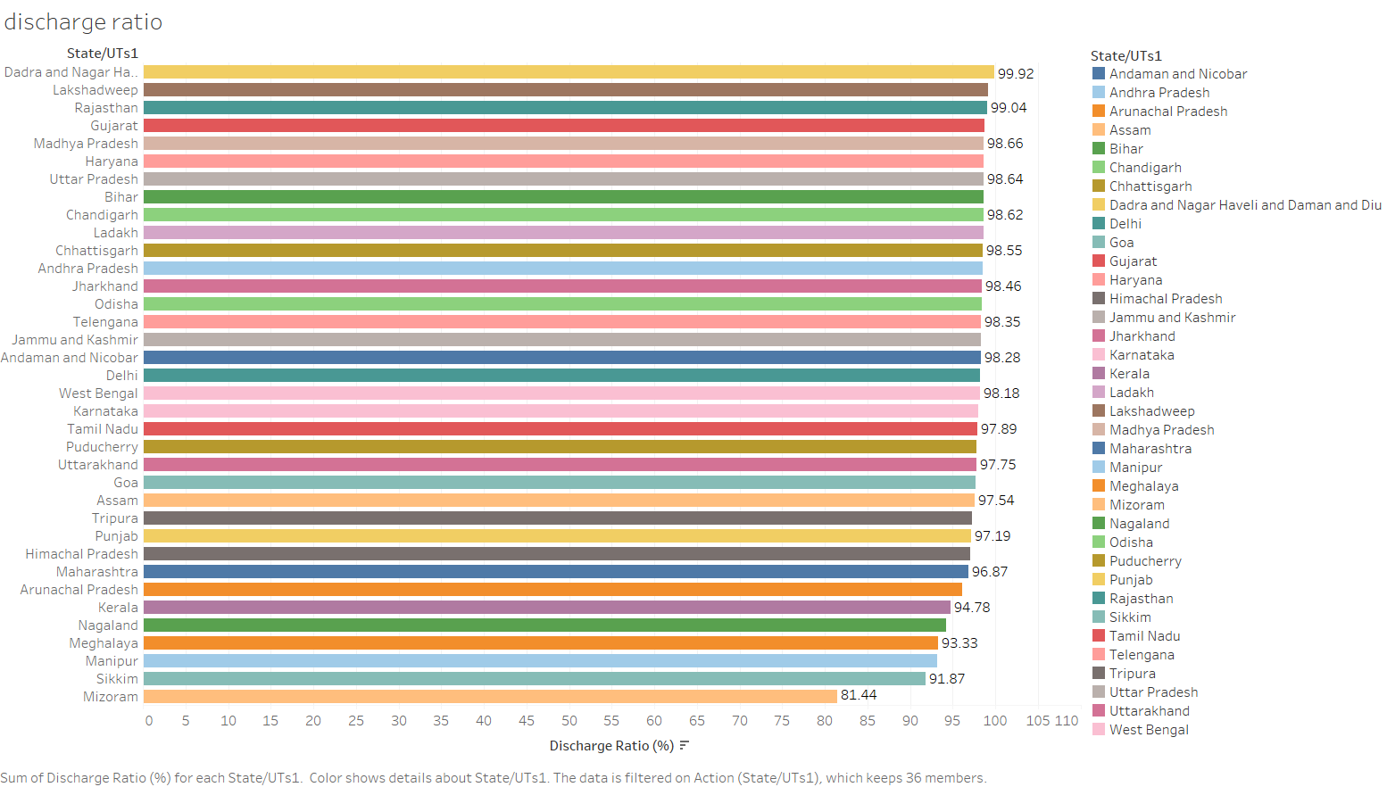

Slide 4
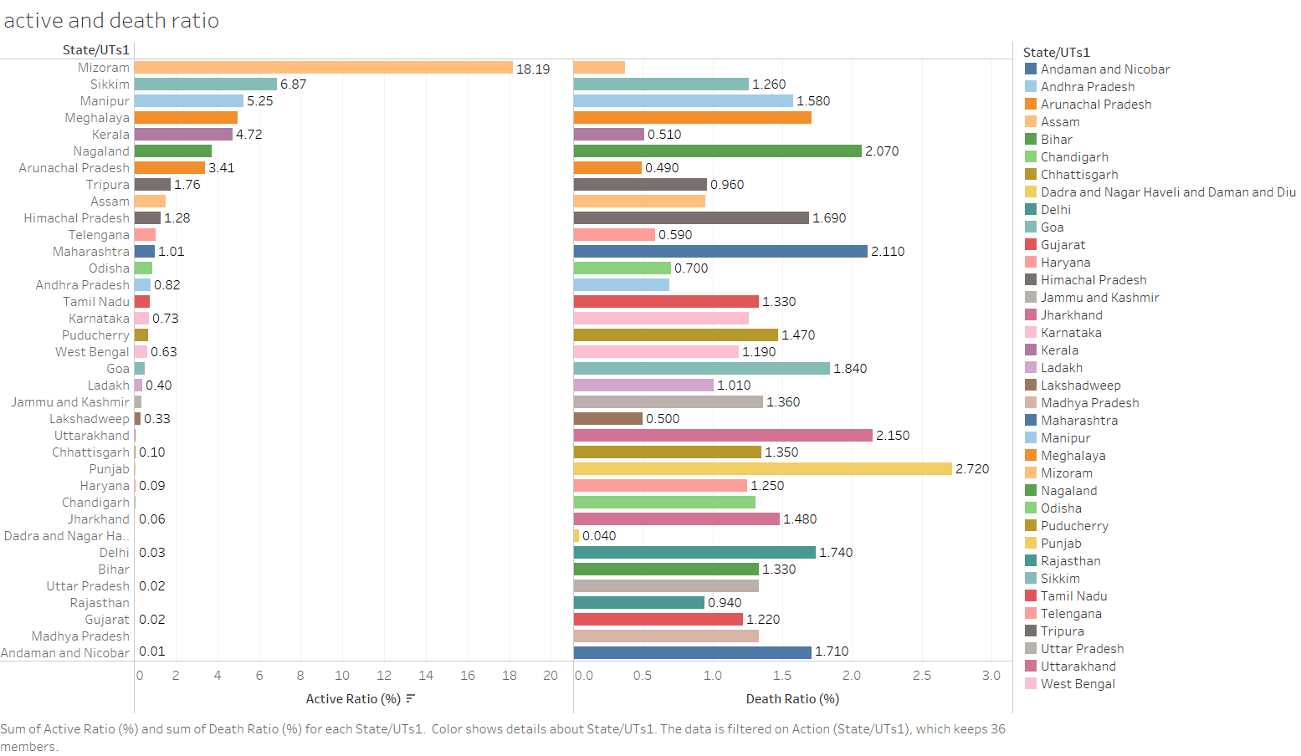

Slide 5
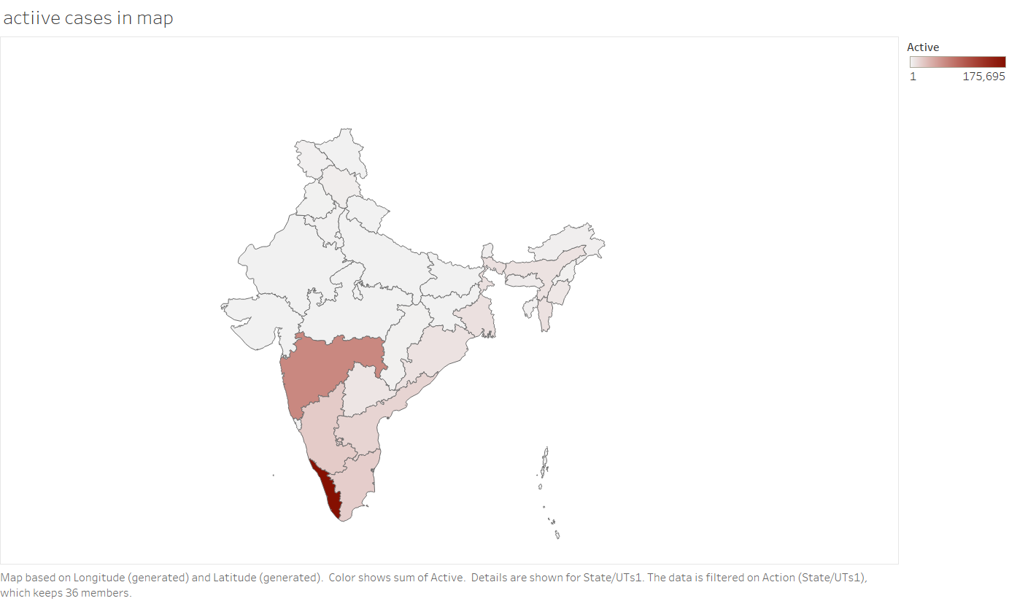

Slide 6
