Slide 1
Infrastructure Connections

Slide 2

Internet
SNRC1
SNRC2
IGR
AR
AR
BR
Intra Complex Connection
BR
AR
Back bone Connection
AR
AR
Inter-network Connection
Different Type of Network

Slide 3
INSTAR Inventory application/module is part of the INSTAR suite that is used by
Capacity Management work center users to inventory the IP infrastructure network,
so that the customers can be provisioned to the edge routers,
which link to the backbone routers.
INSTAR Inventory is mainly responsible for inventorying the routers,cards, circuits
between the routers
INSTAR Provisioning creates the provisioning data like port assignment, WAN address
for each of the end of the circuit.
ARACS is responsible for generating configlets and downloading configlets in the router
Dummy configlets are generated for infra connections

Slide 4
Infrastructure Connection process
User inventories the ARs and BRs, AGGRs
User inventories the uplinks between BR-BR or AR-BR
Inventory sends to Provisioning the XML to create infrastructure connection.
For each end of the circuit , sap,endpoint,portassignment,wan address will be created
Interface string is generated
Configlets are generated (dummy)

Slide 5
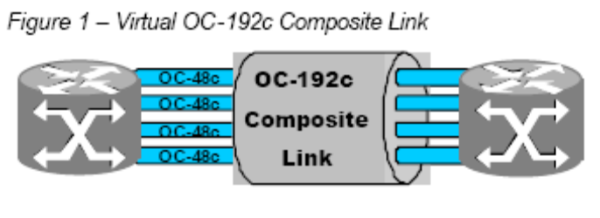
Infrastructure Connection process – Different scenarios
Single Link Two ended connection
Single Link One ended connection
Composite Link Group
Ethernet with Vlans
Ethernet w/o Vlans
COMPOSITE LINKS is a powerful link aggregation technology that enables a
set of upto 64 SONET/SDH physical links to be configured as a single logical
connection. Composite Links enable non-disruptive addition and removal of
bandwidth.Each Composite Link member is a SONET/SDH interface, using Packet over
SONET (POS) encapsulation. Each member is established using the
standardPPP protocol, thus offering multi-protocol support.
Figure 1 shows a simple example of a virtual OC-192c Composite Link
consisting of four OC-48c/STM -16c member links

