Slide 1
Introduction to Probability and Information Theory-I

Slide 2
Probability
Mathematical framework for representing uncertain statements.
Quantifying uncertainity.
How does this uncertainity comes from? How is it associated with AI?
Probability theory allows us to make uncertain statements and reason in the presence of uncertainty.

Slide 3
Sources of Uncertainity
Inherent Stochasticity in the system being modelled/ ignorance of intrinsic variability (aleatoric uncertainity)- Door games. E.g. Card game.
Incomplete Observability- When all variables are not observable.
Incomplete Modelling- modelling a system that discards some information, resulting in uncertainty/ ignorance of hidden underlying causes or mechanism, generating data (Epistematic uncertainity). E.g. Robot discretizing a search space during object identification

Slide 4
Type of Probabilities
Frequentist Probability: relates to the rate at which events occur.
E.g. Coin flipping.
Bayesian Probability: relates to qualitative levels of uncertainty (fundamentally related to information than trials).
E.g., Probability of disease prediction.
Machine learning deals with Bayesian probabilities.

Slide 5
Probability in AI
Probability can be used in AI, in two ways:
Probability tells how AI should reason, based on which we can design systems to compute and approximate expressions.
Exploiting probability and statistics to analyse the behaviour of AI system.

Slide 6
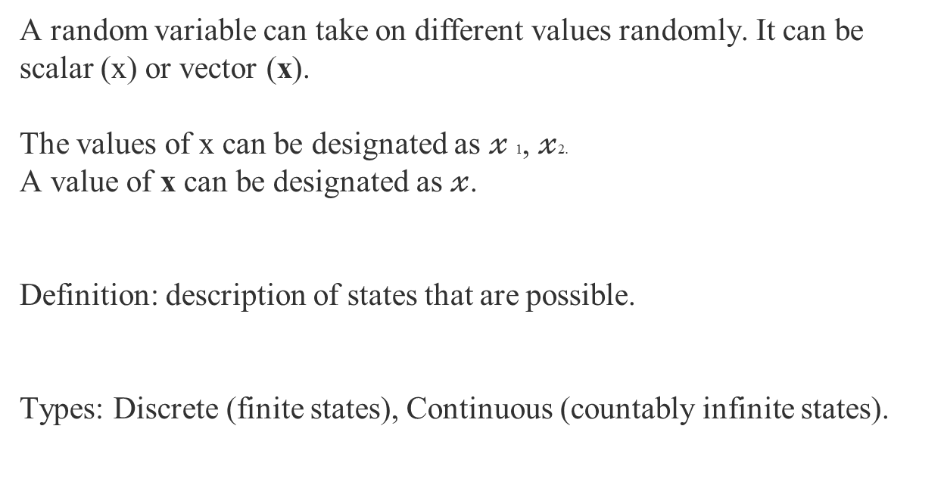
Random Variables
A random variable can take on different values randomly. It can be scalar (x) or vector (x).
The values of x can be designated as $𝓍$1, $𝓍$2.
A value of x can be designated as $𝓍$.
Definition: description of states that are possible.
Types: Discrete (finite states), Continuous (countably infinite states).

Slide 7


Probability Distributions
Definition: description of how likely a random variable or set of random variables will take each of its possible state.
Probability distribution for Discrete Random variable: Probability mass function.
Probability distribution for Continuous Random variable: Probability Density function.

Slide 8


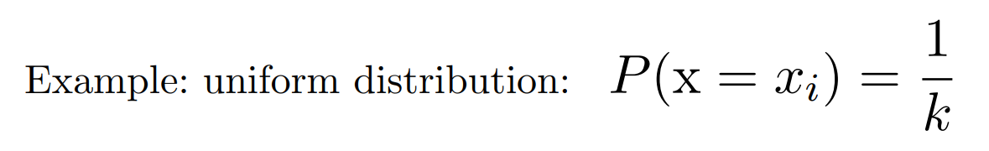
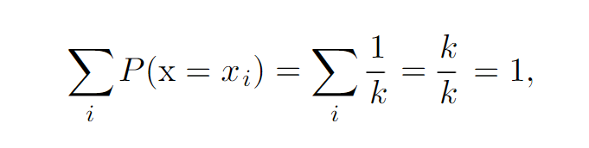
Probability Mass function
Conditions on a function, to be probability mass function:
The domain of P must be set of all possible states of x.
It should follow that the value of P(x) for any x should range between 0 and 1.
The sum of probabilities of all random states should be equal to 1.

Slide 9


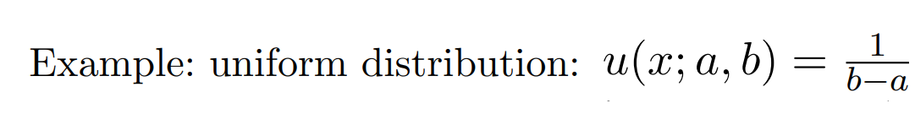
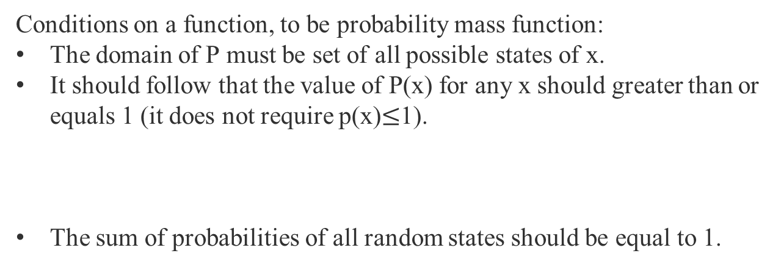
Probability Density function
Conditions on a function, to be probability mass function:
The domain of P must be set of all possible states of x.
It should follow that the value of P(x) for any x should greater than or equals 1 (it does not require p(x)$≤$1).
The sum of probabilities of all random states should be equal to 1.

Slide 10
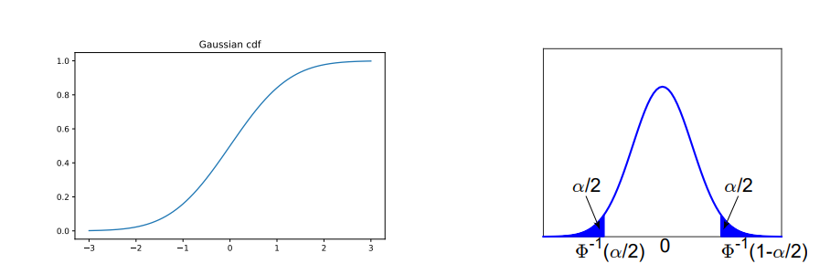

PDF vs CDF
$$F\left(X≤ 𝓍\right)=Φ\left(𝓍\right)$$
If we need to find the data point, given its probability, we need to take inverse of cdf, as shown in the PDF on the right side.

Slide 11
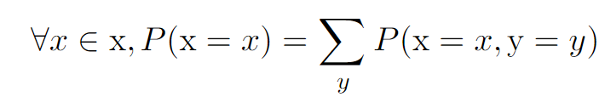
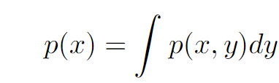
Marginal Probability
Given a set of variable, if we need to find the probability over a subset of variables occuring in a particular state, the probability is called marginal probability. The resultant distribution is called marginal probability distribution.

Slide 12
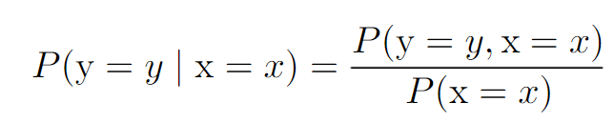

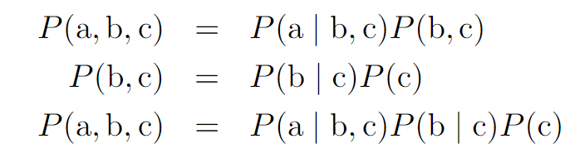
Conditional Probability
If we need to find a probability of an event, given some event is already occurred, the probability is called conditional probability.
Chain Rule of Probability
Example

Slide 13



Independence (Mutual Exlcusion)
If two events are independent, their pdfs can be written as product of pdfs of two events.
Independence notation:
Conditional Independence: Two events are conditionally independent, given a third event, if pdf of over x and y factorizes as:
Conditional Independence notation:

Slide 14
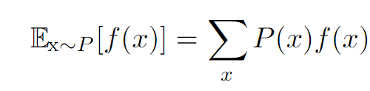
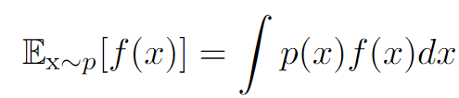




Expectation
Expectation
Annotations:
If identity is clear from the distribution
If it is clear that over which variable, we are taking expectation over
Default case (Avergage):
Expectations are linear.

Slide 15
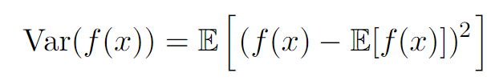
Variance
Variance is how much an event or a value, defined by a random variable is different, when sampled from a probability distribution.
When variance is low, the f(x) is clustered near the expected value of that function.

Slide 16


Covariance
Gives a sense of the degree of relationships (dependency) with each other.
Rules:
High covariance means both functions are a way far from their expected values.
Positive covariance: the values of that variable tends to take high values, relatively.
Negative Covariance: self explanatory.
Covariance matrix: diagonal elements shows variance i.e.,

Slide 17
Commonly used pdfs
Bernoulli Distribution
Multinoulli Distribution
Gaussian Distribution
Exponential and Laplace Distribution

Slide 18




Bernoulli Distribution
Bernoulli Distribution (special case of Binomial distribution): Over a binary random variable, and is controlled by single parameter (theta and phi are same, just to differentiate between binomial and bernoulli distribution, the binomial distribution equations have thet, while bernoulli dirstibtuion equations has phi).
Binomial Distribution Bernoulli Distribution
When N=1, it is Bernoulli distribution.

Slide 19





Multinoulli/Categorical Distribution
Multinoulli is a special case of Multinomial distribution.
Multinomial Distribution: Multinoulli Distribution
C-1 parameters
E.g., if y is converted into one hot encoder
When N=1, then it is multinoulli distribution.

Slide 20
One hot encoding

Slide 21
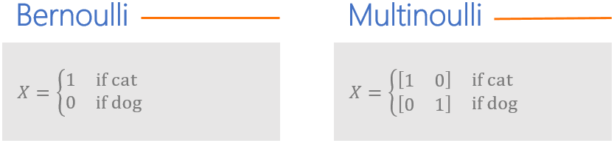
Bernoulli and Multinoulli

Slide 22
Thank You

