Slide 1
DS303
Course Project
Students: Anuj Gupta (21d070014)
Aryan Mishra (210020023)
Atharva Kulkarni (210070047)
Ravi Kumar (210010052)
Professors: Manjesh Hanawal and
Biplab Banerjee

Slide 2
Aim
We endeavor to implement a machine learning model by referring to a research paper. We aim to classify various animals by training a Convolutional Neural Network on a large dataset which we procured from Kaggle.

Slide 3
Reference Paper
Recognition Of Animal Species On Camera Trap Images Using Machine Learning And Deep Learning Models
Rajasekaran Thangarasu, Vishnu Kumar Kaliappan, Raguvaran Surendran, Kandasamy Sellamuthu, Jayasheelan Palanisamy

Slide 4
Dataset and
Preprocessing
We acquired the dataset from Kaggle and preprocessed the data before training the model. We restricted our dataset to 1000 images per label and resized the images to 300*300 pixels. Then, we created an array containing input images and another array to hold their labels.

Slide 5
Labels Definition
Animals | Labels
Butterfly | 0
Cat | 1
Chicken | 2
Cow | 3
Dogs | 4
Elephant | 5
Horse | 6
Sheep | 7
Spider | 8
Squirrel | 9

Slide 6
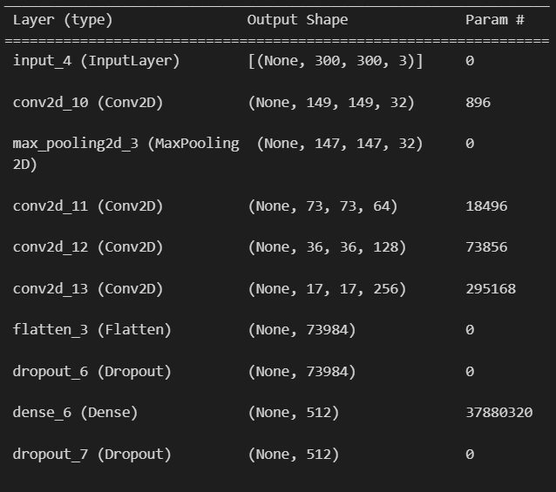
Model and Layers Summary

Slide 7
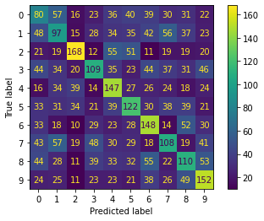
Demo Results
Confusion Matrix (between y_test and y_predicted)

Slide 8
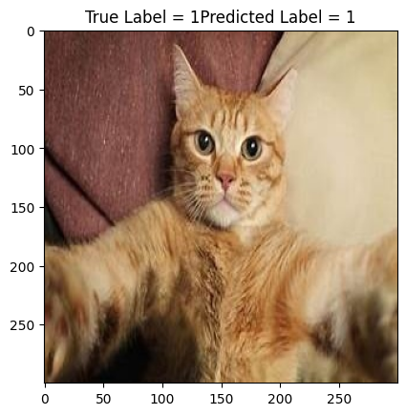
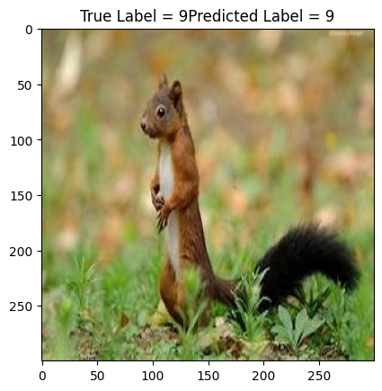
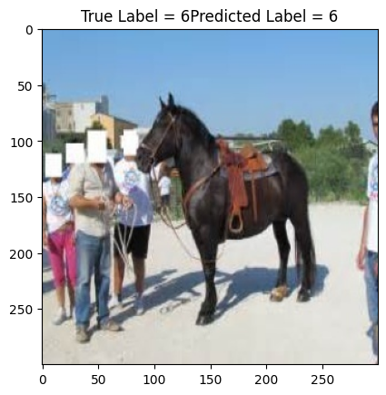
Demo Predictions

Slide 9
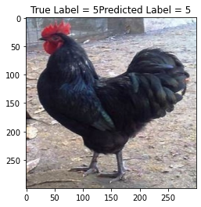
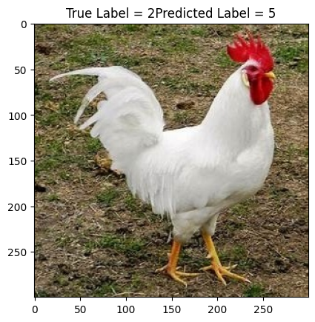
Demo Predictions

Slide 10
A Remark
Due to less number of images in the dataset, our model lags in accuracy. It achieved training accuracy of 98.15 percent and validation accuracy of 31.03 percent. This is a result of overfitting to the dataset. We tried fixing this but since the model is large, it takes lot of time (around 3 hours) for training, so we could not improve the validation accuracy before the deadline. Possible solutions to avoid overfitting would be using a smaller model, using more data or increasing dropout.

Slide 11
References
Recognition Of Animal Species On Camera Trap Images Using Machine Learning And Deep Learning Models: http://www.ijstr.org/final-print/oct2019/Recognition-Of-Animal-Species-On-Camera-Trap-Images-Using-Machine-Learning-And-Deep-Learning-Models.pdf
Tensorflow Documentation: https://www.tensorflow.org/api_docs
Dataset: https://www.kaggle.com/datasets/alessiocorrado99/animals10
DS 303 Lectures and Slides

Slide 12
Contribution of each Member
Everyone : Literature survey, paper understanding, tuning and demo
Atharva Kulkarni : Model selection, data preprocessing, presentation
Ravi Kumar : Dataset acquiring, data preprocessing, readme
Aryan Mishra : Model selection, code implementation, readme
Anuj Gupta : Model selection, code implementation, presentation

Slide 13
Thank You

