Slide 1
CS754 Course Project
Prior Image Constrained Compressed Sensing
Group members:
Anuj Gupta, 21D070014
Mayank Gupta, 210101002
Soham Inamdar, 210100149

Slide 2
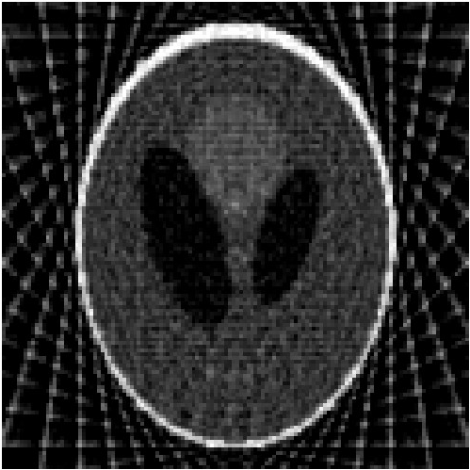
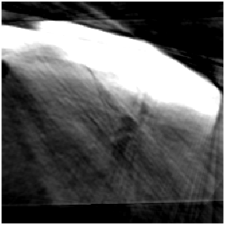
Limitations of Filtered Back Propagation
When the number of projections does not satisfy the Shannon/Nyquist sampling requirement, the images reconstructed using FBP contain streaking artifacts.
Streaking
Artifacts

Slide 3

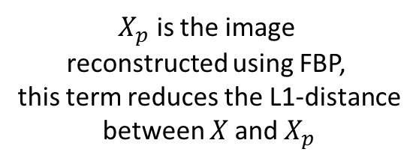

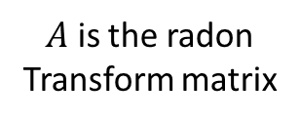
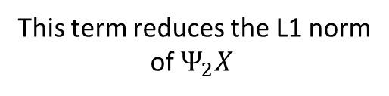
PICCS equation
$X_{p}$ is the image
reconstructed using FBP,
this term reduces the L1-distance
between $X$and $X_{p}$
This term reduces the L1 norm
of $Ψ_{2}X$
$A$ is the radon
Transform matrix
$Ψ_{1}=Ψ_{2}=$ discrete gradient matrix

Slide 4
PICCS Algorithm
A prior image reconstructed from the union of interleaved dynamical data sets using FBP is utilized to constrain the image reconstruction using CS.
In the reconstructed prior image, the dynamical information is lost but the static structures in the image are well reconstructed without undersampling streaking artifacts.
This is implemented in two steps:
  In the first step, the standard algebraic reconstruction technique is used to construct X from Y=AX.
  In the next step, the constraint of the PICCS equation is minimized using the steepest gradient descent.
  This is done iteratively until some thresholding condition is met.

Slide 5
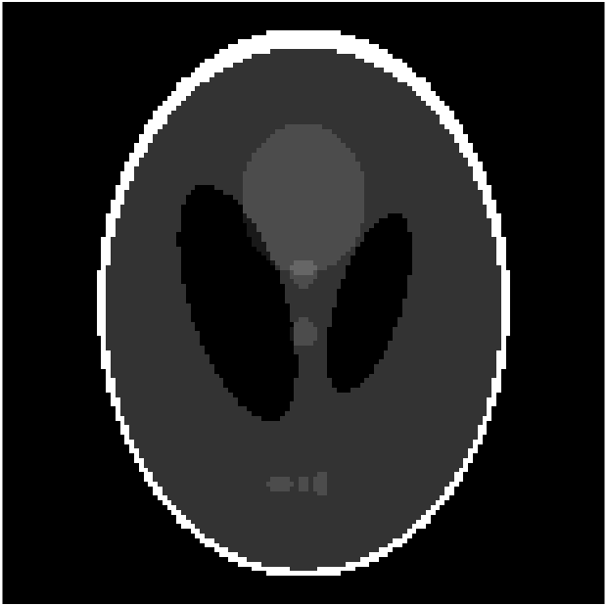
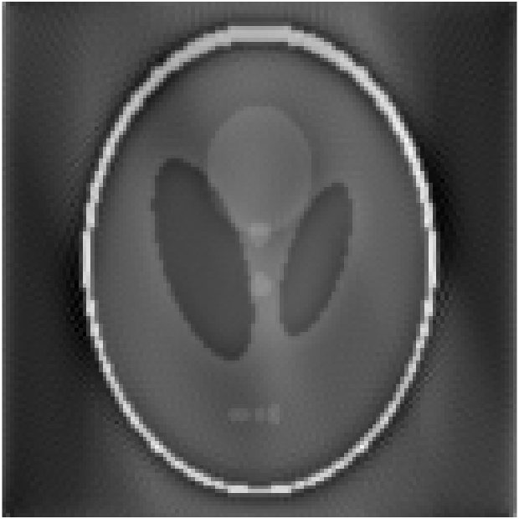
Results on using PICCS for Shepp Logan Phantom without interleaving
Original Image Filtered Back projection Reconstructed Image

Slide 6
Observations from the previous slide
The filtered back projection has a lot of streaking artifacts, and the reconstructed image doesn't have any streaking artifacts although it is a bit lighter than the actual image.
No interleaving of multiple dynamic images have been performed for these images. Better results have been obtained on performing interleaving with multiple images from the same dataset (shown later).

Slide 7
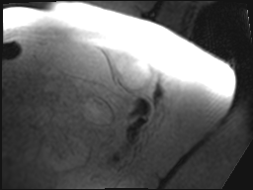
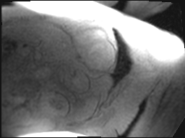
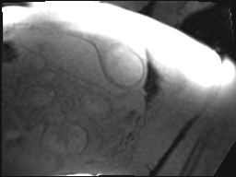
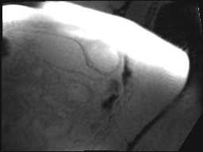
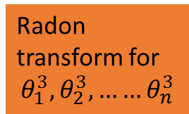
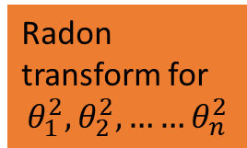
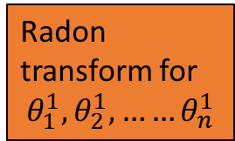

Interleaving
Radon transform for
$$θ_{1}^{1}, θ_{2}^{1},……θ_{n}^{1}$$
+
All radon transforms have under sampled view angles
distributed across the angular range. The view angles of different dynamic images are selected such that their union provides a fully sampled dataset. Prior image is obtained by using FBP on the interleaved projections.
Radon transform for
$$θ_{1}^{2}, θ_{2}^{2},……θ_{n}^{2}$$
+
Radon transform for
$$θ_{1}^{3}, θ_{2}^{3},……θ_{n}^{3}$$
.
.
.
Radon transform for
$$θ_{1}^{4}, θ_{2}^{4},……θ_{n}^{4}$$

Slide 8
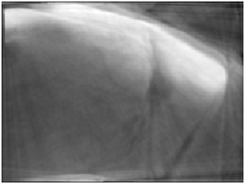
Results obtained on myocardium perfusion dataset
Myocardium in rest
Original Image
Filtered Back Projection

Slide 9
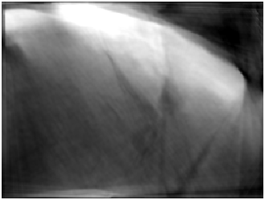
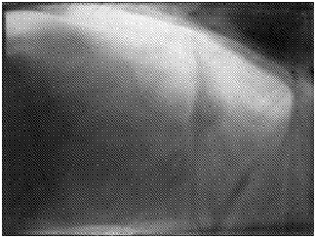
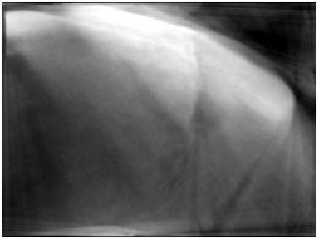

Results obtained on myocardium perfusion dataset
Myocardium in rest
og
Iteration 6
Iteration 20
Iteration 16
Iteration 2
RMSE – 0.2389

Slide 10
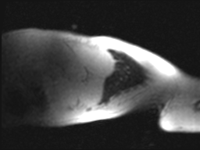
Results obtained on myocardium perfusion dataset
Myocardium in rest 2
Original Image
Filtered Back Projection

Slide 11
Results obtained on myocardium perfusion dataset
Myocardium in rest 2
Iteration 5
Iteration 14
Iteration 7
Iteration 3
RMSE – 0.36

Slide 12
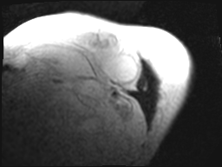
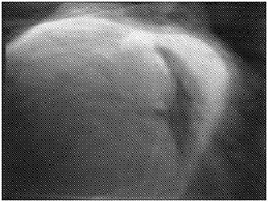
Results obtained on myocardium perfusion dataset
Myocardium in stress
Original Image
Filtered Back Projection

Slide 13
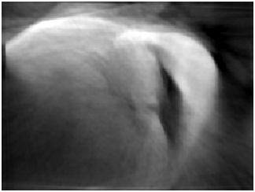
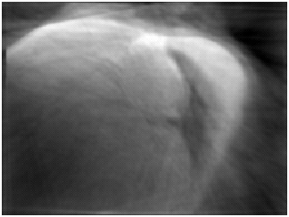


Results obtained on myocardium perfusion dataset
Myocardium in stress
Iteration 5
Iteration 14
Iteration 7
Iteration 2
RMSE=0.27

Slide 14
Thank You!
Have a nice day!
Group members:
Mayank Gupta, 210101002
Anuj Gupta, 21D070014
Soham Inamdar, 210100149

