Slide 1
US Household Energy Consumption
Domain Research and Exploratory Data Analysis
Axita Gupta
02/21/2020

Slide 2
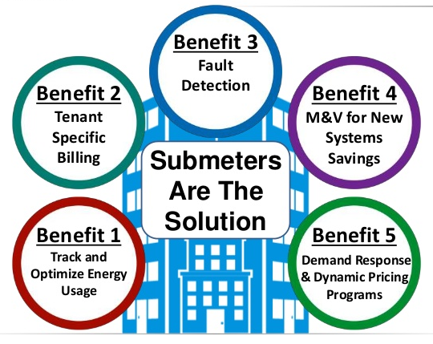
Background – What is the context of this project?
Analyze 47 months of energy usage data to determine:
What kind of analytics and visualizations can be created that would empower Smart Home owners with greater understanding and control of their power usage.
Develop analytics for a new set of electrical sub-metering devices used for power management in Smart Homes.
Axita A Gupta – Course 3 Task 1
https://www.slideshare.net/EEReports/ee-reports-metering-101a-how-submetering-works-50971383

Slide 3
Objective/Goals –
GOAL – Conduct domain research to understand smart homes and sub-meters and perform initial exploration of data
Determine if the installation of sub-metering devices to measure power consumption can be an economically beneficial for both homeowners and the client.
Determine what kind of analytics and visualizations can be generated from energy consumption data.
The IoT client’s main goal is to offer highly efficient Smart Homes that provide customers with power usage analytics.
And also hoping that these analytics will help to grow their business
Axita A Gupta – Course 3 Task 1

Slide 4
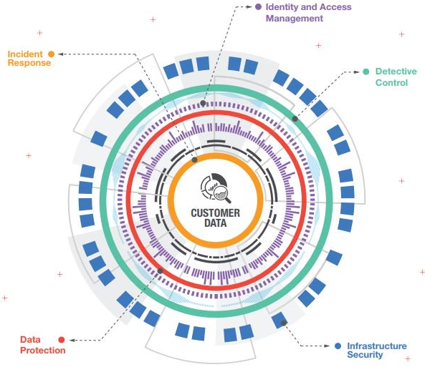
Data Management & Security
Data security management is a way to maintain the integrity of data and to make sure that the data is not accessible by unauthorized parties or susceptible person to corrupt it. Data security is put in place to ensure privacy in addition or protecting this data.
With increased use of smart meters, there has been a tremendous increase in availability of fine grained electricity usage data.
This data has helped utility companies to perform robust and efficient grid operations.
However, at the same time, privacy concerns associated with sharing and disclosure of such data have been raised which includes leakage of personally-identifiable information and behavioral information
Power companies are bounded by rules and regulations to use customer data but other service providers can use this information for unclaimed purposes and even share with third party for advertizing and marketing.
https://www.sciencedirect.com/science/article/pii/S2405959517303582
https://aws.amazon.com/financial-services/security compliance/?sc_channel=sm&sc_campaign=AWS_Security&sc_publisher=TWITTER&sc_country=Security%20&%20Identity&sc_geo=GLOBAL&sc_outcome=awareness&trk=_TWITTER&sc_content=security_blog_design_security_financial&linkId=50368836
Axita A Gupta – Course 3 Task 1

Slide 5
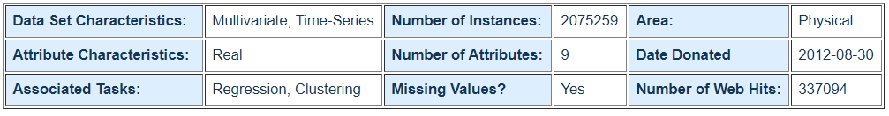
Understanding Data
Measurements of electric power consumption in one household with a one-minute sampling rate over a period of almost 4 years. Different electrical quantities and some sub-metering values are available
Number of Data Points - 2075259 instances
Location - Data collected in a house located in Sceaux (7km of Paris, France)
Duration – December 2006 to November 2010 (47 months)
Since the years 2007, 2008 and 2009 are the only completely years with data, only these years were used to perform analysis
Issues with Data – Missing Dates/Gap in data, ~1.25% rows
Axita A Gupta – Course 3 Task 1

Slide 6
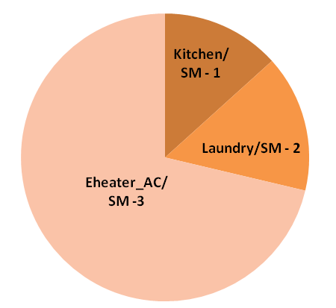
Exploring Data
Comparing sub-meters to find out which sub-meter uses maximum energy vs. which one uses minimum
Sub-meter 3 (Electric Heater and AC) uses maximum power/energy
Sub-meter 1 (Kitchen Appliances) uses minimum power/energy
Axita A Gupta – Course 3 Task 1

Slide 7
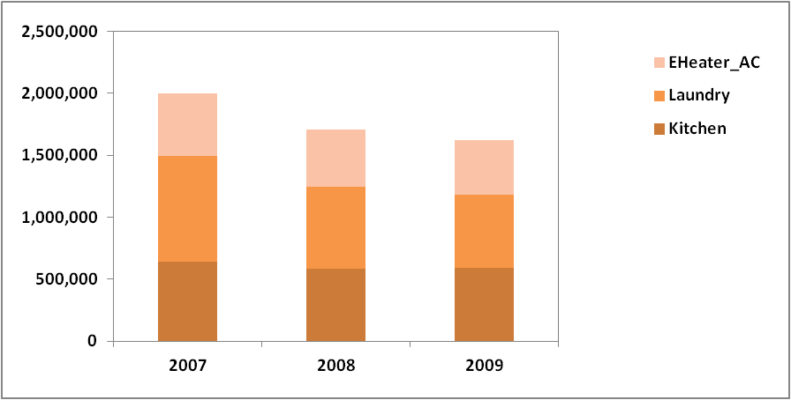

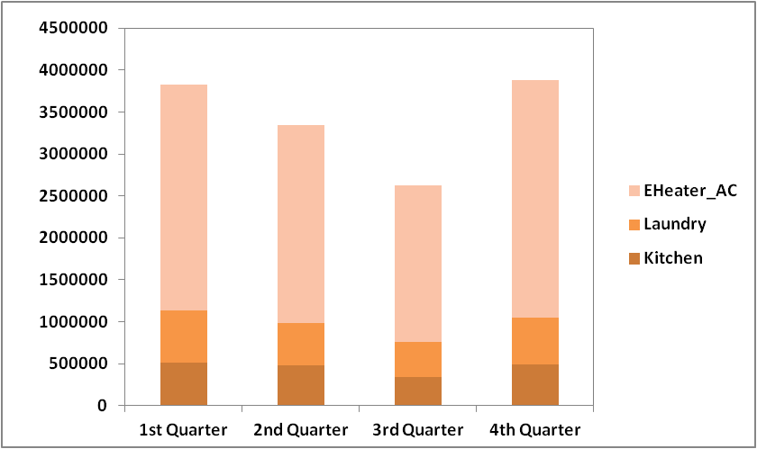
Exploring Data – By Year & Month
By Year:
Overall, maximum energy consumption is observed in 2007 for all sub-meters
Over the course of 3 years energy consumption of kitchen appliances (sub-meter 1) and electric heater and AC(sub-meter 3 has almost remained same.
Slight decrease in energy consumption of sub-meter 2 – laundry is seen over the course of 3 years
By Month (segmented into 4 quarters):
Sub-meter 3 – electric heater and AC consume maximum energy. (Highest in 4th quarter)
Sub-meters 1 & 2 show comparatively similar energy consumption for all the quarters.
Axita A Gupta – Course 3 Task 1

Slide 8
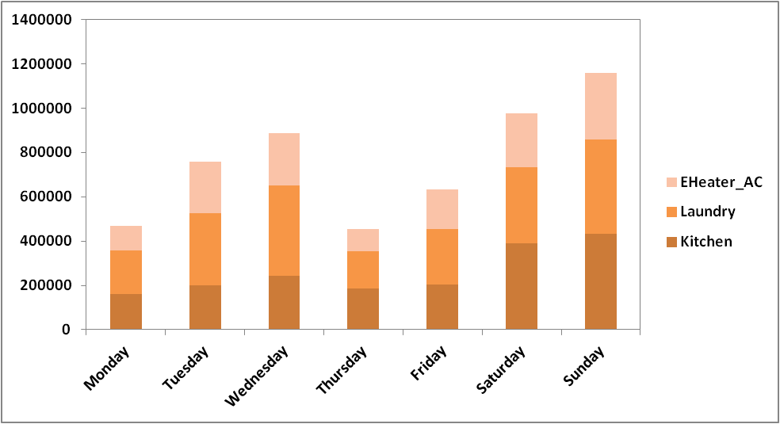
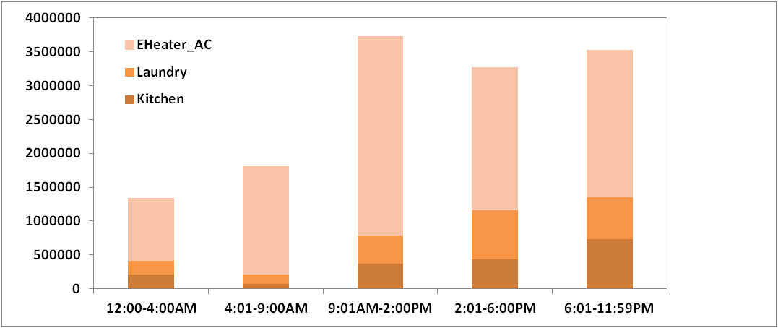
Exploring Data – By Weekdays and Hours
By Weekdays:
Overall, maximum energy consumption is observed for sub-meters 1 & 2 i.e. kitchen and laundry. With highest energy consumption during the weekends.
Sub-meter 3 – electric heater and AC consumed least energy as compared to other two sub-meters.
By Hours of Day:
Sub-meter 3 – electric heater and AC consume maximum energy for all the hours of day as compared to sub-meters 1 & 2.
Sub-meter 1 – kitchen appliances & sub-meter 2 – laundry show increased energy consumption during after noon and evening hours.
Axita A Gupta – Course 3 Task 1

Slide 9
High-Level Recommendations About Existing Data
The business objective was to determine if sub-metered energy data could provide insights that would incentivize homeowners to install sub-meters.
Need to analyze household consumption data with greater detail and then make forecasts to determine if the smart-meters are beneficial.
Existing energy consumption data of a single household provides important initial insights about how each sub-meter consumes energy at very granular level.
This domain research and exploratory analysis can be better understood if more information is available about the data like:
Energy efficiency of the appliances used including information like age of appliance, brand and type.
Age of the house – i.e. how old is the house
Size of the house i.e. square footage
Number of members in the household
Axita A Gupta – Course 3 Task 1

