Slide 1
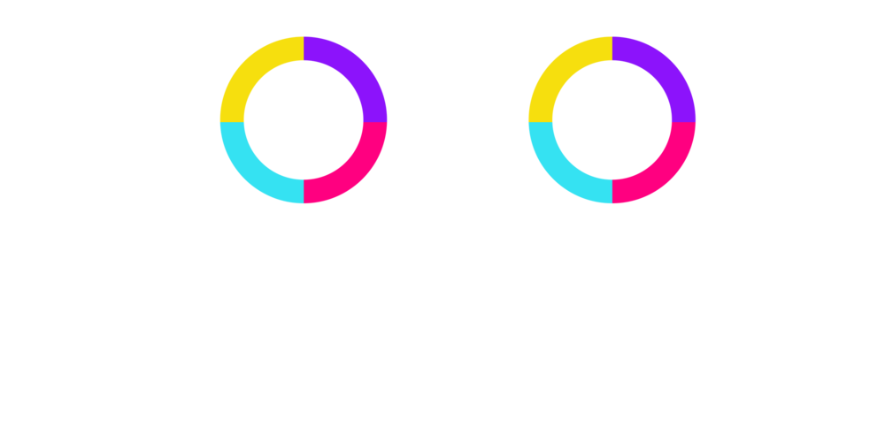
Advanced Programming Project By
Sudeep Reddy(2019313)
Bhaskar Gupta(2019237)

Slide 2
Problems Faced and how we solved them
How do we implement multiple “saved game” options?
By creating an array list of GameState objects and choosing them based on the number the user chooses which would indicate the index number in the array list.
How do we a resume the Game i.e continuing from where you left off from the pause menu?
Create a temporary Save; and Deserialize the Gamestate objects to retain the positions of ball and obstacles and the player’s score.
How to spawn obstacles and have smooth animations for moving them?
Spawn 3 obstacles; 1 on screen and 2 other out of the screen as the obstacles are passed remove them from the screen, add more obstacles in the background and bring them down as a whole.
Match the frame rate and use 2D animation transitions to move the obstacles so the there isn't any stutter/jitter in the animations.
How do we detect collision?
Use Shapes.intersect and getFill() to check intersection and color when the ball collides with the obstacle.
Design patterns used-
State Design Pattern-
To keep track of the state of various game obstacles when storing their positions.
Iterator Design Pattern-
We have used this while iterating through obstacles on the screen to check whether the have been crossed and if crossed then are they out of the game screen to remove them from list and add more obstacles in the background.
Factory Design Pattern-
Used when spawning random obstacles on screen screen.

Slide 3
Contribution to the project-
The project was completed by Bhaskar and Sudeep by their equal contributions throughout all 3 deadlines.
Sudeep-
UML(40%) and Use Case(50%)
GUI
Designing obstacles(40%)
Designing Screens(55%)
Collecting Resources and teaching teammate(35%)
Animations(75%)
Serialization(50%)
Implementing Design Patterns(20%)
Maintaining Organised Code(45%)
Audio(20%)
Bhaskar-
UML(60%) and Use Case(50%)
GUI
Designing obstacles(60%)
Designing Screens(45%)
Collecting Resources and teaching teammate(65%)
Animations(25%)
Serialization(50%)
Implementing Design Patterns(80%)
Maintaining Organised Code(55%)
Audio(80%)

Slide 4
Bonus parts of the project-
Audio
Similar to the original game; when the ball jumps,hits an obstacle or starting a new game.
Smooth and fluid Animations
Of Obstacles moving down and the bouncing off the ball.
Bolt obstacle
Makes you immortal to pass through 5 incoming obstacles.
Boost
Makes you go really fast for 15 obstacles.

