Slide 1
YDstudios Presents
YDTracker™
©Yashasvi Vedula and Dipanshu Gupta

Slide 2
Introduction to YDTracker™
What does YDTracker™ do?
Who would use YDTracker™?
When will the final build be released?
Who to contact for more info?

Slide 3
What does YDTracker™ do?
Path Plotting
Location Tracking of Vehicles
Speed Limit Tracking of Vehicles
One Click SOS Message for Drivers

Slide 4
Path Plotting
A line is plotted along the driver’s path as he moves around.
This can be checked at the end of the trip.

Slide 5
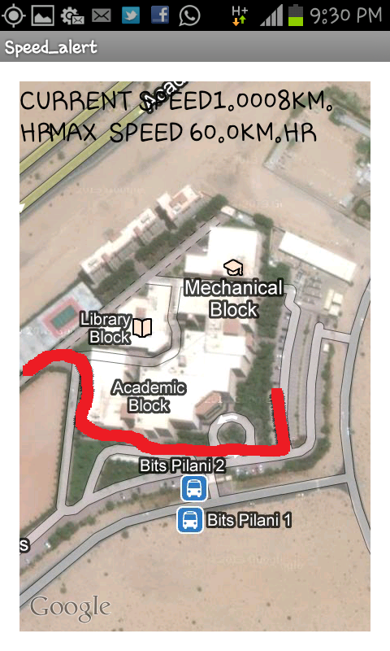

Slide 6
Speed Limit
The owner of the vehicle selects a speed limit for his driver, and every time the driver exceeds it, a message is generated to the owner, stating where the driver has exceeded the speed limit.
Preferences include speed limits, owner’s phone number and a unique key for location tracking.
All preferences are password protected, so only the owner can modify them.

Slide 7
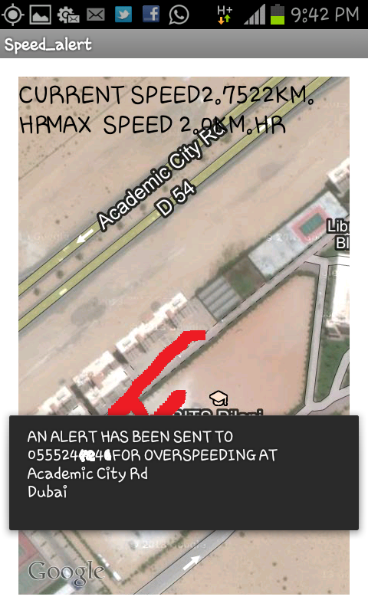
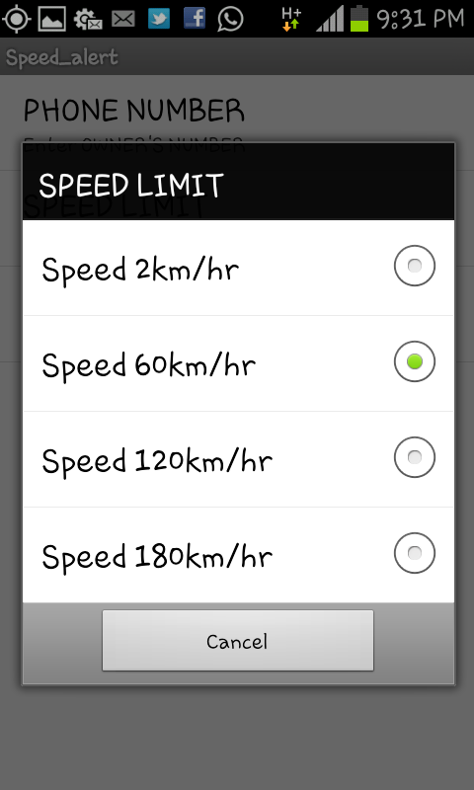

Slide 8
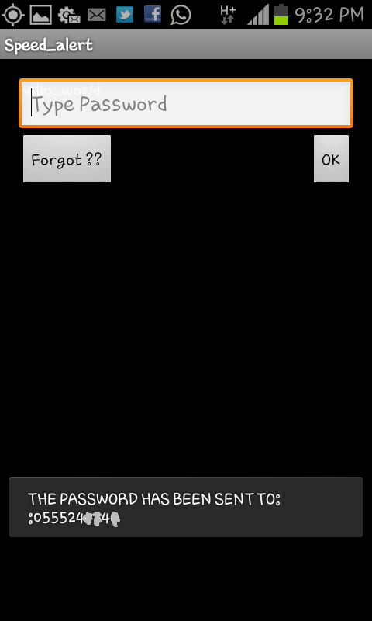

Slide 9
Location Tracking
The owner sends a message, with a particular key as its text, to the driver.
This message then communicates with the app on the driver’s phone and sends the owner the exact location of the driver.

Slide 10
One Click SOS
The app automatically generates an SOS message with the click of a button.
This SOS message, containing the location of the driver, will go straight to the owner’s phone.

Slide 11
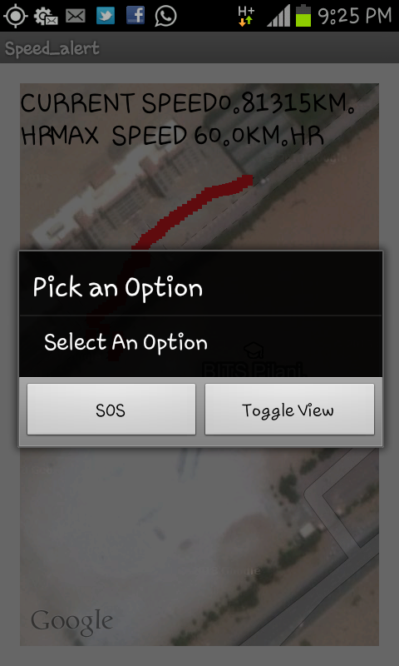

Slide 12
Who Would Use YDTracker™?
Owners of cars who want to know the whereabouts of their vehicles at all times.
Supervisors and owners of taxi services and car rental companies who want to keep track of their vehicles.

Slide 13
When Will the Final Build Be Released?
The final build of YDTracker™ will be released on 3rd April, 2013.

Slide 14
Who To Contact for More Info?
Yashasvi Vedula Dipanshu Gupta
dgupta13@illinois.edu

Slide 15
Thanking You
Yashasvi Vedula
Dipanshu Gupta

