Slide 1
High Frequency Noise Removal From An Image
Aabha Sharma(17ucc001)
Aashish Lamba(17ucc002)
Abhay Gupta(17ucc003)
Abhijeet Mishra(17ucc004)
Submitted To :
Divyang Rawal

Slide 2
Problem Statement
Take an image, generate a noisy image by taking DCT and adding noise at higher frequency part. You can remove such noise by removing the higher frequency content of the image.

Slide 3
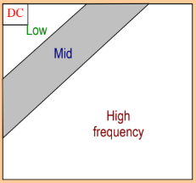
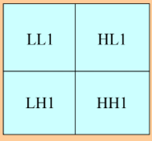
Theory
As we gradually move towards the lower right in an image the frequency of an image increases so the high frequency component for an image lies in the lower rightmost quadrant.

Slide 4
Our Approach . . .
An image is inserted by the user.
We convert it into frequency domain using Discrete Cosine Transform.
To generate the noisy image we add a random noise to the high frequency component.
Now in order to remove the noise ,we removed the high frequency component from the image .
Due to which the the noise is removed from the image.

Slide 5
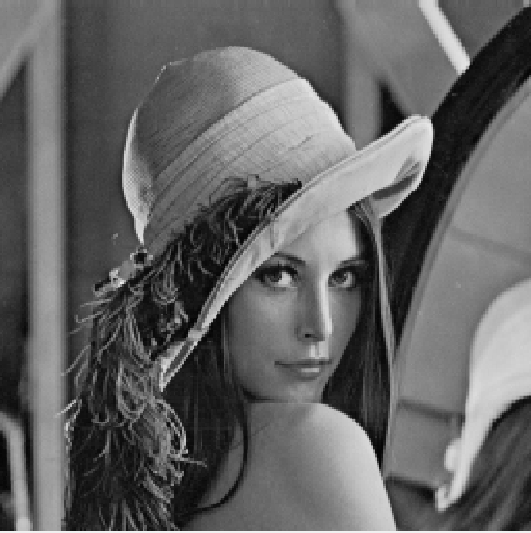
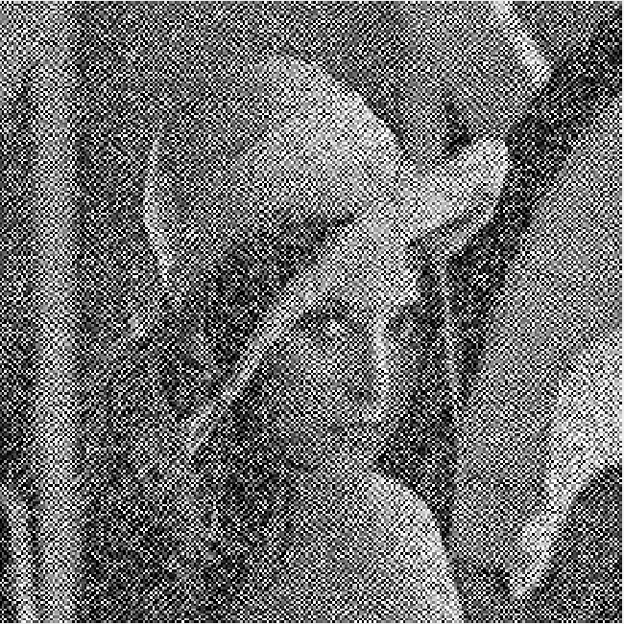

Matlab Code Results
Original Image Noisy Image Denoised Image

Slide 6
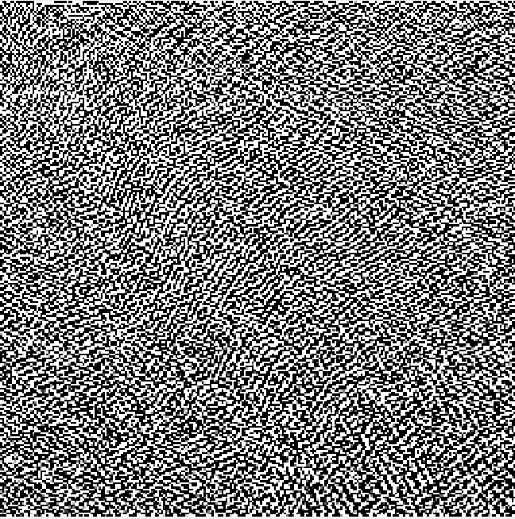
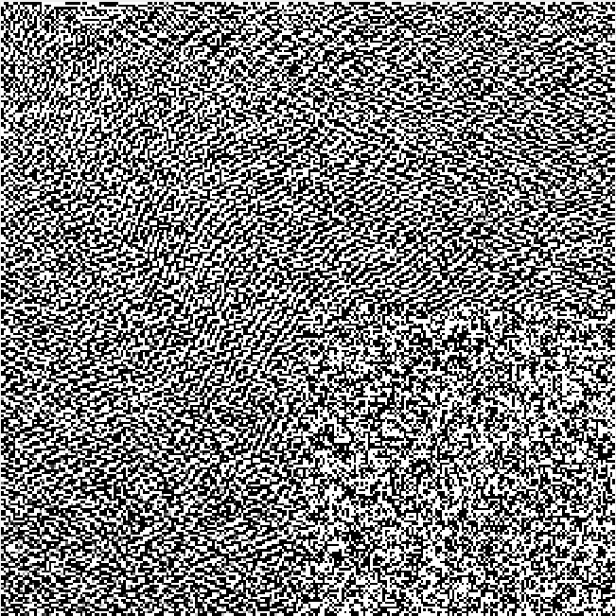
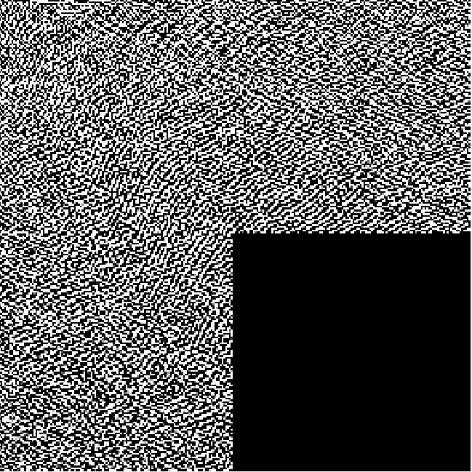
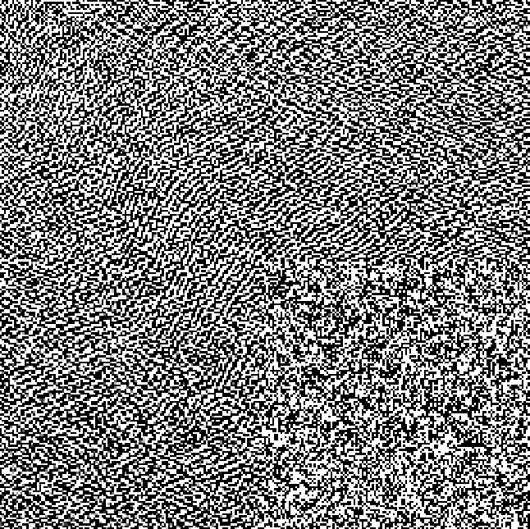
In Frequency Domain...
DCT of original image.
DCT of the image with added noise at high frequency component.
DCT of the image with removed high frequency component.

Slide 7
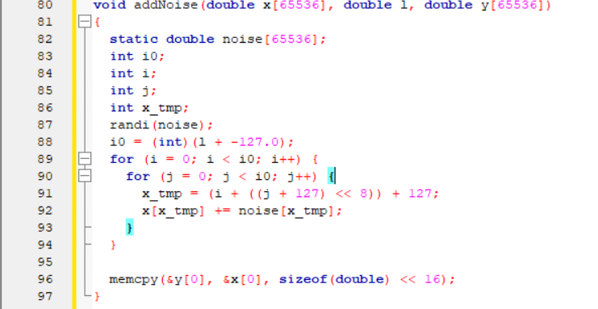
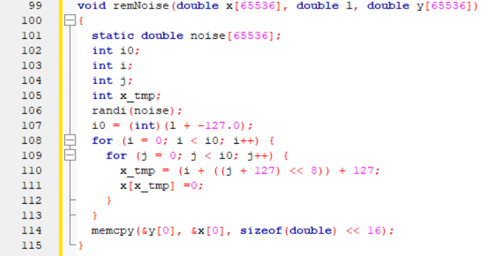
C Program . . .
Adding noise at high frequency part
Removing high frequency part of the image

Slide 8
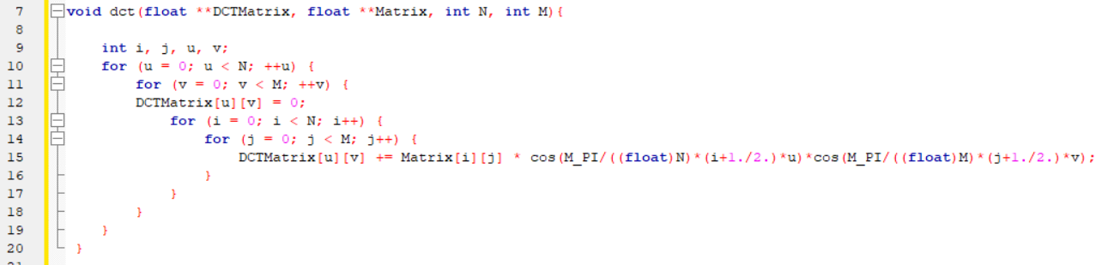
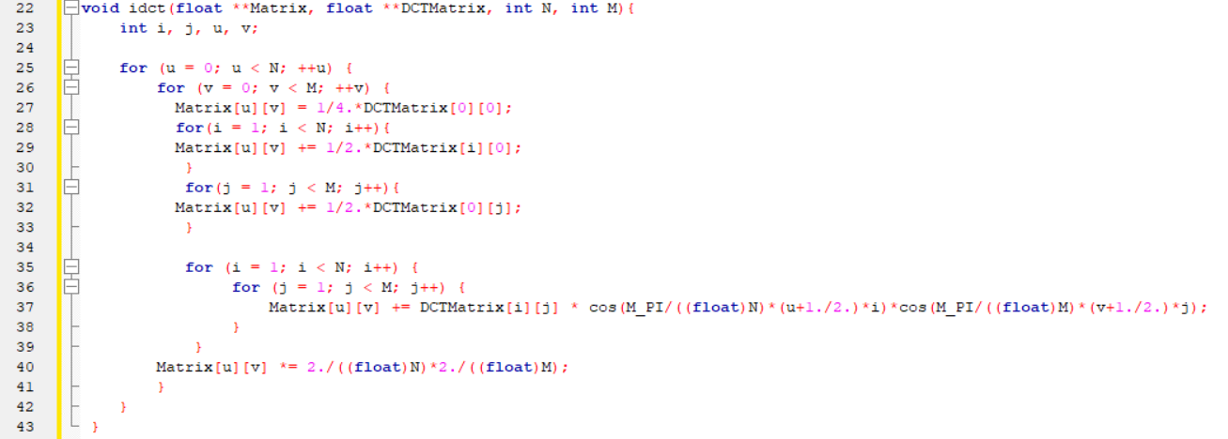
C Code for DCT and IDCT (respectively) . . .

Slide 9
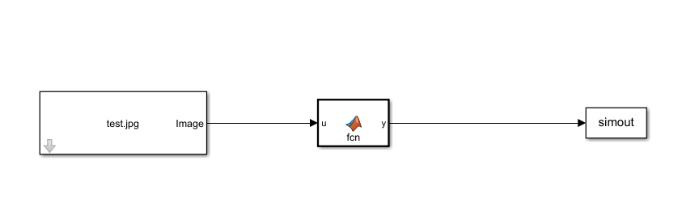
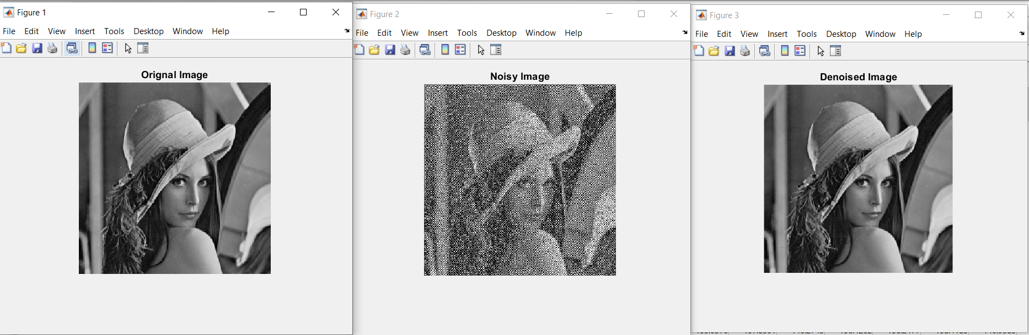
Simulink Block Diagram and Result. . .

Slide 10
Conclusion
From this experiment we conclude that if the noise is present in the high frequency component of an image ,the noise can be reduced or removed as high frequency component contains very less information of the image.

