Slide 1




CBML-108866 - MLOPS
CB-MLOPS Platform

Slide 2


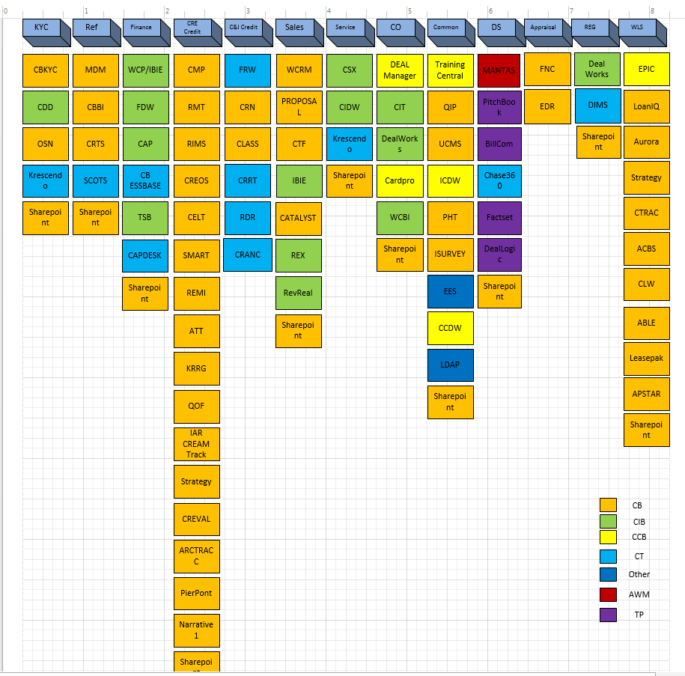
Brief About me.
Name : Gupta Gundlapalli (Vice President , CB AI – MLOPS Lead)
Total Experience: 20+ years
Before JPMC : Data Engineer roles at World Bank, Truist (SunTrust & BB&T former ) ,Capital one.
: Vodafone & Prudential Insurance ( UK clients)
Education: Masters in Computer science ,
Technical Background: MLOPS, Big Data, Public Cloud (AWS, GKP)
EDH Data knowledge base across domains listed.

Slide 3
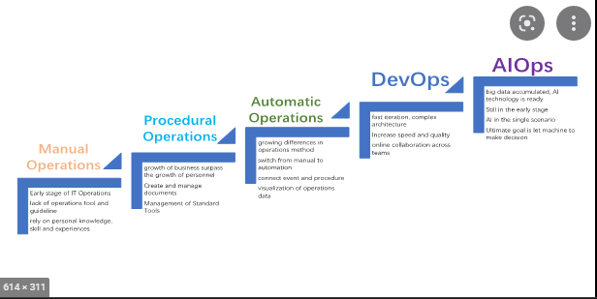
CB-MLOPS
CB MLOPS Platform Highlights
2021
2022
2023
Model Deployment
Model Ops
Model Governance
Data Movement
JADE ECDP Pipeline/
HDFS platform challenges
ML Orchestration
GKP +Airflow
DevOps
Engineering Productivity & Cost

Slide 4


CB MLOps Advancements
CB-MLOPS
2021
2022
2023+
Data Access
ECDP Pipeline to move on-prem to AWS
Hadoop Connectivity Issues
1 month to make data accessible (average)
Deployment
2 models deployed to prod (cumulative)
2~3 months (average)
Cost Reduction
Prioritize speed
Engineering Excellence
Manual testing
Governance
Establish MDLC 1.0 (ML Development Life Cycle)
Data Access
EDH migration to AWS data lake
Access via CADS (Cross-Account Data Sharing)
2 weeks to make data accessible (projected)
Deployment
10 models deployed to prod (cumulative)
1 month (average)
Cost Reduction
Build AWS cost monitoring dashboards
Proactive shutdown of compute resources
Cost-conscious resource provisioning
Engineering Excellence
Automated testing
Pattern build
Resiliency testing
Governance
Integrate MDLC into Agile process
Revising MDLC (2.0) based on new firm-wide standards
Data Access
Leverage EDH AWS data lake
Access via CADS
1 week to make data accessible (projected)
Deployment
1.5 weeks (projected)
Cost Reduction
Enhanced cost monitoring with fine-grained details
Automatic shutdown/scale down of compute resources
Cost-efficient resource planning & provisioning
Engineering Excellence
Standardize SRE practices
Governance
Adopt firm-wide model governance platform
Mature MDLC practices
Standardize Responsible AI practices

Slide 5


CB-MLOPS
CB MLOPS Platform Highlights
MLOPS Platform highlights :
Bringing in DevOps model & engineering capabilities .
Managing GKP and AWS platform stability .
ML use cases ( HG, News, Peers, Service xray, PR)
Risk, Controls and Conduct
Adhering JPMC SDLC process In conjunction with MDLC
Release management SOX controls and governance .
2021
2022
2023
X
  WE ARE HERE!
Model Deployment
Model Ops
Model Governance
Ingestion
Feature Mutation
Model Refresh
Serve
Ideation
Model Training
Optimized Model Build
Model Monitoring
Data Movement
JADE ECDP Pipeline/
HDFS platform challenges
EDA
Model Selection
ML Orchestration
GKP +Airflow
DevOps
Optimization
Model Insights
Feature Engineering
Staging
Model Promotion
Data Movement)
Model Ops &Training
Selection & Promotion
Serving
Engineering Productivity & Cost

Slide 6
MLOPS Maturity
Construct a solid MLOPS platform & develop Accelerated ML operations
Descriptive
Diagnostic
Predictive
Prescriptive
Foundation
Interactive Data Investigation and Experimentation
Manual Training
  Disconnect between ML data scientist and operational serving done by engineers
  Continuous Integration (CI) testing and Continuous Delivery (CD) using ML Pipelines
  Responding to changing data in automated way
  Deliver inquisitive ML models “What If” analysis capability via API’s & interactive dashboards
  Interactive Data Investigation and Experimentation
User “What If” Analysis
Dynamic Machine Learning with Feedback Loop
Model Delivery
Risk & Compliance
X
  WE ARE HERE!
Data Engineering , Feature Engineering/Test Env
Ideation – DUC
Model Training
1

Slide 7
Vision 2023 MLOPS Objectives
Business Results
Key Challenges
Data movement challenges from Premise to AWS.
GKP env constraints and access privileges on Hadoop
Managing 17 AWS production accounts
20+ Functional ID meeting JPMC risk controls
Data encryption strategy in both GKP & AWS - at rest and transit across 17 AWS accounts.
ML pipeline “Template” for each use case
Constant Airflow image upgrade to address Vulnerabilities.
User guide for ML & Model pipeline
Automated test coverage suite for ML pipeline (100% test coverage)
Clean up 65+ divest Terraform services across 17 accts
AWS account consolidation
Cost savings/Operation Overhead
Adopting cloud based “EKS – Airflow” ML orchestrator
Accelerated ML Pipeline with Blue/Green deployments
Graph ML capabilities ( Neptune/Knowledge Graph).
Build Property graph & RDF model
SM serving Pipeline
AWS Managed ML pipeline capabilities
CB-Finops Dashboard
set alerts & budget forecasting
Model monitoring & Drifts
Model Explainability/Feedback loop
Real time ML pipeline ( News analytics)
Online and offline Model store capabilities
MLOPS Platform highlights :
  Unified single platform across all use cases.
  Auto version controls
  Accelerated Model deployments.

