Slide 1

BATTLECODE

Slide 2
BattleCode is a multiplayer coding battle web application in which two players can compete with each other by joining through an unique invite code. This platform is built for competitive programming and the platform is built using various technologies like virtualization using google compute engine and containerization achieved via docker for platform and libraries isolation.
About Battlecode:

Slide 3










Technologies Stack

Slide 4
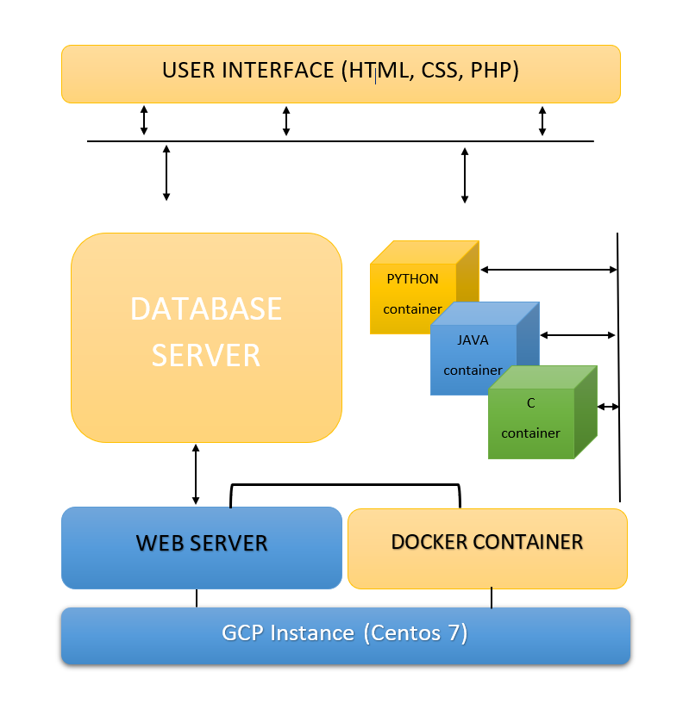

Slide 5
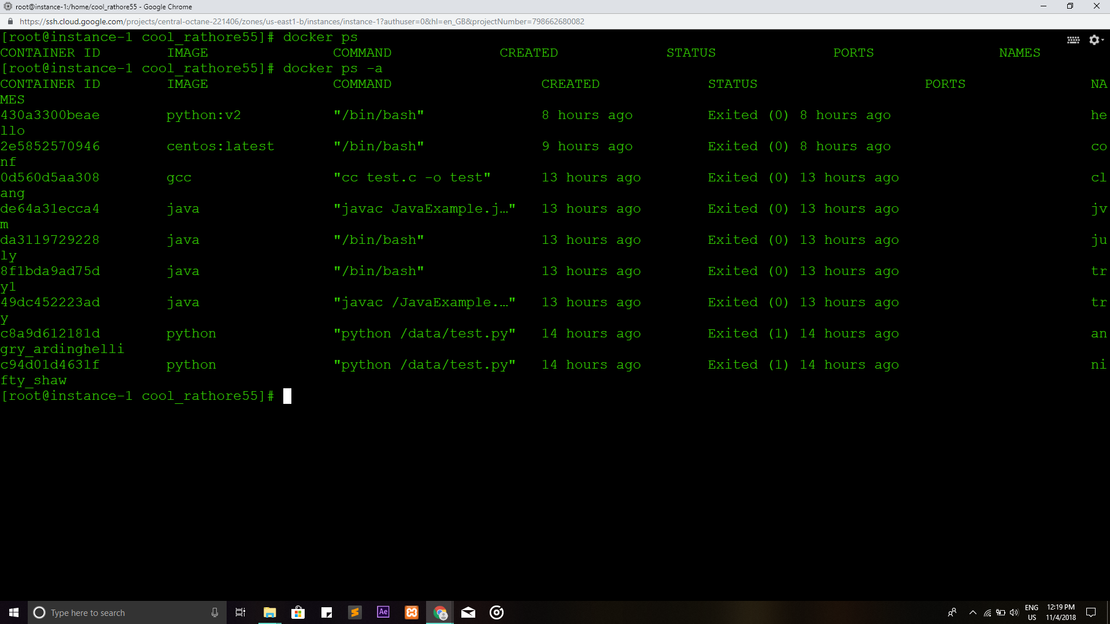

Slide 6
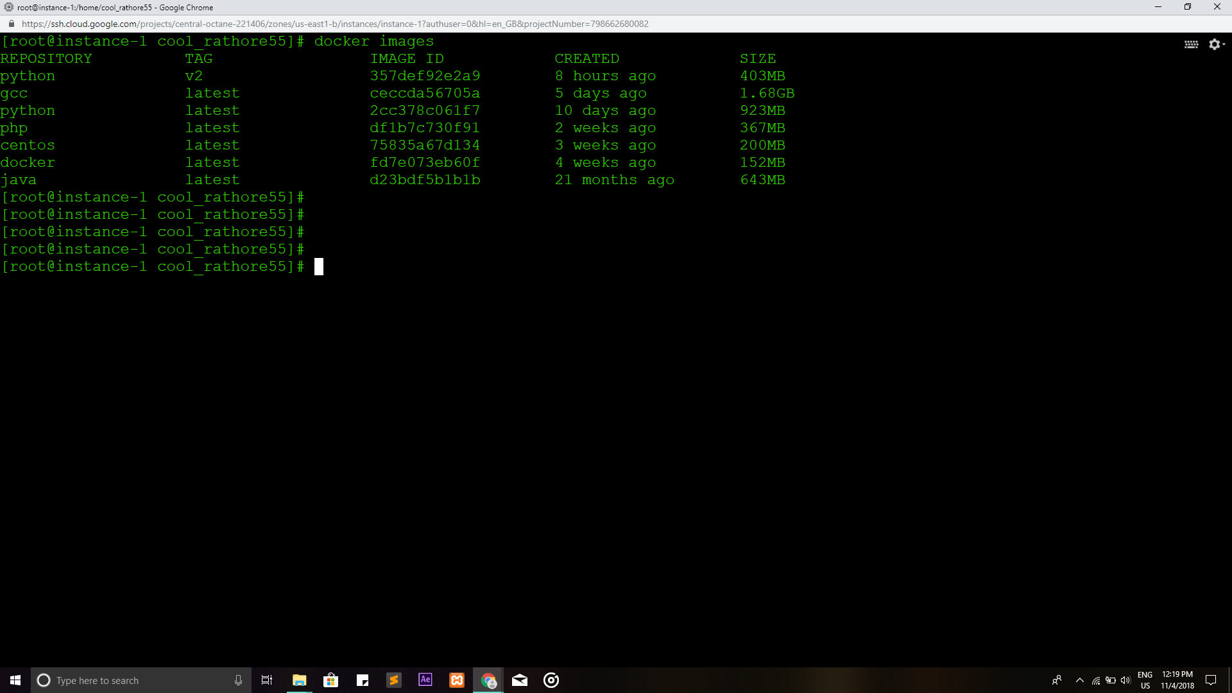

Slide 7
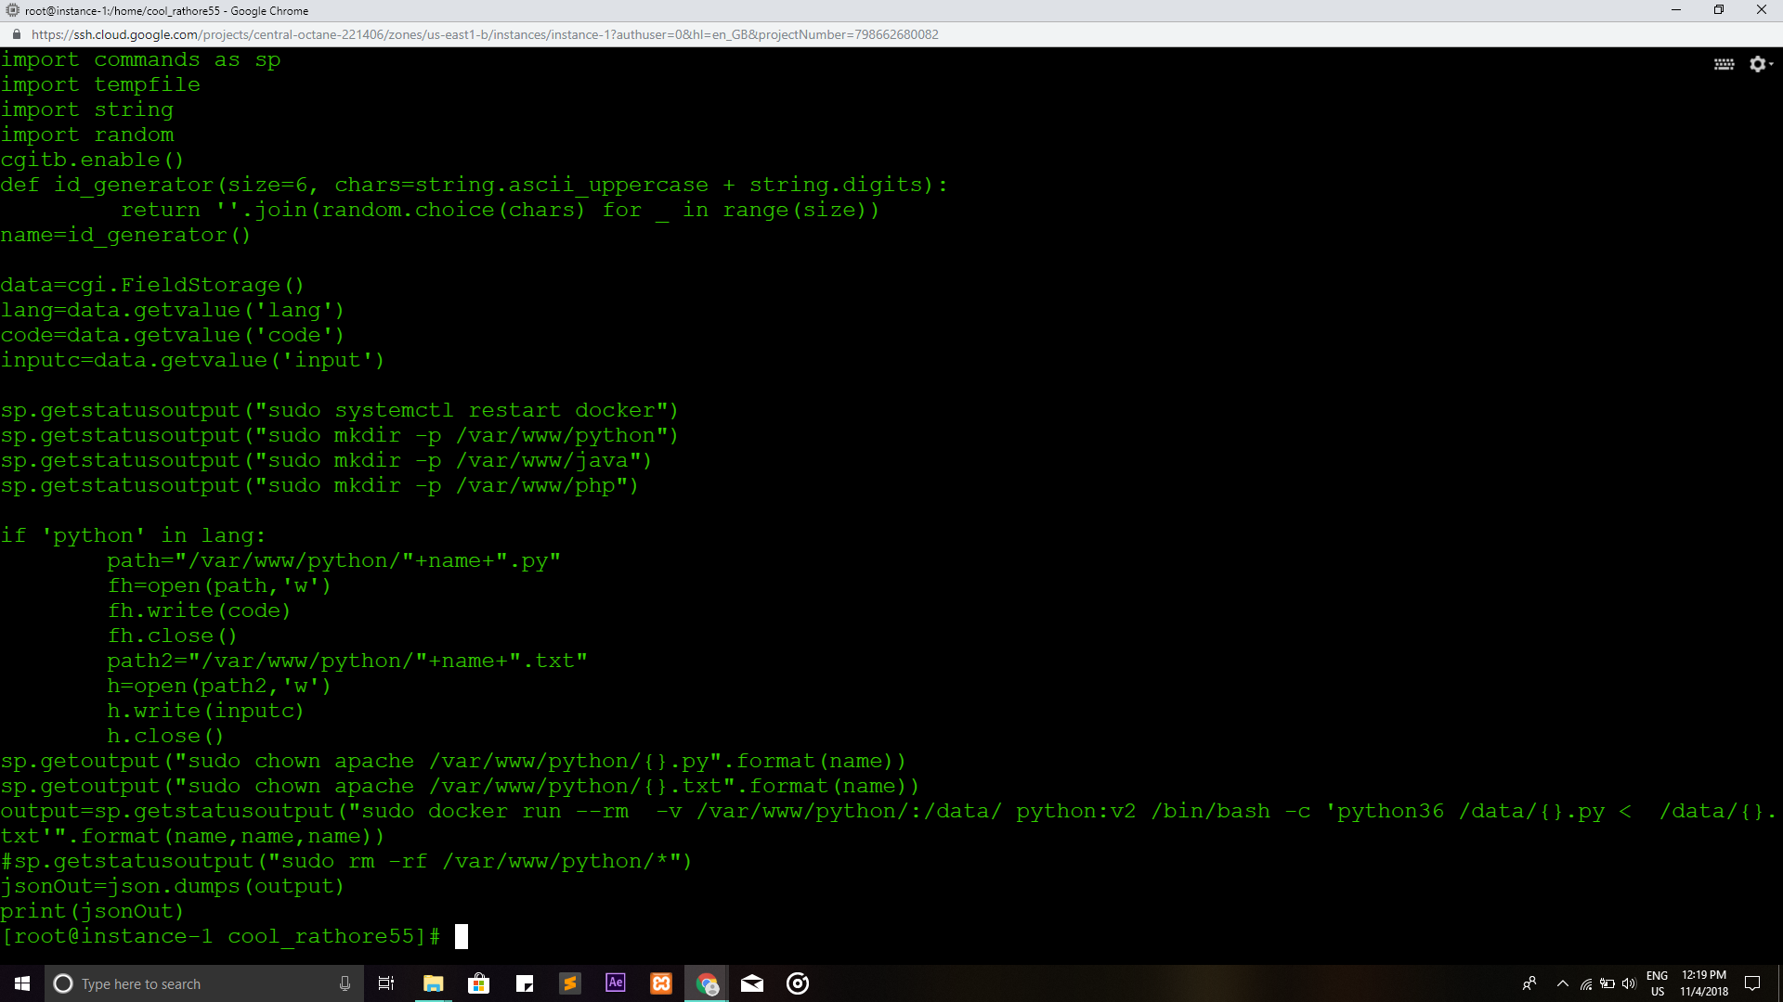

Slide 8
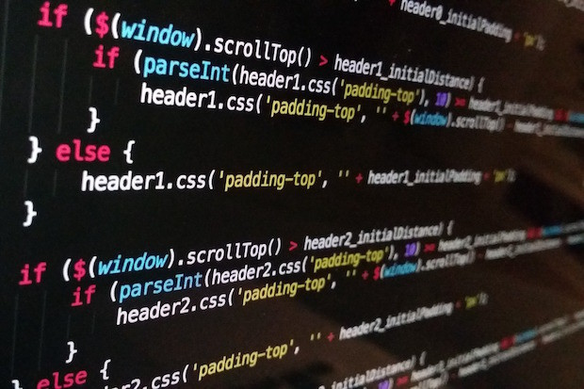
LIVE DEMO

Slide 9
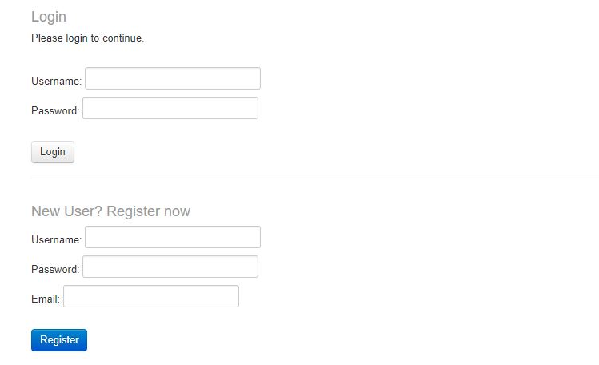

Slide 10
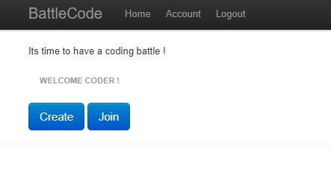
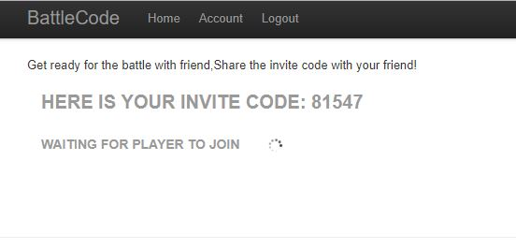
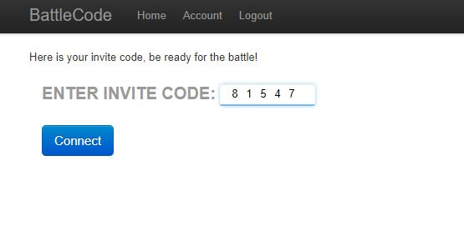

Slide 11
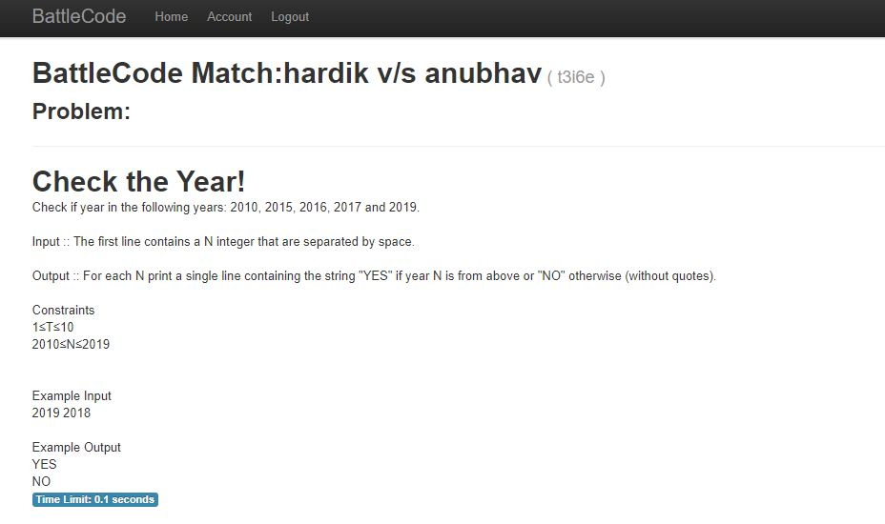

Slide 12
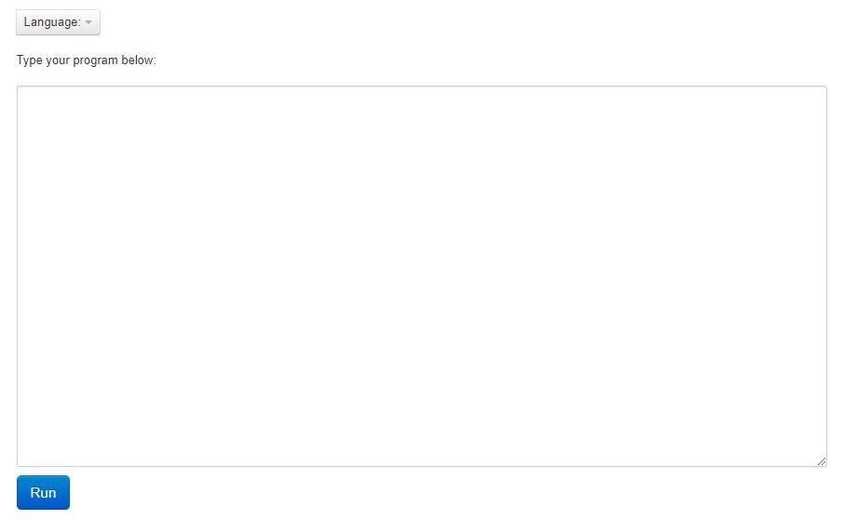

Slide 13
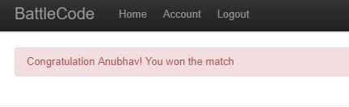
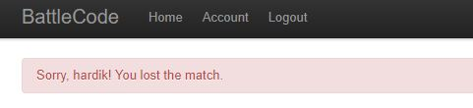

Slide 14
THANK YOU

