Slide 1

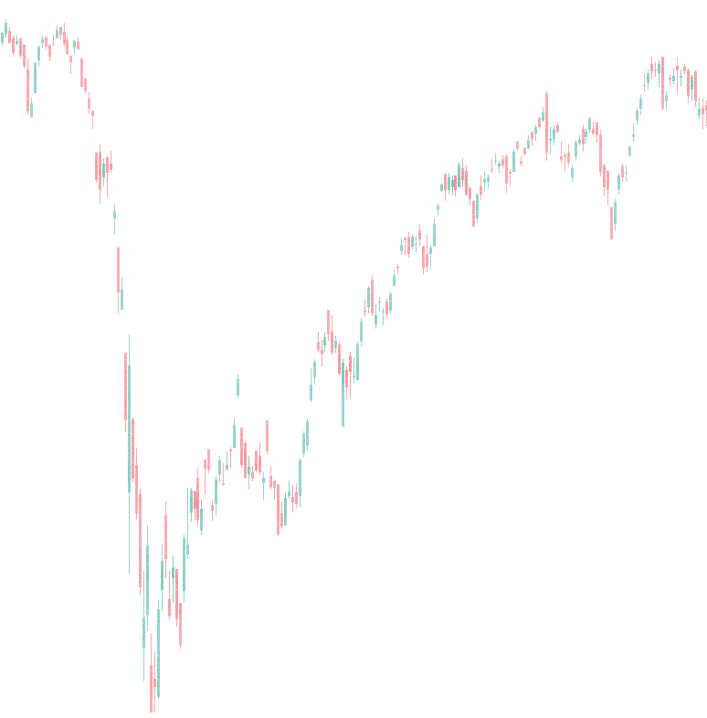
INSTITUTIONAL DATA
Foreign Institutional Investor (FII)
Net Value
-203.13 Crores
Buy Value
8643.63 Crores
Sell Value
8846.76 Crores
Domestic Institutional Investor (DII)
Net Value
1723.79 Crores
Buy Value
6476.52 Crores
Sell Value
4752.73 Crores

