Slide 1
KICKSTARTER PROJECTS
Team Name: Skinny Snakes
Team Members: Harsha Gupta
Reeyaa Vijay Patil
Mohommad Arbaaz Patel
Professor Yegin Genc

Slide 2
Introduction
Kickstarter is an American public benefit corporation based in Brooklyn, New York, that maintains a global crowd-funding platform focused on creativity.
The company’s stated mission is to “help bring creative projects to life”.
Everything on Kickstarter must be a project with a clear goal, like making an album, a book, or a work of art. A project will eventually be completed, and something will be produced by it.

Slide 3
Objective
Our project analyses the dataset from kickstarter and outlines whether a project would be successful or not.
Our project begins by analyzing parameters which makes a project successful. Furthermore, we estimate/predict the success or failure of the projects.
This report would help creators analyze parameters that effect the success of a project, help them estimate their backers for a particular project, the amount of funding a particular category project is likely to get, and also help them realize effects of novelty in a particular category and hence foresee their success.

Slide 4
Data Collection
For this analysis, we will be analyzing a dataset named as “Kickstarter”.
The dataset was obtained from the Kaggle platform which is a csv file.
The dataset consists of 378661 observations (rows) and 17 variables (columns) whom 10 are categorical and 7 are numeric.
The dataset was loaded and processed using the R programming language

Slide 5
Research Questions
What is the percentage state of project on Kickstarter?
What category of projects gets the maximum number of backers?
What is the number of projects in each category?
Does keeping the project open for a longer duration gets more funding?
What projects are affordable by the crowd?
Does project novelty determine success?

Slide 6
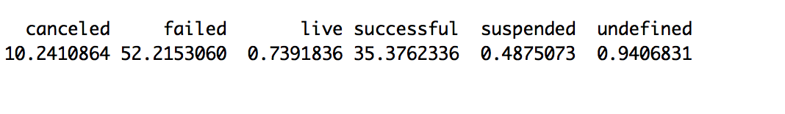
What is percentage state of the projects on Kickstarter?
Output:
Inference: The inference that we derive from the code above is that approximately half of the projects on kickstarter have failed. The projects that have been successful is approximately 35%. The number of projects that are live, suspended or undefined are negligible.

Slide 7
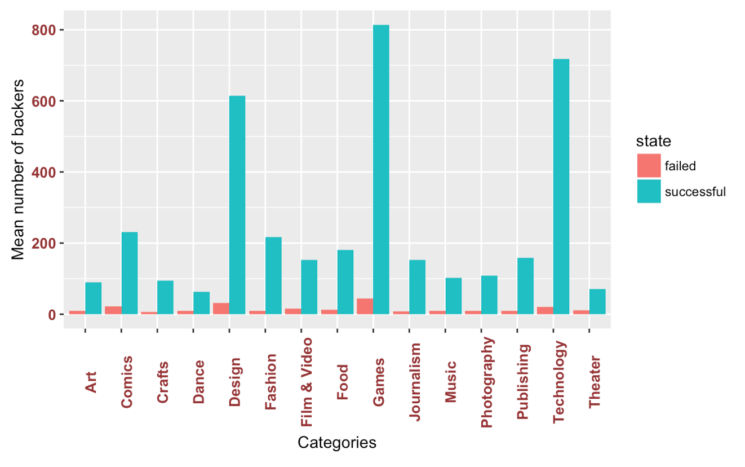
Which category of the projects get the maximum number of backers?

Slide 8
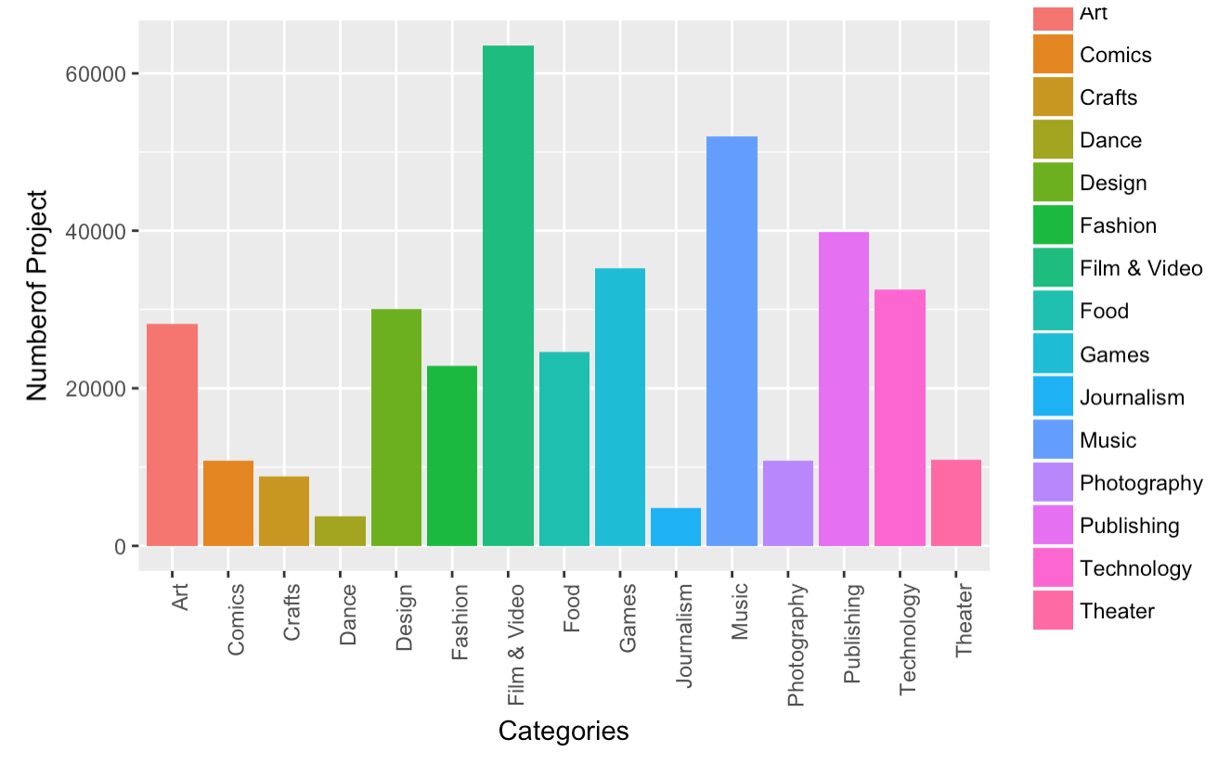
How many projects are introduced in each category?

Slide 9
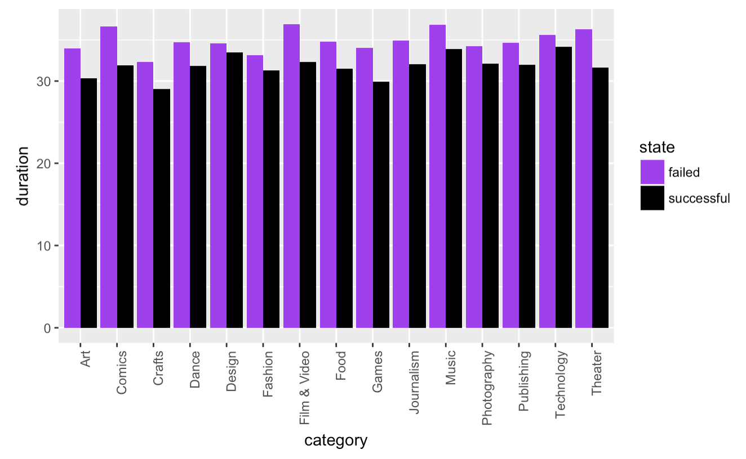
Does keeping a project open for a longer duration get more funding?

Slide 10
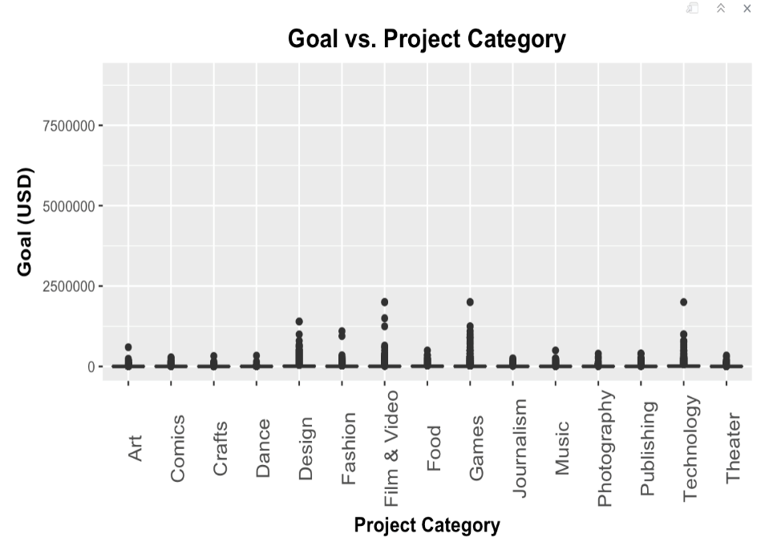
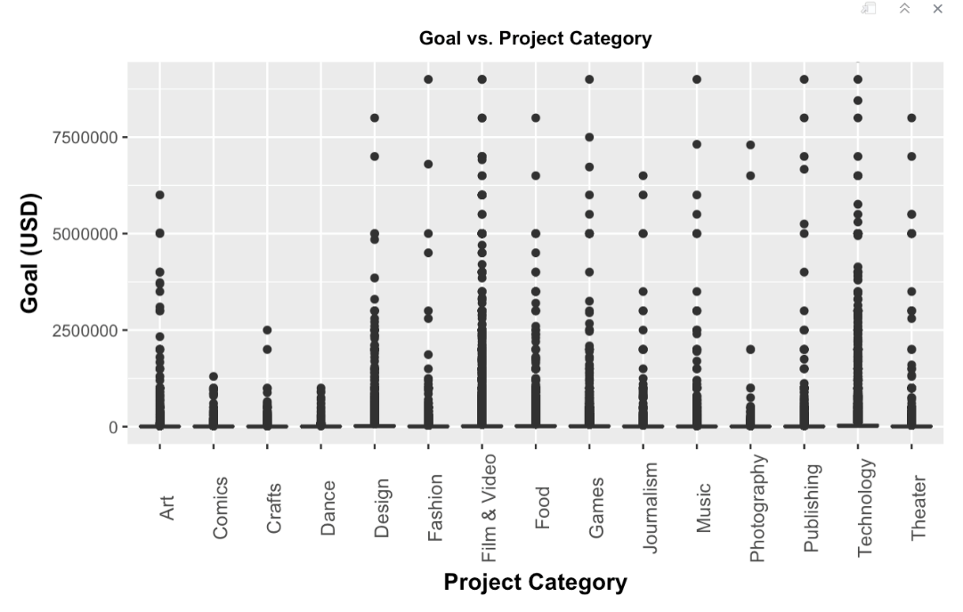
What projects are affordable by the crowd?
For Successful Projects For Failed Projects

Slide 11
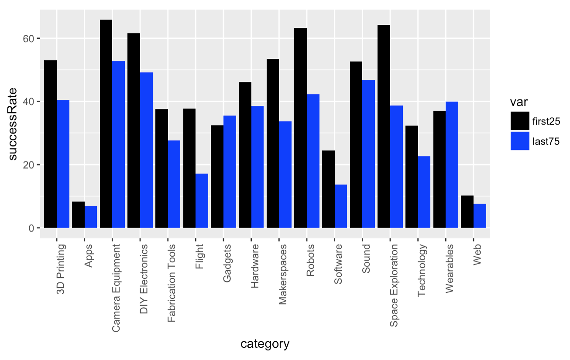
Does project novelty determine success?

Slide 12
Conclusion and Future Scope

