Slide 1
Can five epochs predict CLIP forgetting?
ICAISE 2026 · CC5084
Authors: Saanvi Eha Chandra, Avni Gautam, Krisha Gupta, Neel Ranadive, Aarav Shah, Noah Yoo, Srikanth Samy, Ishaan Gupta
Notes:
Open with the research question. The official paper title is: Early Forecasting of Catastrophic Forgetting in CLIP Fine-Tuning: How Much Does Watching Training Actually Tell You?. Credit every author listed on the slide.
[Sources]
- /private/tmp/research-projects-icaise-read/papers/clip-forgetting-forecasting/main.pdf
[/Sources]

Slide 2
The practical forecasting question
The problem
Fine-tuning on a narrow dataset improves target performance while eroding the zero-shot breadth that made CLIP useful.
The decision
If damage is predictable from a short prefix, a practitioner can stop, lower the learning rate, or change adaptation strategy before paying for the full run.
Research question
Given the first K epochs on an unseen dataset, how accurately can we forecast final forgetting Φ20?
The control
A learned forecaster must beat persistence: predict that final forgetting equals what is already visible at epoch K.
Notes:
Frame the problem before introducing models. State the specific research question and the criterion that makes the answer defensible.
[Sources]
- /private/tmp/research-projects-icaise-read/papers/clip-forgetting-forecasting/main.pdf
[/Sources]

Slide 3
Forty-eight runs, grouped by dataset
DATA
CLIP ViT-B/32 across 16 datasets, three learning rates, and 20 epochs. Five trajectory signals are logged each epoch.
VALIDATION
Leave one dataset out: all three learning-rate runs of the held-out dataset remain unseen; all transforms are fold-local.
FORECASTERS
Static descriptors versus a five-epoch warm-up, using tabular and sequence models plus raw and calibrated persistence.
Notes:
Walk left to right: data, validation boundary, then models or analysis. Emphasize the unit that is held out.
[Sources]
- /private/tmp/research-projects-icaise-read/papers/clip-forgetting-forecasting/main.pdf
[/Sources]

Slide 4
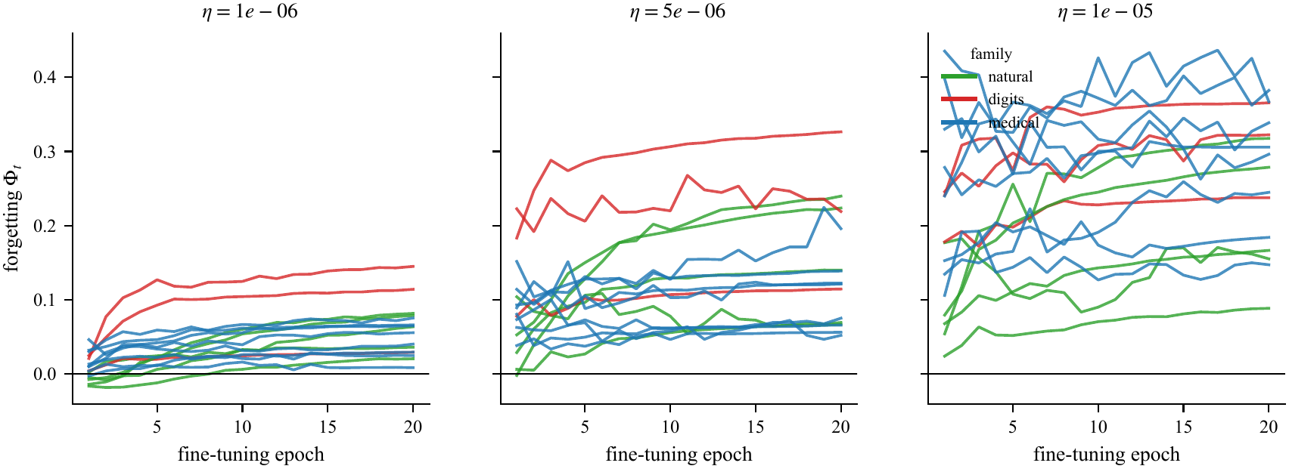
The learning-rate effect
The first five epochs carry signal
Forgetting rises early and then largely persists. Higher learning rates create larger and more variable losses across natural, digit, and medical datasets.
That visual pattern motivates a warm-up forecast—but also a strong persistence baseline.
Notes:
Use the figure to explain why the study design matters. Describe the visual pattern first, then interpret it.
[Sources]
- /private/tmp/research-projects-icaise-read/papers/clip-forgetting-forecasting/main.pdf
- /private/tmp/research-projects-icaise-read/papers/clip-forgetting-forecasting/figures/fig1_forgetting_curves.pdf
[/Sources]

Slide 5
Warm-up forecasting is strong—and simple
Main result
Adding five warm-up epochs more than doubles predictive R² versus static descriptors. But calibrated persistence matches the best learned model within dataset-level uncertainty.
0.917
0.025
0.919
gradient-boosting R² with warm-up
gradient-boosting MAE
calibrated-persistence R²
Notes:
Pause on the three headline values. Explain the strongest supported claim and avoid turning descriptive differences into stronger causal or statistical claims.
[Sources]
- /private/tmp/research-projects-icaise-read/papers/clip-forgetting-forecasting/main.pdf
[/Sources]

Slide 6
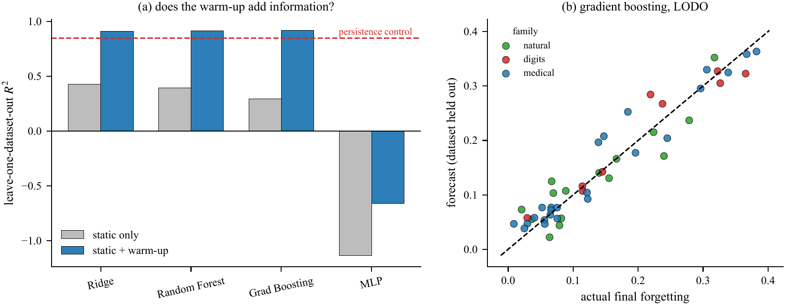
Persistence explains most of it
The warm-up matters
Static descriptors alone reach only R² = 0.43; adding early dynamics raises performance to about 0.92.
The extra drift and loss signals do not demonstrably beat a fold-local calibration of Φ5 alone.
Notes:
Use the second figure to connect the numeric result to the paper's central methodological lesson.
[Sources]
- /private/tmp/research-projects-icaise-read/papers/clip-forgetting-forecasting/main.pdf
- /private/tmp/research-projects-icaise-read/papers/clip-forgetting-forecasting/figures/fig4_forecast_quality.pdf
[/Sources]

Slide 7
Conclusion: five epochs are enough to forecast
What we did
Across 48 CLIP fine-tuning runs on 16 datasets, we predicted final forgetting from static descriptors or the first five training epochs.
FOUND · Five-epoch models reached R² ≈ 0.92
Calibrated persistence matched the learned forecaster
WHY IT MATTERS · Early stopping can be decided quickly
Complex trajectories add little beyond early forgetting
Validate by held-out dataset—not run
Notes:
State the conclusion in three steps: what we did, what we found, and why the result matters. End with the next experiment or validation step that would strengthen the evidence.
[Sources]
- /private/tmp/research-projects-icaise-read/papers/clip-forgetting-forecasting/main.pdf
[/Sources]

Slide 8
Early forgetting is predictive—
but mostly persistent
CC5084 · Questions
Did: forecast final forgetting after five epochs
Found: R² ≈ 0.92; persistence matched
Matters: intervene early with a simple baseline
Notes:
Return to the opening question. Summarize what was done, the main finding, and its importance in three short sentences, then invite questions.
[Sources]
- /private/tmp/research-projects-icaise-read/papers/clip-forgetting-forecasting/main.pdf
[/Sources]

