Slide 1
Do EEG perturbation controls measure what we think?
ICAISE 2026 · CC5085
Authors: Isha Gupta, Ishaan Mohandas, Ashwath Raghu, Jake Rajbhandari, Anya Samuel, Riva Sheth, Mridhula Suresh, Srikanth Samy, Ishaan Gupta
Notes:
Open with the research question. The official paper title is: The Control Is the Instrument: Calibrating Perturbation Tests Used as Evidence That EEG Decoders Read Neural Signal. Credit every author listed on the slide.
[Sources]
- /private/tmp/research-projects-icaise-read/papers/eeg-controls-audit/main.pdf
[/Sources]

Slide 2
A control is a measuring instrument
The usual claim
Remove the μ band, observe an accuracy drop, and conclude that the decoder uses sensorimotor rhythm.
The missing number
That conclusion is valid only if the same perturbation rarely fires when the targeted dependence is absent.
Research question
What are the sensitivity and false-alarm rate of each perturbation control for each decoder family?
Ground truth strategy
Plant the signal in simulation, then corroborate specificity on a real eyes-open versus eyes-closed task with known occipital-alpha physiology.
Notes:
Frame the problem before introducing models. State the specific research question and the criterion that makes the answer defensible.
[Sources]
- /private/tmp/research-projects-icaise-read/papers/eeg-controls-audit/main.pdf
[/Sources]

Slide 3
Calibrate controls against known truth
DATA
A planted-signal EEG simulator, a 30-dataset minimal replication, PhysioNet motor imagery, and 34-subject eyes-open/closed EEG.
CALIBRATION
Measure whether each control fires when its target is present and when it is absent; sweep firing thresholds in the replication.
DECODERS
Band-power/logistic, CSP/LDA, random forest, and EEGNet—representations and model classes with different failure modes.
Notes:
Walk left to right: data, validation boundary, then models or analysis. Emphasize the unit that is held out.
[Sources]
- /private/tmp/research-projects-icaise-read/papers/eeg-controls-audit/main.pdf
[/Sources]

Slide 4
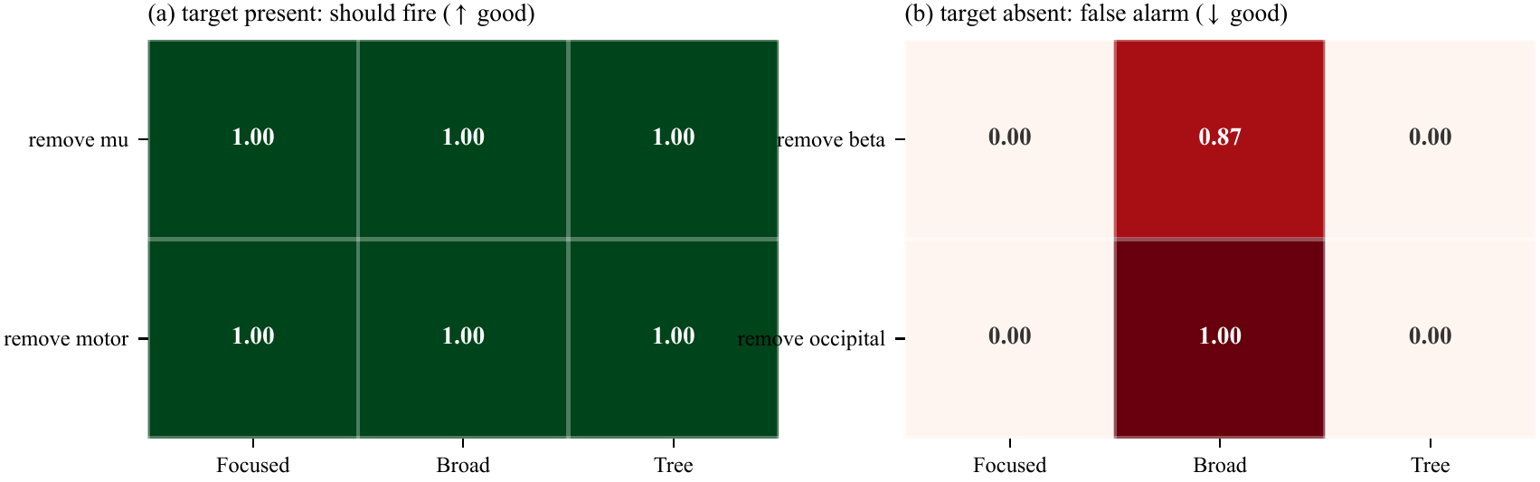
Sensitivity is not enough
The minimal dissociation
All three toy decoders catch the planted signal. Yet the broad feature model false-alarms when an absent band is removed, while focused and tree models stay silent.
Specificity—not sensitivity—does the discriminating.
Notes:
Use the figure to explain why the study design matters. Describe the visual pattern first, then interpret it.
[Sources]
- /private/tmp/research-projects-icaise-read/papers/eeg-controls-audit/main.pdf
- /private/tmp/research-projects-icaise-read/papers/eeg-controls-audit/figures/fig2_toy_fire_rates.pdf
[/Sources]

Slide 5
Reliability is decoder-conditional
Central finding
The same perturbation evidence has sharply different meaning across decoders. Full-grid rates are descriptive; the independent minimal replication preserves the qualitative result.
68.8%
1.3%
3 of 4
band-power mean false-alarm rate
EEGNet mean false-alarm rate
absent targets flagged by band-power on real alpha
Notes:
Pause on the three headline values. Explain the strongest supported claim and avoid turning descriptive differences into stronger causal or statistical claims.
[Sources]
- /private/tmp/research-projects-icaise-read/papers/eeg-controls-audit/main.pdf
[/Sources]

Slide 6
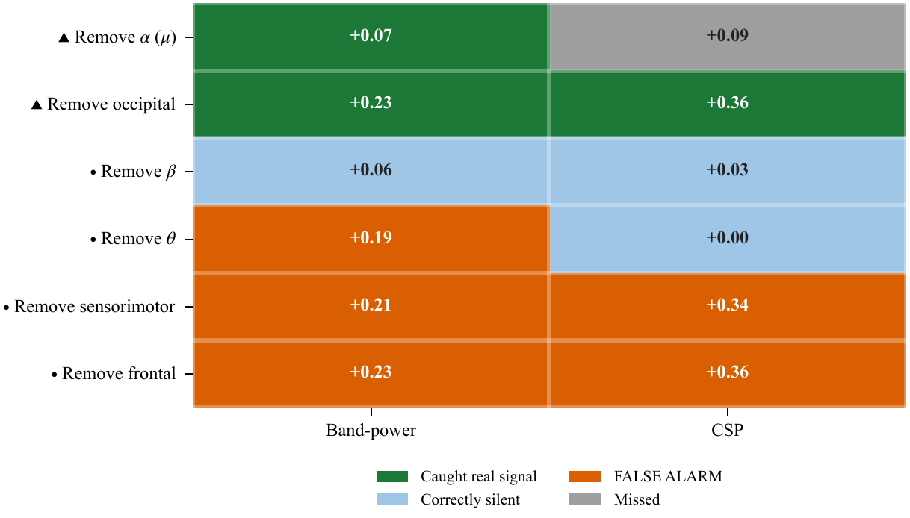
The real-brain specificity check
Real-brain specificity check
Eyes-open versus eyes-closed has a known occipital-alpha signal. Band-power false-alarms on three absent targets; CSP false-alarms on both spatial controls.
This corroborates the specificity warning—not motor-imagery causality.
Notes:
Use the second figure to connect the numeric result to the paper's central methodological lesson.
[Sources]
- /private/tmp/research-projects-icaise-read/papers/eeg-controls-audit/main.pdf
- /private/tmp/research-projects-icaise-read/papers/eeg-controls-audit/figures/fig5_real_brain_validation.pdf
[/Sources]

Slide 7
Conclusion: perturbation drops need calibration
What we did
We planted known EEG signals, tested several decoders and perturbation controls, and checked specificity on real eyes-open/closed data.
FOUND · False-alarm rates depended on decoder
Band-power averaged 68.8%; EEGNet 1.3%
WHY IT MATTERS · The same drop can mean different evidence
Report sensitivity and false-alarm rate together
Avoid causality claims from perturbation alone
Notes:
State the conclusion in three steps: what we did, what we found, and why the result matters. End with the next experiment or validation step that would strengthen the evidence.
[Sources]
- /private/tmp/research-projects-icaise-read/papers/eeg-controls-audit/main.pdf
[/Sources]

Slide 8
Uncalibrated controls create
uncalibrated evidence
CC5085 · Questions
Did: calibrated controls against known truth
Found: false alarms varied sharply by decoder
Matters: accuracy drops need reliability numbers
Notes:
Return to the opening question. Summarize what was done, the main finding, and its importance in three short sentences, then invite questions.
[Sources]
- /private/tmp/research-projects-icaise-read/papers/eeg-controls-audit/main.pdf
[/Sources]

