Slide 1
Will a heart-disease model travel to another hospital?
ICAISE 2026 · CC5086
Authors: Anoushka Aisola, Vihaan Bhoopathy, Rayan Hossain, Spoorthi Idumudi, Nethra Kollipara, Rania Malik, Nishant Nayagam, Yukti Srinivas, Srikanth Samy, Ishaan Gupta
Notes:
Open with the research question. The official paper title is: Cross-Hospital Generalization of Heart-Disease Classifiers: A Directed Transfer Analysis on Four UCI Cohorts. Credit every author listed on the slide.
[Sources]
- /private/tmp/research-projects-icaise-read/papers/heart-disease-cross-hospital/main.pdf
[/Sources]

Slide 2
Internal validation is not deployment
The mismatch
A held-out split within one hospital estimates discrimination in that institution—not transport to another population.
What changes
Covariates, disease prevalence, measurement practice, and missingness can all shift across sites.
Research question
What does the complete directed 4 × 4 transfer matrix reveal that one pooled external AUC hides?
Design question
Does transfer depend more on model family or on the source cohort used for fitting?
Notes:
Frame the problem before introducing models. State the specific research question and the criterion that makes the answer defensible.
[Sources]
- /private/tmp/research-projects-icaise-read/papers/heart-disease-cross-hospital/main.pdf
[/Sources]

Slide 3
Treat every hospital pair as a direction
DATA
920 patients from Cleveland, Hungary, Switzerland, and VA. Thirteen candidate variables; nine portable variables for transfer.
VALIDATION
Within-site cross-validation on the diagonal; a source-only fit for every off-diagonal transfer. All adaptation stays inside source data.
MODELS
Logistic regression, random forest, and MLP. Compare the full matrix and the signed macro generalization gap.
Notes:
Walk left to right: data, validation boundary, then models or analysis. Emphasize the unit that is held out.
[Sources]
- /private/tmp/research-projects-icaise-read/papers/heart-disease-cross-hospital/main.pdf
[/Sources]

Slide 4
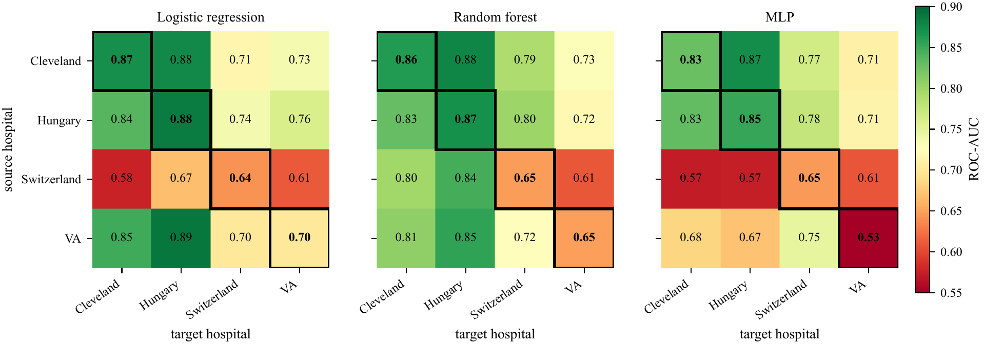
Transfer is asymmetric
Source quality dominates
Performance varies widely across hospital pairs. Switzerland is a difficult source for linear and neural models, while the random forest is more tolerant of its degenerate distribution.
A single external average erases this structure.
Notes:
Use the figure to explain why the study design matters. Describe the visual pattern first, then interpret it.
[Sources]
- /private/tmp/research-projects-icaise-read/papers/heart-disease-cross-hospital/main.pdf
- /private/tmp/research-projects-icaise-read/papers/heart-disease-cross-hospital/figures/fig1_transfer_matrix.pdf
[/Sources]

Slide 5
One internal AUC hides a wide transfer range
Main result
Cross-hospital performance is heterogeneous rather than uniformly worse. The random forest has the highest macro external AUC, but pair choice dominates the story.
0.910
0.571–0.888
0.781
Cleveland internal AUC with all 13 variables
range across directed transfers
random-forest macro external AUC
Notes:
Pause on the three headline values. Explain the strongest supported claim and avoid turning descriptive differences into stronger causal or statistical claims.
[Sources]
- /private/tmp/research-projects-icaise-read/papers/heart-disease-cross-hospital/main.pdf
[/Sources]

Slide 6
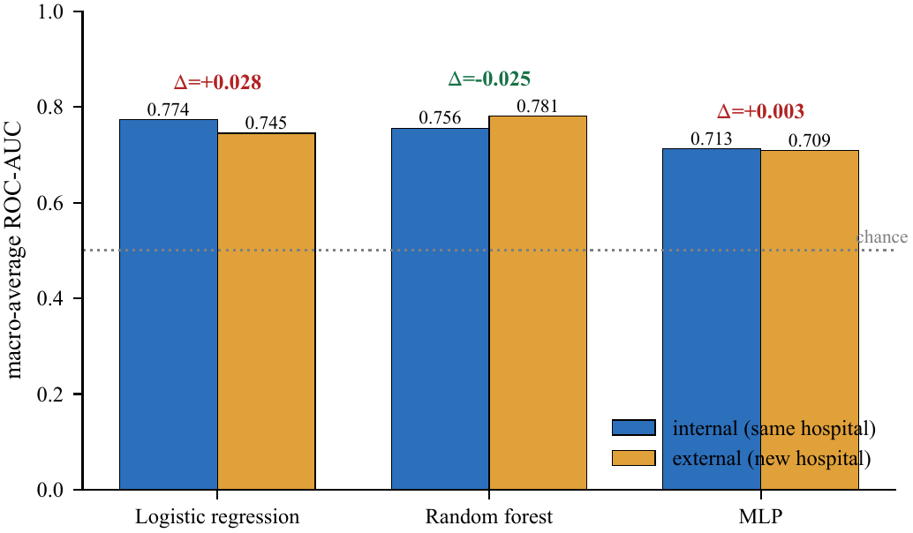
A gap statistic can mislead
A scalar can mislead
The random forest has a negative gap: average external AUC exceeds average internal AUC. That does not prove robustness because the two averages cover different estimands.
Report absolute target performance and the full matrix.
Notes:
Use the second figure to connect the numeric result to the paper's central methodological lesson.
[Sources]
- /private/tmp/research-projects-icaise-read/papers/heart-disease-cross-hospital/main.pdf
- /private/tmp/research-projects-icaise-read/papers/heart-disease-cross-hospital/figures/fig2_generalization_gap.pdf
[/Sources]

Slide 7
Conclusion: the hospital pair is the real unit
What we did
We trained three classifiers on each of four UCI hospital cohorts and evaluated every directed source-to-target transfer.
FOUND · Transfer ranged from 0.571 to 0.888 AUC
Source cohort mattered more than model family
WHY IT MATTERS · One average hides deployment risk
Report the full directional transfer matrix
Do not deploy this benchmark model
Notes:
State the conclusion in three steps: what we did, what we found, and why the result matters. End with the next experiment or validation step that would strengthen the evidence.
[Sources]
- /private/tmp/research-projects-icaise-read/papers/heart-disease-cross-hospital/main.pdf
[/Sources]

Slide 8
The hospital pair matters
more than the decimal
CC5086 · Questions
Did: tested every directed hospital transfer
Found: transfer ranged from 0.571 to 0.888 AUC
Matters: deployment risk is pair-specific
Notes:
Return to the opening question. Summarize what was done, the main finding, and its importance in three short sentences, then invite questions.
[Sources]
- /private/tmp/research-projects-icaise-read/papers/heart-disease-cross-hospital/main.pdf
[/Sources]

