Slide 1
Accurate or interpretable? Exoplanet transit modelling
ICAISE 2026 · CC5088
Authors: Bhavya Gondra, Akhil Muvvala, Milan Petrov, Harish Senthil, Ayan Sharma, Manav Sharma, Pranavan Sivaraman, Adhrit Somayajula, Srikanth Samy, Ishaan Gupta
Notes:
Open with the research question. The official paper title is: Accuracy–Interpretability Trade-offs in Exoplanet Transit Modelling, and a Label-Free Physics-Informed Estimator of Planetary Radii. Credit every author listed on the slide.
[Sources]
- /private/tmp/research-projects-icaise-read/papers/exoplanet-model-comparison/main.pdf
[/Sources]

Slide 2
Two tasks, two scientific objectives
Detection
Does a light curve contain a transit? The primary endpoint is ROC-AUC.
Characterisation
What is the planet-to-star radius ratio? Here parameter accuracy and physical inspectability both matter.
Trade-off question
How much predictive performance is exchanged for additive-surrogate fidelity, a reproducible axis of interpretability?
Physics question
Can a differentiable transit model estimate radius from reconstruction alone, without ever seeing radius labels?
Notes:
Frame the problem before introducing models. State the specific research question and the criterion that makes the answer defensible.
[Sources]
- /private/tmp/research-projects-icaise-read/papers/exoplanet-model-comparison/main.pdf
[/Sources]

Slide 3
Compare models on a shared Pareto plane
DATA
Eight thousand simulated training segments and 3,000 disjoint tests with known parameters, plus 12 confirmed Kepler planets.
SCORING
Detection ROC-AUC or radius MAE, paired with additive-surrogate fidelity A for every model family.
PHYSICS-KAN
Infer transit parameters by reconstructing flux through a differentiable forward model—no radius labels used.
Notes:
Walk left to right: data, validation boundary, then models or analysis. Emphasize the unit that is held out.
[Sources]
- /private/tmp/research-projects-icaise-read/papers/exoplanet-model-comparison/main.pdf
[/Sources]

Slide 4
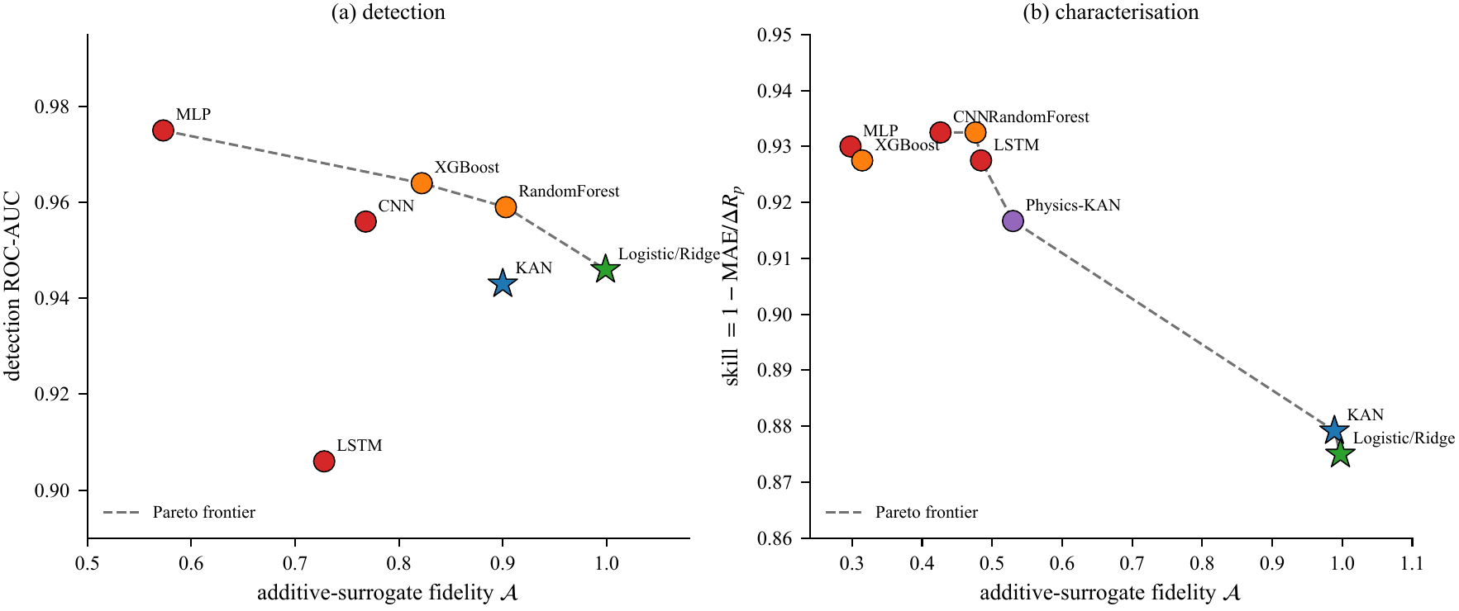
The trade-off is task-specific
Read the Pareto plane
On detection, full transparency costs only 0.029 AUC. On characterisation, the same move costs 85% more radius error.
The physics-KAN occupies a distinct middle ground: less additive, but physically structured and label-free.
Notes:
Use the figure to explain why the study design matters. Describe the visual pattern first, then interpret it.
[Sources]
- /private/tmp/research-projects-icaise-read/papers/exoplanet-model-comparison/main.pdf
- /private/tmp/research-projects-icaise-read/papers/exoplanet-model-comparison/figures/fig3_pareto.pdf
[/Sources]

Slide 5
Physics closes much of the label gap
Matched-simulation result
The MLP leads detection, while the label-free physics-KAN approaches the best supervised radius model. Synthetic performance benefits from a matched forward model.
0.975
0.029
0.0100
best detection AUC; MLP
AUC cost of near-total transparency
label-free radius MAE; 24% above best supervised
Notes:
Pause on the three headline values. Explain the strongest supported claim and avoid turning descriptive differences into stronger causal or statistical claims.
[Sources]
- /private/tmp/research-projects-icaise-read/papers/exoplanet-model-comparison/main.pdf
[/Sources]

Slide 6
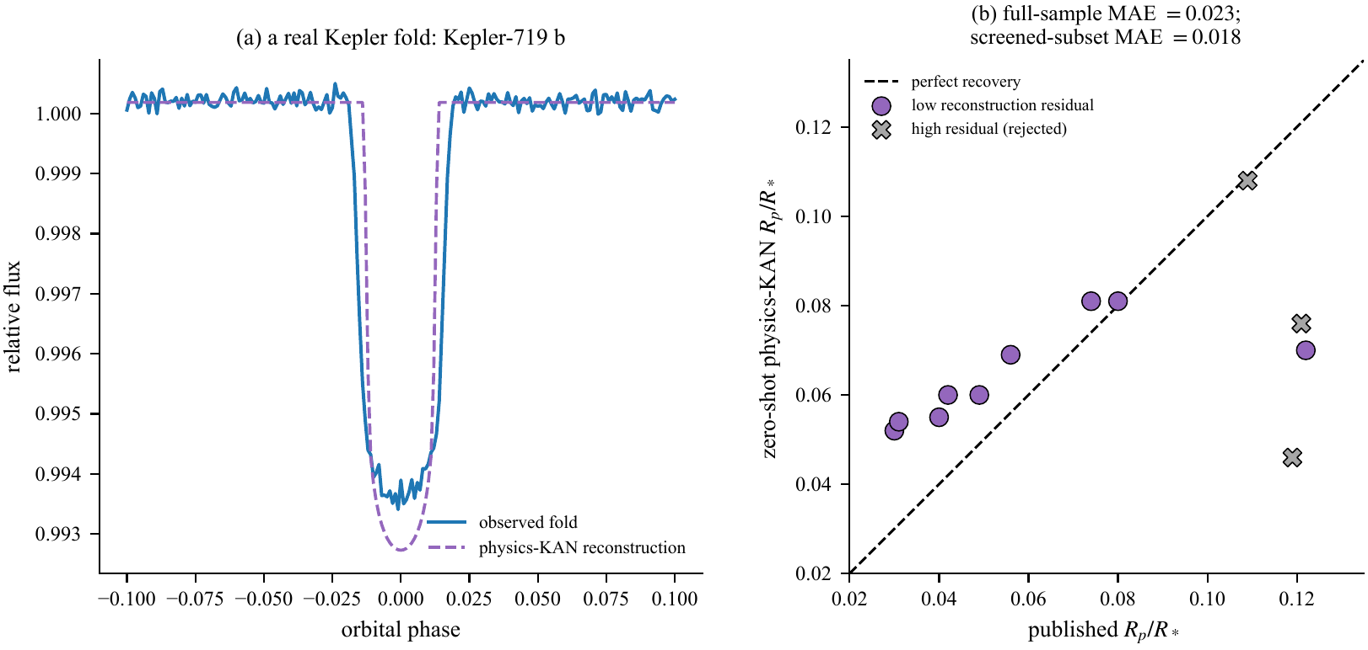
Kepler reveals the reality gap
Zero-shot feasibility
Across 12 confirmed planets, full-sample radius-ratio MAE is 0.023—about 2.3× the synthetic error.
A residual screen improves MAE to 0.018 but rejects one of the best recovered planets, so residual is not accuracy.
Notes:
Use the second figure to connect the numeric result to the paper's central methodological lesson.
[Sources]
- /private/tmp/research-projects-icaise-read/papers/exoplanet-model-comparison/main.pdf
- /private/tmp/research-projects-icaise-read/papers/exoplanet-model-comparison/figures/fig4_real_kepler.pdf
[/Sources]

Slide 7
Conclusion: interpretability depends on the task
What we did
We compared accuracy with additive-surrogate fidelity for transit detection and radius estimation, then built a label-free physics-KAN.
FOUND · Transparency cost 0.029 detection AUC
Physics-KAN reached 0.0100 synthetic radius MAE
WHY IT MATTERS · Physics can replace scarce labels
Kepler MAE rose to 0.023: simulation is not deployment
Treat 12 planets as feasibility evidence
Notes:
State the conclusion in three steps: what we did, what we found, and why the result matters. End with the next experiment or validation step that would strengthen the evidence.
[Sources]
- /private/tmp/research-projects-icaise-read/papers/exoplanet-model-comparison/main.pdf
[/Sources]

Slide 8
Physics closes the label gap—
not the reality gap
CC5088 · Questions
Did: compared accuracy, interpretability, and physics
Found: 0.0100 synthetic vs 0.023 Kepler MAE
Matters: label-free does not mean reality-ready
Notes:
Return to the opening question. Summarize what was done, the main finding, and its importance in three short sentences, then invite questions.
[Sources]
- /private/tmp/research-projects-icaise-read/papers/exoplanet-model-comparison/main.pdf
[/Sources]

