Slide 1
Can a calm-era bankruptcy model survive a recession?
ICAISE 2026 · CC5089
Authors: Ayush Bodalia, Vishruth Burra, Arnav Deokule, Shravan Ginde, Sahasra Namburu, Kavindran Rajangam, Sreehaas Voruganti, Srikanth Samy, Ishaan Gupta
Notes:
Open with the research question. The official paper title is: Does a Bankruptcy Model Trained in Calm Times Survive a Recession? A Temporal Stress Test on U.S. Public Firms. Credit every author listed on the slide.
[Sources]
- /private/tmp/research-projects-icaise-read/papers/bankruptcy-stress-test/main.pdf
[/Sources]

Slide 2
Why temporal robustness matters
The deployment mismatch
Bankruptcy models are trained on past financial statements but used in new economic regimes. A recession changes base rates, firm behavior, and the meaning of risk scores.
A misleading shortcut
A year-by-year AUC curve can mix training rows into evaluation and manufacture a fake crisis cliff.
Research question
Freeze models trained on calm years. Do they still rank imminent failures during the 2008–2009 recession?
Success criterion
Preserved leakage-free ROC-AUC—not a higher crisis PR-AUC caused mechanically by a doubled failure rate.
Notes:
Frame the problem before introducing models. State the specific research question and the criterion that makes the answer defensible.
[Sources]
- /private/tmp/research-projects-icaise-read/papers/bankruptcy-stress-test/main.pdf
[/Sources]

Slide 3
A leakage-free temporal stress test
DATA
78,682 U.S. public-company years, 1999–2018. Eighteen accounting variables become 15 financial ratios; 609 rows are imminent failures.
VALIDATION
Train on 1999–2006 with a company-grouped split. Freeze the pipeline, exclude 2007, and test on 2008–2009.
MODELS
Logistic regression, random forest, and MLP. Primary endpoint: ROC-AUC, with PR-AUC and confidence intervals.
Notes:
Walk left to right: data, validation boundary, then models or analysis. Emphasize the unit that is held out.
[Sources]
- /private/tmp/research-projects-icaise-read/papers/bankruptcy-stress-test/main.pdf
[/Sources]

Slide 4
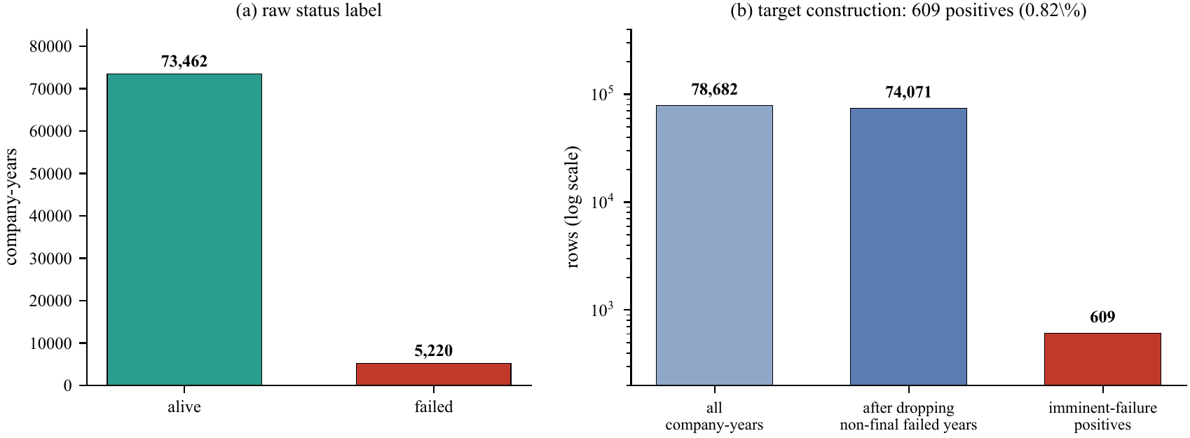
Audit the rare-event target
Rare events define the evaluation
The imminent-failure construction leaves only 609 positives—0.82% of company-years—after removing non-final failed-firm records.
Leakage control and ranking metrics are therefore essential; raw accuracy would conceal the task.
Notes:
Use the figure to explain why the study design matters. Describe the visual pattern first, then interpret it.
[Sources]
- /private/tmp/research-projects-icaise-read/papers/bankruptcy-stress-test/main.pdf
- /private/tmp/research-projects-icaise-read/papers/bankruptcy-stress-test/figures/fig1_class_balance.pdf
[/Sources]

Slide 5
The forest preserves its ranking power
Supported result
The random forest captured a nonlinear distress boundary and retained discrimination under the regime shift. Overlapping 95% intervals support preservation, not proven improvement.
0.755
0.798
0.020
calm-era random-forest ROC-AUC
recession ROC-AUC; Δ = +0.042
calm-era PR-AUC; about 3× no-skill
Notes:
Pause on the three headline values. Explain the strongest supported claim and avoid turning descriptive differences into stronger causal or statistical claims.
[Sources]
- /private/tmp/research-projects-icaise-read/papers/bankruptcy-stress-test/main.pdf
[/Sources]

Slide 6
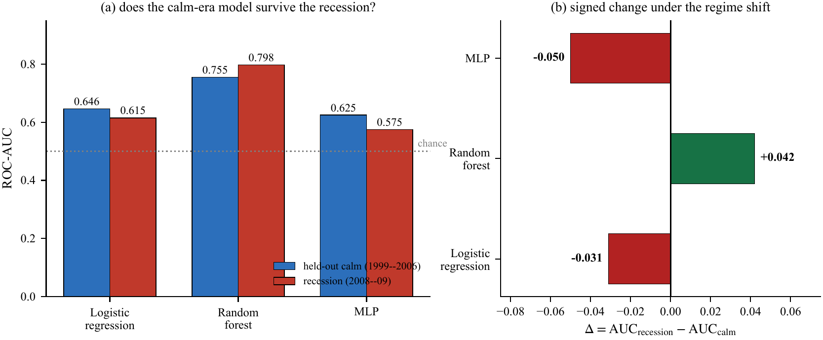
What survives the recession?
One model holds up
Logistic regression and the MLP fall, while the forest rises from 0.755 to 0.798.
Because the intervals overlap, the defensible claim is resilience—not that recessions improve the model.
Notes:
Use the second figure to connect the numeric result to the paper's central methodological lesson.
[Sources]
- /private/tmp/research-projects-icaise-read/papers/bankruptcy-stress-test/main.pdf
- /private/tmp/research-projects-icaise-read/papers/bankruptcy-stress-test/figures/fig3_stress_test.pdf
[/Sources]

Slide 7
Conclusion: test the regime, then recalibrate
What we did
We trained three bankruptcy classifiers on 1999–2006 company data, froze the pipeline, and stress-tested them on the 2008–2009 recession.
FOUND · The random forest held its ranking power
0.755 → 0.798 ROC-AUC; intervals overlap
WHY IT MATTERS · Ranking can survive while thresholds fail
Recalibrate scores when the base rate shifts
Claim resilience—not improvement
Notes:
State the conclusion in three steps: what we did, what we found, and why the result matters. End with the next experiment or validation step that would strengthen the evidence.
[Sources]
- /private/tmp/research-projects-icaise-read/papers/bankruptcy-stress-test/main.pdf
[/Sources]

Slide 8
The model survived—
the threshold did not
CC5089 · Questions
Did: calm-era training → recession test
Found: forest ROC-AUC 0.755 → 0.798
Matters: recalibrate thresholds after shift
Notes:
Return to the opening question. Summarize what was done, the main finding, and its importance in three short sentences, then invite questions.
[Sources]
- /private/tmp/research-projects-icaise-read/papers/bankruptcy-stress-test/main.pdf
[/Sources]

